Slide 1

Python for Data Analysis and Visualization
Data Cleaning
Instructor: Claudia Carroll

Slide 2
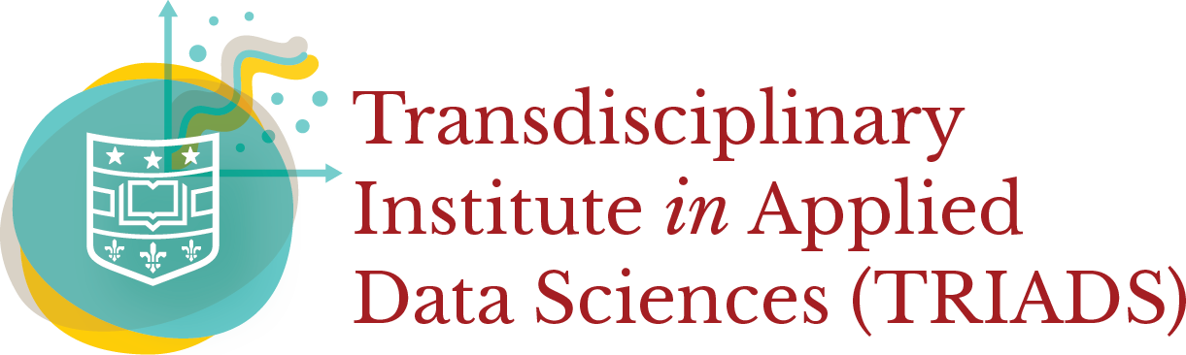
Today's Lesson Plan
Dealing with Null Data
Aggregating Data
Merging Dataframes

Slide 3

Demo 1:
Pandas Review &
Dealing with Null Data

Slide 4
Demo 2: Aggregating Data

Slide 5
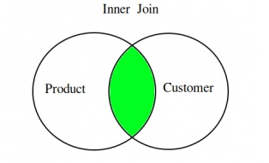
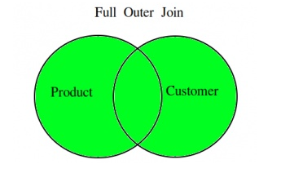
Joins: Inner and Outer

Slide 6
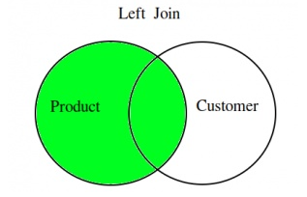
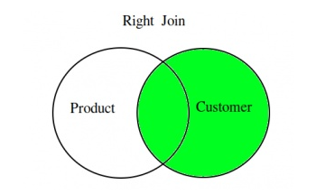
Joins: Left and Right

