Slide 1

Python for Data Analysis and Visualization
Instructor: Claudia Carroll
Fall 2024

Slide 2

Today's Lesson Plan
Dealing with Null Data
Aggregating Data
Merging Dataframes

Slide 3

Demo 1:
Pandas Review &
Dealing with Null Data

Slide 4
Exercise 1: Calculating null cells
Create a new dataframe called SAFI_subset from the SAFI_results.csv that contains the columns respondent_roof_type, respondent_wall_type, respondent_wall_type_other, and respondent_floor_type.
Calculate the percentage of cells in the new dataframe that are null.
Hint: For part 2 you will have to remember you mathematical operators!!

Slide 5
Exercise 1 Part 1
df_SAFI = pd.read_csv("/content/drive/MyDrive/workshop_data/SAFI_results.csv")
df_SAFI_subset = df_SAFI[["C01_respondent_roof_type", "C02_respondent_wall_type",
"C02_respondent_wall_type_other", "C03_respondent_floor_type"]]
df_SAFI_subset.columns = df_SAFI_subset.columns.str.replace(r'^.*?_', '', regex=True)

Slide 6
Exercise 1 Part 1 (Alternative)
df_SAFI = pd.read_csv("/content/drive/MyDrive/workshop_data/SAFI_results.csv")
df_SAFI_subset = df_SAFI[["C01_respondent_roof_type", "C02_respondent_wall_type",
"C02_respondent_wall_type_other", "C03_respondent_floor_type"]]
df_SAFI_subset.rename(columns={'C01_respondent_roof_type':'respondent_roof_type'},
'C02_respondent_wall_type': 'respondent_wall_type'},
'C02_respondent_wall_type_other': 'respondent_wall_type_other'},
'C03_respondent_floor_type': 'respondent_floor_type'}, inplace=True)

Slide 7
Exercise 1 Part 2
col_no = len(df_SAFI_subset.columns)
row_no = len(df_SAFI_subset.index)
total_cells = col_no * row_no
null_cells = 0
for x in df_SAFI_subset.isnull().sum():
null_cells += x
percentage_null = ((null_cells/total_cells) * 100)
print(percentage_null)

Slide 8
Demo 2: Aggregating Data

Slide 9

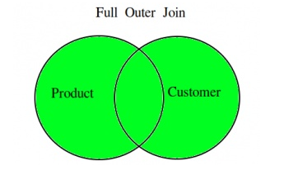
Joins: Inner and Outer

Slide 10
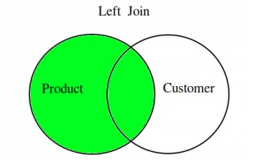
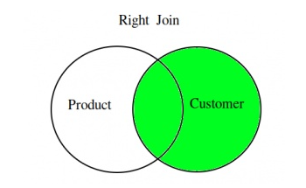
Joins: Left and Right

Slide 11
Exercise 2:
Read in the SAFI_results.csv dataset.
Get a list of the different respondent_wall_type values.
Groupby respondent_wall_type and describe the results.
Create a new dataframe which is the result of an outer join of the grades and students dataframes using only the student ID column to join on. What do you notice about the column names in the new Dataframe?

Slide 12
Exercise 2 (Parts 1-3): Solution
df_SAFI = pd.read_csv("/content/drive/MyDrive/workshop_data/SAFI_results_cleaned.csv", index_col=0)
df_SAFI['respondent_wall_type'].unique()
grouped_data = df_SAFI.groupby('respondent_wall_type')
grouped_data.describe()

