Slide 1

Python for Data Analysis
Claudia Carroll
Part 3: Data Aggregation

Slide 2

Demo 2: Aggregating Data

Slide 3

Exercise 1:
Read in the SAFI_results.csv dataset.
Get a list of the different respondent_wall_type values.
Groupby respondent_wall_type and describe the results.

Slide 4
Exercise 1 Solution:
df_SAFI = pd.read_csv("/content/drive/MyDrive/workshop_data/SAFI_results_cleaned.csv", index_col=0)
df_SAFI['respondent_wall_type'].unique()
df_SAFI.groupby('respondent_wall_type').describe()

Slide 5
Demo: Combining Dataframes

Slide 6
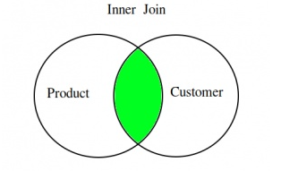
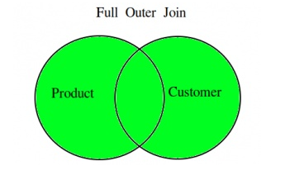
Joins: Inner and Outer

Slide 7
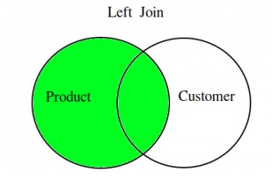
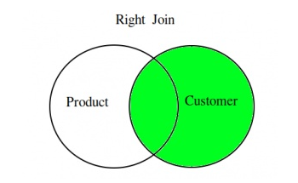
Joins: Left and Right

Slide 8
Exercise 3 (Combining Dataframes)
Create a new dataframe which is the result of an outer join of the grades and students dataframes using only the student ID column to join on. What do you notice about the column names in the new Dataframe?

Slide 9
Exercise 1 (Combining Dataframes): Solution
students_df = pd.read_csv("students.csv", index_col=0)
grades_df = pd.read_csv("grades.csv", index_col=0)
merged_df = pd.merge(students_df, grades_df, on='student_id’, how='left’)
merged_df

