Slide 1

Python for Data Analysis and Visualization
Instructor: Claudia Carroll
Spring 2024
Session 2 (March 27)

Slide 2

Today's Lesson Plan
Review class 1 exercises
Brief introduction to Python dictionaries and JSON format
Demo 1: Dictionaries
Demo 2: JSON files

Slide 3
Class 1 Exercise 1
From the SAFI_results.csv file extract all of the records where the C01_respondent_roof_type (index 18) has a value of 'grass' and the C02_respondent_wall_type (index 19) has a value of 'muddaub' and write them to a file.
Within the same program write all of the records where C01_respondent_roof_type (index 18) has a value of 'grass' and the C02_respondent_wall_type (index 19) has a value of 'burntbricks' and write them to a separate file.
**In both files include the header record.**

Slide 4
Exercise 1 Solution
with open ("SAFI_results.csv") as fr: with open ("SAFI_grass_roof_muddaub.csv", "w") as fw1: with open ("SAFI_grass_roof_burntbricks.csv", "w") as fw2: headerline = fr.readline() fw1.write(headerline) fw2.write(headerline) for line in fr: if line.split(",")[18] == 'grass' : if line.split(",")[19] == 'muddaub' : fw1.write(line) if line.split(",")[19] == 'burntbricks' : fw2.write(line)

Slide 5

Dictionaries and JSON

Slide 6
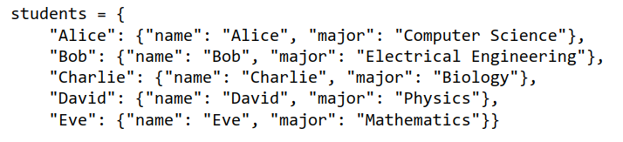
What is a python dictionary
Stores data in key/value pairs
Order is saved (as of Python 3.7)
Duplicate values permitted, but not duplicate keys within one item
Elements can be added and removed
Indicated by curly brackets and colons
Dictionaries can contain nested lists and dictionaries

Slide 7
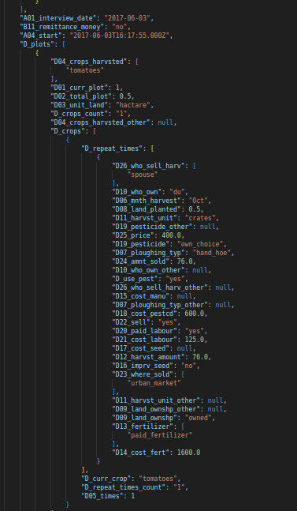
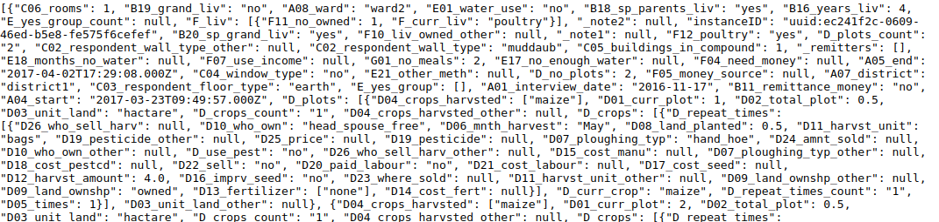
What is a JSON file?
JavaScript Object Notation
Designed for communication of data between different software systems
Highly structured
Stores data in key: value pairs

Slide 8
Where is JSON format used?
Preferred data structure for APIs (application programming interface)
Downloading data from online repositories or websites to local machines
Downloading data from survey apps
Sending or sharing data between programs written in multiple programming languages
Transferring data between servers and websites

Slide 9
Advantages of JSON format
Multidimensional: JSON files can have multiple layers of nested dictionaries so that data can be recorded in more than two dimensions.
Self-contained records: The equivalent of the column name and column values are in every record.
More flexible data: documents do not all have to have the same structure within the same file
More flexible access: Can be viewed directly in a web browser, text application, IDE etc.

Slide 10
Disadvantages of JSON format
Difficult for humans to read!
Some familiarity with the data structure is necessary to query the data
It is more verbose than the equivalent data in csv format (more text)
Can be more difficult to visualize than csv formatted data

Slide 11
Python and JSON files
Syntax compatibility:
JSON files use the same syntax to indicate an object (curly brackets, key: values pairs separated by a colon) as a Python dictionary
JSON files use the same syntax to indicate an array (square brackets, elements separated by commas) as a Python list.
Reading JSON with Python:
Python will read a JSON file as a string unless told otherwise
Python json library reads JSON files as a list of dictionaries

Slide 12
Demo 1: Dictionaries

Slide 13
Exercise 1: Dictionaries Basics
Create a dictionary called dict_roof_types with initial keys of type1 and type2 and give them values of 1 and 3.
Add a third key type3 with a value of 6.
Add code to check if a key of type4 exists. If it does not add it to the dictionary with a value of 1 if it does, increment its value by 1
Add code to check if a key of type2 exists. If it does not add it to the dictionary with a value of 1 if it does, increment its value by 1
Print out all of the keys and values from the dictionary

Slide 14
Exercise 1 (Dictionaries Basics): Solution
dict_roof_types = {'type1' : 1 , 'type2' : 3} dict_roof_types['type3'] = 6 key = 'type4' if key in dict_roof_types : dict_roof_types[key] += 1 else : dict_roof_types[key] = 1 key = 'type2' if key in dict_roof_types : dict_roof_types[key] += 1 else : dict_roof_types[key] = 1 for item in dict_roof_types: print(item, "=", dict_roof_types[item])

Slide 15
Exercise 2: Lists in Dictionaries
Add a dictionary ‘Addresses’ to the personDict dictionary that in turn contains two dictionaries, ‘Home’ and ‘Work’ that use key:value pairs to track addresses under the following values: ‘Street’, ‘City’, ‘Postcode’. (You may make up the addresses!)
Print out the postcode for the work address.
Print out the names of the children on separate lines (i.e. not as a list)

Slide 16
Solution 2 (Lists in Dictionaries):
personDict['Addresses'] = {'Home' : {‘Street' : '23 acacia ave.', ‘City' : 'Romford', 'PostCode' : 'RO6 5WR'}, 'Work' : {‘Street' : '19 Orford Road.', ‘City' : 'London', 'PostCode' : 'EC4J 3XY'} }
print(personDict['Addresses']['Work']['PostCode’])
for child in personDict['Children’]:
print(child)

Slide 17
Demo 2: JSON files
Setup: Download the file 'SAFI.json' from the Class 2 folder on Github and save it to your local desktop folder 'python-data-workshop'
GitHub Link:
https://github.com/ClaudiaECarroll/python_data_class/

Slide 18
Exercise 3: Extracting from JSON files
Write the code to extract each crop (‘D_curr_crop’) grown by each farm (‘id’) in the JSON file and the plot number in which they grow it. The output should be in the following string format”
Farm no. 1 grows maize in plot 1.
Hint 1: You will need to create a counter to track plot number.
Hint 2: There will be several nested loops and conditional statements!

Slide 19
Homework: Class 2
Complete the in-class exercises if we did not have a chance to do so! (pythondata_class2_in-class_exercises.pdf)
Complete the homework exercise sheet for Class 2 (pythondata_class2_homework.pdf)
These materials, along with class powerpoints, are available at:
https://github.com/ClaudiaECarroll/python_data_class/

Slide 20
Exercise 3 (Extracting from JSON files): Solution
unique_outputs = set()
for farms in d:
plot_no = 0
id = farms['A03_quest_no']
if 'D_plots' in farms:
plot = farms['D_plots']
for crops in plot:
plot_no += 1
if 'D_crops' in crops:
crop = crops['D_crops']
for curr_crops in crop:
if 'D_curr_crop' in curr_crops:
combination = (id, curr_crops['D_curr_crop'], plot_no)
if combination not in unique_outputs:
print("Farm no ", id," grows ", curr_crops['D_curr_crop']," in plot", plot_no , ".")
unique_outputs.add(combination)

