Slide 1

Python for Data Analysis and Visualization
Instructor: Claudia Carroll
Spring 2024
Session 4 (April 3)

Slide 2

Today's Lesson Plan
Dealing with Null Data
Aggregating Data
Merging Dataframes

Slide 3
Setup
Go to my GitHub repository for this class:
https://github.com/ClaudiaECarroll/python_data_class
From the Class 4 folder, download the following files:
SN7577i_a.csv
SN7577i_aa.csv
SN7577i_b.csv
SN7577i_bb.csv
SN7577i_c.csv
SN7577i_d.csv
Put these files in your Desktop folder for this workshop.

Slide 4

Demo 1: Dealing with Null Data

Slide 5
Exercise 1: Calculating null cells
Create a new dataframe called SAFI_subset from the SAFI_results.csv that contains the columns C01_respondent_roof_type, C02_respondent_wall_type, C02_respondent_wall_type_other, and C03_respondent_floor_type. Calculate the percentage of cells in the dataframe that are null.
Hint: Arithmetic operators in python are:
+ (addition)
- (subtraction)
* (multiplication)
/ (division)

Slide 6
Exercise 1 (Calculating null cells): Solution
df_SAFI_subset = df_SAFI[["C01_respondent_roof_type", "C02_respondent_wall_type", "C02_respondent_wall_type_other", "C03_respondent_floor_type"]]
col_no = len(df_SAFI_subset.columns)
row_no = len(df_SAFI_subset.index)
total_cells = col_no * row_no
null_cells = 0
for x in df_SAFI_subset.isnull().sum():
null_cells += x
percentage_null = ((null_cells/total_cells) * 100)
print(percentage_null)

Slide 7
Demo 2: Aggregating Data

Slide 8
Exercise 2:
Read in the SAFI_results.csv dataset.
Get a list of the different C01_respondent_roof_type values.
Groupby C01_respondent_roof_type and describe the results.

Slide 9
Exercise 2 (Part 1): Solution
1. Read in the SAFI_results.csv dataset:
import numpy as np
df_SAFI = pd.read_csv("SAFI_results.csv")
print(df_SAFI.shape)

Slide 10
Exercise 2 (Parts 2&3): Solution
2. Get a list of the different C01_respondent_roof_type values:
print(pd.unique(df_SAFI['C01_respondent_roof_type']))
3. Groupby C01_respondent_roof_type and describe the results:
grouped_data = df_SAFI.groupby('C01_respondent_roof_type') grouped_data.describe()

Slide 11
Demo: Combining Dataframes

Slide 12


Joins: Inner and Outer

Slide 13
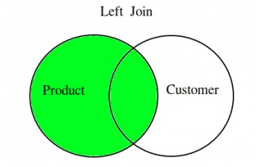
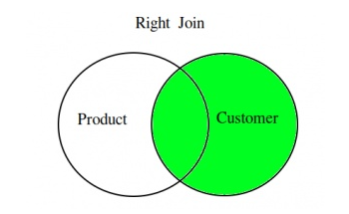
Joins: Left and Right

Slide 14
Exercise 3 (Combining Dataframes)
Examine the contents of the SN7577i_aa and SN7577i_bb csv files using Excel or equivalent. Then, using the SN7577i_aa and SN7577i_bb csv files, create a Dataframe which is the result of an outer join using the Id column to join on. What do you notice about the column names in the new Dataframe?

Slide 15
Exercise 1 (Combining Dataframes): Solution
df_aabb = pd.merge(df_aa, df_bb, how='outer', on = 'Id’)
df_aabb

