Slide 1

Python for Data Visualization
Instructor: Claudia Carroll
Session 1

Slide 2

Goals for the Workshop
Develop further fluency in the Python programming language
Learn how to create and customize simple graphs using the Pandas library
Learn how to create more detailed custom graphs using the Matplotlib and Plotly libraries

Slide 3
Workshop Plan
Class 1 | Basic graphs with Pandas
Class 2 | Graphing messy data with Pandas
Class 3 | Customizing graphs with Matplotlib
Class 4 | Creating interactive graphs with Plotly

Slide 4
Material Breakdown
Topic 1: Basic Graphs with Pandas | Creating simple graphs (bar, line, pie etc.) from Inverting graphs
Topic 2: Graphing Messy Data with Pandas | Grouping and aggregating messy data Graphing grouped and aggregated data Graphing categorical data
Topic 3: Customization with Matplotlib | Customizing graphs with color, size, titles and more.
Topic 4: Interactive Visualizations with Plotly | Creating graphs that embed additional data Basic animated graphs!

Slide 5

Questions?

Slide 6
Pandas Crash Course

Slide 7
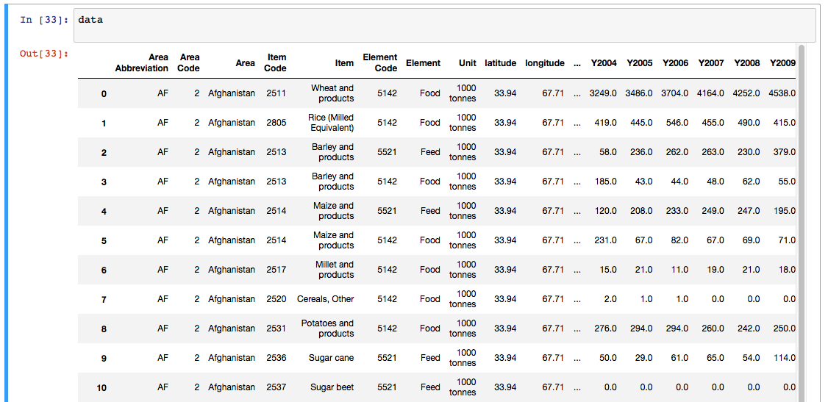
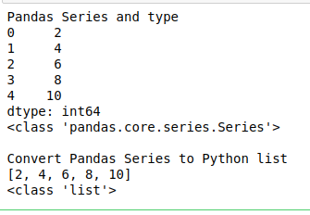
Dataframes and Series
Pandas has two primary data objects:
Pandas Dataframes:
Two dimensional
tabular data structure
Created by:
Loading from tabular data file (csv, excel etc.)
Converting from dictionaries, or combined lists
Pandas Series
One dimensional (usually one row or column)
List-type data structure
Created by slicing a column or row
Lists or dictionaries are converted to series if added to a dataframe

Slide 8
Slicing Dataframes
Slicing One Column | df[“column header”]
Slicing Multiple Columns | df[[“column one”, “column two”]]
Slicing One Row | df.loc[“row index”]
Slicing Multiple Rows | df.loc[[“row index 1”, row index 2]]
Slicing One Cell | df.loc[“row index”: “columns header”]
Slicing Multiple Rows and Multiple Columns | df.loc[[“row index 1”: “row index 2”: “column 1”: “column 2”]]
Slicing all columns between two rows | df.loc[“row index 1”: “row index 2”]
Slicing all rows between certain columns | df.loc[:, “column header 1”: “column header 2”]
Slicing one row between two columns | df.loc[“row index”, “column header 1”: “column header 2”]
Slicing one column between two rows | df.loc[“row index 1”: “row index 2’, “column header”]

Slide 9
Data Cleaning
Find duplicate rows | df.duplicated()
Remove duplicate rows | df.drop_duplicates
Sort dataframe by a column (can also sort by row by passing index) | df.sort_values(by=“column header”)
Lower or uppercase all letters (can be used on columns, rows, headers, and text indices) | X.string.lower() and X.string.upper()
Replace characters with other characters ((can be used on columns, rows, headers, and text indices) | X.replace(“characters to remove”, “characters to insert”)
Rename column headers (can also be used on text indices by passing index = {}) | df.rename(columns={“old column header”: “new column header”, “old column header 2”: “new column header 2”})
Find null cells in a column or row | isna()
Find non-nulls cells in a column or row | notna()
Drop nan rows with null cells (can be used to drop columns with null cells by passing axis=“columns”) | dropna()

Slide 10
Class Materials
https://github.com/ClaudiaECarroll/python_data_vis

