Slide 1
Session 4
Functions!

Slide 2
Today's Lesson
(Optional) For loop practice exercises
Functions Demo and Exercise
Closing Notes

Slide 3
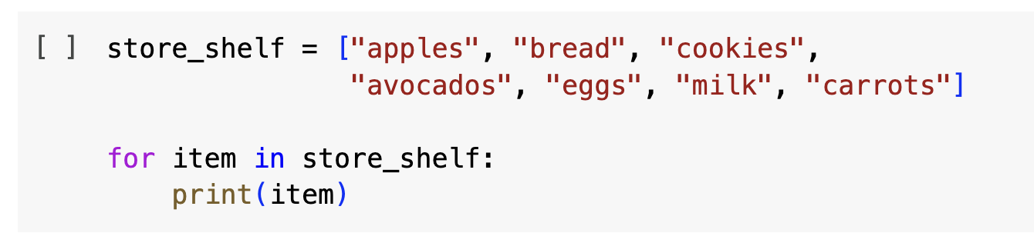
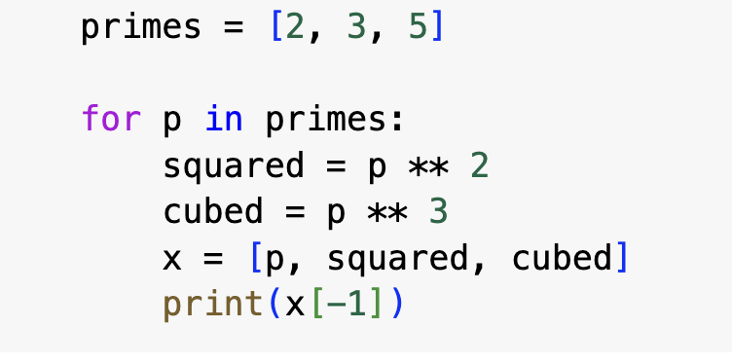
For Loop: Refresher

Slide 4
For Loop Exercise
Using your store_shelf list:
Write a for loop to print all the items in the list starting with the letter “a”
Write a for loop to print all the items in your list that are longer than 5 letters

Slide 5
Solution Part 1
store_shelf = ["apples", "bread", "cookies", "avocados", "eggs", "milk", "carrots"]
for x in store_shelf:
if x[0] == "a":
print(x)

Slide 6
Solution Part 2
store_shelf = ["apples", "bread", "cookies", "avocados", "eggs", "milk", "carrots"]
for x in store_shelf:
if len(x) > 5:
print(x)

Slide 7
For Loop Exercise
Using your department lists from earlier in the lesson:
humanities = ["English", "History", "French", "Art History", "Philosophy"]
sciences = ["Biology", "Chemistry", "Neuroscience", "Physics", "Ecology"]
Write a for loop that finds the words in the humanities list that have the same number of letters as a word in the science list, printing the two words and the statement “These words have the same number of letters!” when there is a match for the number of letters.
**Hint: You can put a for loop inside another for loop!!**

Slide 8
Solution
humanities = ["English", "History", "French", "Art History", "Philosophy"]
sciences = ["Biology", "Chemistry", "Neuroscience", "Physics", "Ecology"]
for x in humanities:
for y in sciences:
if len(x) == len(y):
print(x, y, "These words have the same number of letters!")

Slide 9
Functions

Slide 10
Functions Exercise
Given a list: foods = [“eggs”, “bread”, “milk”, “cookies”], create a function to return all words in the list that are longer than 5 letters.

Slide 11
Functions Exercise Part One
Given a list foods = [“eggs”, “bread”, “milk”, “cookies”], create a function to return all words in the list that are longer than 5 letters.
def long_strings(x):
for food in x:
if len(food) > 4:
print(food)
return
long_strings(foods)

Slide 12
Questions?

Slide 13
Resources for Further Learning
In-Person Training at Wash U:
TRIADS Training and Workshops
Olin Library Workshops
Online Resources:
EdX (https://www.edx.org/learn/python)
Codecademy.com
https://github.com/practical-tutorials/project-based-learning

