Slide 1
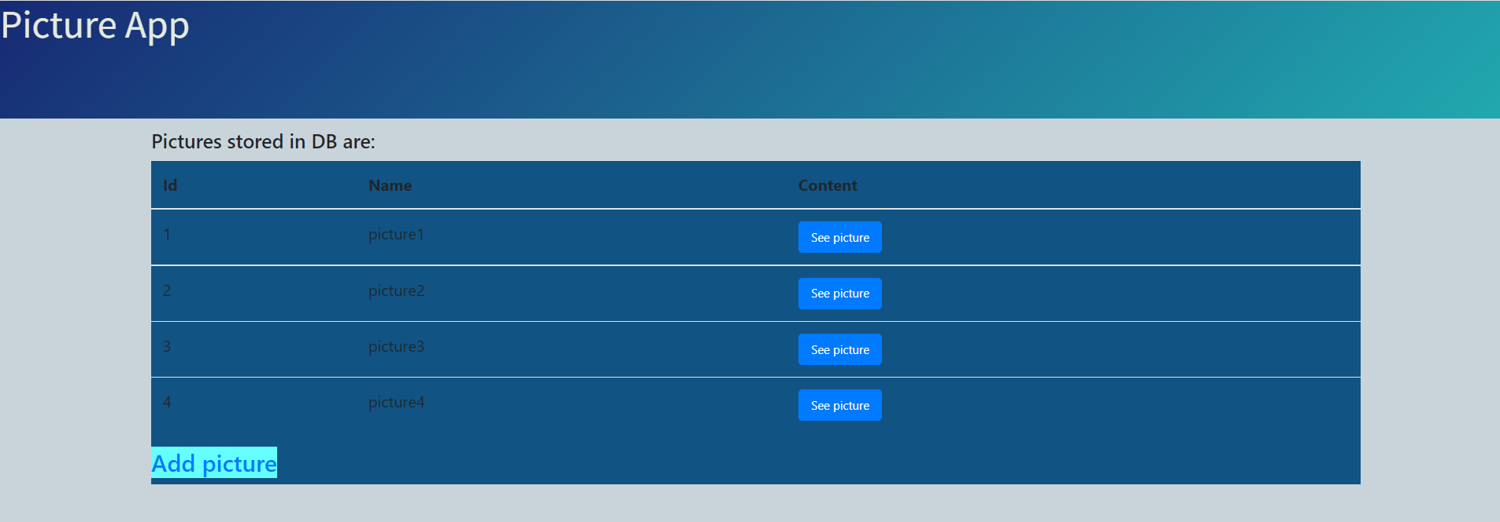
Spring Boot project with: Sql DB(MySql), Spring Data JPA and Thymeleaf
Fonctions:
1. Show picture list in DB

Slide 2

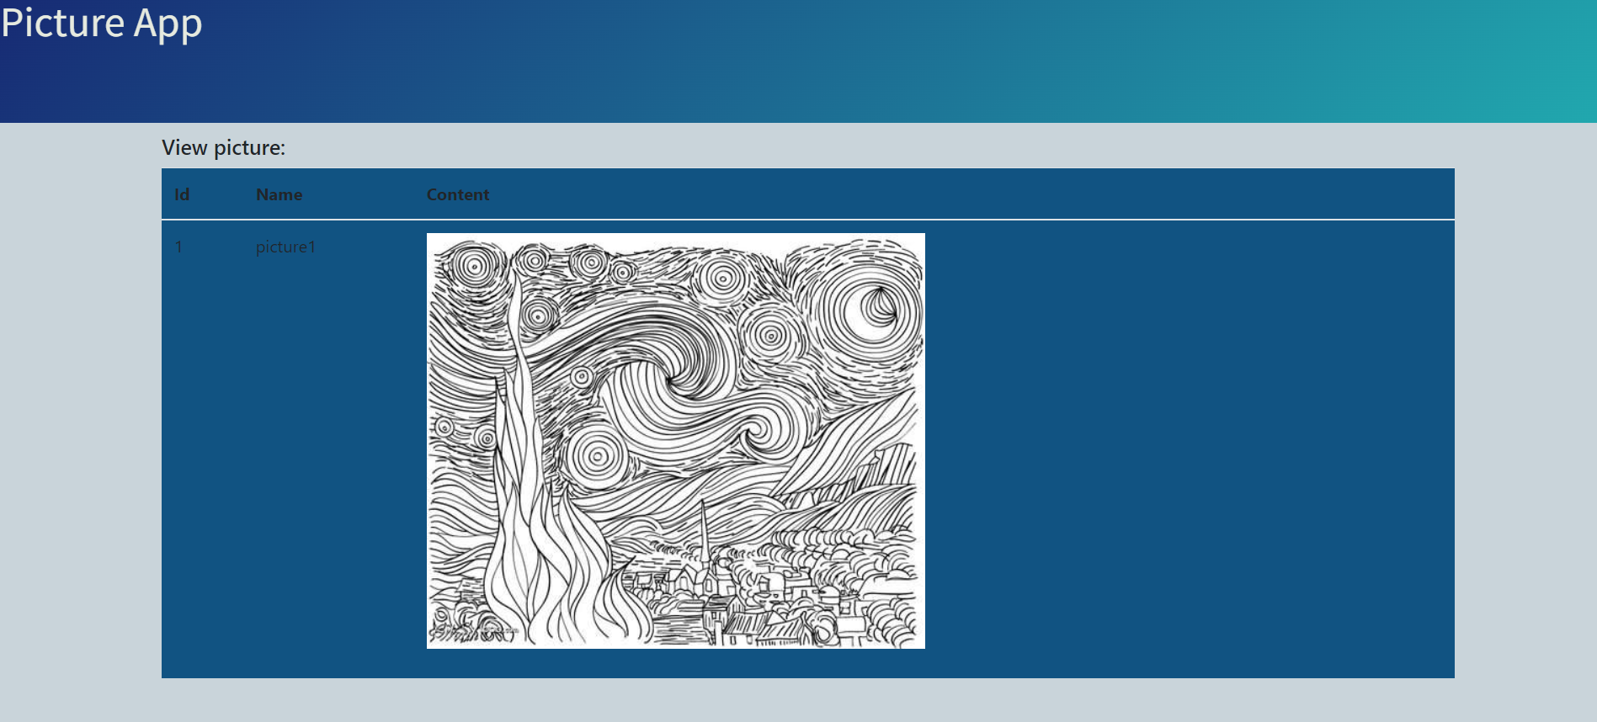
2. Add picture
3. See picture

