Slide 1

Master’s Thesis
Mechatronics Engineering
Presented by Gava Claudia
with supervision of Andrea Del Prete and Elias Fontanari

Slide 2
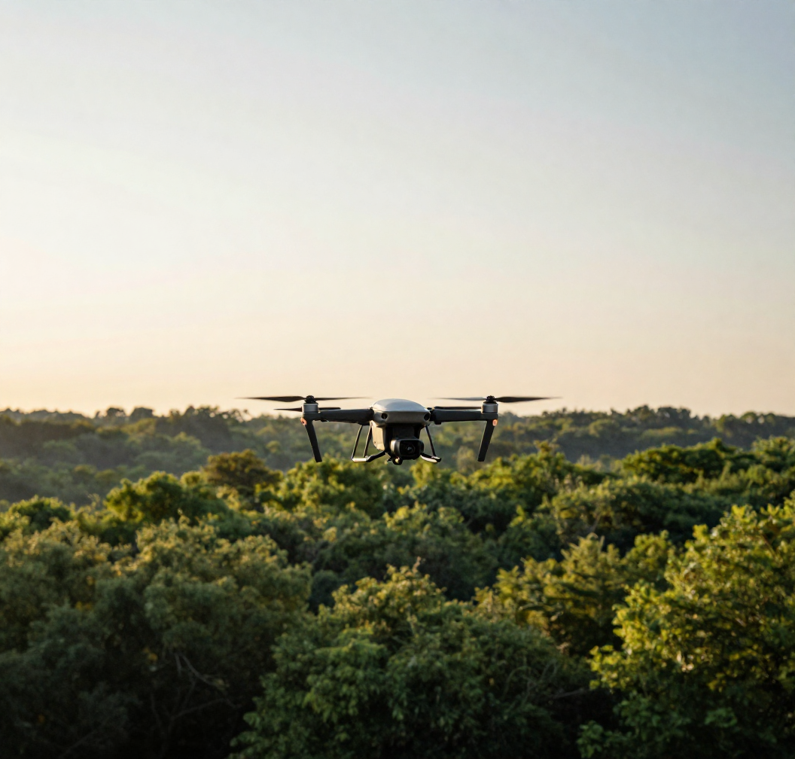
SAFE LIDAR-BASED NAVIGATION OF UNKNOWN ENVIRONMENTS WITH MODEL PREDICTIVE CONTROL
Notes:
Good morning. I am Claudia Gava, and today I will present my thesis on safe drone navigation in unknown environments, developed with the supervision of Professor Del Prete and PhD student Elias Fontanari.

Slide 3
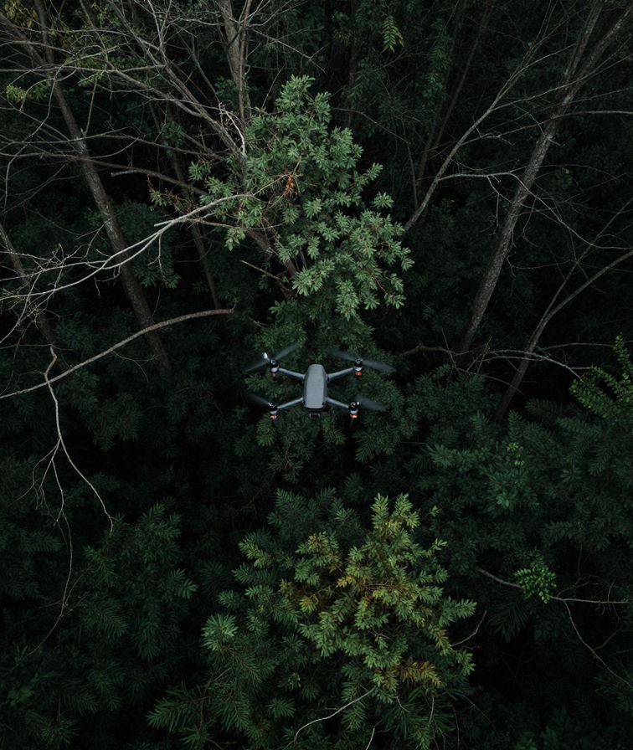
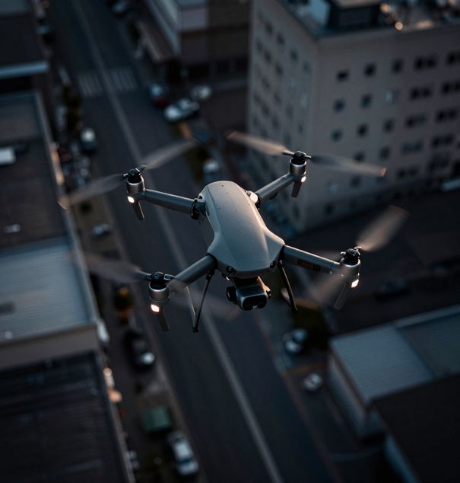
CONTEXT
CHALLENGE:
Safe autonomous navigation in unknown environments for underactuated systems (UAVs)
STATE-OF-THE-ART and LIMITATIONS :
  Standard MPC: Myopic prediction horizons lead to recursive infeasibility and crashes
  → Control Invariant Set
  DeepReach: High computational costs
GOAL:
Combine the optimality of MPC with the safety guarantees of control-invariant terminal constraint set to ensure recursive feasibility
Notes:
Safety management in robotics is a major area of ​​focus, given the increasingly frequent interaction between humans and robots. Furthermore, navigating unmapped spaces requires real-time reactions to obstacles.
In this regard, Standard MPC is excellent for trajectory planning, but on its own—and with a short prediction horizon—it does not offer absolute safety guarantees. To mathematically ensure the drone never crashes the controller needs a Control-Invariant terminal set. Computing this for non-linear systems like drones is extremely difficult. State-of-the-art methods like DeepReach approximate it, but at huge computational costs. Our goal was to overcome this bottleneck, combining MPC's optimality with NN safety guarantees.

Slide 4
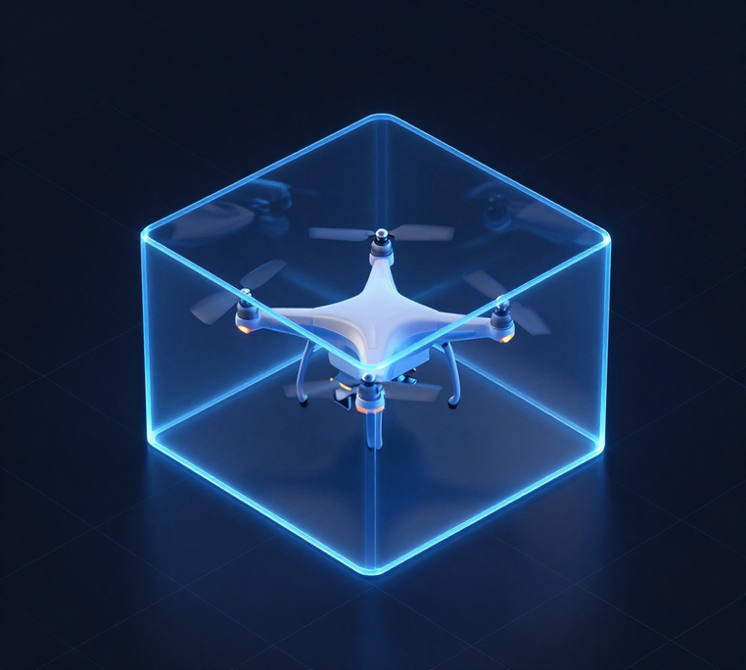



METHOD
  Offline OCP & Dataset Generation
RBOC Method
  Solved thousands of Optimal Control Problems across randomized initial conditions to find the minimal box dimensions
Recovery Box: rectangular volume modeling the exact physical space required for the UAV to stop safely
Notes:
To achieve this, we adapted the VBOC algorithm—originally for manipulators—to drones, introducing the Recovery Box. This is an asymmetric box modeled around the drone, representing its required stopping space. Offline, we solve thousands of optimal control problems to find the minimal box dimensions across random initial conditions

Slide 5
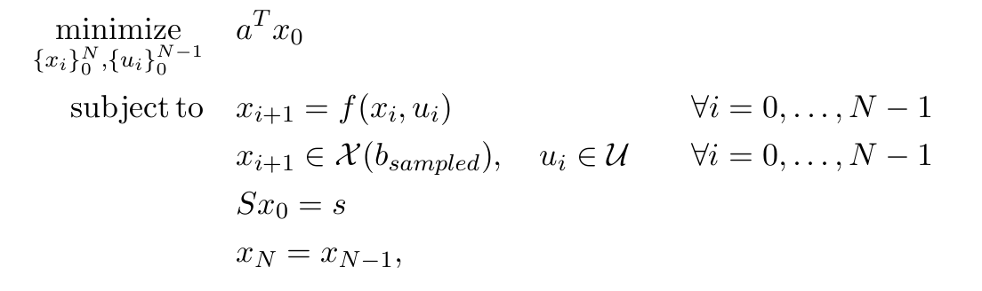



RBOC OCP Formulation
Box scaling factor
Dynamic model
Random I.C.
Notes:
As you can see in its formulation, the Optimal Control Problem minimizes solely the scaling factor. This variable is included in the drone's state $x$and extracted using the binary vector $a$.
The constraints embed the drone's dynamic model—which we analyzed for both a simplified bicopter and the full quadcopter—along with physical limits on velocities, angles, and motors.
Crucially, the constraints mathematically enforce two things: the drone must remain strictly inside the box during the entire maneuver, and the box can never be smaller than the drone itself.
Finally, starting from randomized initial conditions, the last equality constraint ($x_{N}=x_{N−1}$) ensures that the drone reaches a stable equilibrium. This guarantees that at the end of the optimization, the drone has come to a complete and safe stop.

Slide 6
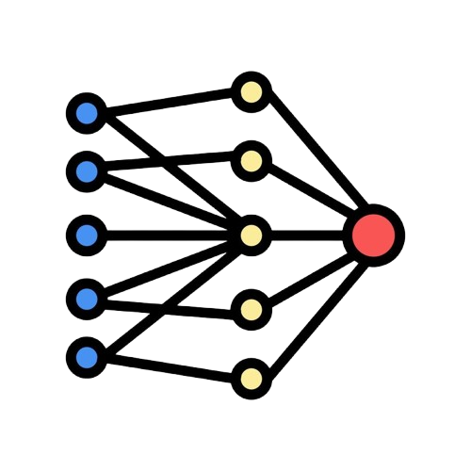



Drone’s state and
  Box Shape
  2. Neural Network Training
  Scaling Factor
  MPC computes the optimal trajectory towards the target, integrating the trained Neural Network as a terminal constraint to prevent short-sighted collisions:
  3. MPC Integration
Notes:
This massive dataset is then used to train a NN. Now, given the drone's current state, the network instantly predicts the required stopping space, outputting a scaling factor. Finally, this network acts as a terminal constraint in our real-time MPC, mathematically guaranteeing that the predicted box always fits inside the obstacle-free space.

Slide 7




RESULTS
I. Safety Validation (vs. DeepReach)
Test:
Pure predictive reliability comparison between RBOC and DeepReach on a Ground Truth OCP dataset
Metric:
  RBOC →
  DeepReach →
 | Model | Ground Truth
True Alarm
False Alarm
True Safe Pred.
Missed Alarm
Notes:
Moving to the results, we first validated the model's safety against DeepReach with a common Ground Truth. The critical metric here is the Missed Alarm rate—when the model predicts safety, but a crash actually occurs.

Slide 8
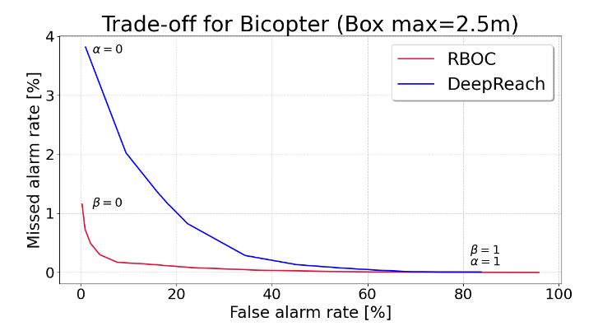
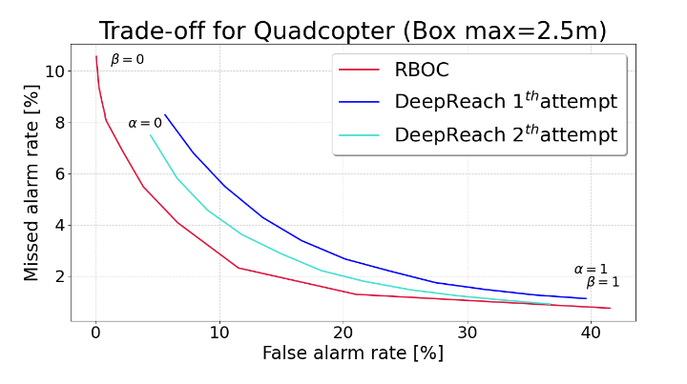
Result:
RBOC dramatically reduces the Missed Alarm rate compared to DeepReach method
Notes:
As can be seen in the graph, our RBOC method (red curve) yields a drastically lower missed-alarm rate compared to DeepReach. While this is evident in the 2D case, RBOC also outperforms DeepReach models in more complex 3D scenarios—across both training setups—by slightly adjusting the conservativeness parameter beta.

Slide 9
II. Navigation Performance - velocity target
(vs. State-of-the-Art methods)
Test:
Autonomous navigation in two unknown environments with varying obstacle densities, where the drone must track a target velocity solely in the x-direction.
 | RBOC-MPC | Std-MPC
Collisions | 0% | 82%
Reach and maintain target | yes | yes
Distacnce [m] | 45 | 46
Cost | 17582 | 11498
Zero-TC MPC
0%
no
1.8
238867
APF
0%
enough
31
92736
Results:
Other limits:
  stopping at local minimum
  oversimplifies the UAV by considering it a point mass
  user-defined gains are highly environment-dependent
Notes:
Finally, we tested continuous navigation tracking a target velocity. Again, RBOC-MPC outperformed the alternatives. Standard MPC failed frequently. Using an MPC with a Zero-Terminal Constraint avoided crashes but essentially paralyzed the drone, resulting in extremely low speeds. We also compared against APF. While APF prevents collisions, it suffers from severe dynamic limitations, which are best seen in action.

Slide 10
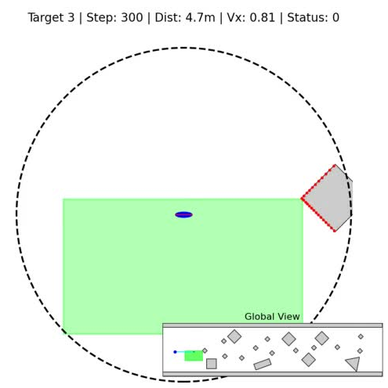
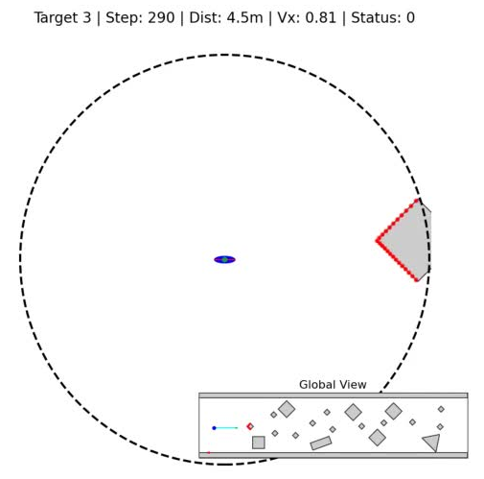
RBOC-MPC
APF
Notes:
Here is the visual comparison. With RBOC-MPC, the drone flies smoothly. The green area is the real-time safe-box. The drone maintains its speed and brakes efficiently only when necessary.
With APF, you see the attractive and repulsive forces. The drone bounces erratically between obstacles because the tuning gains are user-defined and highly environment-dependent. Furthermore, APF oversimplifies the UAV by modeling it merely as a point mass. Adapting this to the complex dynamics of a real quadcopter is difficult and leads to idealized behavior. Finally, when opposing forces cancel each other out, APF suffers from critical stalling, or deadlocks. RBOC completely avoids these issues.

Slide 11
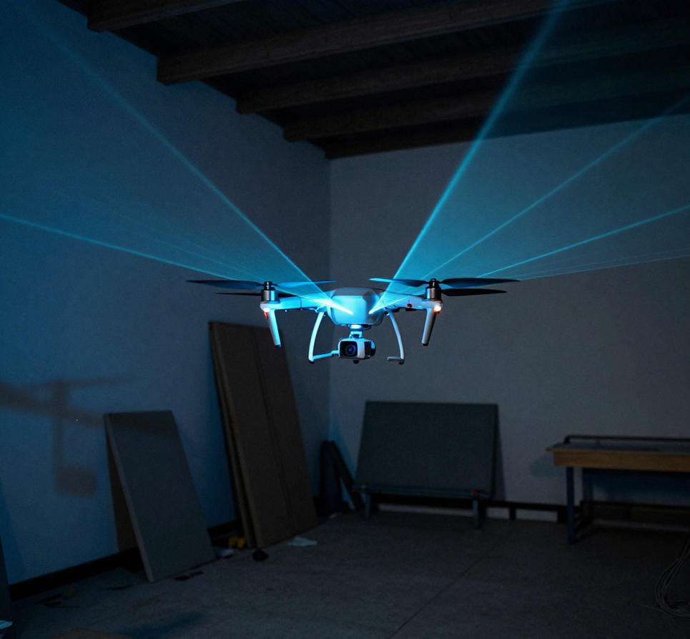
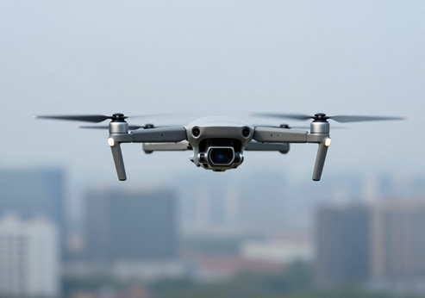
CONCLUSIONS
  Key Contributions
  Future Developments
  Novel Framework: RBOC-MPC
  Guaranteed Safety
  Superiority in both safety management and achieving the assigned target compared to other methods tested
  Global Path Planning Integration to limit stalls and recovery conditions
  Complex geometries for safe-box
  Real-World Validation
Notes:
To conclude, the RBOC-MPC framework successfully guarantees mathematical safety for underactuated UAVs, surpassing the performance of other state-of-the-art methods. Future developments will focus on integrating a Global Path Planner to resolve some trajectory planning limitations, extending the safe-box to complex convex geometries to obtain a more realistic perception of the environment, and above all validating the framework on physical drone hardware.

Slide 12


