Slide 1
rtos 2
César Rodríguez
MIGUEL DIAZ

Slide 2
Index
Memory Allocation
Multitask
RTOS Tick
Queues
Timers
Interrupt Management
Semaphores
Critical Sections
Event Groups
Notifications
Memory Allocation

Slide 3

freertos
FreeRTOS is a class of RTOS that is designed to be small enough to run on a microcontroller..
The size constraints, and dedicated end application nature on an Embedded System, rarely warrant the use of a full RTOS implementation.
FreeRTOS therefore provides the core real time scheduling functionality, inter-task communication, timing and synchronization primitives only.
Additional functionality, such as a command console interface, or networking stacks, can then be included with add-on components.

Slide 4

ESP-IDF FREERTOS
ESP-IDF provides an implementation of FreeRTOS with dual-core symmetric multiprocessing (SMP) capabilities.
It is based on FreeRTOS v10.5.
The FreeRTOSConfig.h header file is considered private and must not be modified by users. FreeRTOS configuration shall be done in the configuration menu.

Slide 5
ESP-IDF FREERTOS
ESP-IDF starts FreeRTOS automatically, users shall never call vTaskStartScheduler() or vTaskEndScheduler().
Users must define a void app_main(void) function which acts as the entry point for user’s application and is automatically invoked on ESP-IDF startup.
Several tasks (including the main task that calls app_main() ) are automatically started and run in the background.

Slide 6
Tasks
Can be viewed as “Small programs”.
They have an entry point which will usually run forever in an infinite loop.
In FreeRTOS tasks are implemented as C functions (They must return void and take a void pointer parameter).
They should be “Event-driven”.

Slide 7
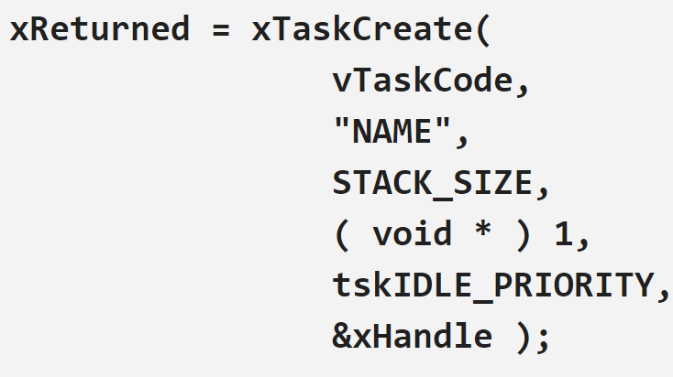
Creating a TASK
Tasks are created using the xTaskCreate() function.
The following parameters must be specified when creating a task:
Task Code
Task Name
Stack
Parameters
Priority
Task Handle

Slide 8
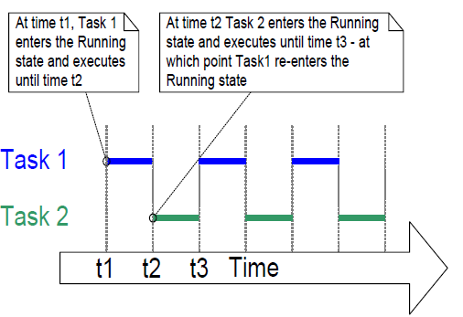
Time measurement
Tasks are executed during a time interval known as “Time Slice”.
The scheduler runs at the end of each time slice in order to select the next task to run.
Time slices are handled through a periodic interrupt known as “Tick Interrupt”.

Slide 9
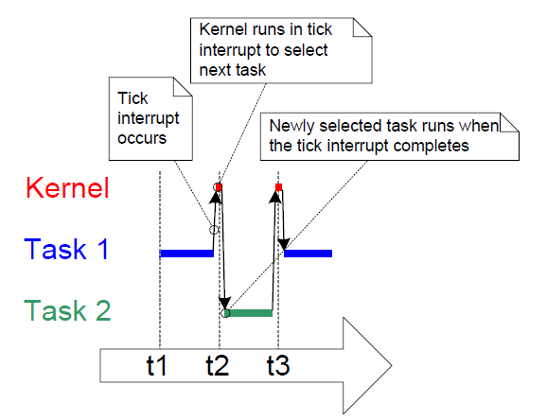
Time measurement
The length of the time slice is set by the tick interrupt frequency, which is configured through the configTICK_RATE_HZ macro (Ex. if set to 100 (Hz), then the time slice will be 10 milliseconds.
The pdMS_TO_TICKS() macro converts a time in milliseconds into a time in ticks.

Slide 10

Task Priorities
Each RTOS Task has a priority value.
Several tasks can have the same priority.
Low priority values denote low priority tasks.
The maximum number of priorities is set by the configMAX_PRIORITIES macro.
Priorities can be modified after the scheduler has started by using the vTaskPrioritySet() function.

Slide 11
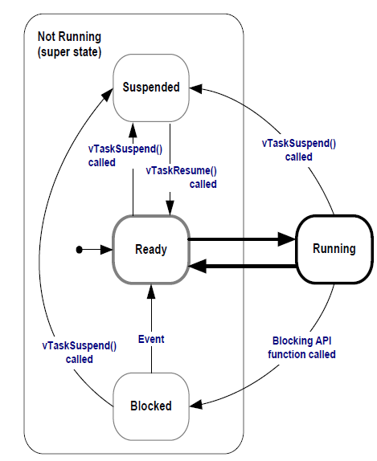
TASK STATES
Only one task can be executing at any given time, so tasks can have the following states:
Blocked State: task that is waiting for an event.
Suspended State: tasks in this state are not available to the scheduler. The only way to enter this state is through the vTaskSuspend() function and the only way out of it is through a call to the vTaskResume() function.

Slide 12
TASK STATES
Ready State: tasks that can run but not currently in the running state.
Running State: processor is executing the task’s code.

Slide 13
vTaskDelay() fUNCTION
Only available when INCLUDE_vTaskDelay is defined as 1 in FreeRTOSConfig.h.
It places the calling task into the blocked state for a fixed number of tick interrupts.
The task does not use any processing time while waiting for the delay to finish.
The pdMS_TO_TICKS() macro can convert a time in milliseconds into a time in ticks.

Slide 14
IDLE TASK
There must always be at least one task that can enter the “Running state”.
An “Idle” task is automatically created by the scheduler when the RTOS Scheduler starts.
This task:
Has the lowest possible priority (0) to ensure it never prevents a higher priority task from running.
Responsible for cleaning up kernel resources after a task has been deleted.

Slide 15
Deleting TASKS
FreeRTOS tasks must not be allowed to return from their implementing function.
If a task is no longer required, it should be deleted.
Tasks can use the vTaskDelete() function to delete themselves or any other tasks.
If “NULL” is passed to vTaskDelete() a task can delete itself.

Slide 16
Scheduling algorithm
The scheduling algorithm is the software that chooses which task in the “ready state” should run.
The algorithm can be changed using the following macros in FreeRTOSConfig.h
configUSE_PREEMPTION: set to 1 to use preemptive RTOS scheduler or 0 to use cooperative RTOS Scheduler.
configUSE_TIME_SLICING: set to 1 to switch between tasks of equal priority or 0 to avoid switching between tasks.

Slide 17
Scheduling algorithm
Fixed Priority: scheduling algorithms that do not change the priority assigned to the tasks being scheduled, but also do not prevent the tasks from changing their own priority, or that of other tasks.
Pre-emptive: scheduling algorithms that will immediately “pre-empt” the running task if a task that has a higher priority enters the running state.
Time Slicing: used to share processing time between tasks of equal priority, even when tasks do not explicitly yield or enter the blocking state.

Slide 18
Scheduling algorithm
FreeRTOS Scheduler can be configured to work as:
Scheduling Algorithm | configUSE_PREEMPTION | configUSE_TIME_SLICING
Prioritized Pre-emptive Scheduling with Time Slicing. | 1 | 1
Prioritized Pre-emptive Scheduling without Time Slicing. | 1 | 0
Co-operative Scheduling. | 0 | Any Value

Slide 19
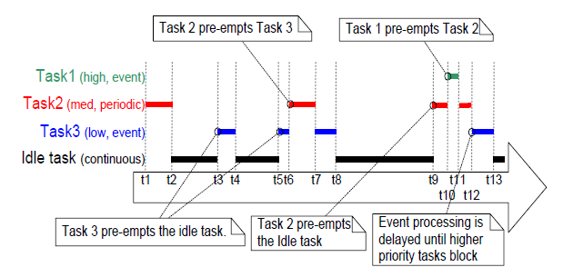
Prioritized Pre-emptive Scheduling with Time Slicing
Example 1: Tasks with different priorities

Slide 20
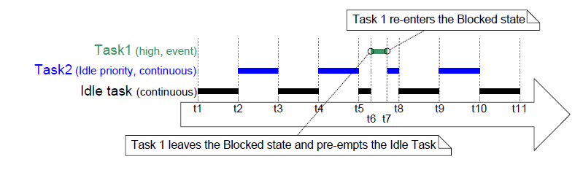
Prioritized Pre-emptive Scheduling with Time Slicing
Example 2: Tasks that share priority.

Slide 21
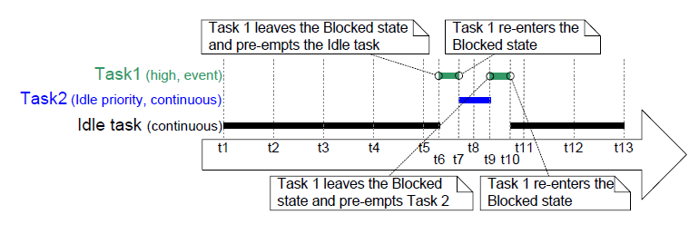
Prioritized Pre-emptive Scheduling without Time Slicing
Example 1: Tasks that share priority.

Slide 22
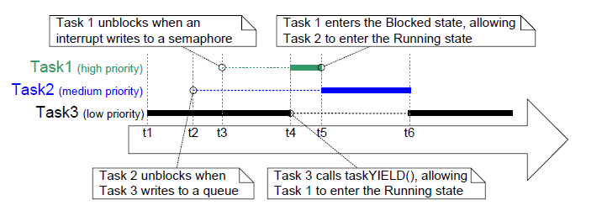
Co-operative Scheduling
Example 1: Tasks with different priorities

Slide 23
Queue
Communication mechanism between threads and interrupts.
Can hold a finite number (length) of fixed size data items.
Normally used as FIFO Buffers.
It is possible to write to the front or back of a queue and also to overwrite data.

Slide 24





QUEUE EXAMPLE

Slide 25
QUEUE
The same queue can be accessed by multiple tasks or ISR.
When tasks attempt to read from a queue, a “block time” can be specified. Tasks will remain in the “Blocked State” to wait for data to be available in the queue until data is placed in the queue or if the “block time” expires.
Tasks can also specify a “block time” when writing to a queue. They will remain in the “Blocked State” until space in the queue becomes available or if the “block time” expires.

Slide 26
Creating a queue
Queues are created using the xQueueCreate() function.
If the queue is created successfully, the function shall return a handler of type QueueHandle_t that is used to reference the queue.
The queue length and item size must be specified when creating the queue.

Slide 27
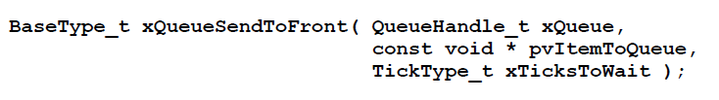
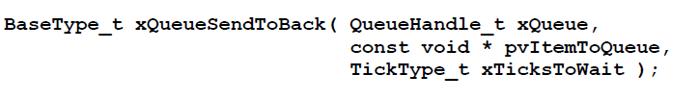
Placing data in a queue
xQueueSendToBack(): used to send data to the back (tail) of a queue.
xQueueSendToFront(): used to send data to the front (head) of a queue.

Slide 28

Reading data from a queue
xQueueReceive(): used to read an item from a queue. The read item is removed from the queue.
uxQueueMessagesWaiting(): used to query the number of items currently in the queue.

Slide 29
Software timers
Used to schedule the execution of a function in a set time or periodically.
The executed function is known as “Timer Callback Function”.
Software timers are handled by the RTOS kernel.
The configUSE_TIMERS macro should be set to 1 to enable them.
A timer period is the time between the timer being started and its callback function being executed.

Slide 30
Timer callback functions
They are implemented as C functions.
They must return void and take a handle to a SW Timer as parameter.
They must be kept short and must not enter the blocked state.

Slide 31
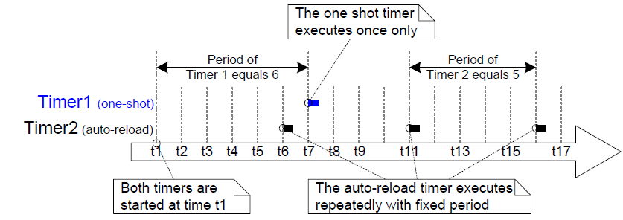
Types of Timers
One Shot Timers: Will execute its callback function only once. It can be restarted manually but it will not restart itself.
Auto Reload Timers: Will restart itself every time it expires, resulting in a periodic execution of its callback function.

Slide 32
Timer states
A SW Timer can be in one of the following states:
Dormant: the timer exists and can be referenced by its handle, but it is not running.
Running: will execute its callback function after a time equal to its period has elapsed since the software timer entered the Running state, or since the software timer was last reset.
The xTimerDelete() API function deletes a timer. A timer can be deleted at any time.

Slide 33
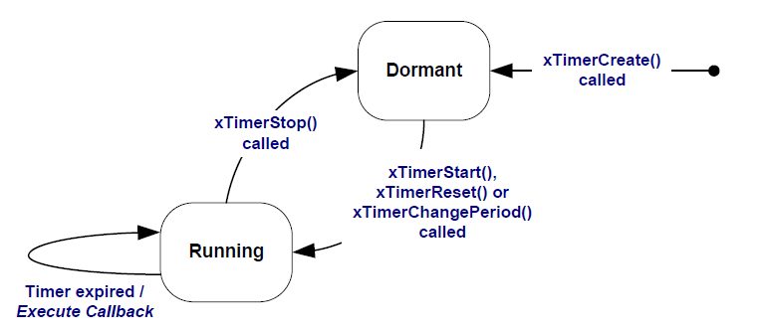
Timer states
Auto Reload SW Timer States and Transitions.

Slide 34
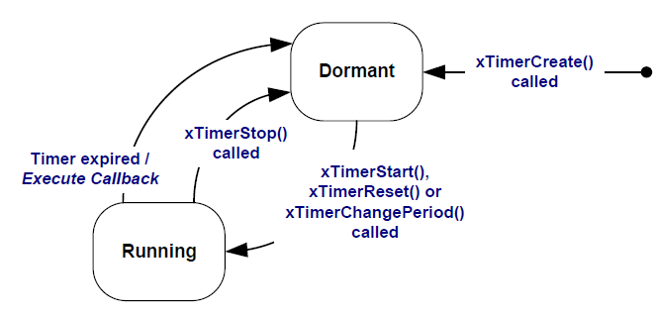
Timer states
One Shot SW Timer States and Transitions.

Slide 35
RTOS Daemon task
Standard FreeRTOS task that is created automatically when the scheduler is started.
All software timer callback functions execute in the context of this task.
It will only process commands or execute timer callback functions, when it is the highest priority task that is able to run.

Slide 36
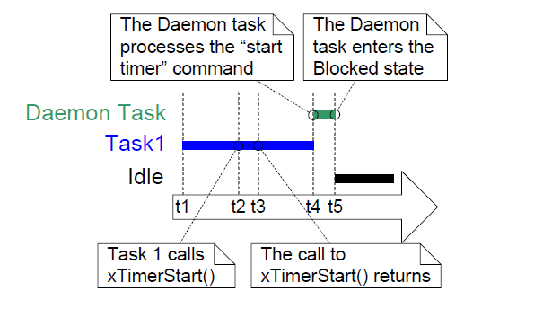
RTOS Daemon task

Slide 37
Timer command queue
Standard FreeRTOS queue that is created automatically when the scheduler is started.
Software timer API functions send commands from the calling task to the daemon task on a queue called the ‘timer command queue

Slide 38
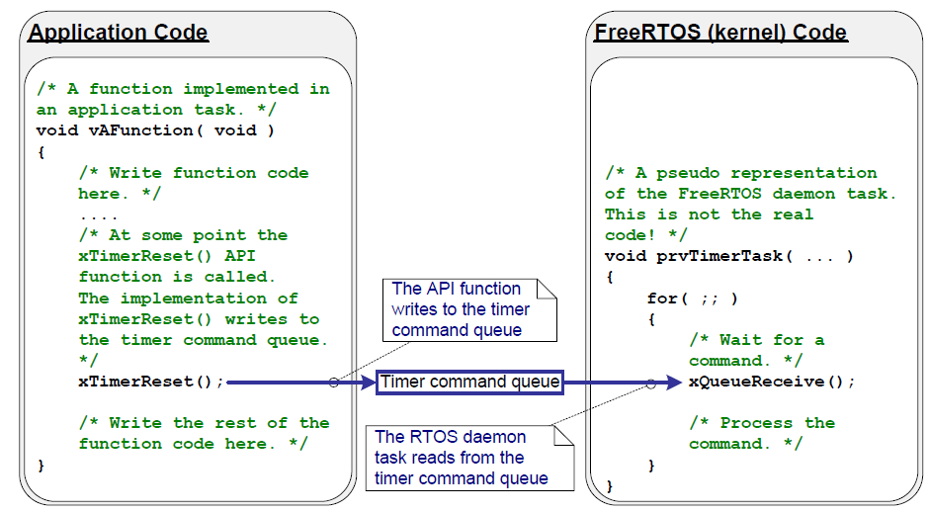
Timer command queue

Slide 39
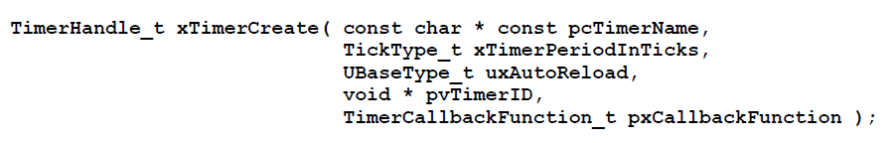
Creating a sw timer
Software timers are referenced by variables of type TimerHandle_t.
xTimerCreate() is used to create a software timer and returns a TimerHandle_t to reference the software timer it creates.
Software timers can be created before the scheduler is running, or from a task after the scheduler has been started.

Slide 40


Handling a timer
xTimerStart() is used to start a software timer that is in the Dormant state, or reset a software timer that is in the Running state.
xTimerStop() is used to stop a software timer that is in the Running state. Stopping a software timer is the same as transitioning the timer into the Dormant state.

Slide 41
Interrupt management
Often it is necessary to use the functionality provided by a FreeRTOS API function from an interrupt service routine (ISR).
FreeRTOS provides two versions of some API functions; one version for use from tasks, and one version for use from ISRs (interrupt-safe).
Functions intended for use from ISRs have “FromISR” appended to their name (Ex. “xQueueReceive()” and “xQueueReceiveFromISR()”) .

Slide 42
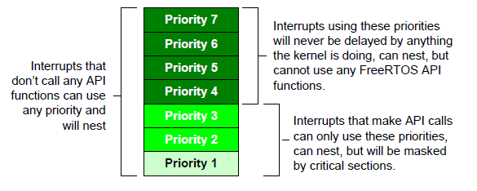
Interrupt management
configMAX_SYSCALL_INTERRUPT_PRIORITY is used to define the higher interrupt priority from which interrupt-safe functions can be called.
configKERNEL_INTERRUPT_PRIORITY: sets the interrupt priority used by the tick interrupt.
Considering a processor that supports seven interrupt priorities, configMAX_SYSCALL_INTERRUPT_PRIORITY is set to 3 and configKERNEL_INTERRUPT_PRIORITY is set to 1:

Slide 43

Binary Semaphores
Can be considered as a queue with a length of one, so it is always either full or empty.
Used for task synchronization.
The operations that can be done with a semaphore are:
Create
Acquire
Release

Slide 44
Binary Semaphores
The xSemaphoreCreateBinary() API is used to create a binary semaphore.
Handles to semaphores should be stored in variables of type “SemaphoreHandle_t”.

Slide 45
Binary Semaphores
Taking’ a semaphore means to ‘obtain’ or ‘receive’ the semaphore. It can be taken only if it is available.
Semaphores can be ‘given’ using the xSemaphoreGive() function.

Slide 46
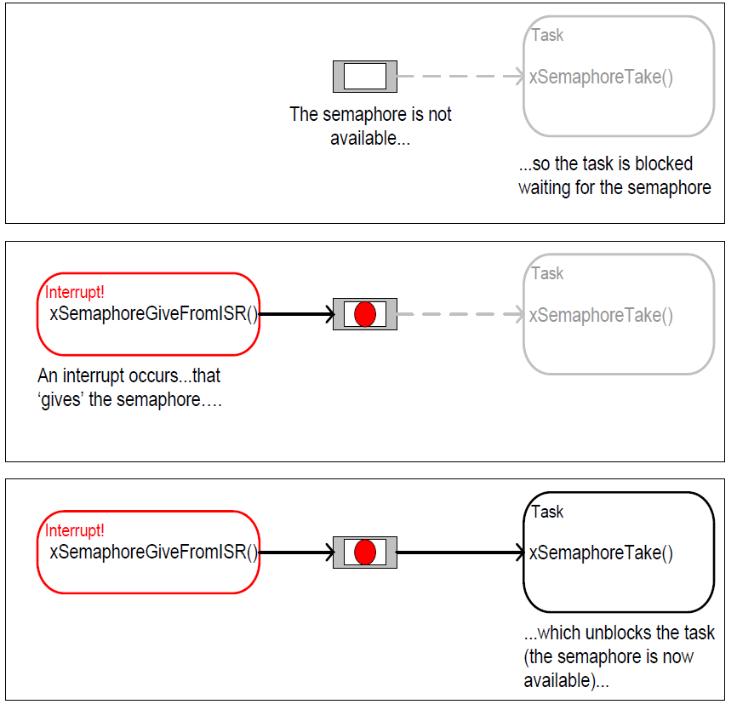
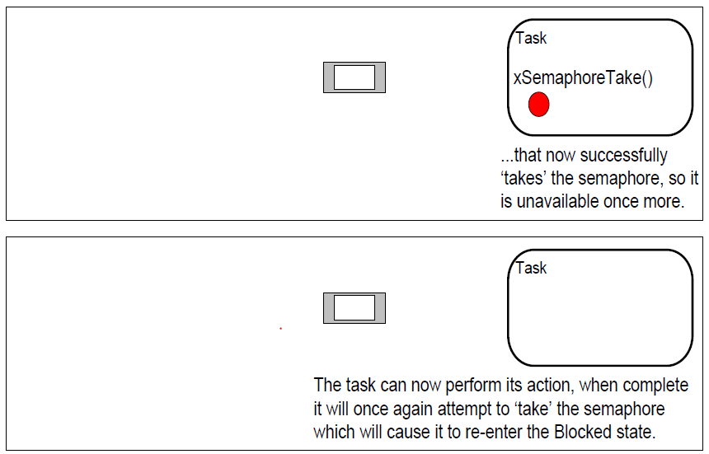
Binary Semaphores

Slide 47
Counting Semaphores
Can be thought of as queues that have a length of more than one.
Tasks are not interested in the data that is stored in the queue—just the number of items in the queue.
Can be used for counting events or managing resources.
Each time a counting semaphore is ‘given’, another space in its queue is used.
The number of items in the queue is the semaphore’s ‘count’ value.

Slide 48
Counting Semaphores
The xSemaphoreCreateCounting () API is used to create a counting semaphore.
When creating a counting semaphore, we must specify the maximum value to which the semaphore can count and the starting value.
Handles to semaphores should be stored in variables of type “SemaphoreHandle_t”.

Slide 49
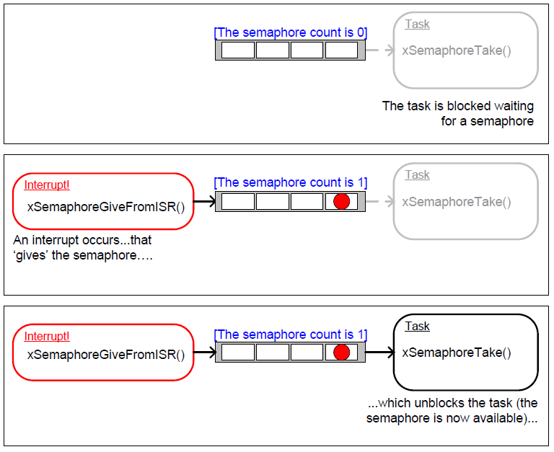
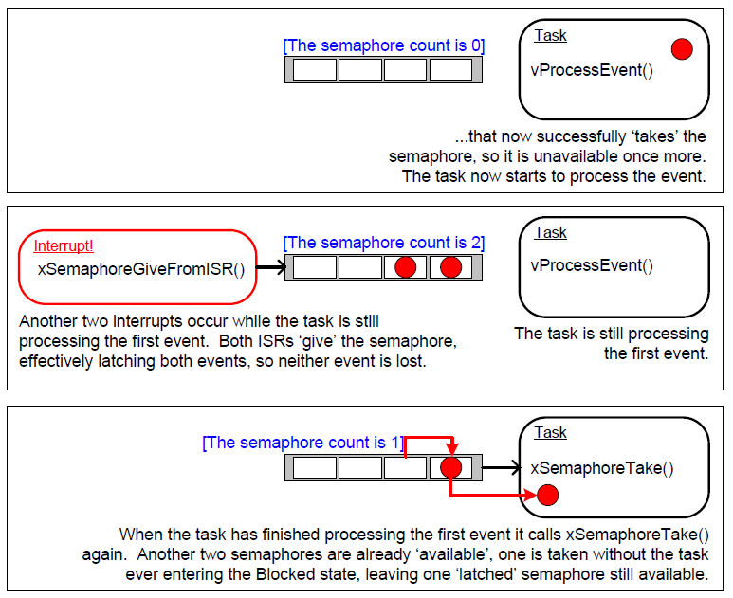
Counting Semaphores

Slide 50
Resource Management
In a multitasking system there is potential for error if one task starts to access a resource but does not complete its access before being transitioned out of the Running state. If the task leaves the resource in an inconsistent state, then access to the same resource by any other task or interrupt could result in data corruption, or other similar issue.
Mutual exclusion techniques are used to ensure data consistency is maintained at all times access to a resource that is shared between tasks.

Slide 51
Critical sections
Critical sections are sequences of code that must operate in an atomic manner (can not be divided or interrupted).
Basic critical sections protect a region of code from access by other tasks and by interrupts
They should remain short.

Slide 52
Critical sections
FreeRTOS provides the taskENTER_CRITICAL() and taskEXIT_CRITICAL() functions to indicate the code is entering or exiting a critical section.
These functions work by disabling interrupts up to the interrupt priority set by configMAX_SYSCALL_INTERRUPT_PRIORITY.
Every call to taskENTER_CRITICAL() must be paired with a call to taskEXIT_CRITICAL().

Slide 53
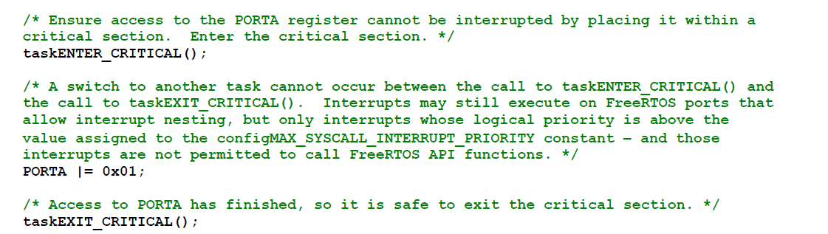
Critical sections

Slide 54


SUSPENDING THE SCHEDULER
Critical sections can also be created by suspending/locking the scheduler.
This method only protects a region of code from access by other tasks, because interrupts remain enabled.
The vTaskSuspendAll() function can be used to suspend the scheduler.
The scheduler can resume operation by calling the xTaskResumeAll() function.

Slide 55
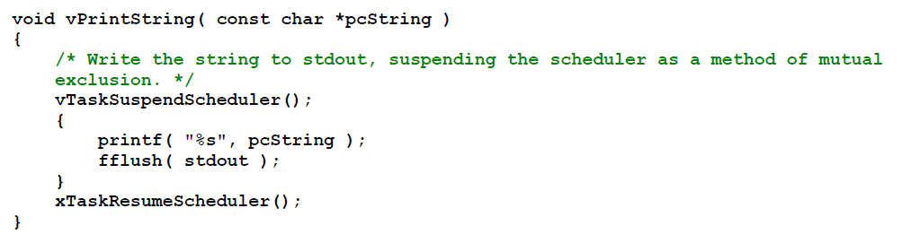
SUSPENDING THE SCHEDULER

Slide 56
MUTEXES
A Mutex is a special type of binary semaphore that is used to control access to a resource that is shared between two or more tasks.
Its name comes from “Mutual Exclusion”.
They can be thought of as a token that is associated with the resource being shared. For a task to access the resource, it must first successfully ‘take’ the token. When the task is finished with the resource, it must ‘give’ the token back. Only when the token has been returned can another task successfully take the token.

Slide 57
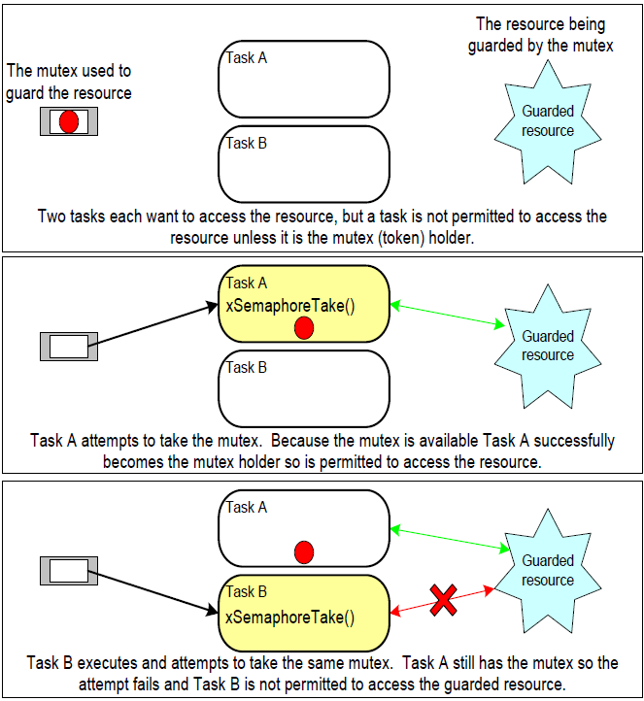
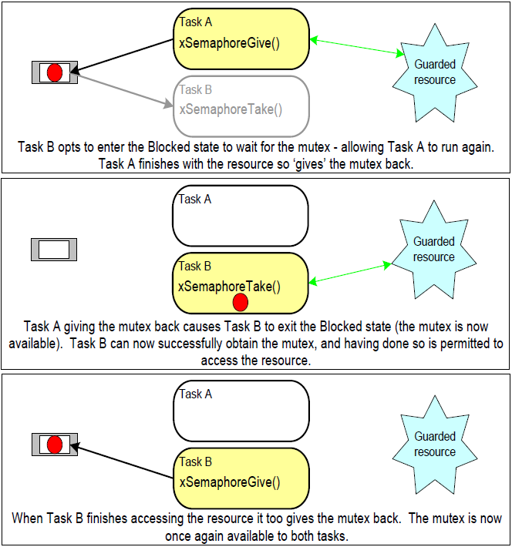
MUTEXES

Slide 58
MUTEXES
The xSemaphoreCreateMutex() function can be used to create mutexes.
A mutex is a type of semaphore, so handles for them should be stored in variables of type “SemaphoreHandle_t”.
Mutexes can be taken through the xSemaphoreTake() function and given through the xSemaphoreGive() functions.

Slide 59
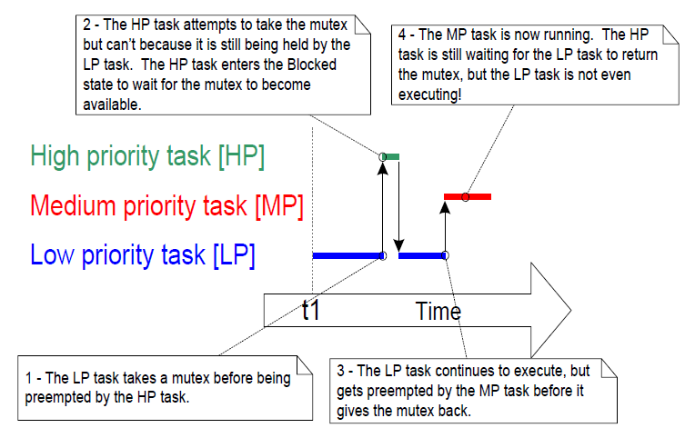
Priority inversion
A higher priority task being delayed by a lower priority task is called ‘priority inversion’.

Slide 60
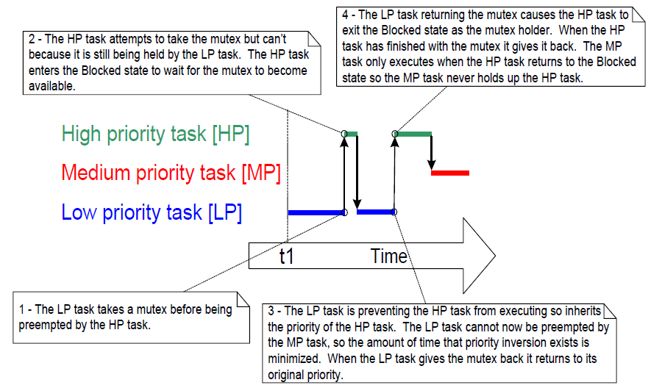
Priority inheritance
Priority inheritance works by temporarily raising the priority of the mutex holder to the priority of the highest priority task that is attempting to obtain the same mutex.

Slide 61
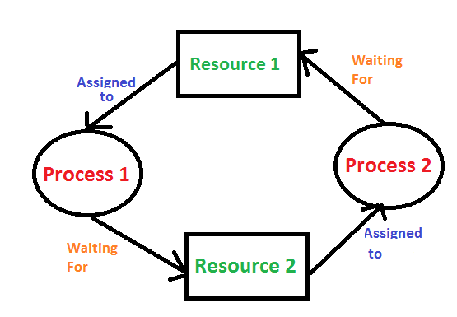
Deadlock
Deadlock occurs when two tasks cannot proceed because they are both waiting for a resource that is held by the other.

Slide 62
Recursive mutexes
A task can deadlock with itself if it attempts to take the same mutex more than once, without first returning the mutex.
This type of deadlock can be avoided by using a recursive mutex instead of a standard mutex.
A recursive mutex can be ‘taken’ more than once by the same task, and will be returned only after a call to ‘give’ the recursive mutex has been executed for every preceding call to ‘take’ the recursive mutex.

Slide 63
Recursive mutexes
Recursive mutexes are created using xSemaphoreCreateRecursiveMutex() function.
Recursive mutexes are ‘taken’ using xSemaphoreTakeRecursive().
Recursive mutexes are ‘given’ using xSemaphoreGiveRecursive().

Slide 64

Gatekeeper tasks
Gatekeeper tasks provide a clean method of implementing mutual exclusion without the risk of priority inversion or deadlock.
Gatekeeper tasks have sole ownership of a resource. Only them are allowed to access the resource directly. Any other task needing to access the resource can do so only indirectly by using the services of the gatekeeper.

Slide 65

Event Groups
Feature that allow events to be communicated to tasks.
Allow a task to remain in the blocked state until one or more events occur.
Unblock all the tasks that were waiting for the same event.

Slide 66
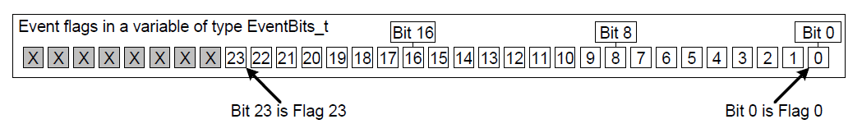
Event Groups
An event ‘flag’ is a Boolean (1 or 0) value used to indicate if an event has occurred or not.
An event ‘group’ is a set of event flags.
The state of each event flag in an event group is represented by a single bit in a variable of type EventBits_t.

Slide 67
Event Groups
It is up to the application writer to assign a meaning to individual bits within an event group.
The number of event bits in an event group is dependent on the configUSE_16_BIT_TICKS macro:
If configUSE_16_BIT_TICKS is 1, then each event group contains 8 usable event bits.
If configUSE_16_BIT_TICKS is 0, then each event group contains 24 usable event bits.
Any number of tasks can set bits in the same event group, and any number of tasks can read bits from the same event group.

Slide 68
Event Groups
Event groups are referenced using variables of type EventGroupHandle_t.
The xEventGroupCreate() API function is used to create an event group.
The xEventGroupSetBits() API function sets one or more bits in an event group, and is typically used to notify a task that the events represented by the bit, or bits, being set has occurred.

Slide 69
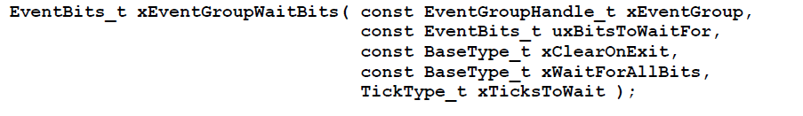
Event Groups
The xEventGroupWaitBits() API function allows a task to read the value of an event group, and optionally wait in the Blocked state for one or more event bits in the event group to become set, if the event bits are not already set.
Event bits can also be cleared using the xEventGroupClearBits() API function.

Slide 70
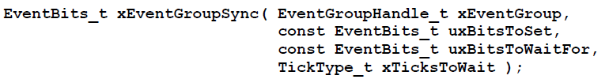
Event Groups
The xEventGroupSync() function allows two or more tasks to use an event group to synchronize with each other. It allows a task to set one or more event bits in an event group, then wait for a combination of event bits to become set in the same event group, as a single uninterruptable operation.

Slide 71
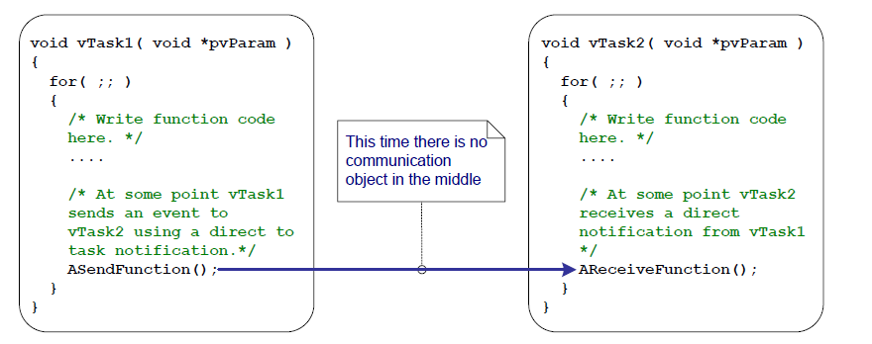
Task NOTIFICATIONS
Allow tasks to interact with other tasks, and to synchronize with ISRs, without the need for a separate communication object.

Slide 72
Task NOTIFICATIONS
Each task has a ‘Notification State’, which can be either ‘Pending’ or ‘Not-Pending’, and a ‘Notification Value’, which is a 32-bit unsigned integer.
When a task receives a notification, its notification state is set to pending.
When a task reads its notification value, its notification state is set to not-pending.
A task can wait in the Blocked state, with an optional time out, for its notification state to become pending.

Slide 73
Task NOTIFICATIONS
Advantages of task notifications are:
They are significantly faster than using a queue, semaphore or event group to send an event or data to a task.
Requires significantly less RAM than using a queue, semaphore or event group to perform an equivalent operation.

Slide 74
Task NOTIFICATIONS
Limitations of task notifications are:
Task notifications can be used to send events and data from an ISR to a task, but they cannot be used to send events or data from a task to an ISR.
Task notifications are sent directly to the receiving task, so can only be processed by the task to which the notification is sent.
A task’s notification value can only hold one value at a time.
If a task attempts to send a task notification to a task that already has a notification pending, then it is not possible for the sending task to wait in the Blocked state for the receiving task to reset its notification state.

Slide 75
Task NOTIFICATIONS
The xTaskNotifyGive() function sends a notification directly to a task, and increments (adds one to) the receiving task’s notification value.
Calling xTaskNotifyGive() will set the receiving task’s notification state to pending, if it was not already pending.

Slide 76
Task NOTIFICATIONS
The ulTaskNotifyTake() function allows a task to wait in the Blocked state for its notification value to be greater than zero, and either decrements (subtracts one from) or clears the task’s notification value before it returns.

Slide 77
Memory Allocation
FreeRTOS allows the user to use Dynamic (Heap) or Static (fixed memory location) allocation for the different RTOS Objects such as:
Tasks
Timers
Queues
Mutexes
This can be configured with the “configSUPPORT_DYNAMIC_ALLOCATION “ macro.

Slide 78
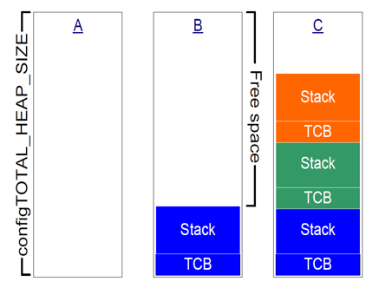
Dynamic Memory Allocation
Fewer function parameters are required when an object is created.
Potential to minimize RAM usage.
The application writer does not need to concern themselves with allocating memory themselves.
The RAM used by an RTOS object can be re-used if the object is deleted.
FreeRTOS comes with 5 different implementations for heap management, developers can choose the one that bests suits their application.

Slide 79
Static memory allocation
Application writer has more control.
RTOS objects can be placed at specific memory locations.
RAM footprint can be determined at link time.
The application writer does not need to concern with handling of memory allocation failures.
Allows the RTOS to be used in applications that don't allow dynamic memory allocation.

