Slide 1
Microcontrollers 2
César Rodríguez
Jose Arzaga

Slide 2
Index
C and assembly languages
Memory
ESP32-C3 Overview
Startup Process
Interrupts
Peripherals
GPIO
ADC
DAC
UART
Timer/CCP
RTC

Slide 3

C Programming language
Developed in the early 70’s by Dennis Ritchie.
One of the most popular languages for embedded systems development.
C compilers support almost every microcontroller.
Code is independent of target processor.
Allows developers to handle HW directly.
Supported by microcontroller vendors.

Slide 4

Assembly Language
Closest to actual machine code.
Produces smaller size binaries.
Difficult to work with.
Dependent on target microcontroller.
More efficient than C (memory and performance).

Slide 5
Assembly vs C
Assembly Language | C Language
Different depending on microcontroller | General Purpose
Low Level Interface | High Level Interface, can use assembly too.
Assembler convert to machine code | Compiler converts into machine code
Binary size is small | Binary is longer than assembly
Program execution is faster | Program execution is slower
Complex programs | Programs are friendlier for developers
Used mostly for critical sections of program | Most popular language
Slow development | Fast development
Less flexible | More flexible
Developer must know processor architecture to code. | Developer must have basic knowledge of processor.

Slide 6
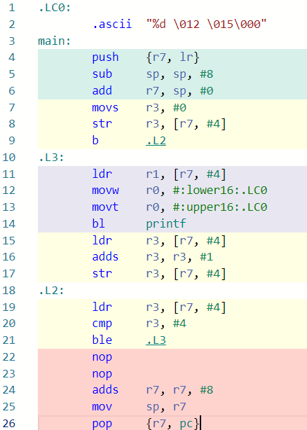
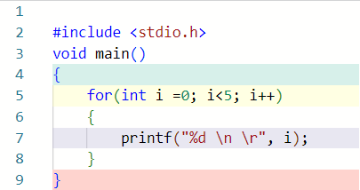
for Statement
GCC For 32-bit ARM
C Language

Slide 7
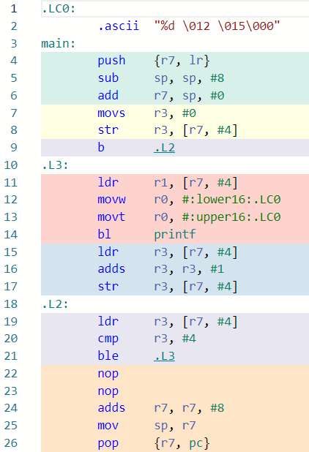
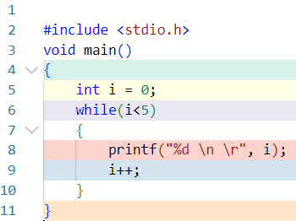
While statement
GCC For 32-bit ARM
C Language

Slide 8
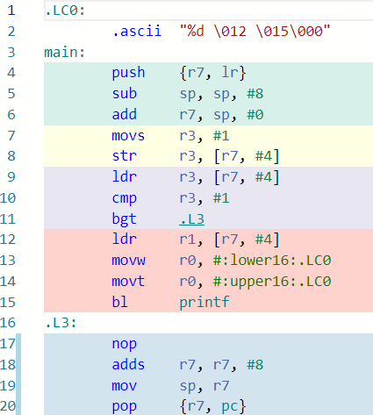
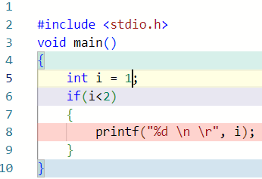
if statement
GCC For 32-bit ARM
C Language

Slide 10
Memory Types – Non-Volatile
ROM (Read Only Memory): can be used to store data on an embedded system permanently. It is usually used to store at least the software required by an embedded device to function on the field.
Mask ROM: Data is permanently programmed into a chip by the manufacturer.
EEPROM (Electrically Erasable Programable ROM): can be erased and reprogrammed more than once . Its contents can be written and erased “in bytes” electrically.
FLASH: can be written and erased in blocks/sectors. It is cheaper and faster than an EEPROM.

Slide 11
Memory Types –Volatile
RAM (Random Access Memory): its contents are erased if the board loses power. Any location can be accessed directly and randomly.
SRAM (Static RAM): stores data using transistors. Faster and consume less power than DRAM.
DRAM (Dynamic RAM) : stores data using capacitors, so it requires a “refresh” mechanism to maintain the integrity of its data. Cheaper and have more storage space than SRAM.

Slide 12
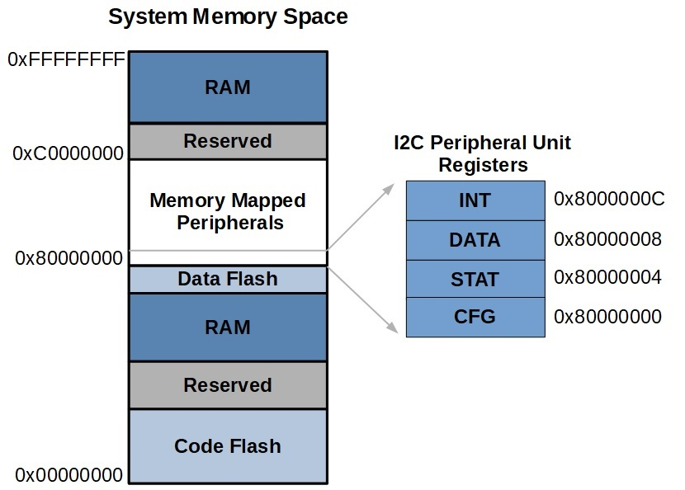
Memory Types –registers
Can:
Reside inside the CPU Core. High speed memory locations that hold data temporarily during the execution cycle of program instructions.
Be memory mapped to HW Peripherals, these registers are used to configure and control
Hold a fixed number of bits (Ex. 8, 16, 32)

Slide 13
ESP32-C3FN4 Memory
384 KB of Internal ROM.
400 KB of Internal SRAM
8 KB of RTC Memory
4 MB of external FLASH.
Note: there may be different bus access restrictions (Some parts of the memory might just be accessible by data or instruction bus).

Slide 14
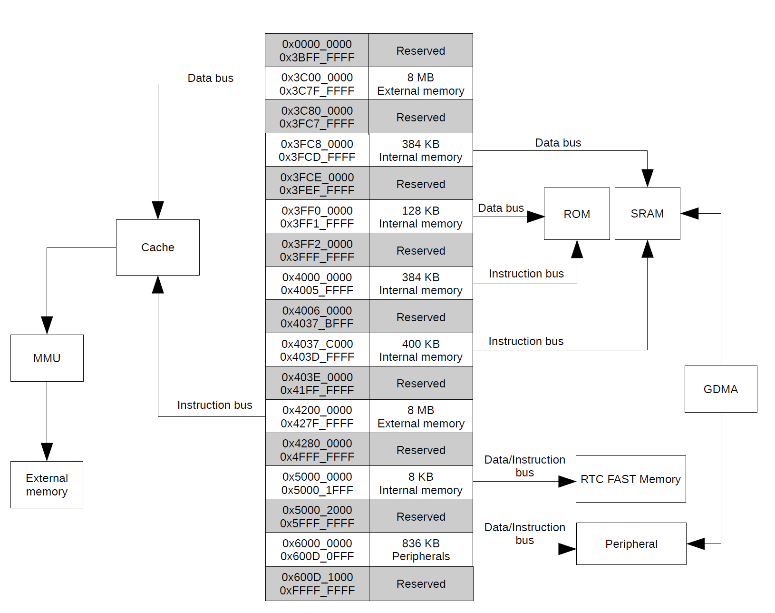
ESP32-C3FN4 Memory

Slide 15

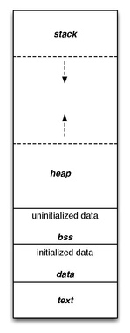
Memory Layout
Static
Text
Data
BSS
Dynamic:
Stack
Heap

Slide 16
Memory Layout – STATIC
Text (.text): Holds functions and constant data. It is usually stored in FLASH memory. It is often read only to prevent any modifications by accident.
Initialized Data (.data): Contains global and static variables that are initialized by the program to a value different tan zero.
Uninitialized Data (.bss): Contains all global and static variables that are not initialized or are initialized to zero. It is set to zero at the beginning of the program.

Slide 17
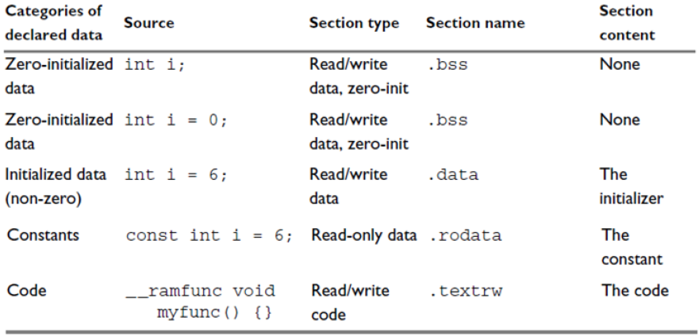
Memory Layout – STATIC

Slide 18
Memory Layout – DYNAMIC
Stack: It is a LIFO structure, used to store stack frames. A stack frame is created whenever a function is called and it can contain local variables, arguments, return value, the address of where to return to and information about the caller’s environment, such as some of the machine registers. When a function returns, memory is cleared automatically.
Heap: It is a memory section used for dynamic memory allocation, which can be done by functions such as malloc, calloc, free, etc. Memory must be allocated, used and freed in the code.

Slide 19
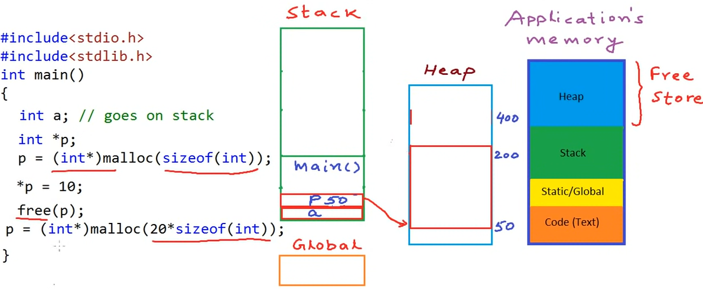
Memory Layout – DYNAMIC

Slide 20
Map file
The linker can produce a Map File.
A map file lists the memory location of functions and variables.
It can also give a summary of memory usage.
The format of the file will be different for each linker.

Slide 21
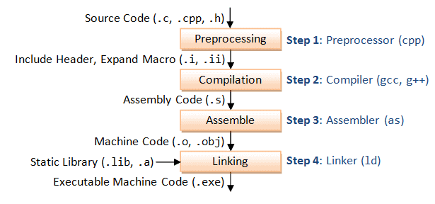
C compilation process

Slide 22
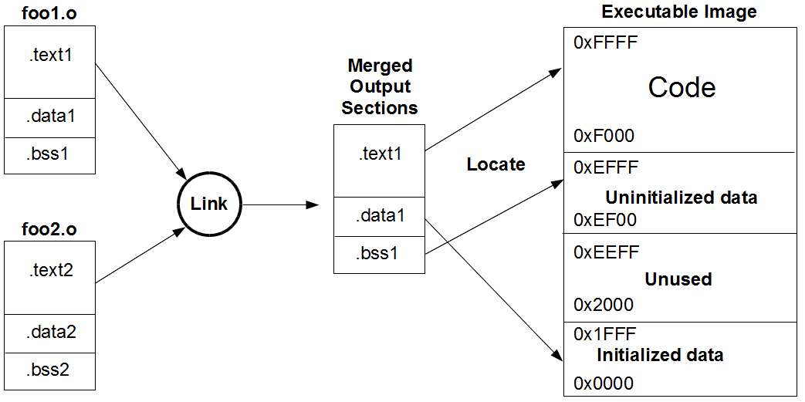
Linker script
File that tells the linker how to handle sections and how to place them in the available memory regions.

Slide 23
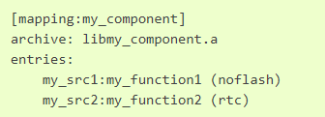
ESP Linker Script
Allow to specify memory placements for :
Object Files (.obj, .o files)
Symbols (variables, functions)
Archive (.a files)
Location of linker script(.lf) need to be specified in the LDFRAGMENTS argument.

Slide 24
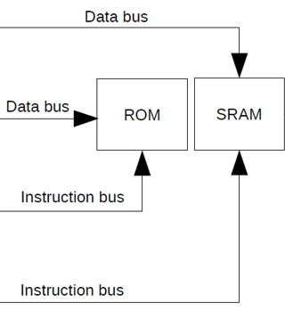
memory placement macros in espressif
IRAM_ATTR: used to place code in RAM.
DRAM_ATTR: used to place constant data in RAM.

Slide 25
Startup File
Piece of code (Assembly or C) that executes before main function of the application.
Dependent of target processor.
Performs various initialization steps by configuring HW so that the application can run.

Slide 26
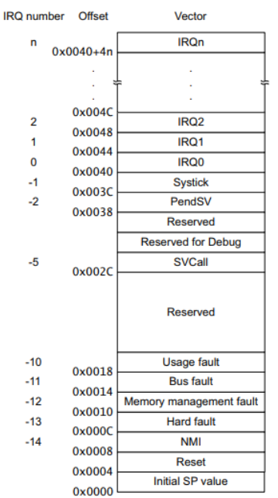
STARTUP FILE
Copying initialized (.data) and uninitialized (.bss) data from flash to RAM memory.
In some cases, used to map memory.
Allocate space for the stack and initialize the stack pointer
Contains an array of function pointers ( interrupt vector table) that point to various interrupt vector routines such as reset handler, NMI handler, bus fault handler, etc.

Slide 27
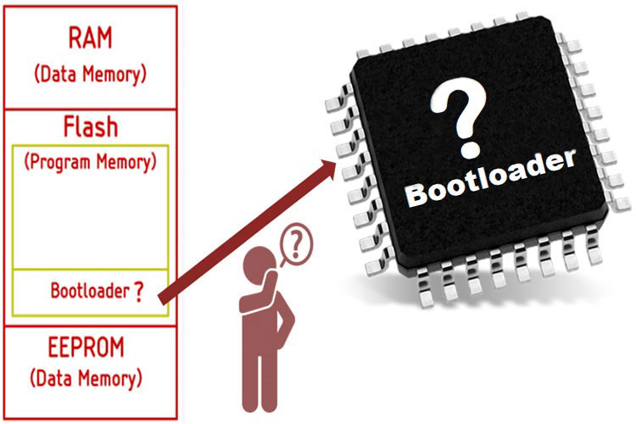
Bootloader
Code that runs before the “main application”.
Gets the “minimum” elements running.
Bootloader code is usually smaller than application code.
Should reside in an area of FLASH memory that is protected from writing.

Slide 28
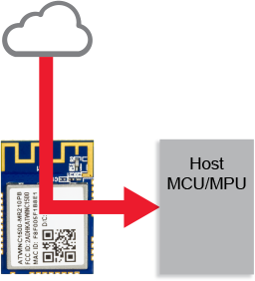
Bootloader
A bootloader:
Performs various HW checks.
Initializes the processor and peripherals (Ex. Watchdog)
Configure registers.
Used to Perform Firmware updates.

Slide 29
ES32-C3 STARTUP PROCESS
First Stage Bootloader
1. First Stage Bootloader:
After a reset, the CPU will start running immediately to perform initialization.
Identify boot mode by looking at GPIO_STRAP_REG.
Load second stage bootloader to RAM.
Second Stage Bootloader
Application Startup

Slide 30
ES32-C3 STARTUP PROCESS
First Stage Bootloader
2. Second Stage Bootloader:
Minimal configuration of internal modules.
Initializes FLASH encryption and secure features (If enabled).
Select application partition to boot.
Load image to RAM
Verify integrity of the application and jumps to main app.
Second Stage Bootloader
Application Startup

Slide 31
ES32-C3 STARTUP PROCESS
First Stage Bootloader
3. Application Startup:
Clocks are configured
Initialize memory data (.data and .bss).
SPI flash is reconfigured.
MMU is configured.
Configures brown out detector.
Initialize serial console.
Create main task and run scheduler.
app_main() function is called.
Second Stage Bootloader
Application Startup

Slide 32
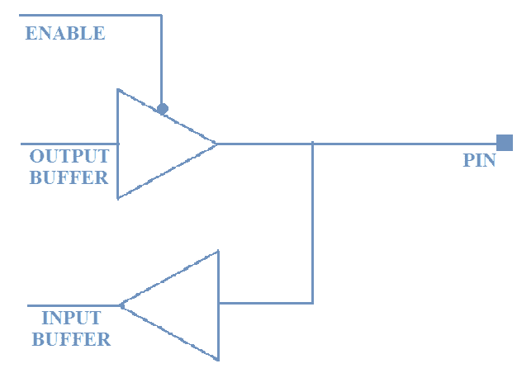
GPIO
Stands for “General Purpose Input Output”
Configured through microcontroller registers.
A group of GPIO pins is called a Port (Ex. PORTA, PORTB).
Used for:
Interact with sensors.
Receive user inputs.
Send voltage signals.
Support other MCU Peripherals.

Slide 33
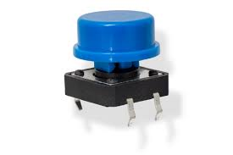
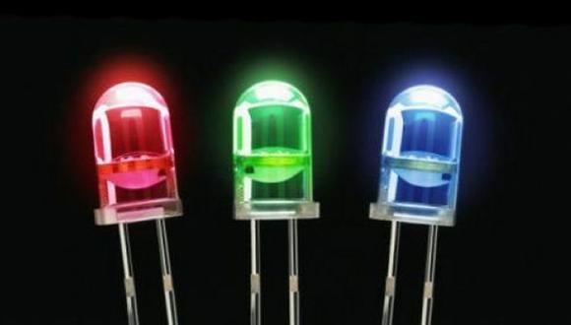
GPIO Mode
GPIO can be configured as an input to bring information into the microcontroller (Ex. Reading a button).
GPIO can be configured as an output to send a digital signal to an external device (Ex. Controlling an LED).
In some cases, GPIO need to be configured for an “alternate” mode to support another MCU peripheral.

Slide 34
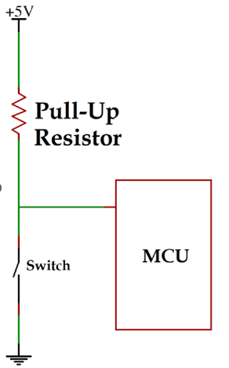
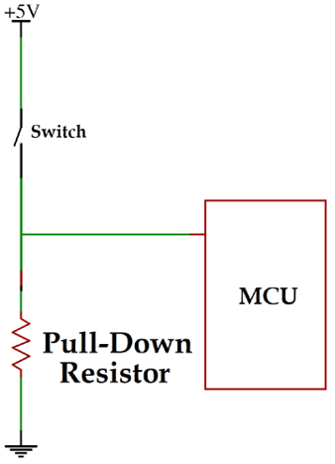
GPIO Input modes
As an input, a GPIO could be configured as:
High-Impedance: the pin is left open; it does not consume any current. The state is indeterminate.
Pull-Up: the state of the pin will be high, unless an external pull-down circuit is introduced.
Pull-Down: the state of the pin will be low, unless an external pull-down circuit is introduced.

Slide 35
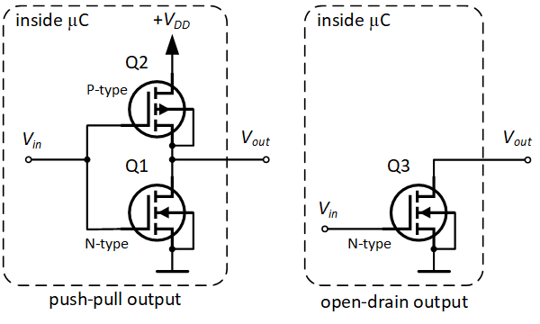
Gpio OUTPUT MODES
As an output, a GPIO could be configured as:
Push-Pull: PMOS and NMOS transistors are used to drive the output to the desired level.
Open Drain: PMOS transistor is not used and requires a Pull-up resistor. Used to control devices that operate at a different voltage level.

Slide 36
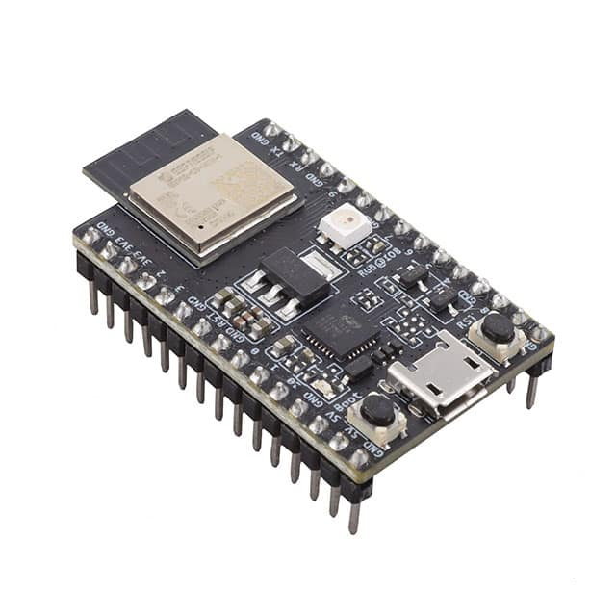
Gpio on esp32-c3
ESP32-C3 has 22 GPIO pins.
Selectable Pull-up/Pull-down resistor.
Can be configured for High impedance.
Edge or level triggered Interrupts.
Can be multiplexed with other peripherals (Ex. SPI, UART, etc.).

Slide 37
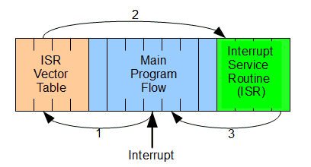
Interrupts
Events that temporarily suspend the main program execution to attend the interrupt source.
Code used to attend an interruption is called Interrupt Service Routine (ISR).
Microcontrollers have different interrupt sources available.
Each interrupt source has its own ISR.

Slide 38
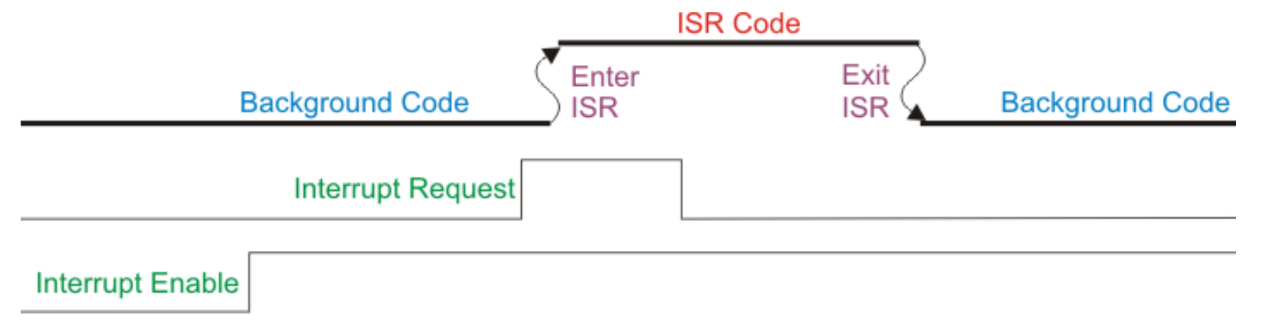
INTERRUPTS
The time between the generation of the interrupt request and the execution of the ISR is called latency.
Lower latency is always better.
Interrupt requests need to be cleared (HW or SW) after interrupt is attended.
They are usually disabled by default.

Slide 39
Interrupts
Each interrupt has an entry in a memory region called interrupt vector table.
These entries might contain code or the location where the ISR is stored.
An ISR should be as fast and efficient as possible.

Slide 40
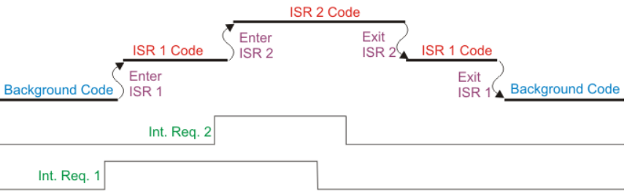
INTERRUPTS
Interrupts can have different priority levels.
Interrupts with higher priority are attended first and could cause an interruption when another ISR is running.

Slide 41
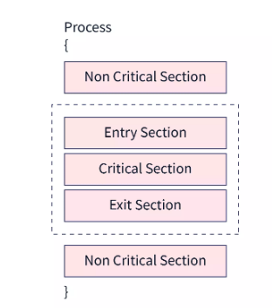
interrupts
If not handled carefully, interrupts can cause data corruption or undesired behavior in a program.
Data access where there is no possibility of interruption or corruption is known as “Atomic Access”.
Code that must have indivisible access to data is called a “Critical Section”.

Slide 42
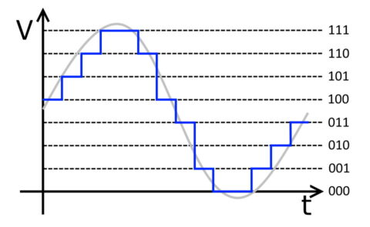
ADC
Stands for “Analog to Digital Converter”.
Allows the microcontroller to convert an analog voltage signal to a digital signal.

Slide 43

ADC Concepts
Reference Voltage: Maximum input voltage that can be converted.
Channel: ADC input which will be measured.
Resolution: the smallest voltage change that can be recognized.
Sampling Rate: Number of ADC Samples per unit of time (Should be at least two times the frequency of the measured signal).

Slide 44
ADC Concepts
Conversion Time: Time it takes to the ADC to perform one full conversión.
Sampling Time: Time it takes for the ADC to take the measured sample.

Slide 45
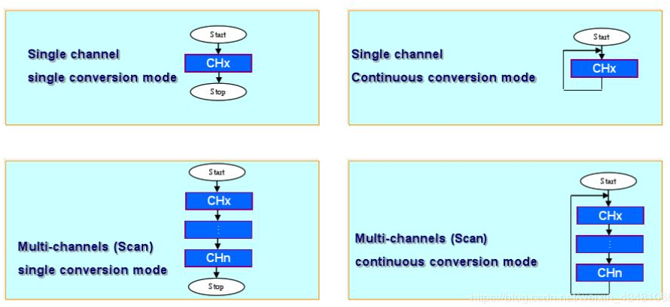
Conversion modes

Slide 46
ADC Usage (Single channel, single conversion)
ADC Initialization
Select channel
Enable ADC Voltage Regulator
Start Conversion
Calibrate ADC
Wait for conversion to finish
Enable ADC
Get Conversion result

Slide 47
ADC on esp32c3
2 ADCs
ADC1 supports 5 channels and is factory calibrated.
ADC2 supports 1 channel, can measure internal signals and is not factory calibrated.
12 Bit
Continuous or one-shot conversions
Reference voltage: 1100 mV (Can vary from 1000 to 1200 mV).
It is recommended to add a 0.1 μF filter capacitor between pins and ground.

Slide 48
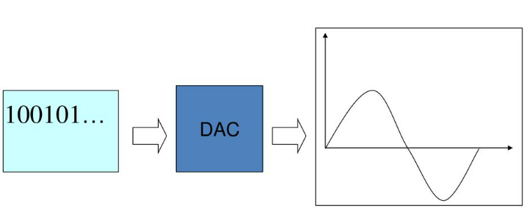
dac
Stands for “Digital to Analog Converter”.
Allows the microcontroller to convert an analog voltage signal to a digital signal.

Slide 49

DAC Concepts
Reference Voltage: Maximum output voltage that can be converted.
Conversion Time: time required for the DAC to settle to its final value.
Resolution: the smallest output change the DAC can produce.

Slide 50
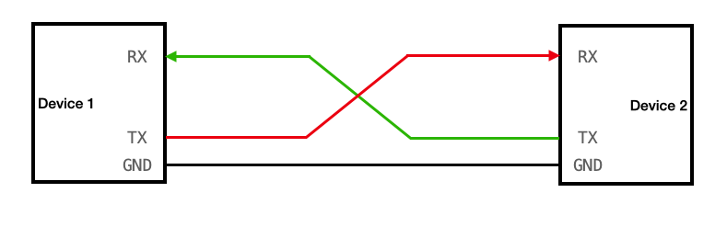
UART
Stands for “Universal Asynchronous Receiver-Transmitter”.
One of the most used device to device communication protocols.
Requires at least 2 lines, a transmitter (TX) and a receiver (RX).
Communicating devices must share the same ground.

Slide 51
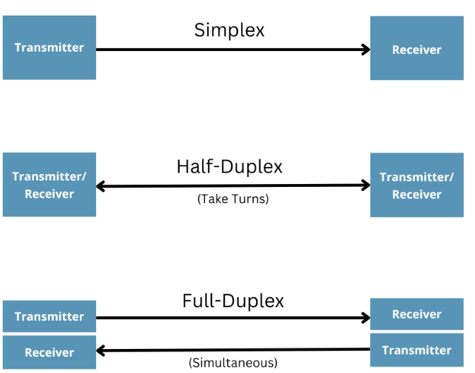
UART
Simplex: Information is only transmitted by one device.
Half Duplex: both devices can transmit information, but only one at a time.
Full Duplex: Both devices can transmit at the same time.

Slide 52
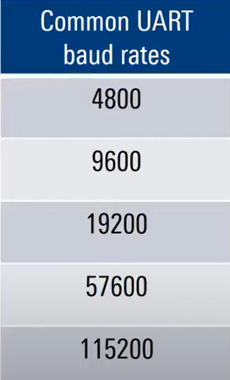
UART
Transmitter and Receiver do not share a clock signal.
Both sides must transmit/receive at the same known speed.
This speed is known as Baud Rate.
They must also use the same configuration parameters

Slide 53
UART DATA FRAME
Start bit: Transition from idle (high) to low.
Data bits (configurable): Sent after start bit, length can be configured.
Parity: Used for error detection. Can only detect a single “incorrect” bit Can be:
Even: number of 1’s in the frame must be even.
Odd: number of 1’s in the frame must be odd.
Stop bit (1 or 2): Transition from low to high.

Slide 54
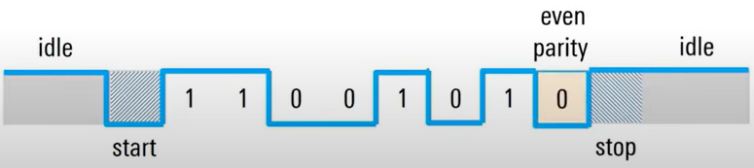
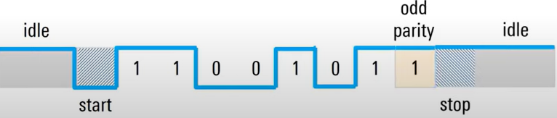
UART DATA FRAME

Slide 55
UART on esp32-c3
Two UART interfaces (UART0 and UART1).
Can use HW flow control (CTS and RTS).
UART Interfaces connect to DMA.
Supports speeds of up to 5Mbps.

Slide 56
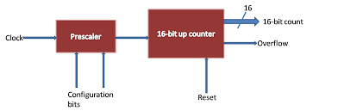
timer
Piece of HW inside a microcontroller that performs counts.
Count is limited by the timer resolution.
Count can be up or down.
They require a clock source to “manage time”.

Slide 57
Timer
Timers can be used to:
Schedule tasks.
Generate PWM signals.
Create timeouts.
Input Capture: Measure the number of counts between an event.
Output Compare: Toggle a pin when the timer reaches a certain value.

Slide 58
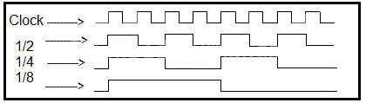

TIMER
A pre-scaler is used to divide the timer’s clock source and increase the time range.
$frequency Timer=\frac{frequency Clock}{Prescaler}$

Slide 59
TIMER
An auto-reload value can be configured.
For a timer counting Up, the count will go from 0 to the auto-reload value.
For a timer counting Down, the count will go from the auto reload value to 0.
When timers overflow/underflow, they set a flag, which can be inspected with code or trigger an interrupt.

Slide 60
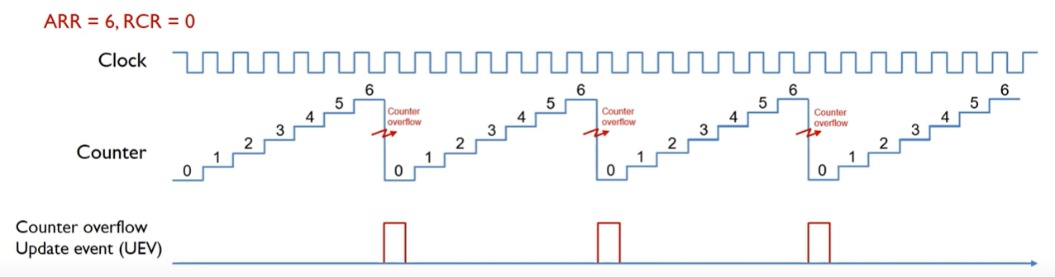
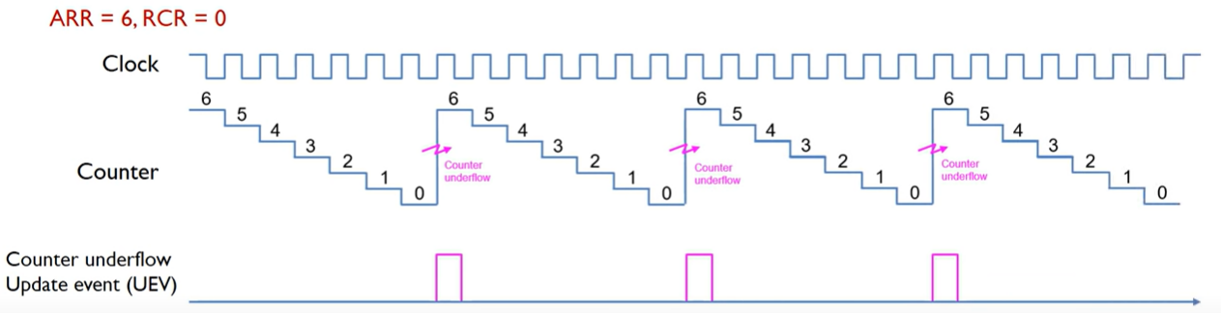
TIMER

Slide 61
TIMERS on esp32-c3
2 General Purpose Timers (54 bits).
54-bit auto reload.
16-bit pre-scaler (from 2 to 65,536).
Incrementing or decrementing.

Slide 62
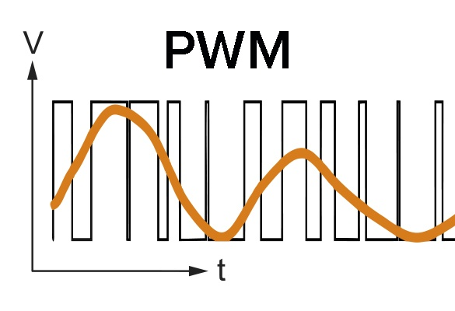
PWM
Stands for “Pulse Width Modulation”.
Method for obtaining analog-looking signals on digital pins.
A Square wave is created by switching High and Low a pin of the microcontroller.
This succession of high/low levels can simulate an intermediate voltage between the two levels.

Slide 63
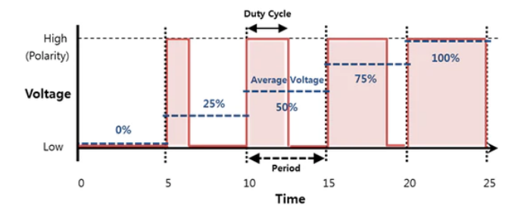
PWM
Duty Cycle: percentage of time the signal is on over a time period.
Duty Cycle will control the “observed” analog voltage on the PWM pin (Ex. For a 5V signal with a 10% duty cycle, the measured voltage will be 0.5V)
Frequency: Number of pulses per second.

Slide 64
PWM ON ESP32-C3
LED PWM Controller
Six channels.
Configurable periods and duty cycle.
Multiple clock sources.
Can operate even when microcontroller is in “light-sleep mode”.
Supports gradual increase/decrease of duty cycle.

Slide 65

RTC
Stands for “Real Time Clock”.
Timers dedicated to maintaining a 1 second time base.
Used to keep track of clock time and calendar day.
Usually designed to work during low power modes.

Slide 66
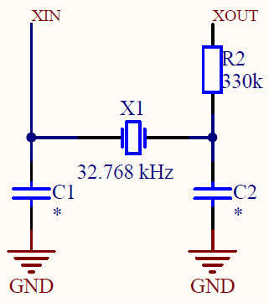
RTC
Accuracy depends on the clock source.
The most common source is an external 32.768 KHz oscillator.
This allows to get 1 Hz (1 second) pulses.

Slide 67
RTC on esp32-c3
Can manage time using the following sources:
RTC timer:
Allows keeping the system time during any resets and sleep modes.
The frequency deviation depends on an RTC Clock Source and affects accuracy only in sleep modes, in which case the time will be measured at 6.6667 us resolution.
High-resolution timer:
Not available during any reset and sleep modes
Allows greater accuracy. It uses the APB_CLK clock source (typically 80 MHz), which has a frequency deviation of less than ±10 ppm. Time will be measured at 1 us resolution.

