Slide 1
Embedded software
Claudia Prieto

Slide 2

Modules
Embedded software introduction
C programming for microcontrollers introduction
Embedded Software architecture
Application and interface development
Real Time Operating Systems (RTOS)

Slide 3
C programming for microcontrollers
Module | Topics
C programming for microcontrollers, introduction | General purpose computer programs vs embedded systems programs Fundamental and derived data types (enum, struct, union, typedef) Data type modifiers: signed, unsigned, const, register, volatile and static Control flow: conditional (if/else, switch) and loops (while, for). Functions and macros. Arrays. Structures. Arrays of structures. Unions Pointers. Variables. Functions Integrated Development Environments. Configuration management and version management.

Slide 4
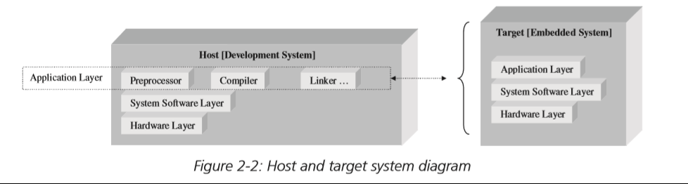
PC software vs embedded software [1]
Embedded systems architecture. Tammy N.

Slide 5
PC software vs embedded software
Usual restrictions in an embedded system
Cost, limited resources (memory, power, temperature, processing capability)
Predictability
Performance
Responsiveness, how fast can a request or input be processed?
Reliability, robustness, safety, i.e. BIT, POST
Some interesting concepts:
Embedded tool chain
OS, RTOS, baremetal
Embedded middleware
Debugging and testing

Slide 6
HW06 – GCC compiler
Read and follow the instructions for chapter 11 "How compiler works". Please refer to book "An Introduction to GCC for the GNU compilers gcc and g++". Use any GNU toolchain, recommended ones are MinGW and CygWin.
Deliverable: Document the steps followed, archive the generated files, make sure to document toolchain and version.
Date: September 14, 2021 Tuesday

Slide 7
HW07 – .lst, .map and machine instructions
Using the HelloWorld project done for previous assignments, using Atollic TrueStudio and microcontroller STM32F334R8). Enable the generation of .list, .map and executable file (.hex or .elf). Make sure to find the first 3 instructions of the main function. Compare those 3 instructions and explain what they do by using ARM reference manual:
https://developer.arm.com/docs/ddi0403/e/armv7-m-architecture-reference-manual
Deliverable: Document the steps followed, and the explanation of these 3 instructions. Include a Word document, the .list, .map, .hex and .elf files.
Date: September 21, 2021 Tuesday

Slide 8
HW08 – output file format
Search for .hex (Intel), .mot (Motorola) and .elf file formats, describe the format and add an example obtained from the Hello World project. Provide 3 advantages and disadvantages of each.
Deliverable: Include a Word document, the example of .hex, .mot/.srec and .elf files.
Date: September 21, 2021 Tuesday

Slide 9
Fundamental and derived data type
enum
C programming Language [3], page 39, appendix A4.2 (final), appendix A8.4
Struct / union / typedef
C programming language [3], Chapter 6.

Slide 10
Fundamental data types [3]
Data types
char – 8 bits
int – integer, usually goes aligned with the architecture of the microcontroller we are working on (i.e. 32 bits)
float – float single precision
double – float double precision
What size are these?
It depends on the machine this program will be running on.
Some qualifiers:
Short – applicable for int
Long – applicable int + float
unsigned – range will start from 0
signed – two complement representation

Slide 11
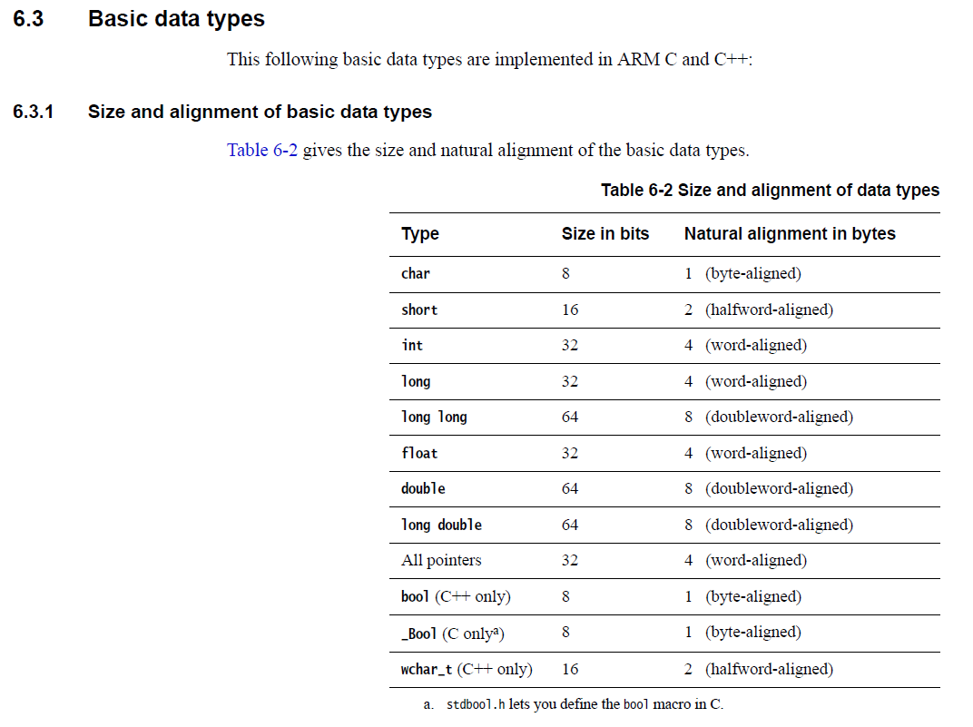
[4]

Slide 12
HW09 – fundamental data types
Review this link:
https://developer.arm.com/documentation/dui0491/i/C-and-C---Implementation-Details/Basic-data-types
Create a program in Atollic TrueStudio, by declaring variables with the first 8 data types described in Table 32 and find out with sizeof, what is the size of each data type.
Deliverable: Word file with the table of data types and sizes plus source code.
Word file @ Teams
Source code @ GitHub
https://github.com/ClaudiaPrieto/2021-2_EmbeddedSw
Claudia to create a folder for assignments. Jesus to create in it, a folder HW09, place code in there.
Date: 2021.09.24 friday

Slide 13
Constants, how to define them [3]
0x1234 – hexadecimal
1234L or 1234l – long
1234U – unsigned
123.4 or 1.234e2 or 1234f - float
031 – octal (starting with zero)
'a' - char
"a" - string

Slide 14
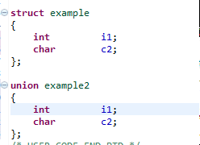
Derived data types [3]
location | Example (struct) | Example2 (union)
0 | i1 | C2 / i1
1 |  | i1
2 |  | i1
3 |  | i1
4 | c2
Enum
Grouping constant values
We can declare variables with enum types to contain better the values that are accepted
Symbolic representation is much easier when debugging
Structures
Composed data types
Size will be the sum of all of its elements
Unions
A way to represent a value with different data types
Size will be the size of the largest element

Slide 15
Derived data types [3]
Bit fields in structures and unions
struct {
unsigned int is_keyword : 1;
unsigned int is_extern : 1;
unsigned int is static : 1;
} flags;

Slide 16
HW10 – Enum and structs
Find 5 enums and 5 structs, this could be taken from previous assignment or last semester project. This project should have been done in Atollic TrueStudio.
List the selected enum and structs, as well as load the project in the microcontroller and understand how structure instances are shown when using the debugger.
If possible, show when enums are used, i.e. in the list file.
Enums and structs should be taken from 3 different peripherals or software components.
Deliverable: report @ Teams and source code in GitHub, indicate if using the exact same project as a previous assignment.
Date: 2021.09.24 friday

Slide 17
HW11 - Structures
Follow steps of [3] in sections 6.1 through 6.6. Please do this in CygWin or MinGW.
Make sure to generate all the necessary files (does not have to fit in one single file). Make use of the estructures, compile and execute them.
Where are those structures stored, is it stack, is it heap, where are them?
Deliverable: Word document to include the steps followed and what files were created, also include the MinGW commands that were used for each step @ Teams
Please upload .c/.h files to GitHub
Date: 2021.09.24 Friday

Slide 18
Other data type modifiers [3]
Usual: short, long, unsigned, signed
register
static
volatile

Slide 19
register keyword [3] [6]
A register declaration advices the compiler that the variable will be heavily used and place them in CPU registers. Only a few variables in each function may be kept in registers, and only certain types are allowed. Also there is a limitation in the number of registers in a core.
Interesting: The address-of operator & may not be applied to an object declared register, even if the implementation chooses not to keep the object in a register
It has its inconveniences as the compiler is already doing that job. Refer to [6]

Slide 20
static keyword [3] [5]
When using static, these variables remain in existence even when the flow of the program gets out of this scope.
Common usages:
local variable in a function,
global variable in a module
function in a module
The use of the static keyword has many uses. Its most effective use is to limit the scope of variables defined within a module or function. Through the use of static, variables and functions can be hidden from the external program, resulting in behavior that is similar to the use of private and public in more modern object oriented languages.
Refer to [5]

Slide 21
volatile keyword [3] [7]
Declaring an object volatile announces that it has special properties relevant to optimization.
The purpose of volatile is to force an implementation to suppress optimization that could otherwise occur. For example, for a machine with memory-mapped input/output, a pointer to a device register might be declared as a pointer to volatile, in order to prevent the compiler from removing apparently redundant references through the pointer.
A variable should be declared volatile whenever its value could change unexpectedly. In practice, only three types of variables could change:
1. Memory-mapped peripheral registers
2. Global variables modified by an interrupt service routine
3. Global variables accessed by multiple tasks within a multi-threaded application
Refer to [7]

Slide 22
HW12 - volatile
Develop two examples (or find them if they are already in the libraries added by STM32CubeMX).
One of them should be with a variable that can be accessed by an interrupt. Second case should be related to a peripheral.
Implement the code in Atollic TrueStudio, check the .lst file on the following scenarios:
1. Not using volatile in that variable + no optimization
2. Using volatile in that variable + no optimization
3. Not using volatile in that variable + optimization
4. Using volatile in that variable + optimization
Deliverable: Word file with explanation of the four scenarios for each of the two examples and conclusions.
Word file @ Teams
Project @ GitHub
Date: 2021.10.04 Monday

Slide 23
HW13 - Static
Develop a project in Atollic TrueStudio with a code similar to the one of the next slide:
Try to use each variable in each scope (marked in blue), with and without static, they can be different files
Compile and generate output files
Open .map, what variables can be found there?
Check each variable in .lst file, where are they stored?
Deliverable: Word file with explanation of the request and conclusions.
Word @ Teams
Project @ GitHub
Date: 2021.10.04 Monday

Slide 24
HW13
int global_scope;
void main(){
int main_scope;
for(int for_scope; ...; ...){
if(int if_scope) {}
}
}
void fn1(void){
int fn1_scope;
}

Slide 25
Functions and macros [3]
Both functions and macros allow to make modules and parts of code easier to understand. It pretty much provides structure to our programs.
return-type function-name (parameter declarations, if any)
{
declarations
statements
}
A function usually implies a jmp or branch in assembly, it also implies saving context at the beginning and returning that in the end. Which requires push and pop instructions at assembler level.

Slide 26
Functions and macros (2)
Function
Macro
Inline function
Good handling of returning value and args data type
It always uses jmp/call + push + pop
Modularizes code easily
Helps to modularize code, though aesthetics is hard to follow, it works ok for simple code
Do not handle return value or arguments
It is preprocessed and that set of code will be repeated by preprocessor in every "call" that is made
Modularizes code easily
Good handling of returning value and args data type
That set of code will be repeated in every call that is made, so no jmp or call, no push or pop instructions will take place

Slide 27
Optimization with function in-lining [2] (1)
Another type of source-level optimization, called function inlining, increases the efficiency of frequently-called functions.
Whenever a function is used, a certain amount of extra time is required for the CPU to carry out the call: it must store the function arguments in the appropriate registers and memory locations, jump to the start of the function (bringing the appropriate virtual memory pages into physical memory or the CPU cache if necessary), begin executing the code, and then return to the original point of execution when the function call is complete. This additional work is referred to as function-call overhead. Function inlining eliminates this overhead by replacing calls to a function by the code of the function itself (known as placing the code in-line).

Slide 28
Optimization with function in-lining (2)
In most cases, function-call overhead is a negligible fraction of the total run-time of a program. It can become significant only when there are functions which contain relatively few instructions, and these functions account for a substantial fraction of the run-time—in this case the overhead then becomes a large proportion of the total run-time.
Inlining is always favorable if there is only one point of invocation of a function. It is also unconditionally better if the invocation of a function requires more instructions (memory) than moving the body of the function in-line. This is a common situation for simple accessor functions in C++, which can benefit greatly from inlining. Moreover, inlining may facilitate further optimizations, such as common subexpression elimination, by merging several separate functions into a single large function.

Slide 29
HW14 – Functions and macros
Please use TrueStudio to do the following:
Write a macro that do not receive arguments
Write a macro receiving 2 numbers and add them
Write a function receiving no arguments and no return value
Write a function with two arguments (numbers) and return the addition of those two numbers
Same as 3 with inline
Same as 4 with inline
7) In main function, use the macros and functions used in 1 to 4. Make sure to use the function or macro in main, also, you can use LL or HAL libraries to make it easier. Make this project with no optimization and with optimization.
8) Review .map and .lst files or use the debugger to understand what happens in each of the cases from 1 to 6.
See the code, what instruction was used before a function, the first instruction executed when in the function and what is the last instruction executed in the function. And what it means?

Slide 30
HW14
9) Write another macro like the one in item2, same thing but try to have one without parenthesis surrounding it, and one with parenthesis surrounding it. What is the difference? What is the risk of using a macro vs a function?
#define add(a,b) (a+b)
In main function, make sure to use it like this:
c = add(3,4);
d = add(3,4)/5;
10) Research what is this used for ##. Include 3 advantages and 3 disadvantages to the Word file, as well as add an example to the code.
Deliverable: Word file with explanation of the request and conclusions. Project.
Word @ Teams
Project @ GitHub
Date: 2021.10.15 Friday

Slide 31
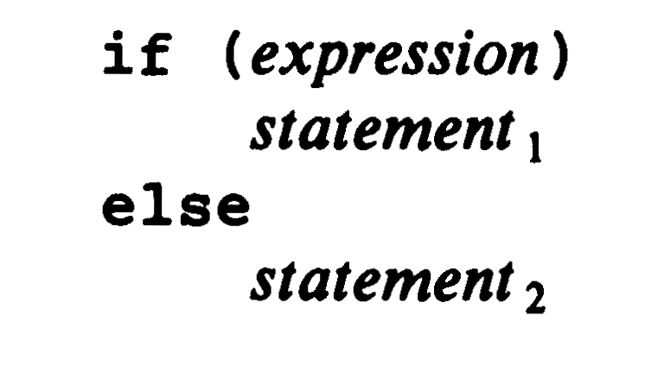
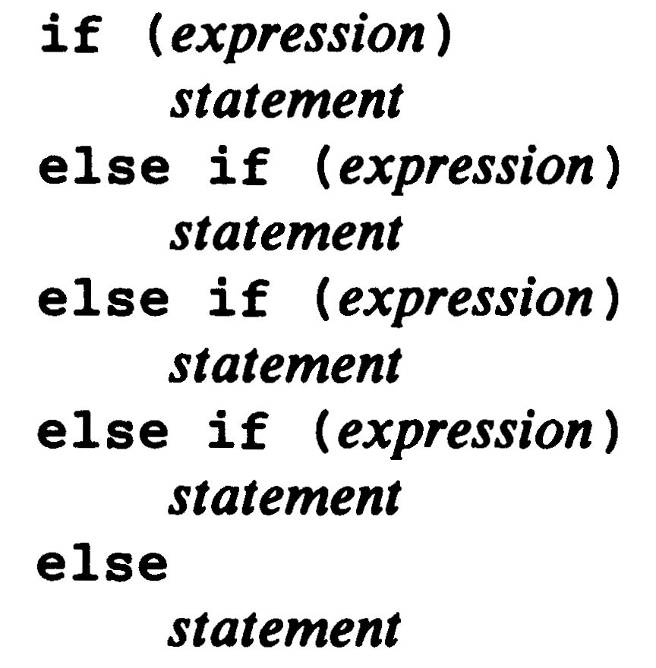
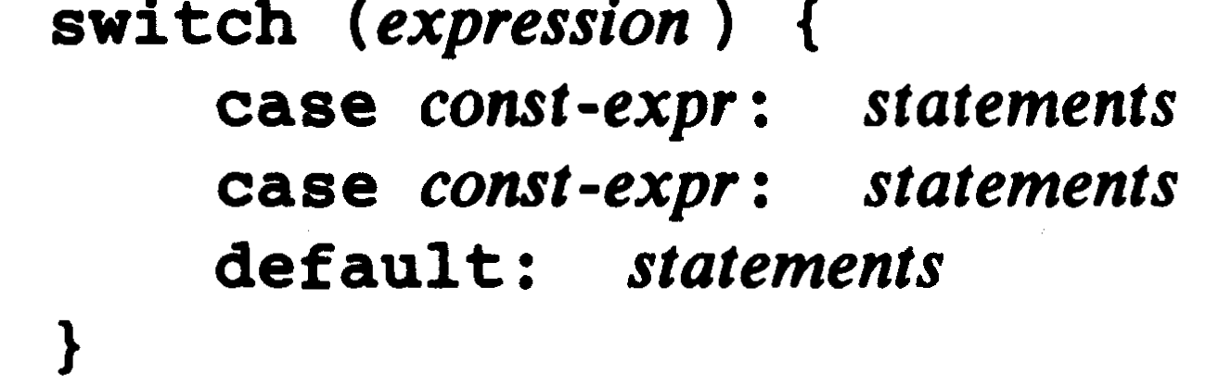
Control flow [3]
Conditional (chapter 3.2 to 3.4)
If/else
Conditional
Switch
Do not forget about break

Slide 32
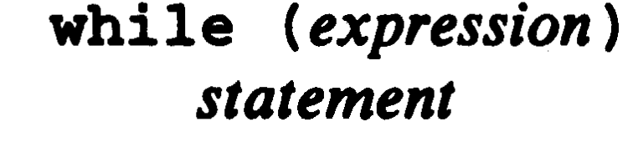
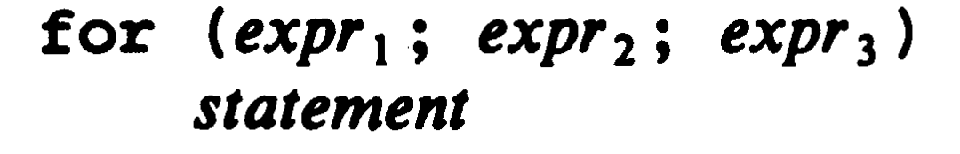
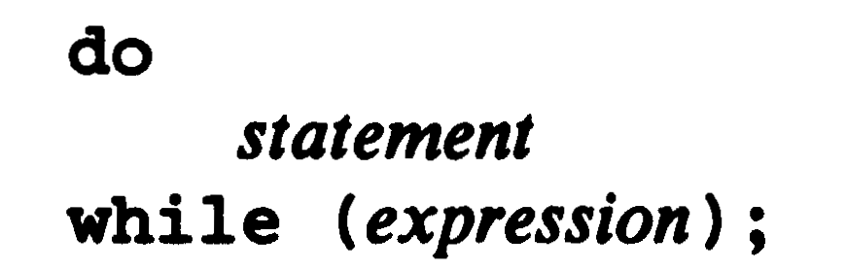
Control flow (2)
while
for
Do-while
Do not forget break and continue
The break statement provides an early exit from for, while, and do, just as from switch. A break causes the innermost enclosing loop or switch to be exited immediately.
The continue statement is related to break, but less often used; it causes the next iteration of the enclosing for, while, or do loop to begin. In the while and do, this means that the test part is executed immediately; in the for, control passes to the increment step.

Slide 33
Optimization loop unrolling [2]
A prime example of an optimization with a speed-space tradeoff is loop unrolling. This form of optimization increases the speed of loops by eliminating the “end of loop” condition on each iteration. For example, the following loop from 0 to 7 tests the condition i < 8 on each iteration:
for (i = 0; i < 8; i++)
{
y[i] = i;
}
At the end of the loop, this test will have been performed 9 times, and a large fraction of the run time will have been spent checking it.
A more efficient way to write the same code is simply to unroll the loop and execute the assignments directly:
y[0] = 0;
y[1] = 1;
y[2] = 2;
y[3] = 3;
y[4] = 4;
y[5] = 5;
y[6] = 6;
y[7] = 7;

Slide 34
Arrays [3] [8]
Arrays is a collection of elements that could be of one data type and fixed-size.
Data structure is a format for organizing and storing data.
Index starts in 0
Interesting thing when setting an array of characters vs other data types
int num[4] = {0, 10, 20, 30};
char str[] = "Hi!";
0x0 | num[0] | 0
0x4 | num[1] | 10
0x8 | num[2] | 20
0xC | num[3] | 30
str[0] | 'H'
str[1] | 'i'
str[2] | '!'
str[3] | \0

Slide 35
Pointers and arrays [3] [8]
Lets go through Chapter 4 from reference [3] and Chapter 5 from reference [8]
& - Give me the address of this variable
* - Give me the value stored in the address of this variable
Let's remember, these are operators and there is a precedence marked for C language. If you don't remember the precedence, parenthesis are always your friend.

Slide 36
References
[1] Tammy Noergaard. Embedded Systems Architecture, Second Edition: A Comprehensive Guide for Engineers and Programmers. Elsevier, 2005.
[2] Brian Gough. An Introduction to GCC for GNU compiler gcc and g++. Network Theory Limited, 2004.
[3] Brian Kernighan, Dennis Ritchie. The C Programming Language. Prentice Hall, 1988
[4] ARM. ARM Compiler toolchain, compiler reference. ARM DUI 0491I (ID012213), version 5.03. https://developer.arm.com/documentation/dui0491/i/
[5] Jacob Beningo. Using the static word in C. April 11, 2013. https://www.beningo.com/131-using-the-static-keyword-in-c/

Slide 37
References
[6] Jacob Beningo. Tips and Tricks – Reserved Words to Avoid in C. January 23, 2015. https://www.beningo.com/8-reserved-words-to-avoid-in-c/
[7] Barr group. How to use C's volatile Keyword. July 2001. https://barrgroup.com/embedded-systems/how-to/c-volatile-keyword
[8] Peter Van Der Linden. Expert C Programming: Deep C secrets. Prentice Hall, 1994

