Slide 1
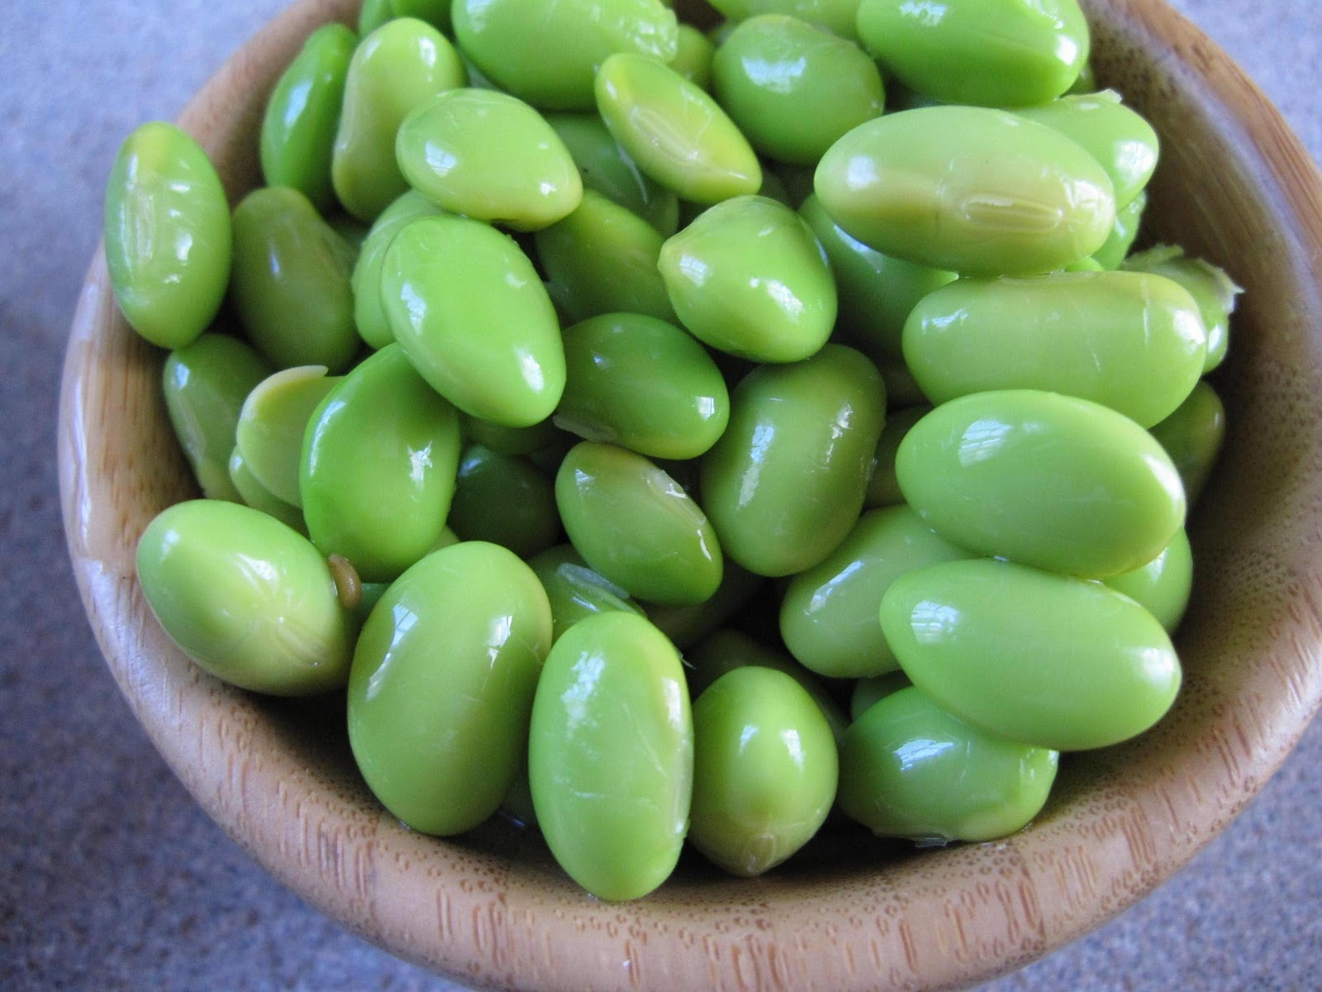
Explorations in Data Analyses for Metagenomic Advances in Microbial Ecology
10 July– 20 July 2016
Kellogg Biological Station
Michigan State University

Slide 2
GOOD MORNING!
Please make a nametag (back table)
Take a linux/unix handout (back table)
Take 1 blue and 1 pink stickie (back table)

Slide 3
Overview Lecture
Our goals for EDAMAME
Course logistics: Schedule and expectations
Getting warmed up: What is a microbial community?
Traits of microbial communities
The ”OTU”
Our Tutorial Dataset for the Week

Slide 4
Our goals for YOU
Be audacious in the face of analyses!
Analysis is hard. Have no fear. It is completely normal to struggle.
Understand the problem in the pipeline /where the workflow was breaking down
Be able to find resources to fix problems
Where to find help and how to ask for help optimally
Learn how to critique and test others’ analyses pipelines

Slide 5
Our goals
Provide a safe & welcoming place to learn
Lots of help from many people with different backgrounds – help each other out. Share your expertise and discuss challenges/troubleshoot together
Many guests to provide insight into different tools and research areas
Research specific help when possible

Slide 6
Our expectations
Ask lots of questions, and try really hard to get all you need to execute analyses independently when you return to your group
Don’t be afraid to ask for help when you need it! (we all have to do this sometime)
Acceptance and patience (in both directions)

Slide 7
Our hopes
Enthusiasm!
Engagement!
Fearlessness!
Fun!

Slide 8
Our Learning Goals
Overarching Goals are posted the wiki: https://github.com/edamame-course/2016-tutorials/wiki
More specific objectives

Slide 9
A Snapshot of our action packed days
7-8: Breakfast. Head’s up: They close promptly.
9:00 am-ish – Lecture/Tutorial
10:30 am – Morning Tutorial
12-1 pm – Lunch
1:15 pm – Afternoon Tutorial
4 pm – Break
5-6:30 – Dinner
8 pm – Guest lecture / activity
9 pm- ? – Social time, fire pit

Slide 10
Introductions – Your Instructors
Prof. Ashley Shade – Michigan State
Prof. Adina Howe – Iowa State
Dr. Tracy Teal – Data Carpentry

Slide 11
Your FEARLESS TAs
Shade Lab
Howe Lab
John Chodkowski
Siobhan Cusack
Taylor Dunivin
Jackson Sorensen
Jinylung Choi
Phillip Colgan
Jared Flater
Fan Yang

Slide 12
Our Esteemed Guest Lecturers
Pat Schloss University of Michigan
Stuart Jones University of Notre Dame
Jim Tiedje Michigan State University
Jim Cole Michigan State University
Rich Lenski Michigan State University
Pat Bills MSU HPCC

Slide 13
Food and drink
Most meals will be at the KBS dining hall. Over the weekend they will be closed for a few meals. We will arrange for group meals; please do your part to chip in – we’ll keep the cost as economical as possible.
Snacks !
We can also make group arrangements to head to “town” – check with one of the TAs. You might want to head to the market on your own. Kalamazoo is not too far away.
A note on adult beverages

Slide 14
Recreational stuff
Some options at KBS are volleyball, frisbee, bocci ball, swimming
You may have to check with the KBS office for some of the options.
There are good places to run, to swim, to hike, to bike, to fish, to boat
There is also a few laundry rooms; we have a few pods of detergent

Slide 15
WIFI
MSUnet Guest 3.0

Slide 16
Learning Resources : Etherpad
https://public.etherpad-mozilla.org/p/EDAMAME-2016
Etherpad for shared note taking – there is a designated SCRIBE for each session, but everyone can add.

Slide 17
Learning Resources: Stickies!
Put them on your lap top
Red sticky means “I am in need of help...”; Green means “I’m doing ok”
You don’t have to use them all the time, but we may ask some of you to put them up so we can get an assessment of where we are at as a group.
Before Lunch and before afternoon break, we will collect “minute notes” for anonymous feedback about how you’re doing. Red for a question/complaint and Green/Blue for a complement

Slide 18
For every tutorial, there will be
Lead instructor
Co-instructor
Scribe – takes etherpad notes, updates tutorials immediately
Several TAs to assist in the room and respond to red stickies

Slide 19
Web and social media
All the tutorials are on our github wiki and will be updated as we go: https://github.com/edamame-course/2016-tutorials/wiki/Schedule
Webpage : edamamecourse.org
Course email list – please let me know if you do NOT want your name and email distributed to the group
Tweet #edamame2016 !!
Blog: MO BIO Culture Dish
Our friends at Notre Dame!

Slide 20
Code of Conduct
Please read the course code of conduct:
https://github.com/edamame-course/docs/blob/gh-pages/extra/edamame_code_of_conduct.md
Bottom line:
Let’s all be nice to one another. Disrespectful conduct is grounds for immediate dismissal.

Slide 21
Our Support comes from
The National Institutes of Health (R25)
Institute for Cyber-Enabled Research (Snacks!)
MO-BIO (t-shirts!)
Amazon Web Services (computing!)
… Thank our sponsors! Tweet! blog! Show them some love!

Slide 22
Mo BIO
Blogging opportunity!
Emelia DeForce is REALLY excited to have EDAMAME guest post!

Slide 23
Any questions or comments?

Slide 24
Let’s do it.

Slide 25
What are the Burning Questions in microbial ecology?
Exploration: describing patterns, understanding diversity, discovery (e.g., rare biosphere, dark matter)
Community structure – function relationships
Sequencing SOP – active area of research. How can we use this technology to answer our burning questions?
Host – microbe relationships
…many more!

Slide 26
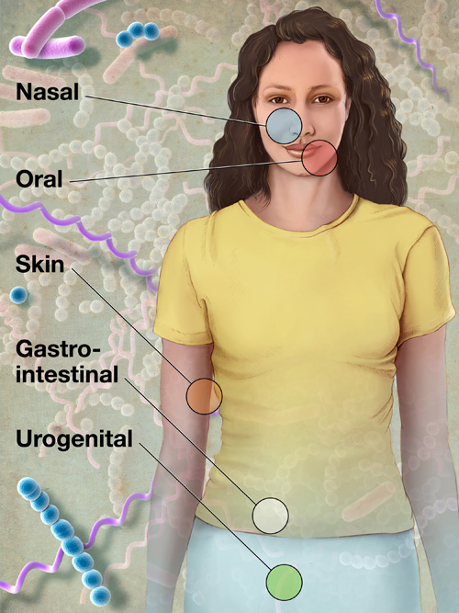
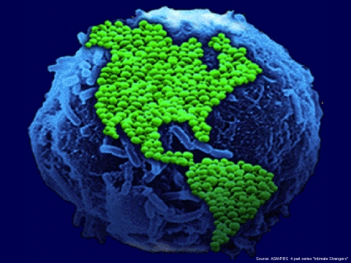
What is a microbial community?
C₆H₁₂O₆
CH₄
CO₂
CO₂
C₂H₃O₂⁻
Acyl-HSL
O₂
HPO₄²⁻
NH₄⁺
H₂
NO₃⁻
N₂
MeS
SO₄²⁻
HS⁻
Me²⁺

Slide 27
What is a microbial community?
Many taxa (species; >2)
Exist in the same locality
Interact with each other and/or with the environment

Slide 28
The “OTU” operational taxonomic unit
Species = basic unit of classification
Defined somewhat arbitrarily
Typical = 97% sequence identity
Originally, identity based on full length 16S rRNA gene
roughly equivalent to genus level
Does not well-distinguish “taxa” for all bacteria (e.g., Streptomyces)

Slide 29
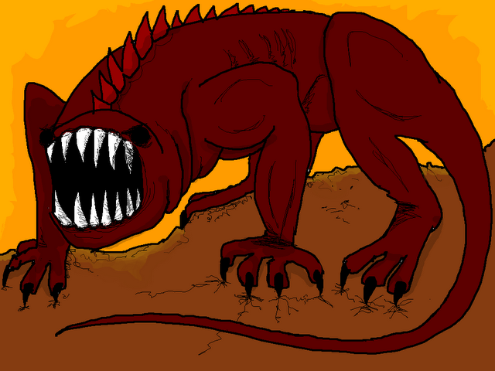
Ecological traits of microbial communities
Understand the Nature of the Beast. Microbial community data are:
“Species” rich
Depend on operational taxonomic unit (OTU) definitions
Dynamic : sensitive to environmental changes
Distinctive: even very similar habitats “house” distinct microbial communities (e.g., every human has her own gut community)
Influenced by dispersal?
Influenced by gene-swapping (phage, HGT)
Large proportion of dormant members
Large proportion of rare members
(A beast, hyperboleandahalf.blogspot.com)

Slide 30
What are our options for sequencing and analysis?
What sequencer?
If amplicon, which gene? Which variable region?
What quality control options?
Defining OTUs
Describing communities
Testing hypotheses
Visualizing results

Slide 31
Introduction to our Tutorial Dataset
Motivation : get an idea of a complete analysis from start to finish
Everyone working on the same dataset helps the instructors maximize their time when helping students to troubleshoot
There is time dedicated to apply what you learned on the tutorial dataset to your own dataset

Slide 32
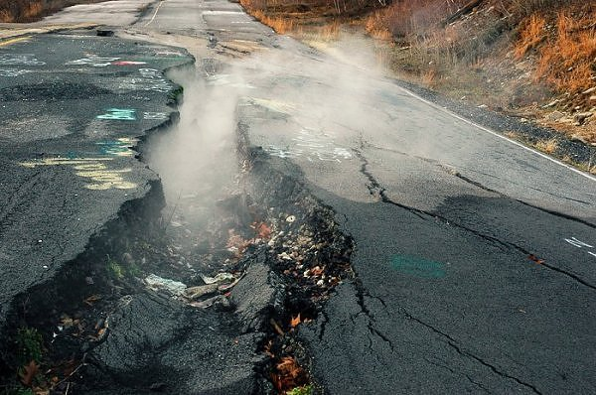
Centralia, PA: burning since 1962
Nowiknow.com

Slide 33
Key Questions
What is the diversity and structure of microbial communities in Centralia soils?
Do temperature/geochemical gradients or historical fire activity explain differences in community structure?
Stability: resistance and resilience
What are the lifestyles of organisms in fire-affected sites?
Thermophiles: dormancy strategies, cellulose degradation, thermal tolerance and stress responses
Bioremediative organisms: heavy metals and other coal combustion products
Novel antibiotic producers?
Is Centralia a site of novel microbial diversity?

Slide 34
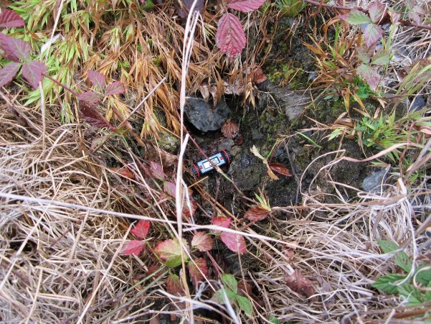
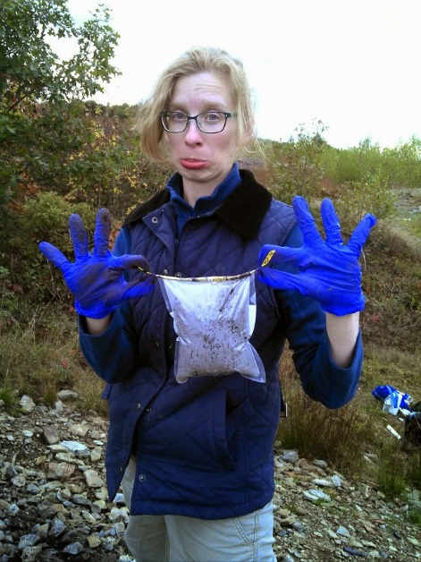
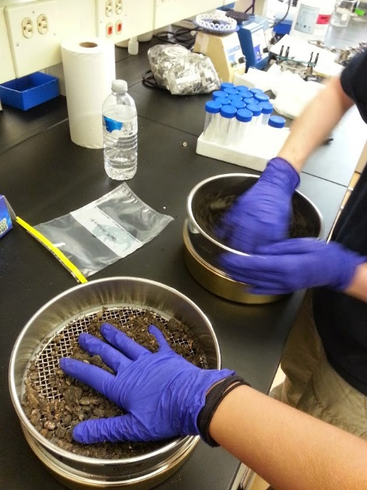
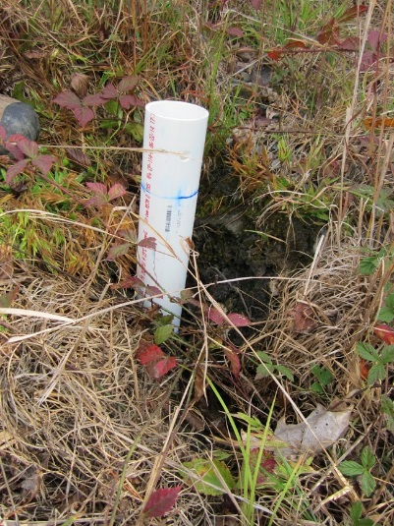
Sample collection
Sieved (4 mm pore)

Slide 35
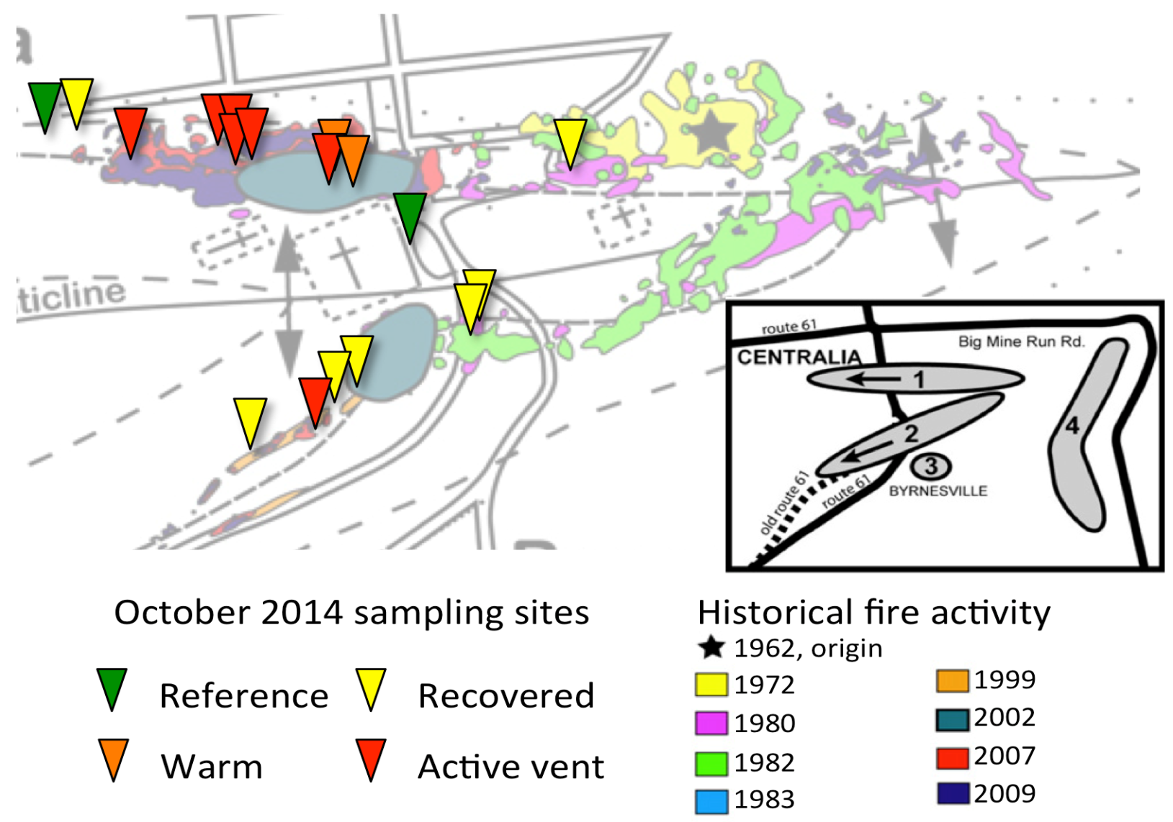
Underground coal mine fire
Recovered : 7
ActiveVent : 7
Warm : 2
Reference : 2
1
C08
C07
C12
C11
C09
C16
C18
C13
C10
C15
C14
C17
C02
C01
C04
C05
C03
C06
2
Sampling Period: Oct. 5-6, 2014
Figure 1. Sampling sites

Slide 36
Datasets for the week
18 soils (0-20 cm cores) along active fire fronts 1 and 2
Illumina paired-end V4 16S rRNA amplicon sequencing on each of 3 replicate DNA extractions. 54 total amplicon samples
Soil chemistry and contextual data on each core – 18 total soils with measurements
Metagenome sequencing on the DNA extracted from the soil of an active vent sample, Cen13 (temperature = 57 C) – 1 sample

Slide 37
Other things you should know about these datasets/ analyses
Sequenced VERY deeply
We will be working with small datasets subsampled randomly from the full datasets
Subsampling is key for developing a workflow/troubleshooting scripts
We will be working entirely on “the cloud” using Amazon
Please attribute the EDAMAME tutorials if you use or share them. We have a CC-BY license.

