Slide 1
Top Holiday Destinations
Data analysis using Pandas
Claudia Silver

Slide 2
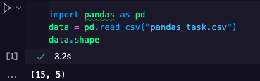
1. How many rows and columns are there in the file?
We find out by reading the file and using .shape
The table has 15 rows and 5 columns:
VSCode screenshot

Slide 3
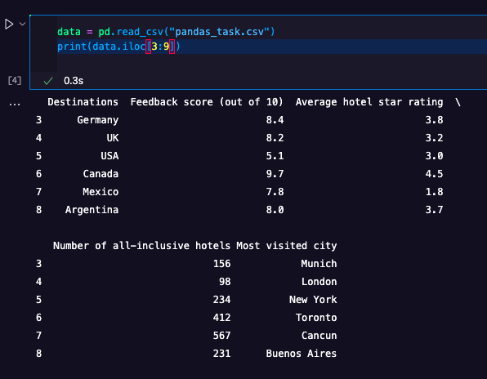
Print rows 3 to 8
Using iloc
Caption

Slide 4
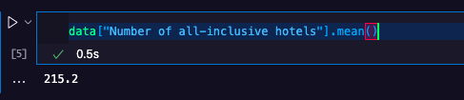
Find the mean of all-inclusive hotels across all destinations
Accessing the series, then using mean()
VSCode screenshot

Slide 5
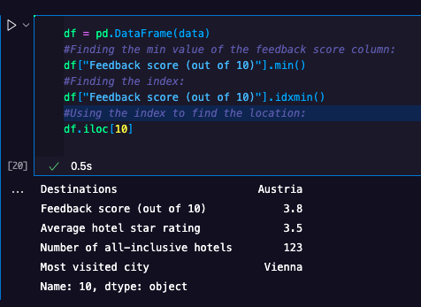
Find the lowest scoring destination
It’s Austria…
VSCode screenshot

Slide 6
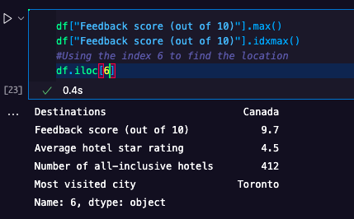
Find the highest scoring destination
It’s Canada!
VSCode screenshot

Slide 7
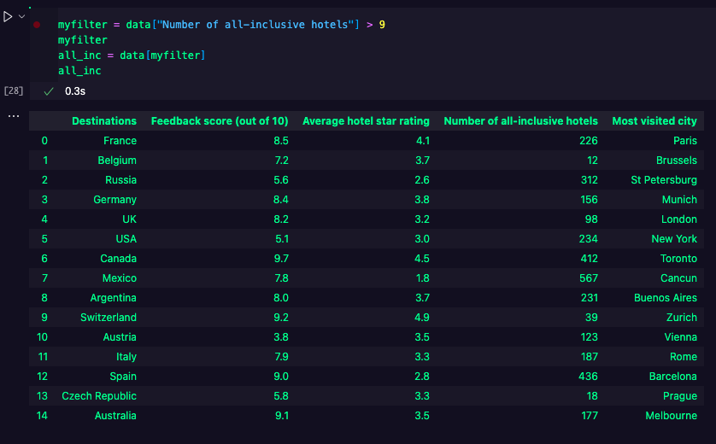
Find all destinations with more than 9 all-inclusive hotels
All of them meet this criterion!
Caption

Slide 8
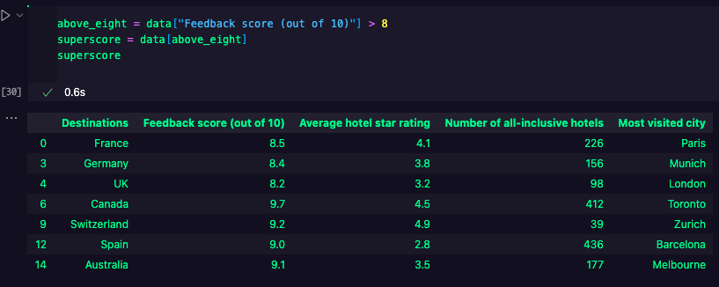
Filter the data by score above 8
VSCode screenshot

Slide 9
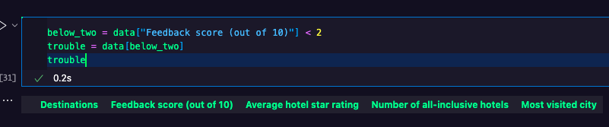
Filter the data by score below 2
No destination has such a low score, phew!
VSCode screenshot

Slide 10
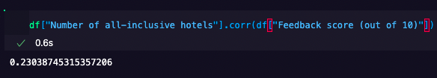
Is there a correlation between the number of a destination’s all-inclusive hotels and its feedback score?
First, we compute the correlation coefficient:
VSCode screenshot

Slide 11
The correlation coefficient is 0.23 (to 2 significant figures)
Hence, the correlation is weak and therefore negligible.

Slide 12
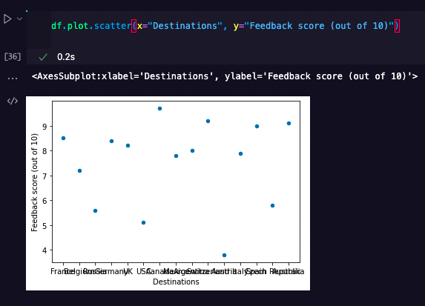
Data visualisation diagram to show destination and highest score

