Slide 1


DSxHealth application
Alba Garcia and
Clàudia Valverde

Slide 2
“Fast unsupervised brain anomaly detection and segmentation with diffusion models”

Slide 3
Introduction to the problem
Proposed model
Proposed anomaly segmentation method
Experiments and Results
Conclusion and future lines
Discussion
Outline

Slide 4
INTRODUCTION TO THE PROBLEM
Motivation
Goal: Segmentation of lesions in neuroimaging for diagnosis, prognosis, and treatment selection.
How can segmentation be performed?
Autoregressive models (transformers)
Denoising diffusion probabilistic models (DDPM or diffusion models)
By hand
Notes:
Aqui explicaria el que posa al punt 1.Introduction del paper, les diferents maneres de fer segmentation, abans de centrar-nos en diffusion models

Slide 5
INTRODUCTION TO THE PROBLEM
Motivation and limitations
Goal: Segmentation of lesions in neuroimaging for diagnosis, prognosis, and treatment selection.
How can segmentation be performed?
time-consuming
dependent on human expertise
By hand
Autoregressive models (transformers)
Denoising diffusion probabilistic models (DDPM or diffusion models)

Slide 6
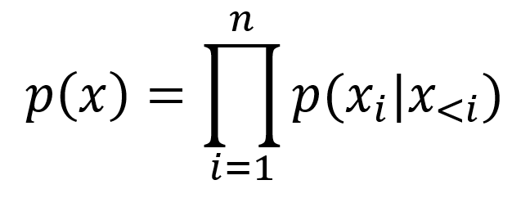
INTRODUCTION TO THE PROBLEM
Motivation and limitations
Goal: Segmentation of lesions in neuroimaging for diagnosis, prognosis, and treatment selection.
How can segmentation be performed?
Learn the probability density function of normal data -> highlight deviations
Factorize the joint distribution of pixel intensities as a product of the conditional distributions -> can track likelihood
Transformers: attention mechanisms
Autoregressive models (transformers)
Denoising diffusion probabilistic models (DDPM or diffusion models)
By hand
Notes:
Autoregressive models: directly maximize the expected log-likelihood of training data

Slide 7
INTRODUCTION TO THE PROBLEM
Motivation and limitations
Goal: Segmentation of lesions in neuroimaging for diagnosis, prognosis, and treatment selection.
How can segmentation be performed?
Cost of inference time:
need to use and ensemble of models with differently ordered version of the input to mitigate the unidirectional bias created by the fixed order of sequence elements
Autoregressive models (transformers)
limitations
Denoising diffusion probabilistic models (DDPM or diffusion models)
By hand
Notes:
The unidirectional bias is intrinsic to how the autoregressive model is built
The different ordered versions for the input are derived from the multidimensional latent representation of vector quantized variational autoencoder (VQ-VAE).

Slide 8
INTRODUCTION TO THE PROBLEM
Motivation and limitations
Goal: Segmentation of lesions in neuroimaging for diagnosis, prognosis, and treatment selection.
How can segmentation be performed?
Accumulation of prediction errors:
the sequential sampling strategy introduces a gap between training and inference
Autoregressive models (transformers)
limitations
Denoising diffusion probabilistic models (DDPM or diffusion models)
By hand
Notes:
The unidirectional bias is intrinsic to how the autoregressive model is built
The different ordered versions for the input are derived from the multidimensional latent representation of vector quantized variational autoencoder (VQ-VAE).

Slide 9
INTRODUCTION TO THE PROBLEM
Motivation and limitations
Goal: Segmentation of lesions in neuroimaging for diagnosis, prognosis, and treatment selection.
How can segmentation be performed?
Fast approach
Eliminate the unidirectional bias
Avoid accumulated prediction errors
Trained to iteratively denoise the input by reversing a forward diffusion process used before to corrupting it
DDPM or diffusion models
Autoregressive models (transformers)
By hand

Slide 10
INTRODUCTION TO THE PROBLEM
Motivation and limitations
Proposal: use VQ-VAE to compress the input image and model its latent space using a diffusion model.
Propose mechanisms to explore the capacities of DDPMs and perform extensive experiments on brain data with synthetic and real lesions.

Slide 11
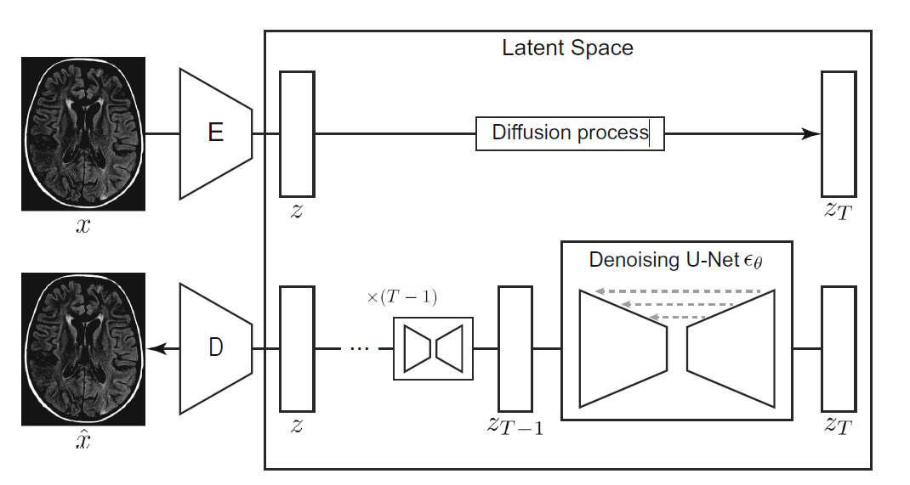
PROPOSED MODEL
VQ-VAE + DDPM
Notes:
Aqui explicaria els punt 2. Background del paper

Slide 12
PROPOSED MODEL
VQ-VAE + DDPM

Slide 13
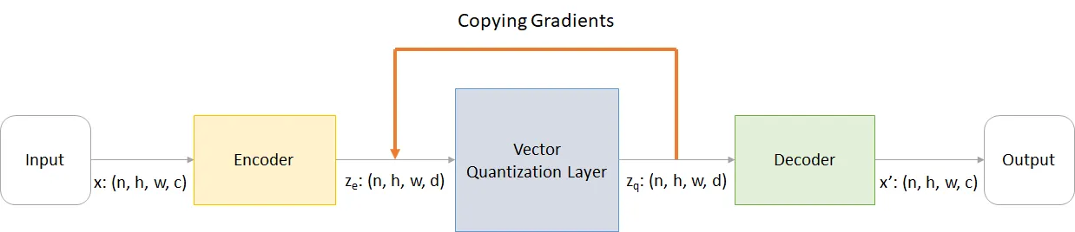
PROPOSED MODEL
Vector Quantized Variational Autoencoder (VQ-VAE)
Autoencoder with discrete latent space
Encoder maps input image x to a smaller dimensional latent representation z_e
VQ layer selects embeddings from a dictionary based on distance
Decoder reconstructs the observation, outputs x’
https://shashank7-iitd.medium.com/understanding-vector-quantized-variational-autoencoders-vq-vae-323d710a888a
Notes:
explicat millor que al paper: https://shashank7-iitd.medium.com/understanding-vector-quantized-variational-autoencoders-vq-vae-323d710a888a

Slide 14
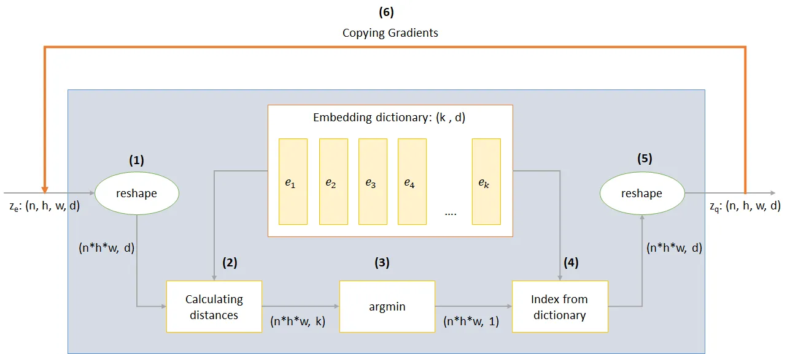
PROPOSED MODEL
Vector Quantization Layer
Codebook: embedding dictionary with finite number k of vectors
Element-wise quantization: find the the index of closest vector using argmin
Coping gradients for training process
Loss function that trains dictionary embeddings, encoder and decoder
https://shashank7-iitd.medium.com/understanding-vector-quantized-variational-autoencoders-vq-vae-323d710a888a
Reconstruction
Exponential moving average
Commitment
Notes:
Reconstruction loss: which optimizes the decoder and encoder
Codebook: l2 or l1 error to move the embedding vectors eᵢ towards the encoder output -> goal is to learn the embedding dictionary
Commitment loss: train embeddings eᵢ as fast as the encoder parameters, make sure that the encoder commits to an embedding
// sg represents stop gradient operator meaning no gradient
// flows through whatever it's applied on
With that loss we train both the dictionary embeddings as well as encoder and decoder network

Slide 15
PROPOSED MODEL
VQ-VAE + DDPM
Notes:
Aqui explicaria els punt 2. Background del paper

Slide 16
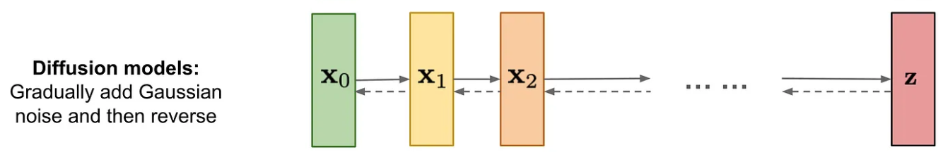
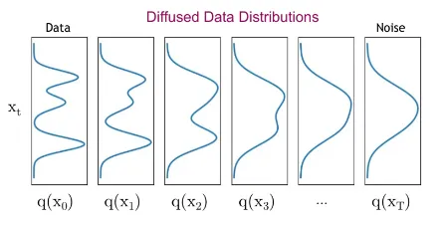
PROPOSED MODEL
Denoissing Diffusion Probabilistic Model
Parameterized Markov chain trained using variational inference
Learns the distribution of the latent representation
Forward process: adds Gaussian noise - q(x_{{1:T}}|x₀)
Reverse process: removes Gaussian noise - pθ(x_{{t-1}}|x_{t})
https://medium.com/@gitau_am/a-friendly-introduction-to-denoising-diffusion-probabilistic-models-cc76b8abef25
Notes:
per figures: https://medium.com/@gitau_am/a-friendly-introduction-to-denoising-diffusion-probabilistic-models-cc76b8abef25
per explicacio: https://dmytro-kuzmenko.medium.com/diffusion-model-pathway-chapter-i-denoising-diffusion-probabilistic-models-5012fc615b8b
per explicació i derivacio matematica: https://medium.com/@deep_space/navigating-ddpms-a-closer-look-at-denoising-diffusion-probabilistic-models-a55f74d5227a
def markov chain: A Markov chain is a mathematical concept used to model a sequence of possible events in which the probability of each event depends only on the state attained in the previous event

Slide 17
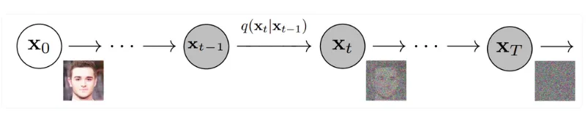
Diffusion Models
FORWARD PROCESS
Gradually destroys the structure of the training data via a fixed Markov chain (Gaussian prior) over T diffusion steps
The goal of this step is to get an approximate the posterior distribution q(x_{{1:T}}|x₀)
REVERSE PROCESS

Slide 18
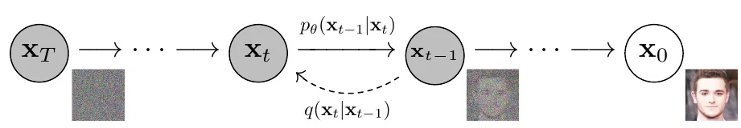


Diffusion Models
FORWARD PROCESS
REVERSE PROCESS
Recover the original data x₀ from the noisy input x_{T}
The goal is to learn the distribution pθ(x_{{t-1}}|x_{t}) that is the same as learning q(x_{{t-1}}|x_{t})
pθ is modelled as
In the training we minimize variational lower bound of the log likelihood
Notes:
the mean and variance of the added noise is adjusted at each time-step, affecting the amount of noise introduced at each stage, therefore variance schedule determines how the noise level evolves during the diffusion process
we cannot use bayes theorem because the integrals are intractable due to the requirement of all possible space of images for computing the integral to get the desired distribution -> we use the variational lower bound

Slide 19
Diffusion Models
Loss formulation
Variational lower bound can be rewritten using the Kullback–Leibler (KL) divergence
L_{T}: is constant as q has no parameters to learn
L_{T-1}: penalises errors in one reverse step and requires a direct comparison between p_{θ}(x_{t−1}|x_{t}) and its corresponding diffusion process posteriors
L₀: final transition → configured as an independent discrete decoder
Once x₁ is obtained, our objective is to synthesize x₀. To do that, the model needs to output discrete log likelihoods for every individual pixel.
L_{T}
L_{T-1}
L₀
Notes:
KL divergence measures how one probability distribution is different from a second reference probability distribution
LT (first term in S), it is constant as q has no parameters to learn as its just adds noise to the image repetitively using a variance-schedule and xT is a Gaussian -> can be ignored for model training

Slide 20
PROPOSED ANOMALY SEGMENTATION METHOD

Slide 21
PROPOSED ANOMALY SEGMENTATION METHOD
Step by step
Train VQ-VAE and DDPM on healthy dataset to guide the brain image in the later healing process (reverse process)
VQ-VAE encoder: obtain latent representation z of the test images
1
2
Notes:
In brief, we use the learned variational lower bound across the DDPM’s Markov chain to identify the latent values that were unlikely to occur in the training set. We replace these unlikely values with more probable ones according to the DDPM, and then we use the latent spatial information to filter the residual maps (obtained from the difference between the original image and the healed image).

Slide 22
PROPOSED ANOMALY SEGMENTATION METHOD
Step by step
3
DDPM forward process to obtain noisy representations z_{t} across the Markov chain in order to identify values that are unlikely to occur in the training set.
! Observation
if input image is healthy → reverse process only removes the added Gaussian noise. ( low KL divergence in L_{T-1})
if image contains anomaly →reverse process removes part of the singal of the original analogous regions. Not following the expected Gaussian transition.
(high L_{T-1} in the anomalous region)
Notes:
Healthy image: low KL divergence in L_{T-1}
Anomaly image: high L_{T-1} in the anomalous region

Slide 23
PROPOSED ANOMALY SEGMENTATION METHOD
Step by step
3
DDPM forward process to obtain noisy representations z_{t} across the Markov chain in order to identify values that are unlikely to occur in the training set.
! Observation
if input image is healthy → reverse process only removes the added Gaussian noise.
if image contains anomaly →reverse process removes part of the singal of the original analogous regions. Not following the expected Gaussian transition.
4
Find a threshold to create a binary mask indicating where the anomalies are and use it to guide the ‘healing’ process.
Compute the values of values of L_{T-1} for all healthy images (pixel by pixel) in the validation set and for the steps t=[400,600] of the Markov chain.
Averaging the loss for all images, the threshold is set as the 97.5 percentile of this value.
Using the threshold, the images are binarized as 1 or 0.
Notes:
notes:
the loss is computed for each pixel of the image
Using the threshold, the images are binarized as 1 or 0 -> meaning loss bigger than threshold is anomaly (1) and loss smaller than threshold is normal (0)

Slide 24
PROPOSED ANOMALY SEGMENTATION METHOD
Step by step
DDPM reverse process: remove ‘noise’ from the regions that have anomalies.
each step denoises the masked regions a little bit but keeps the rest of the image as original. Resulting in z₀ being the latent variable with the anomalies corrected.
The goal is to inpaint the highlighted regions in m using the rest of the image as context.
VQ-VAE decoder: to decode back to the pixel space x’ and obtain the residuals |x-x’|(pixel by pixel). This residuals are smoothed using a Gaussian filter to clean areas that the DDPM did not specify as anomalous
Finally, we can identify regions with anomalies of each brain image from the regions on the final residual maps with high values.
5
6
7
Notes:
aqui es on substitueix la noise dels anomalies x la dels healthy (gaussian, oi?)

Slide 25
PROPOSED ANOMALY SEGMENTATION METHOD
In summary:
Use the learned variational lower bound across the DDPM’s Markov chain to identify the latent values that were unlikely to occur in the training set (anomalies).
Replace these unlikely values with more probable ones according to the DDPM (learnt distribution).
Use the latent spatial information to filter the residual maps (obtained from the difference between the original image and the healed image, that is the generated image).

Slide 26
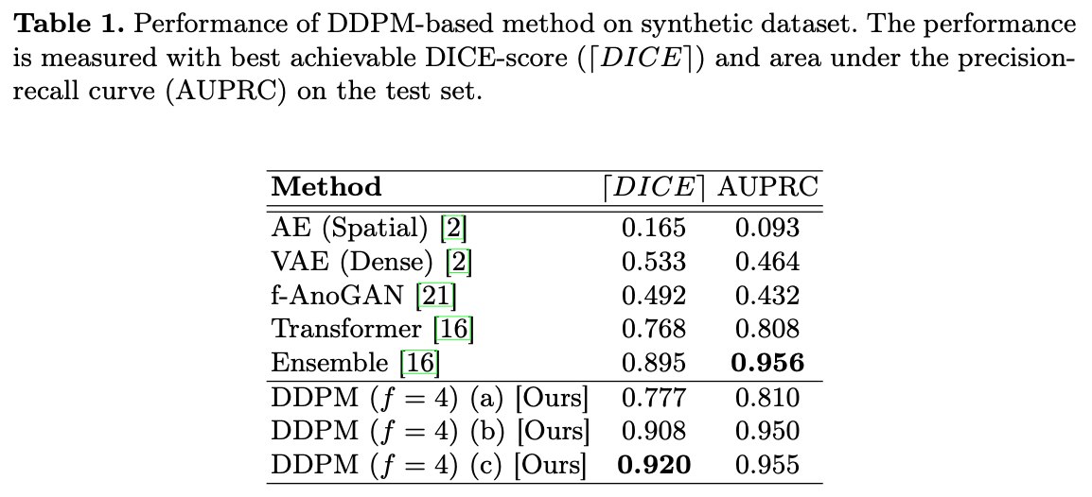
EXPERIMENTS AND RESULTS
1.Anomaly Segmentation and Detection on Synthetic Anomalies
Dataset: MedNIST dataset trained with “HeadCT” 9k corrupted with sprites images and validated on 100 corrupted with sprites images
a)reverse steps on z (no masks)
b) a) + upsampled mask to the residual maps
c) the complete approach
Each step of the method improves performance
Notes:
The process of corrupting the dataset with sprites involves overlaying or inserting predefined sprite images onto healthy brain images. These sprite images may represent various types of simulated pathological lesions or abnormalities that are artificially introduced into the original healthy brain scans.
By adding these synthetic anomalies in a controlled manner, researchers can assess how well DDPMs can identify and delineate these anomalous regions from normal brain tissue during anomaly detection task

Slide 27
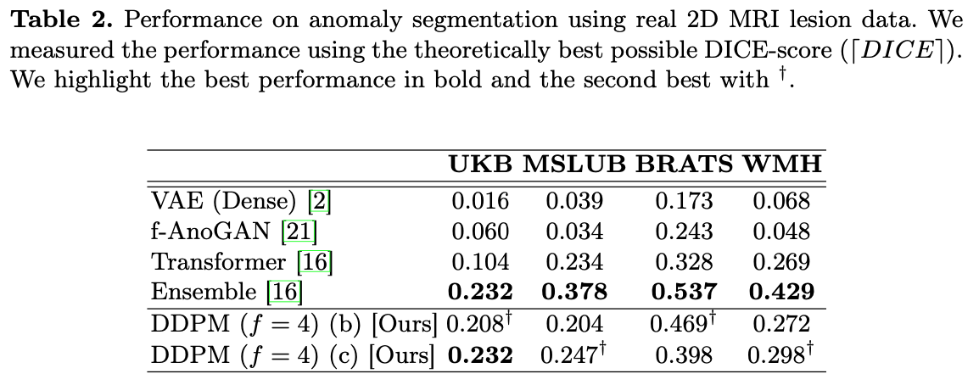
EXPERIMENTS AND RESULTS
2. Anomaly Segmentation on MRI data
Training Dataset: Normative dataset of 15k participants with the lowest lesion volume in the UK Biobank (UKB).
Evaluation Dataset: small vessel disease (WMH), tumours (BRATS), demyelinating lesions (MSLUB), white matter hyperintensities (UKB).
The method performs as well as an ensemble of transformers on the same training set. When testing in other sets, ensemble generalizes better.

Slide 28
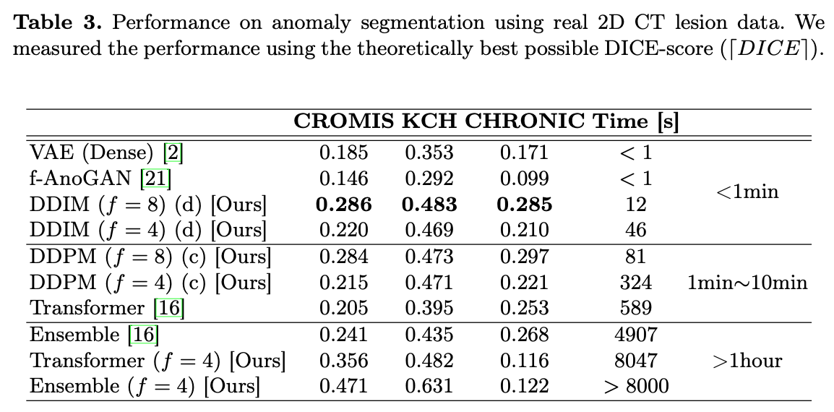
EXPERIMENTS AND RESULTS
3. Inference Time of Anomaly Segmentation on CT data
Time consumption is critical for clinical viability, specially in analysis of intracerebral hemorrhages (ICH).
Model trained on: CT axial slices that did not contain ICH from 200 participants from CROMIS dataset.
Model evaluated on: 21 participants from CROMIS, KCH and CHRONIC datasets.
Notes:
CT → computed tomography
DDIM → denoising diffusion implicit models. speed up reverse process

Slide 29
CONCLUSIONS AND FUTURE LINES
Method to use DDPMs to perform anomaly detection and segmentation.
Model performs competitively on both synthetic and real data
Better performance compared to a single transformer
Holds promise in scenarios where inference has time constraints
The method’s faster inference will help bring high-performance anomaly detection to the clinical frontline.
DDPMs have the potential to be even further improved, bringing more advances to anomaly detection in a medical image.

Slide 30
DISCUSSION
PROS
Good for cases where time inference is critical. Although further optimization is needed for real-time clinical applications.
DDPMs are built upon a solid theoretical foundation.
CONS
Although competitive results, they are not state-of-the-art.
The paper lacks detailed explanation of the model and the methodology.

Slide 31
REFERENCES
Paper: https://arxiv.org/pdf/2206.03461
VQ-VAE: https://shashank7-iitd.medium.com/understanding-vector-quantized-variational-autoencoders-vq-vae-323d710a888a
DDPM:
https://medium.com/@gitau_am/a-friendly-introduction-to-denoising-diffusion-probabilistic-models-cc76b8abef25
https://dmytro-kuzmenko.medium.com/diffusion-model-pathway-chapter-i-denoising-diffusion-probabilistic-models-5012fc615b8b
https://medium.com/@deep_space/navigating-ddpms-a-closer-look-at-denoising-diffusion-probabilistic-models-a55f74d5227a

Slide 32
Data Science for Health

