Slide 1
Mask-aware networks for crowd counting
A novel approach to crowd counting using mask-aware networks

Slide 2
Mask-aware networks for crowd counting
I Introduction
II Related work
III Our proposed method
IV Experiment
V Conclusion
References

Slide 3
Introduction
Crowd counting is a significant topic in the multimedia and computer vision community, aiming to count objects, such as people, in images or video frames.
Traditional approaches utilize density maps generated from dot-level annotations due to challenges in detailed annotations.

Slide 4
Related Work on Crowd Counting
Various approaches have been developed to address crowd counting issues.
Early methods utilized hand-crafted features and classifiers for pedestrian detection.
Recent advancements involve CNN-based detectors like Faster R-CNN and YOLO for improved performance and speed.

Slide 5
Proposed Method Overview
Our proposed method focuses on density map estimation using a network with three main modules: the backbone, mask prediction branch, and mask-aware density regression branch.
Point-wise annotations are used to create ground-truth density maps, and Gaussian kernels are employed for density estimation.
The density regression problem is framed as a mean square loss regression.

Slide 6
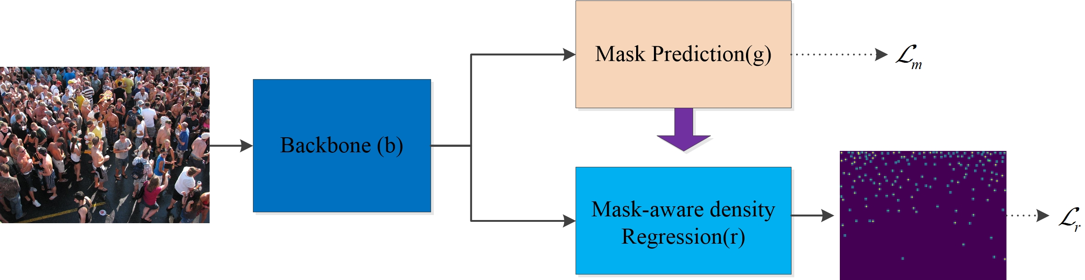
a diagram of a group of people standing in a crowd

Slide 7
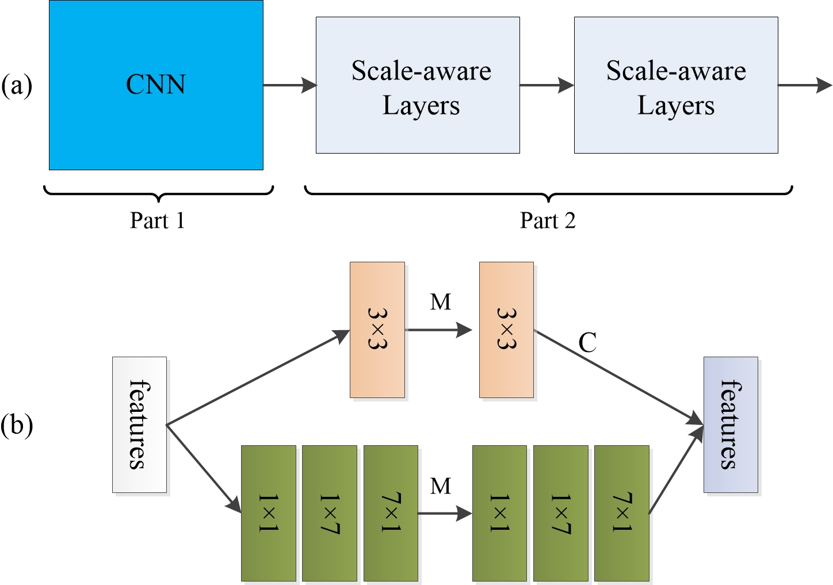
a diagram of a computer system with multiple layers

Slide 8
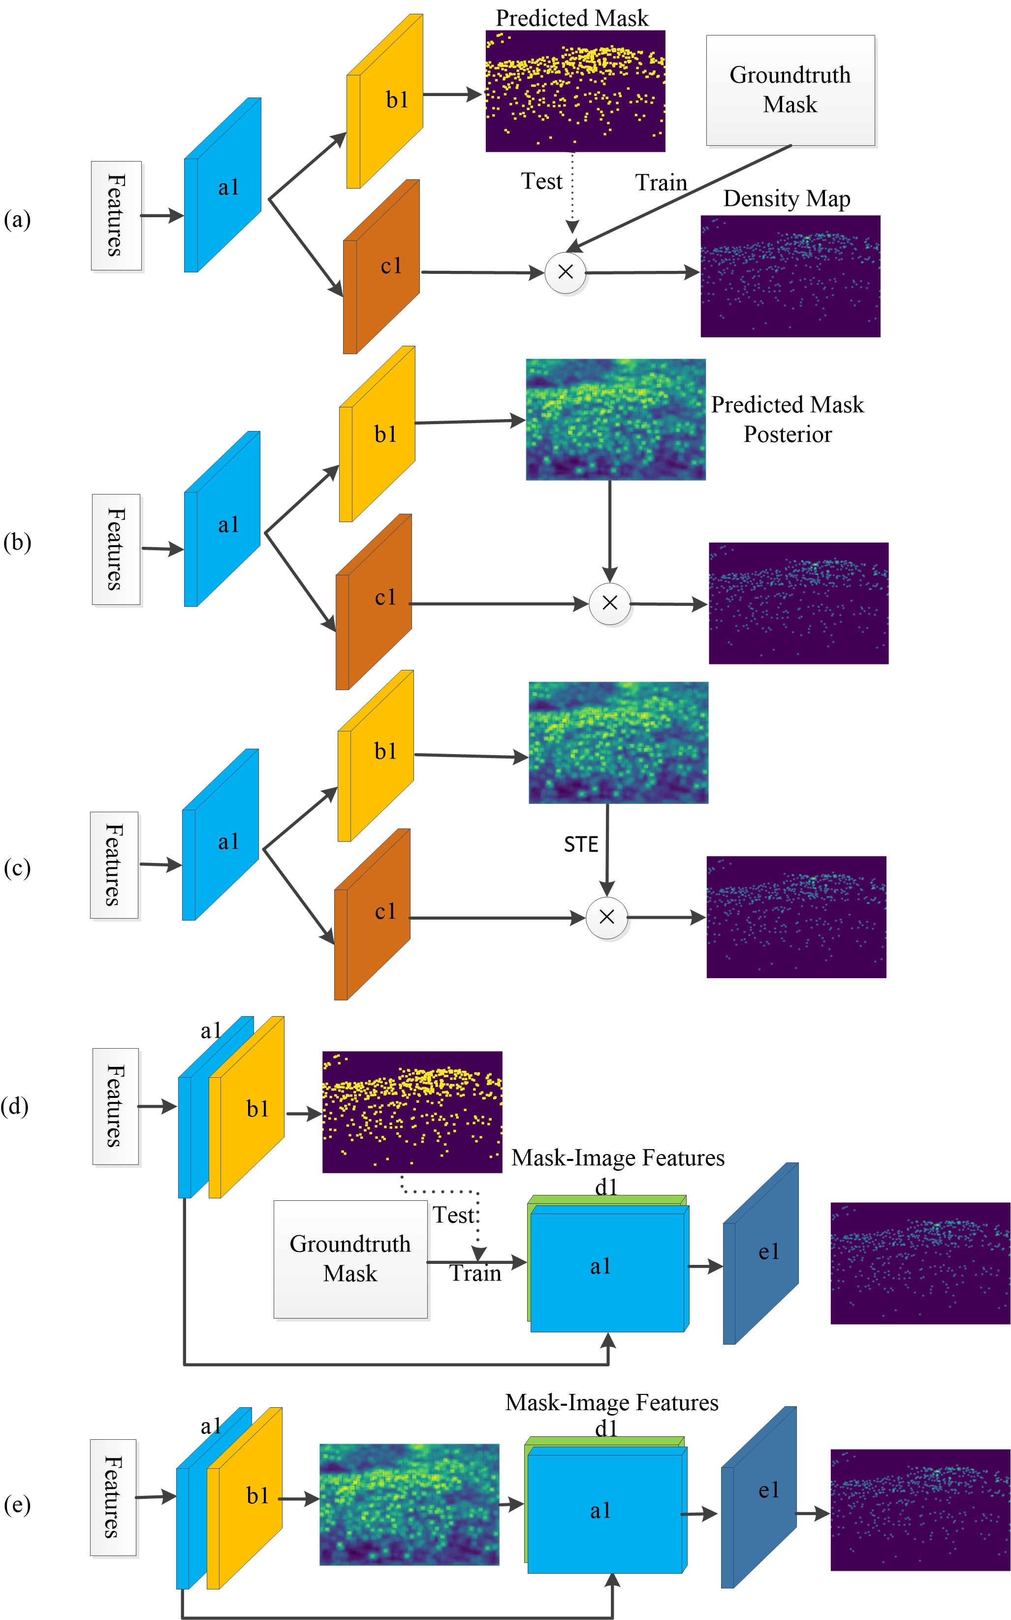
a diagram of a flow diagram of a computer system

Slide 9
Experimental Setup
Experiments conducted on challenging public datasets
Aim to verify improvements over baselines and identify most effective density estimation solution
Comparison with state-of-the-art methods using mean absolute error and mean square error as evaluation metrics
Datasets used: shanghaitech, ucf cc, and worldexpo

Slide 10
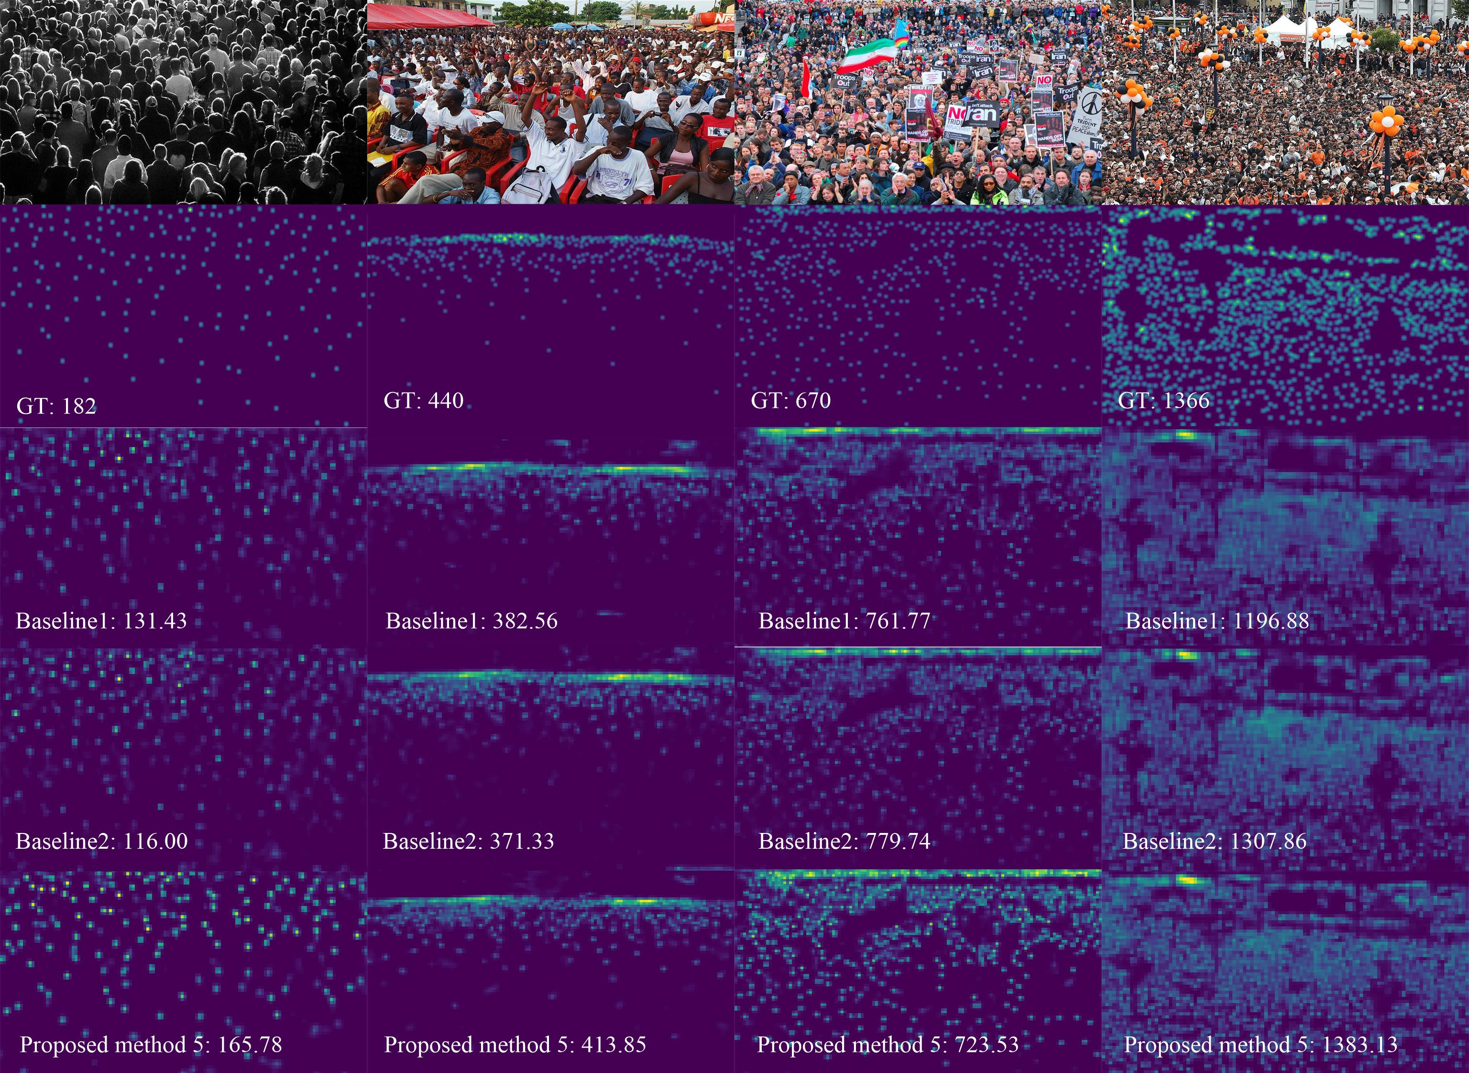
arafed image of a crowd of people at a concert

Slide 11
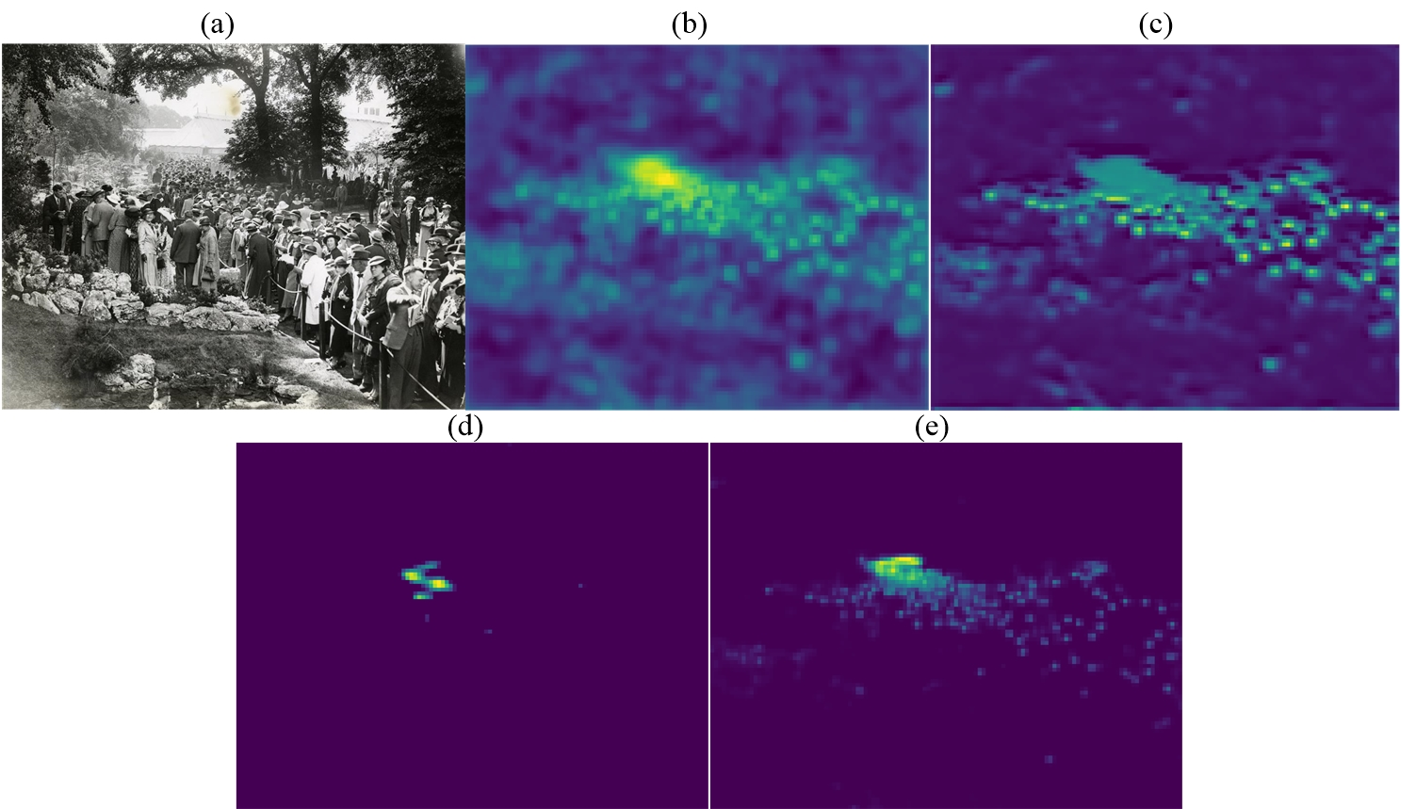
a group of four pictures of people standing in a forest

Slide 12
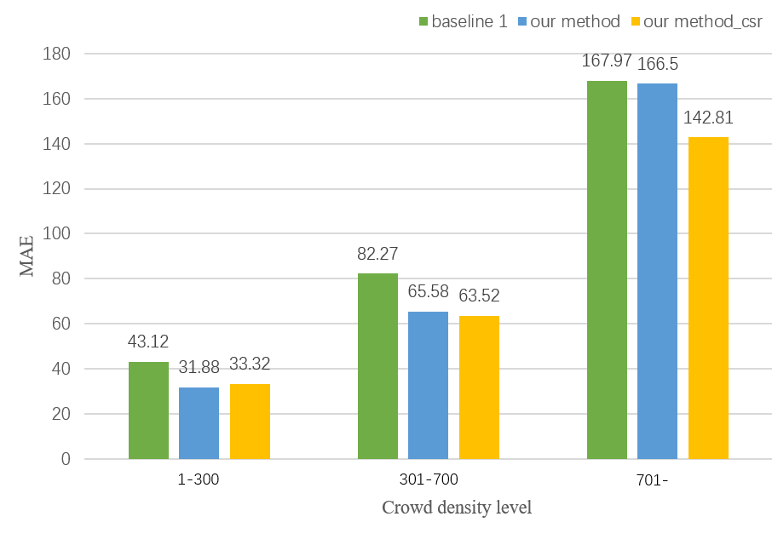
a close up of a bar chart with a number of different bars

Slide 13
Conclusion
The paper presents a deep neural network approach to address the crowd counting problem.
Authors introduce a method that uses a dedicated network branch for predicting foreground/background masks and incorporates mask prediction into density map estimation.
Performance evaluation on various datasets shows that the method achieves state-of-the-art crowd counting results.

Slide 14
References
The text covers a wide range of references related to crowd understanding and object detection in various research papers published in prestigious journals and conferences such as IEEE Transactions, ACM International Conference on Multimedia, European Conference on Computer Vision, and more.
Topics include deep learning methods for crowd counting, crowd behavior analysis, real-time object detection, and pedestrian detection in dense crowds, among others.
The references also delve into techniques such as CNN-based single image crowd counting, histograms of oriented gradients for human detection, and the use of convolutional neural networks for crowd behavior analysis.

Slide 15
Mask-aware Networks for Crowd Counting
Mask-aware networks introduce a dedicated branch to predict object/non-object masks.
These masks are combined with the input image to generate a density map.
This approach helps differentiate between the presence and absence of objects, making density estimation easier.

