Slide 1
arXiv:1901.00039v2
Technical Presentation

Slide 2
Table of Contents
arXiv:1901.00039v2 [cs.CV] 20 Jun 2019
I Introduction
II Related work
III Our proposed method
IV Experiment
V Conclusion
References

Slide 3
Introduction to Crowd Counting Problem
The crowd counting problem involves counting the number of objects within an image or video frame.
Traditionally, this problem is solved by estimating density maps from object location annotations.

Slide 4
Problem Statement
Crowd counting is a challenging problem in multimedia and computer vision, aiming to count the number of objects within an image or video frame.
Objects-of-interest, such as people, can occur at various scales with occlusions and cluttered visual appearances.
Existing datasets often use weak-level annotations, labeling each object with a dot inside, due to the difficulty in providing detailed annotations like bounding boxes or segmentation masks.

Slide 5
Related Work Overview
Many approaches have been proposed to study the issues in crowd counting. In this section, we provide a brief review of the related work in crowd counting.
Detection-based methods have been commonly used for crowd counting. Early methods utilized hand-crafted features like haar wavelets and histogram oriented gradients to model pedestrians, which were then input to classifiers for pedestrian detection.

Slide 6
Our Proposed Method
Point-wise Annotation for Training Images
Each object-of-interest is annotated with a dot
Pointwise annotation converted into a density map: d = x xibelong to a g

Slide 7
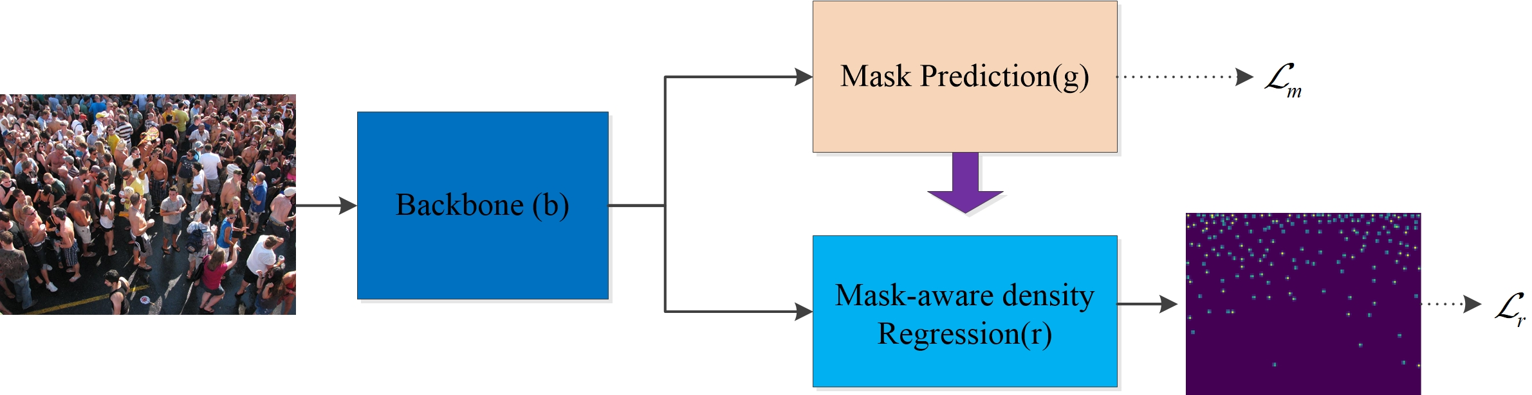
a diagram of a group of people standing in a crowd

Slide 8
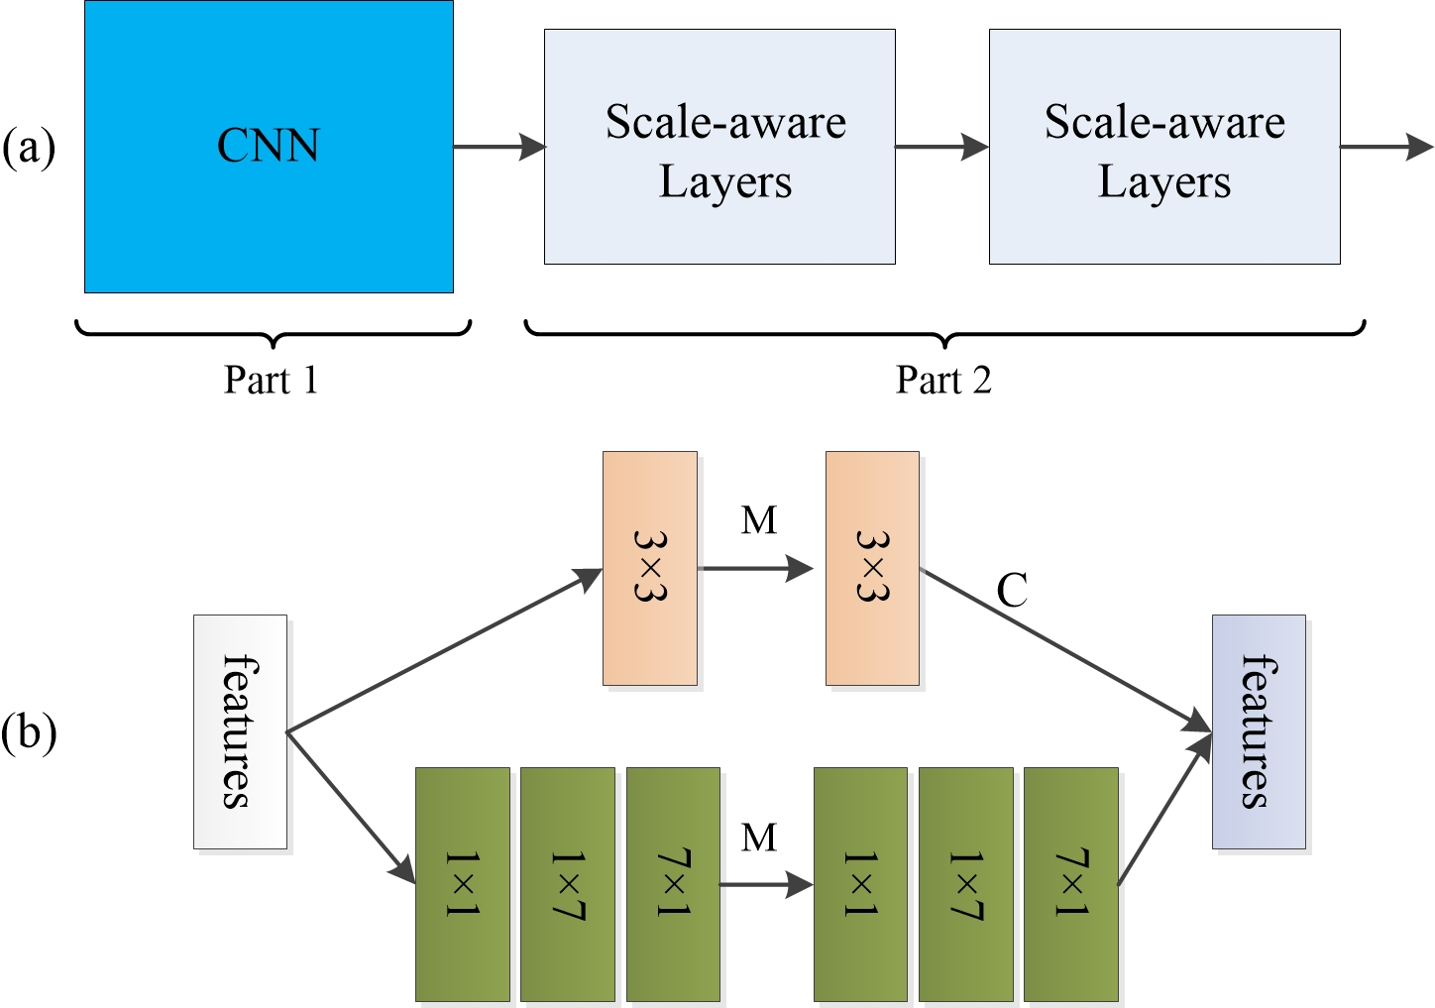
a diagram of a computer system with multiple layers

Slide 9
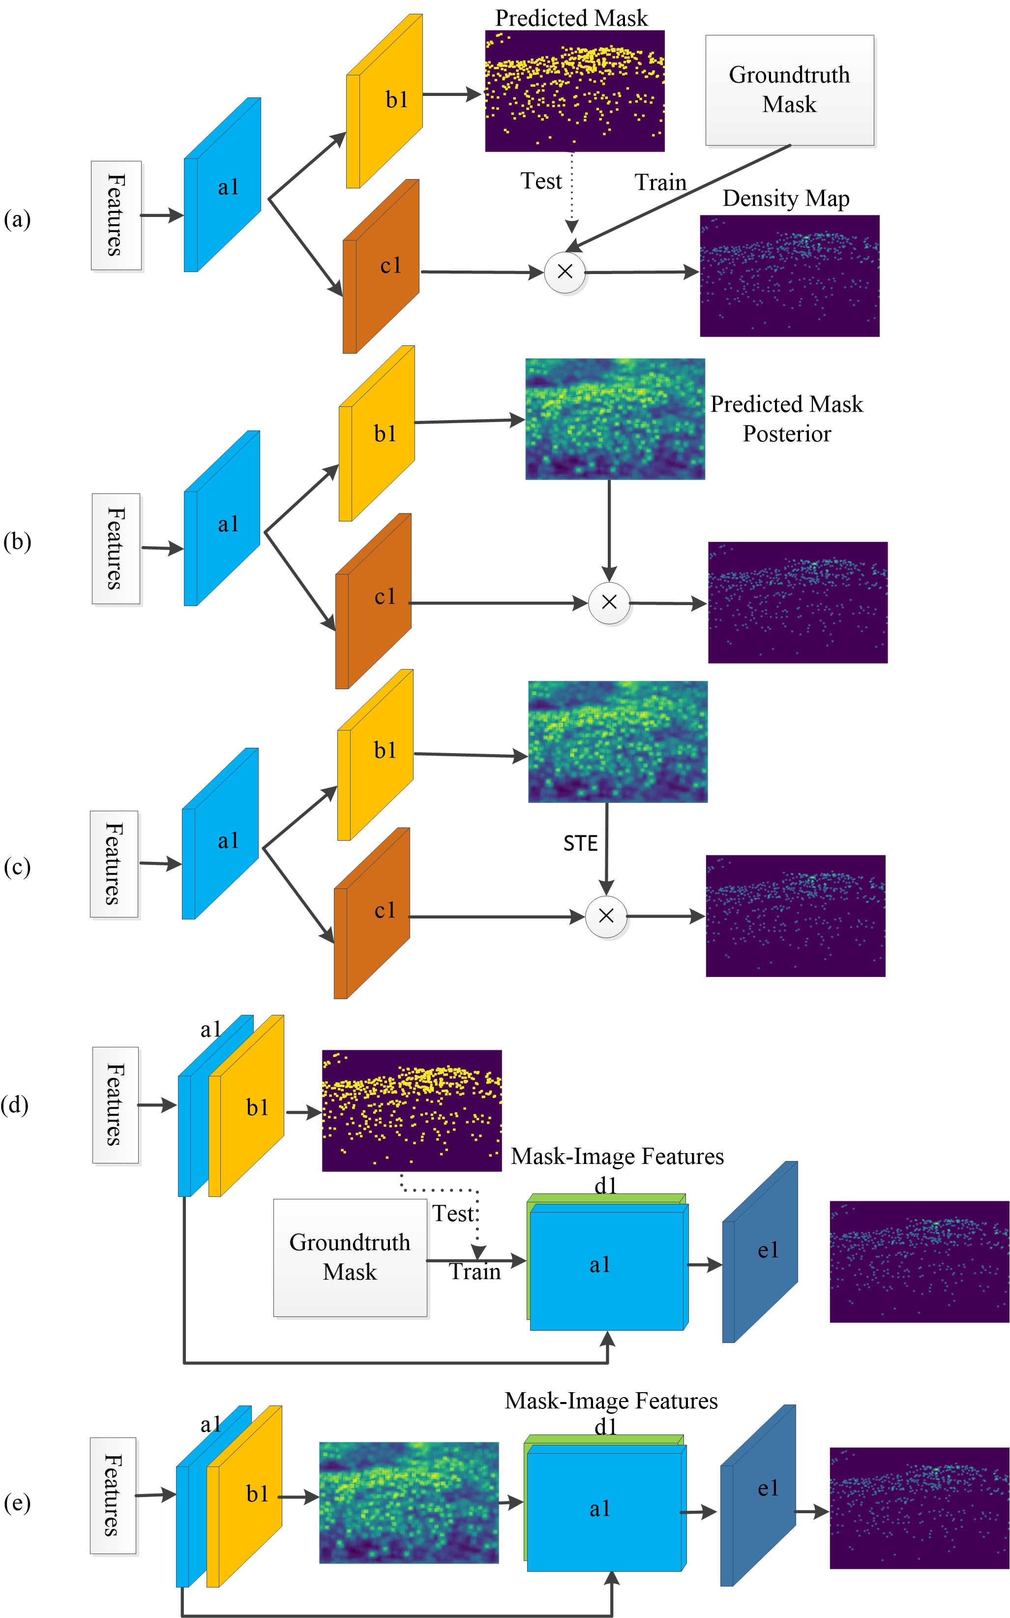
a diagram of a flow diagram of a computer system

Slide 10
Experiment Overview
In this section, we delve into the details of our experiment to validate the effectiveness of our proposed mask-aware strategies for crowd counting density estimation.
We utilized a network of 3980 frames sampled from video sequences, with 3380 frames allocated for training and the remaining for testing.

Slide 11
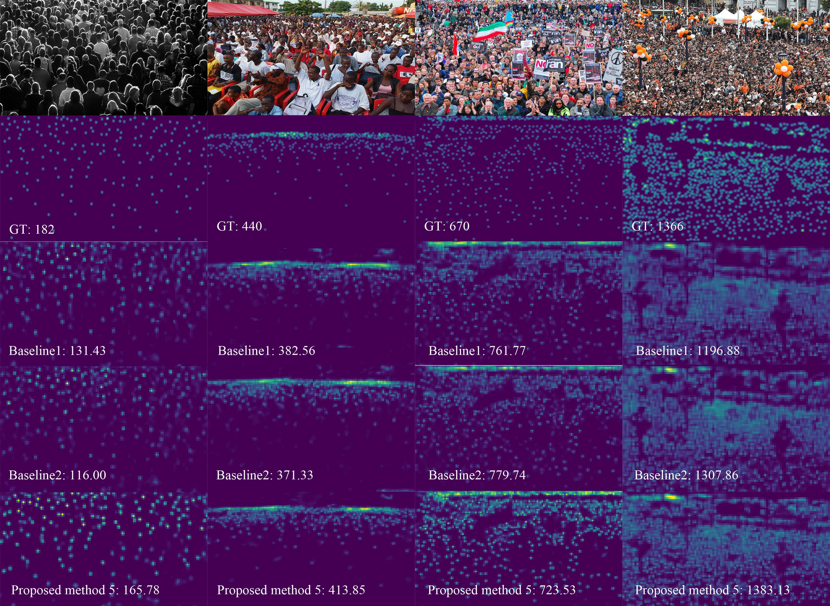
arafed image of a crowd of people at a concert

Slide 12
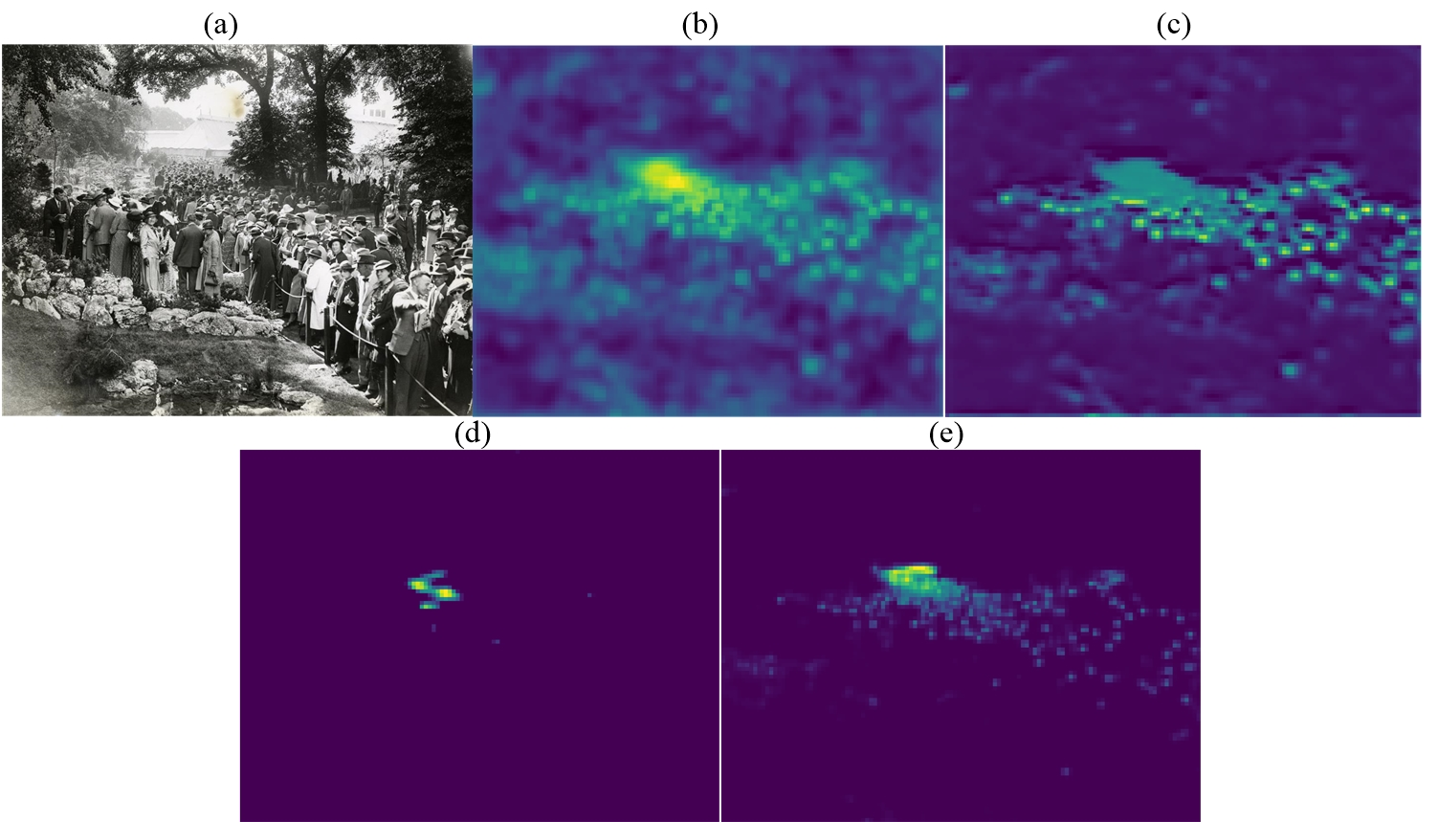
a group of four pictures of people standing in a forest

Slide 13
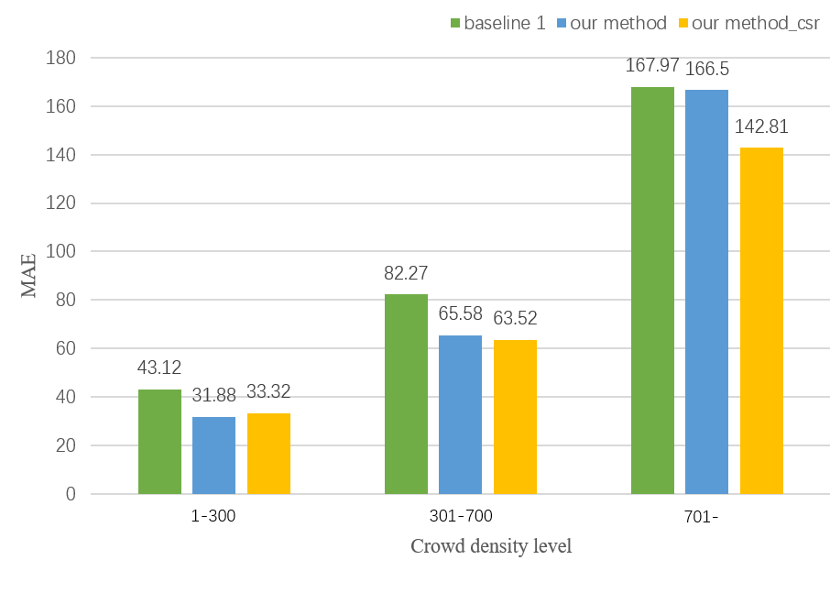
a close up of a bar chart with a number of different bars

Slide 14
Conclusion
In conclusion, this paper has addressed the crowd counting problem using deep neural networks. Our main discovery highlights the benefits of utilizing deep neural networks in crowd counting tasks.
Our research contributes to the field of video technology, specifically in the context of IEEE Transactions on Circuits and Systems for Video Technology.

Slide 15
References
In this section, we present the results of a detailed analysis of the references cited in our paper. The references provide a solid foundation for our research and support the validity of our findings.
By examining the various sources referenced throughout the paper, we can gain a deeper understanding of the existing literature in the field and how it relates to our own work.

