Slide 1

Email Spam Detection

Slide 2

Goal Definition
Spam email:
unwanted message
malicious/fraudulent message
Our goal:
Build a model for spam detection
to improve safety of the people

Slide 3
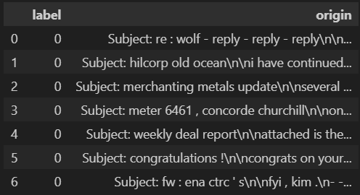
Data Acquisition
Dataset
Enron-Spam (2006)
Attributes:
label: 1 for spam, 0 for ham
origin: textual email

Slide 4

Data Exploration
Found 33702 email
Found 3217 duplicates
Found 0 missing values
Balanced dataset
- 17157 spam
- 16545 ham

Slide 5

Data Preprocessing
Renamed attribute ‘origin’ in ‘email’
Removed duplicates
Check again for distribution of dataset
- 15910 spam
- 14575 ham
Feature creation: 5 new attributes
- total lenght
- number of words
- number of special characters
- number of hyperlinks
- number of digits
Stopwords removal

Slide 6
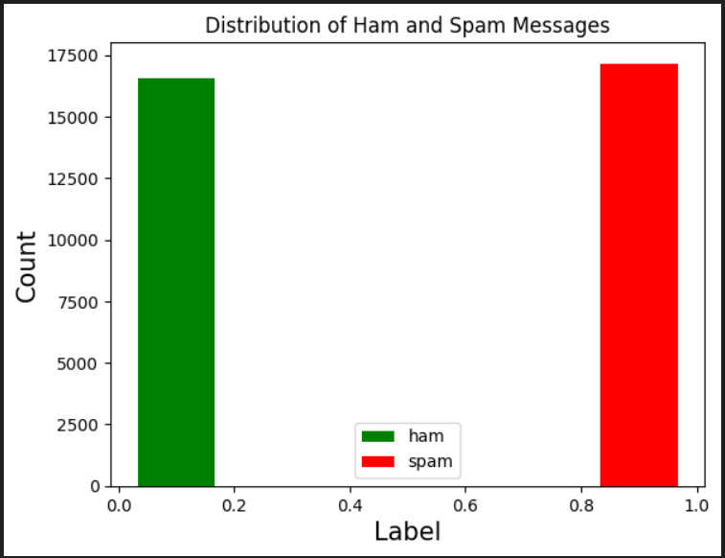
Data Visualization
Visual Representation of the distribution of the email in the Dataset using Histogram

Slide 7
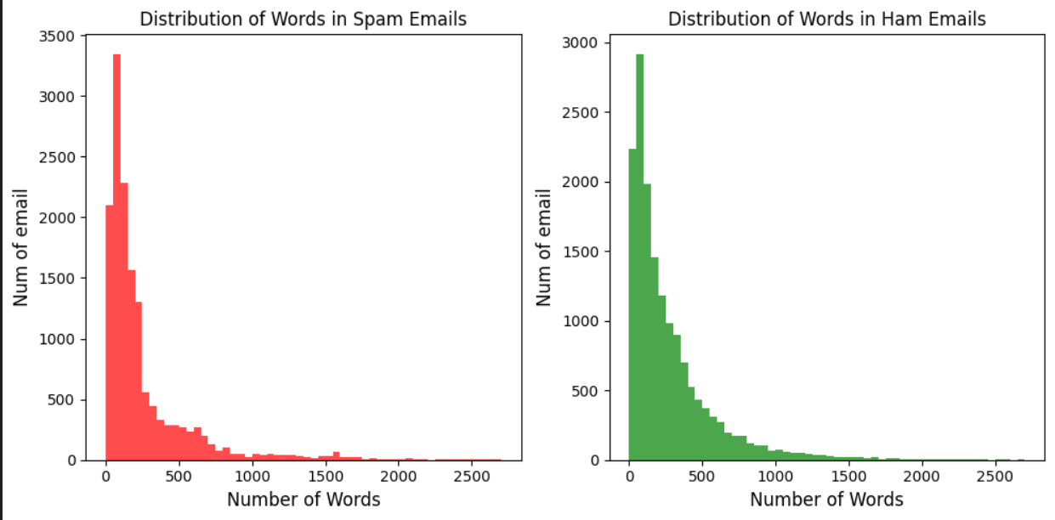
Data Visualization
Graphical Representation of the distribution of words in spam and ham email

Slide 8
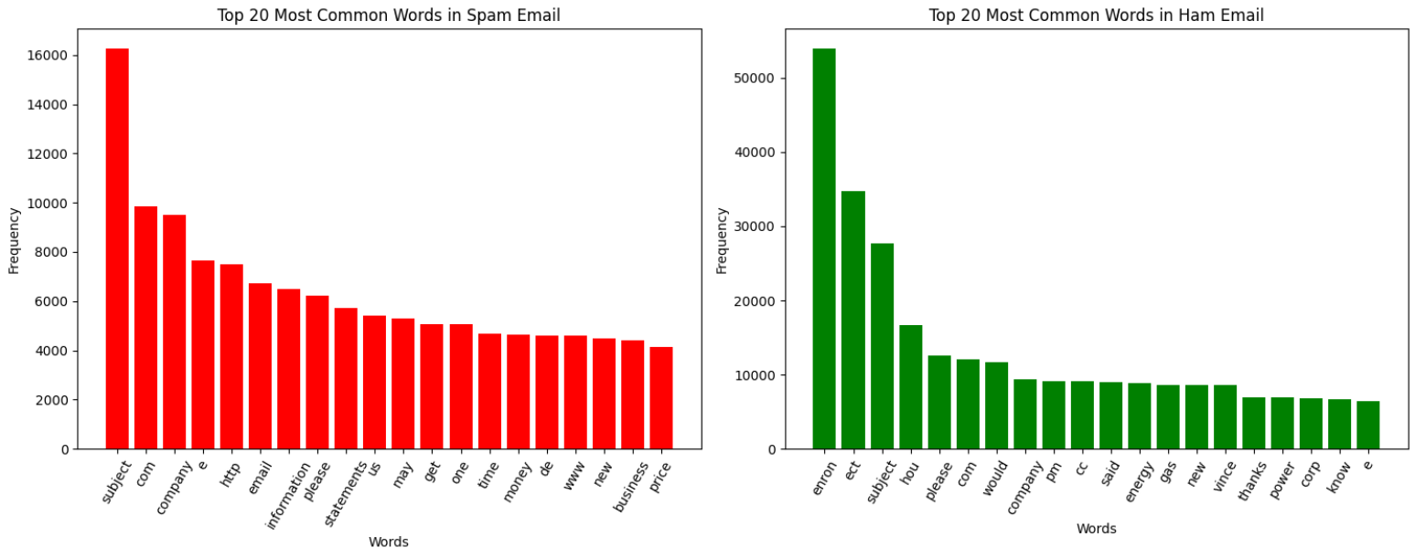
Data Visualization
Visual Representation of the most common 20 words in spam and ham email

Slide 9

Data Visualization
Graphical Representation of the 100 most common words using WordCloud

Slide 10

Data Processing
Hold Out Approach:
- 70% training set
- 30% test set
5 Classifiers:
- Multinomial Naïve Bayes
- Logistic Regression
- Support Vector Classifier
- Decision Tree Classifier
- Random Forest Classifier
CountVectorizer vs TfidfVectorizer

Slide 11
Perfomance Evaluation
Classifier | Accuracy | Precision | Recall | F1-Measure
Multinomial Naive Bayes | 0.9852 | 0.9909 | 0.9780 | 0.9844
Logistic Regression | 0.9833 | 0.9714 | 0.9945 | 0.9828
SVC | 0.9886 | 0.9808 | 0.9956 | 0.9881
Decision Tree Classifier | 0.9552 | 0.9490 | 0.9579 | 0.9534
Random Forest | 0.988 | 0.9796 | 0.9887 | 0.9841
Comparison table of the different metrics obtained using
hold out approach

Slide 12

Data Processing
K-fold Cross-Validation Approach:
- K = 10 folds
5 Classifiers:
- Multinomial Naïve Bayes
- Logistic Regression
- Support Vector Classifier
- Decision Tree Classifier
- Random Forest Classifier

Slide 13
Perfomance Evaluation
Classifier | Accuracy | Precision | Recall | F1-Measure
Multinomial Naive Bayes | 0.9865 | 0.9918 | 0.9799 | 0.9858
Logistic Regression | 0.9855 | 0.9754 | 0.9948 | 0.9850
SVC | 0.9901 | 0.9835 | 0.9959 | 0.9897
Decision Tree Classifier | 0.9512 | 0.9482 | 0.9498 | 0.9490
Random Forest | 0.9848 | 0.9824 | 0.9858 | 0.9841
Comparison table of the different metrics obtained using
K folds cross validation approach

Slide 14
Validation
Every Wilcoxon test, except for 3 pairs, give a p-value that is lower than the confidence level α (tipically 0.05)
We can reject the Null Hypothesis for all the other and we can conclude that the result is statistically significant.
We can identify the best classifier as the one that will have the lowest error rate.
For the 3 pairs with p-value higher than α, we cannot reject the Null Hypotesis, so we cannot say nothing from the statistical point of view
 | MNB | LR | SVC | DT | RFC
MNB | - | 0.0506 | 0.0019 | 0.0019 | 0.0858
LR | 0.0506 | - | 0.0019 | 0.0019 | 0.3222
SVC | 0.0019 | 0.0019 | - | 0.0019 | 0.0019
DT | 0.0019 | 0.0019 | 0.0019 | - | 0.0019
RFC | 0.0858 | 0.3222 | 0.0019 | 0.0019 | -

Slide 15

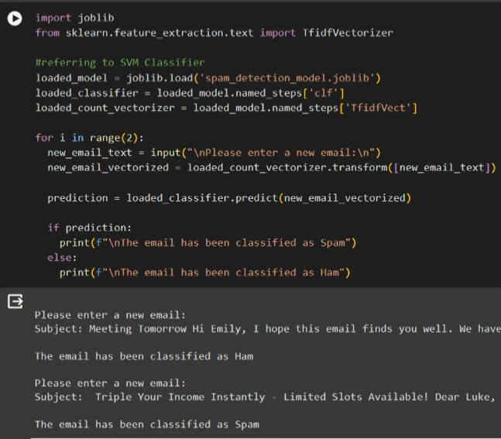
Real Time Classifier
Real time software that:
- Receives as input a keyboard-typed email
- Produces in output the answer (spam or ham)
We used emails taken from our mailbox, to show how it works

Slide 16

Conclusions
All Classifiers performed very well with Accuracy higher than 95%
In particular 3 of them showed the best results:
- SVC (99%)
- Multinomial Naïve Bayes (98.7%)
- Logistic Regression (98.6%)
These results seemed reasonable compared with other articles related to the same topic

Slide 17

Future Improvements
Increase Dataset size adding more Spam and Ham email
Use of different Classifiers
Additional Preprocessing:
- Stemming
- Lemmatization

Slide 18

Thank you for your attention
Calogero Costa
Claudio Costanzo

