Slide 1


TUGA IT 2017
dbatools SQL Server and PowerShell Together
Rob Sewell Cláudio Silva MVP
LISBON, PORTUGAL

Slide 2





THANK YOU TO OUR SPONSORS

Slide 3
AGENDA
Overview
Requirements
Demos, Demos, Demos
Questions
dbatools.io | powershell.sqlpass.org | sqlps.io/vote | sqlps.io/youtube | sqlps.io/slack
Notes:
No code

Slide 4
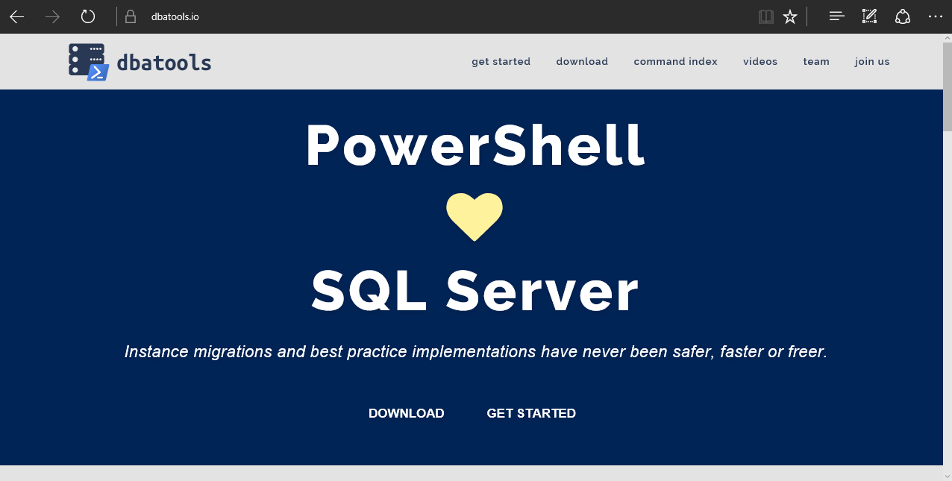
Visit the website
https://dbatools.io
dbatools.io | powershell.sqlpass.org | sqlps.io/vote | sqlps.io/youtube | sqlps.io/slack
Notes:
Solve people’s problems
But make sure you LOVE what you’re working on

Slide 5
System Requirements
Recommended
Client
PowerShell v5
SQL Server Management Studio 2012+
Server
SQL Server 2005+
Minimum
Client
PowerShell v3
SQL Server Management Studio 2008 R2
Server
SQL Server 2000
No PowerShell for pure SQL commands
PowerShell v2 for Windows commands
dbatools.io | powershell.sqlpass.org | sqlps.io/vote | sqlps.io/youtube | sqlps.io/slack

Slide 6
Installation
PowerShell Gallery (PowerShell v5+)
Install-Module dbatools
Install-Module dbatools –Scope CurrentUser
GitHub – dbatools.io/git
Invoke-Expression (Invoke-WebRequest https://dbatools.io/in)
Clone repo found at dbatools.io/git, Import-Module dbatools
dbatools.io | powershell.sqlpass.org | sqlps.io/vote | sqlps.io/youtube | sqlps.io/slack
Notes:
Solve people’s problems
But make sure you LOVE what you’re working on

Slide 7
DEMOS !
dbatools.io | powershell.sqlpass.org | sqlps.io/vote | sqlps.io/youtube | sqlps.io/slack
Notes:
Solve people’s problems
But make sure you LOVE what you’re working on

Slide 8


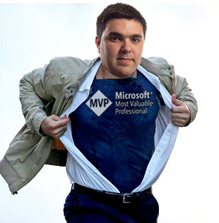



Questions
Rob
Cláudio
@sqldbawithbeard
@claudioessilva
robsewellsqldba
claudioessilva
sqldbawithAbeard.com
redglue.eu/blog
dbatools.io | powershell.sqlpass.org | sqlps.io/vote | sqlps.io/youtube | sqlps.io/slack

Slide 9
THANK YOU TO OUR SPONSORS

