Slide 2
Modern Database Administration using PowerShelL

Slide 3
About Us
Chrissy LeMaire
PowerShell MVP
Creator of dbatools.io
PASS PowerShell VG, Belgian PowerShell UG
DBA with General Dynamics IT at NATO Spec Ops HQ
Rob Sewell
PowerShell advocate
Creator of dbareports.io
PASS PowerShell VG, SQL Saturday Exeter
PowerShell Consultant and Trainer

Slide 4
Agenda
Overview
Requirements
Hella demos
Questions

Slide 5
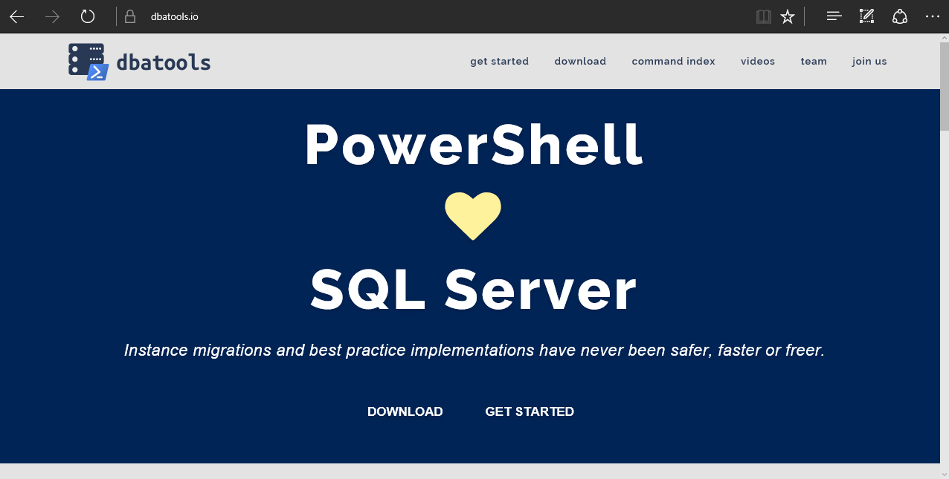

Slide 6
Requirements
Minimum
Client
PowerShell v3
SQL Server Management Studio 2008 R2
Server
SQL Server 2000
No PowerShell for pure SQL commands
PowerShell v2 for Windows commands
Remote PowerShell enabled for Windows commands
Recommended
Client
PowerShell v5
SQL Server Management Studio 2012+
Server
SQL Server 2008R2+

Slide 7
Install is easy
PowerShell Gallery
Install-Module dbatools
Install-Module dbatools –Scope CurrentUser
GitHub – dbatools.io/git
Invoke-Expression (Invoke-WebRequest https://dbatools.io/in)
Clone repo found at dbatools.io/git, Import-Module dbatools

Slide 8
Visit the site

Slide 9

Demos!

Slide 10
Summary
dbatools simplifies the life of a data pro
dbatools wants you!
dbatools.io/firstpull
dbatools.io/firstpullvideo

