Slide 1

The State of PowerShell, SQL Server, and SQLPS
Presented by
The PASS PowerShell Virtual Chapter Team
powershell.sqlpass.org | sqlps.io/vote | sqlps.io/youtube | sqlps.io/slack

Slide 2

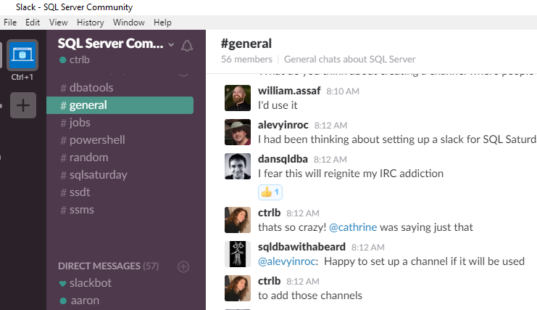
Join us now on
The SQL Server Community is now on Slack
sqlps.io/slack
Click in upper left corner then #poshvc_qa
Notes:
The GoToWebinar will still be available for those who are blocked from using Slack
There’s a possibility that Slack may block us for a bit, if that is the case, we’ll default to GTW

Slide 3
Agenda
New cmdlets!
Dedication
Demos
Posh VC
1
2
3
4
5
6
7
8
Story
Trello!
Upcoming
Questions
powershell.sqlpass.org | sqlps.io/vote | sqlps.io/youtube | sqlps.io/slack
Notes:
Introduce the new cmdlets that will be available in the July release of SQLPS
Do demo of one or two really great new cmdlets
Give VERY brief history of SQLPS and acknowledge challenges, leading up to the significant changes being made recently
Show quotes from Microsoft about their dedication and investment to PowerShell and SQL Server
Introduce Trello board
Super cool demos from each of us
Show PowerShell / SQL Presentations coming up this year, including SQL Saturdays, SQL PASS Summit and whatever else.
Promote our webpage and YouTube channel (we'd love to hit 750 subscribers by July 15 ;D)
Take questions
What you guys think?

Slide 4






SQL PowerShell VC
Established 2010
28 presenters, 35 sessions
4,000+ members
Aaron Nelson
Lead
Chrissy LeMaire
Co-lead
Laerte Junior
Co-lead
Rob Sewell Officer
powershell.sqlpass.org | sqlps.io/vote | sqlps.io/youtube | sqlps.io/slack

Slide 5
25 New Cmdlets + 3 Fixes + New Name
New Name!
Import-Module SqlServer
Always Encrypted
Add-SqlAzureAuthenticationContext
Add-SqlColumnEncryptionKeyValue
Complete-SqlColumnMasterKeyRotation
Get-SqlColumnEncryptionKey
Get-SqlColumnMasterKey
Invoke-SqlColumnMasterKeyRotation
New-SqlAzureKeyVaultColumnMasterKeySettings
New-SqlCngColumnMasterKeySettings
New-SqlColumnEncryptionKey
New-SqlColumnEncryptionKeyEncryptedValue
New-SqlColumnEncryptionSettings
New-SqlColumnMasterKey
New-SqlCspColumnMasterKeySettings
Remove-SqlColumnEncryptionKey
Remove-SqlColumnEncryptionKeyValue
Remove-SqlColumnMasterKey
Set-SqlColumnEncryption
SQL Server Agent
Get-SqlAgent
Get-SqlAgentJob
Get-SqlAgentJobHistory
Get-SqlAgentJobSchedule
Get-SqlAgentJobStep
Get-SqlAgentSchedule
Error Log
Get-SqlErrorLog
Set-SqlErrorLog
Invoke-Sqlcmd
-ConnectionString Parameter
-OutputAs (As) Parameter
Provider
WhatIf and Confirm now fully supported
powershell.sqlpass.org | sqlps.io/vote | sqlps.io/youtube | sqlps.io/slack
Notes:
Introduce the new cmdlets that will be available in the July release of SQLPS

Slide 6
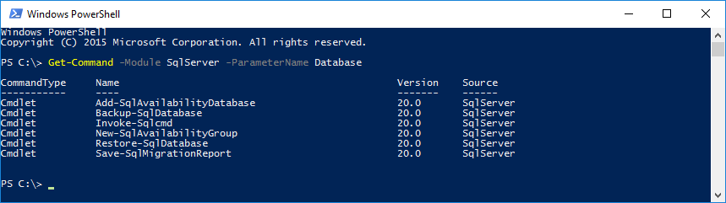
How do I know what cmdlets are out there?
Get-Command -Module SqlServer
Get-Command -Module SqlServer -ParameterName Database
Get-Help Get-SqlErrorLog -Examples
Get-Help Get-SqlAgent -Detailed
powershell.sqlpass.org | sqlps.io/vote | sqlps.io/youtube | sqlps.io/slack

Slide 7

Why is this so significant?
PowerShell support in SQL Server was neglected for years
Other platforms have tons more commands and get things done faster
Lync – 700+
SharePoint – 700+
Exchange – 700+
SQL Server, pre July 2016: 46
“A few years back the SQL organization needed many of the engineers in the team to go help on Azure SQL Database. This included many of us from the tools team which had obvious impact on our ability to do anything significant in the SQL Client Tools space as a whole. We have been reinvesting in the tools again and I get a chance to be a part of leading our SQL Client Tools Renaissance we have begun.”
Ken Van Hyning, Engineering Manager for SQL Server Client Tools and All-Around Hero
powershell.sqlpass.org | sqlps.io/vote | sqlps.io/youtube | sqlps.io/slack

Slide 8

Microsoft wants to hear from you!
“I see these cmdlets on Trello, please upvote the ones you want to see us working on next!”
Vin Yu, Program Manager, Data Platform
“Good stuff is on the way folks...help Chrissy and Aaron get me the highest priority improvements. Your vote counts ;-)”
Ken Van Hyning, Engineering Manager for SQL Server Client Tools
“Meanwhile, the DBA/MVP community has created its own channels where SQL tools team members participate. The Trello board is building momentum, and there's a new Slack channel. More of us are trying to monitor forums like #sqlhelp, reddit and stackoverflow on a regular basis as well."
David Shiflet, Principal Software Engineering Manager, SQL Azure
“Trello is addicting!”
Our Busy Hero, SQL PowerShell Engineer, Matteo Taveggia
powershell.sqlpass.org | sqlps.io/vote | sqlps.io/youtube | sqlps.io/slack
Notes:
Microsoft is showing total dedication to PowerShell for SQL Server

Slide 9

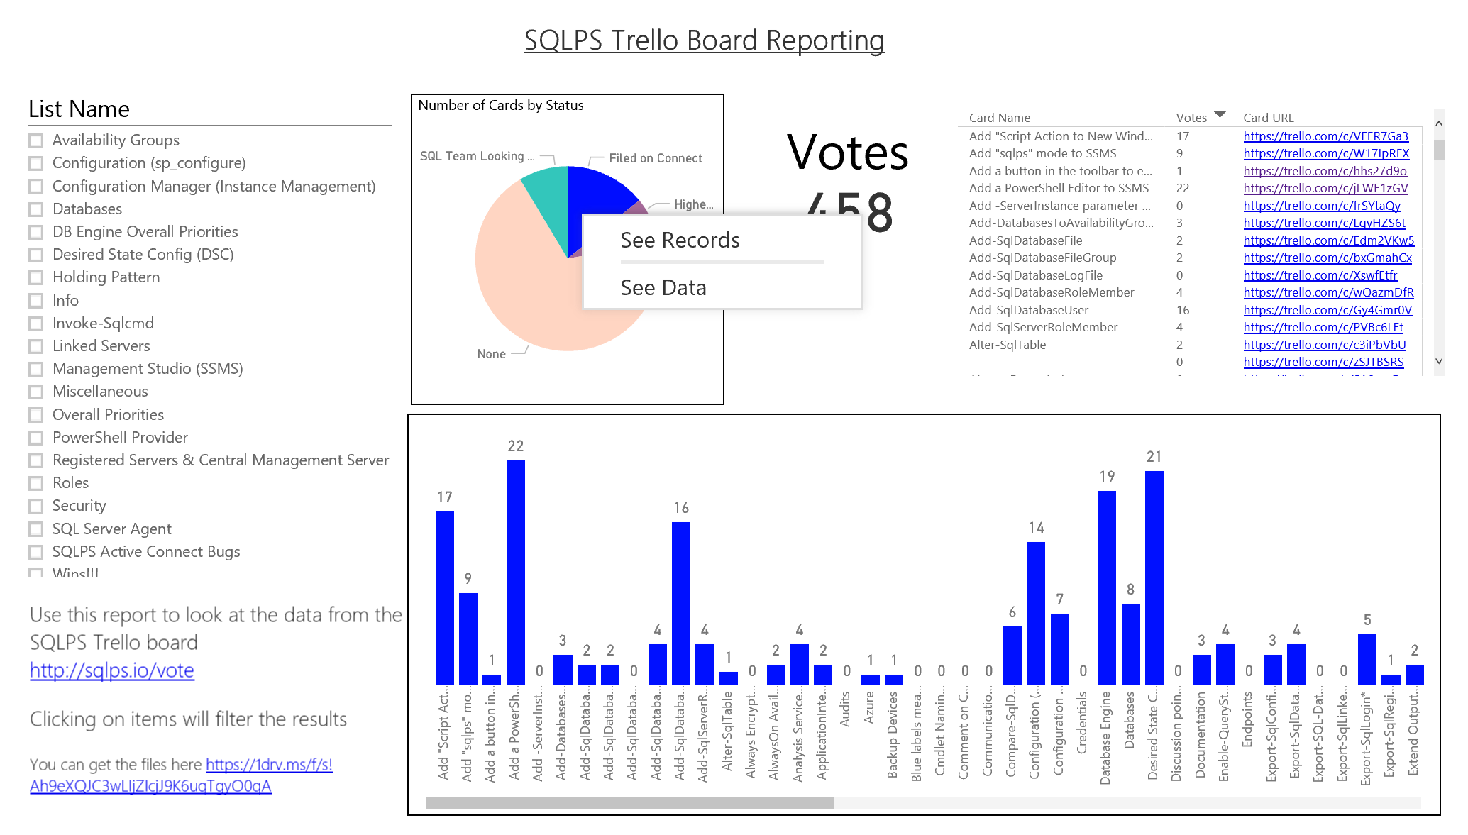
Trello Board
sqlps.io/vote
sqlps.io/reports
powershell.sqlpass.org | sqlps.io/vote | sqlps.io/youtube | sqlps.io/slack
Notes:
Introduce Trello board
Trello - please vote on the items you want next IE not the ones with Blue labels
Please add comments to the cards
If you have a suggestion for a new card Ask us or email powershell@sqlpass.org
Please click on the connect links and vote
WE will get connect items raised after each monthly SSMS drop – Microsoft handle it like this according to Ken @sqltoolsguy
This is a new experiment for us to improve the dialog with the community. So far it has been a powerful way for us to get a broad view of what is of interest to our users. (Special thanks to Chrissy and Aaron for getting this going…they are awesome!)
That's correct, that once an item gets enough interest on Trello a connect item gets created. All connect items are sync'd to our internal TFS server we use for tracking all our work. For each monthly release we budget time to take care of connect items. Engineers on the team then pick up as many connect items (based on vote count) they can get done and will work on getting them fixed for the next monthly update.
The connect item aspect is important for us as it is still a decent way for engineers to follow up directly with the submitter if they have questions on the actual issue or suggestion.
We have also set up some Power Bi reporting so that you can see the data (as we are all data folks) you can filter by list on the left, then filter by card below see how many votes it has and then click the link and go to the card in Trello and upvote them

Slide 10
Aaron’s Demo
Get-SqlDatabase -ServerInstance localhost | Backup-SqlDatabase
Get-SqlDatabase -ServerInstance localhost | Backup-SqlDatabase -CompressionOption On
Get-SqlDatabase -ServerInstance localhost | Where { $_.Name -ne 'tempdb' } |
Backup-SqlDatabase -CompressionOption On
powershell.sqlpass.org | sqlps.io/vote | sqlps.io/youtube | sqlps.io/slack

Slide 11
Lets just backup the ones we like
OGV with the –PassThru parameter is your friend
Let’s do that across multiple instances
powershell.sqlpass.org | sqlps.io/vote | sqlps.io/youtube | sqlps.io/slack

Slide 12

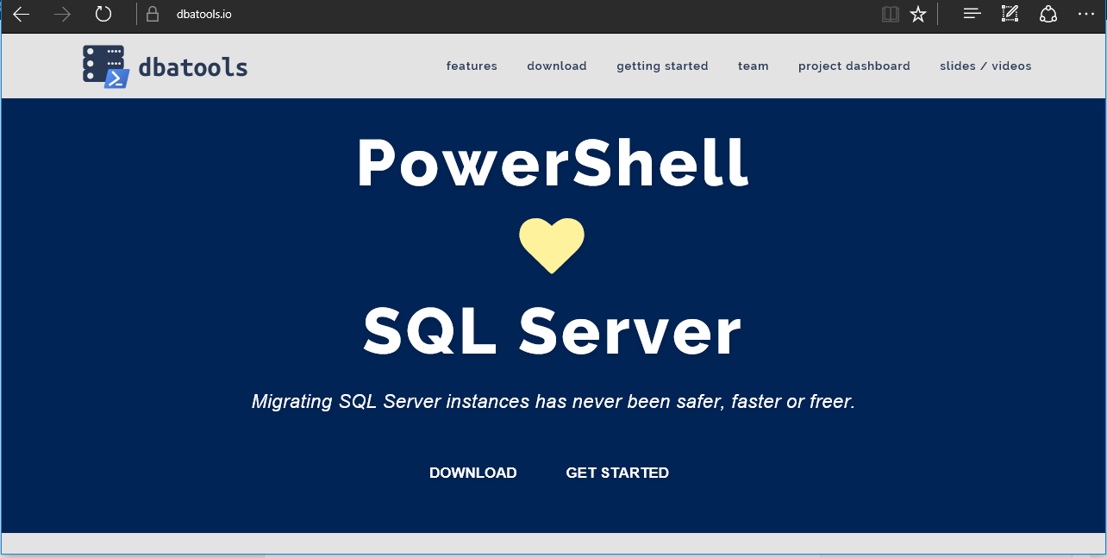
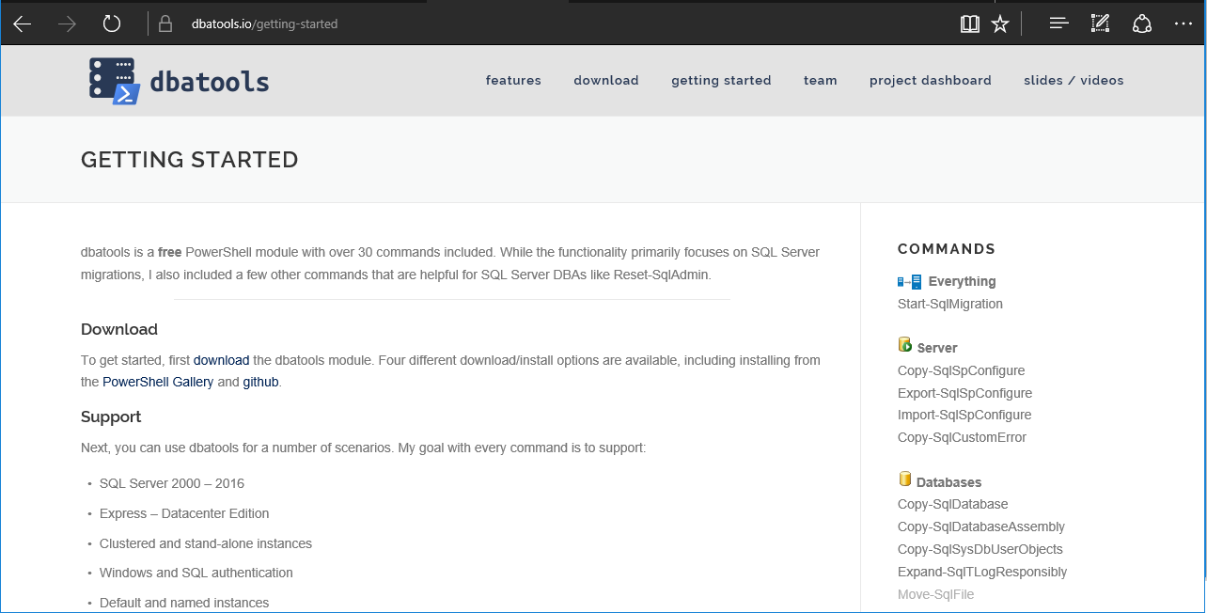
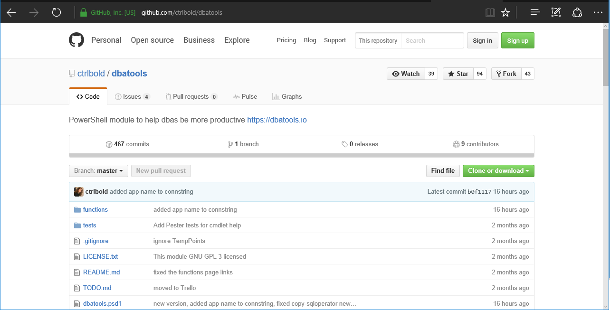
Chrissy’s Demo, dbatools
dbatools.io
powershell.sqlpass.org | sqlps.io/vote | sqlps.io/youtube | sqlps.io/slack
Notes:
As well as all of the new stuff, we wanted to show one example of using PowerShell within a useful real life solution to give you ideas of how YOU can use PowerShell
Chrissy is gonna migrate a SQL Server / SharePoint instance, update SQL Client alias, shut down old SQL Server and then show SharePoint is still running cuz the migration worked (This is a lightning session I had proposed, it takse less than 5 mins. Will have a video for it.)

Slide 13
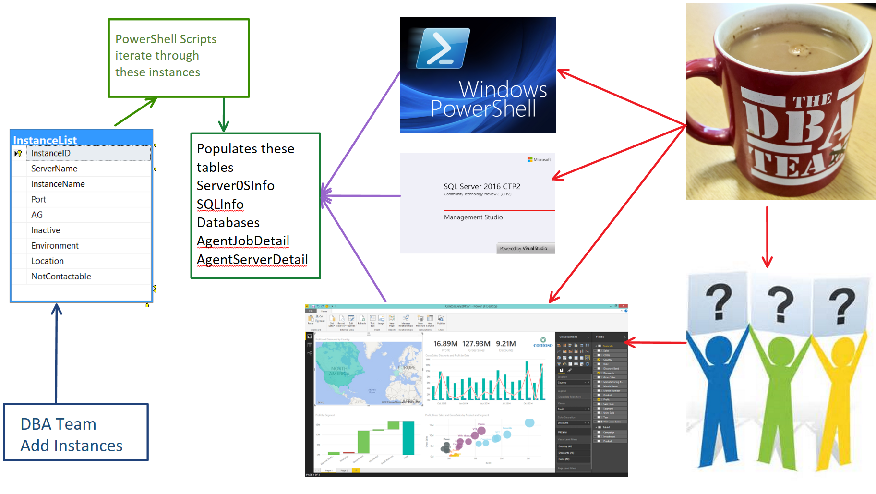
Rob’s Demo: A Solution Example
powershell.sqlpass.org | sqlps.io/vote | sqlps.io/youtube | sqlps.io/slack
Notes:
As well as all of the new stuff, we wanted to show one example of using PowerShell within a useful real life solution to give you ideas of how YOU can use PowerShell
Powershell scripts are set to run regularly against every instance in the InstanceList table and gather information and populate the tables. This enables a single pane of data and the PowerBi enables users to stop bothering the DBA and be confident that they are getting regularly updated data

Slide 14


Join our YouTube + SQL Community Slack
sqlps.io/youtube
sqlps.io/slack
powershell.sqlpass.org | sqlps.io/vote | sqlps.io/youtube | sqlps.io/slack
Notes:
Promote our webpage and YouTube channel (we'd love to hit 750 subscribers by July 15 ;D)

Slide 15

Questions
powershell.sqlpass.org | sqlps.io/vote | sqlps.io/youtube | sqlps.io/slack

