Slide 1

SQL PowerShell Past, Present & Future (and Community)
Aaron Nelson, Data Platform (SQL Server) MVP
Chrissy LeMaire, Cloud and Datacenter Management (PowerShell) MVP

Slide 2
Brief History of SQL Server + PowerShell
Notes:
Why is this significant

Slide 3
First Release - SQL Server 2008
August 2008
Minishell - SQLPS.exe
Snapin - SqlServerProviderSnapin100
5 commands + Provider
Invoke-SqlCmd
Invoke-PolicyEvaluation
Convert-UrnToPath
Encode-SqlName
Decode-SqlName

Slide 4
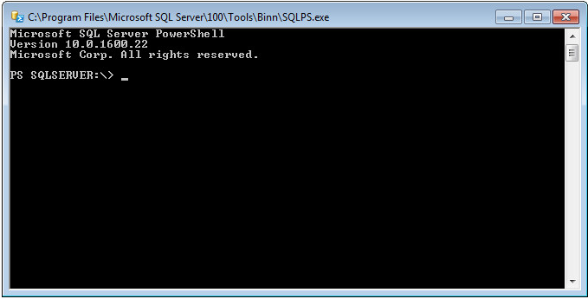
SQLPS.exe
Notes:
Minishell was restrictive and buggy. After public outcry, Jeffrey Snover let the community know it was per his suggestion.

Slide 5
Second Release - SQL Server 2012
April 2012
Module called SQLPS
33 total commands (28 new)
22 Availability Group commands
4 SQL Credential commands
2 Backup Restore Commands
New areas in the SQL Server Provider PS SQLSERVER:\> ———– SQL SQLPolicy SQLRegistration DataCollection XEvent Utility DAC IntegrationServices SQLAS
Notes:
44 Months

Slide 6
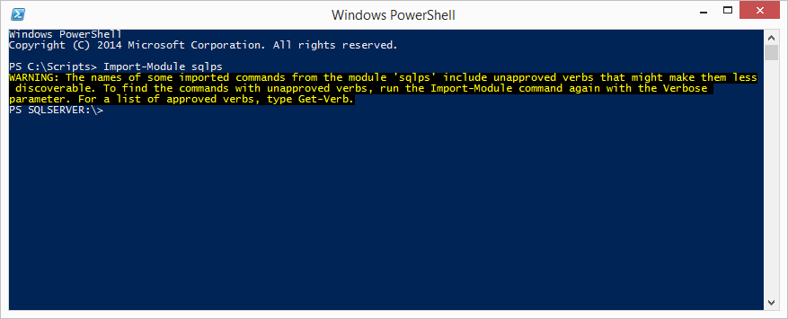
SQLPS Module

Slide 7
Third Release - SQL Server 2014
April 2014
45 total commands (12 new)
Firewall commands
4 Get commands (Database, Instance)
3 Set Commands
Start/Stop SQL instance
SQLSERVER:\DatabaseXEvent
Notes:
6 years into it and we’ve only got 45 commands
Add-SqlFirewallRule
Get-SqlCredential
Get-SqlDatabase
Get-SqlInstance
Get-SqlSmartAdmin
Remove-SqlFirewallRule
Set-SqlAuthenticationMode
Set-SqlNetworkConfiguration
Set-SqlSmartAdmin
Start-SqlInstance
Stop-SqlInstance
Test-SqlSmartAdmin

Slide 8
SQLPS Module

Slide 9
Issues persisted
Tab-completion didn’t work
Invoke-SqlCmd was buggy
-WhatIf actually performed commands
SQLPS was slow to load
SQLPS changed the directory unexpectedly
SQLPS used unapproved verbs
Other platforms offered 700+ cmdlets
Notes:
We were still stuck at 45

Slide 10







The SQL Community wasn’t happy with the module
Notes:
Responses ranged from sad to resigned to pissed.
Felt Microsoft was unresponsive. Commands were random and few. No basic commands. Bugs were never/rarely fixed.

Slide 11

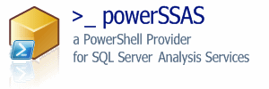

Community Response
PowerSSAS - 2007
SQLPSX - 2008
Get-SqlServer
Get-SqlDatabase
Get-SqlLogin
Get-SqlServerRole
75+ additional commands
SSRS PowerShell Provider - 2009
SPADE - 2011
Automated Installation Engine
dbatools - 2015
Migrations & Best Practices
Notes:
But these were still just filling in the gaps that were left by Microsoft’s neglect

Slide 12



2016 has been an amazing year!
Notes:
2016 changed everything

Slide 13

SQL Client Tools Renaissance
“A few years back the SQL organization needed many of the engineers in the team to go help on Azure SQL Database. This included many of us from the tools team which had obvious impact on our ability to do anything significant in the SQL Client Tools space as a whole. We have been reinvesting in the tools again and I get a chance to be a part of leading our SQL Client Tools Renaissance we have begun.”
Ken Van Hyning, Engineering Manager for SQL Server Client Tools and All-Around Hero
Notes:
Microsoft also became more open in communicating the issues
Ken explained that engineers were poached, and the SQL Tools were neglected

Slide 14
Everything’s changed
The SQL Server team hired a dedicated PowerShell engineer
Microsoft began taking Connect Items (suggestions + bug reports) seriously
SQLPS was renamed to SqlServer
Made it easier to do REGULAR RELEASES!
Initially these were monthly releases
But then they were doing two a month of SSMS
Working to separate from SSMS and go straight to the PowerShell Gallery

Slide 15
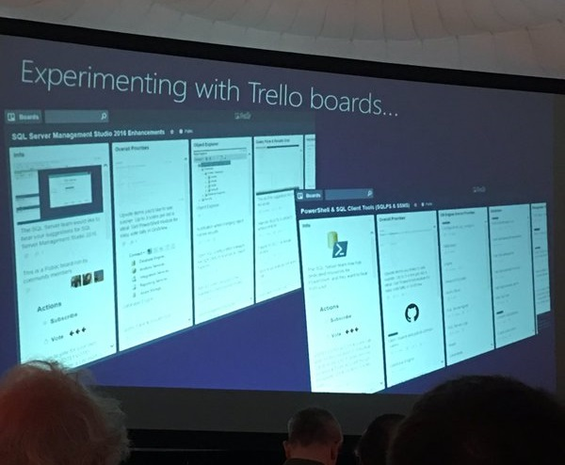
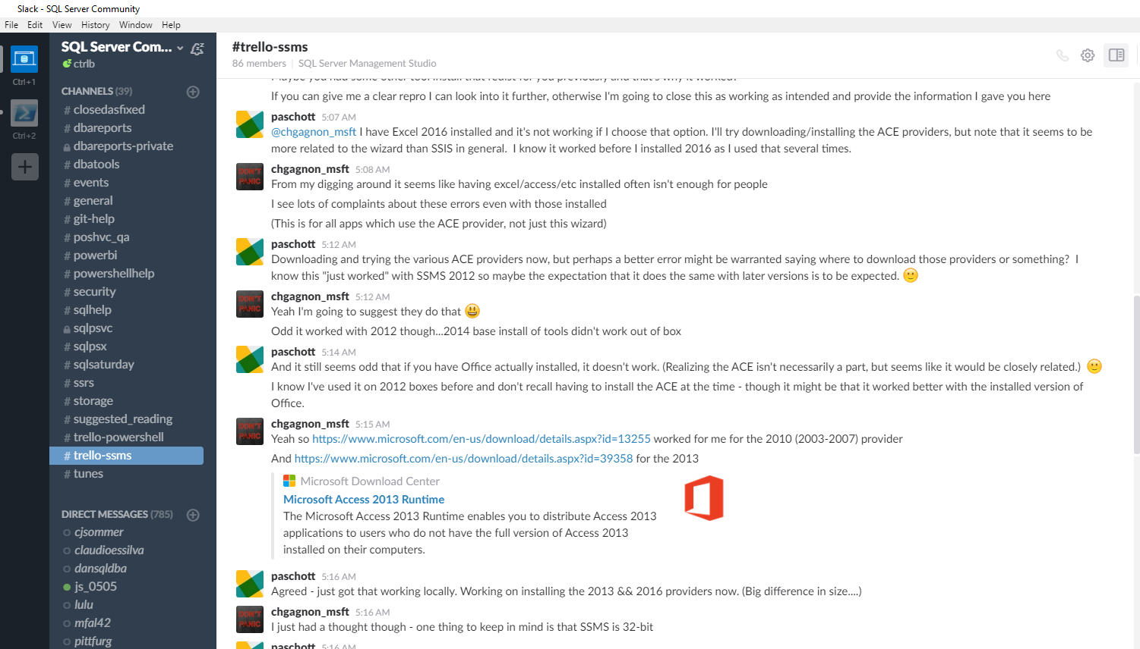
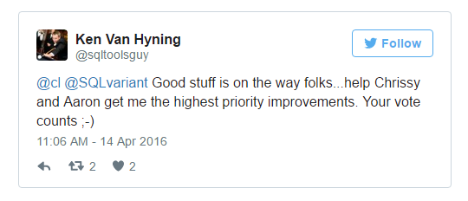
SQL Client Tools Renaissance
The SQL Server team began directly interacting with the community
SQL Community Trello boards - sqlps.io/vote & sqlps.io/ssms
SQL Community Slack - sqlps.io/slack
Twitter
The highest voted commands were created! Most talked about issues, fixed.
Notes:
Now the SQL team actually leads in community interaction, and other platform communities are asking their own Microsoft product group to use the SQL Server team’s approach as a model

Slide 16
So many new commands
New Name!
Import-Module SqlServer
Error Log
Get-SqlErrorLog
Set-SqlErrorLog
Always Encrypted
Add-SqlAzureAuthenticationContext
Add-SqlColumnEncryptionKeyValue
Complete-SqlColumnMasterKeyRotation
Get-SqlColumnEncryptionKey
Get-SqlColumnMasterKey
Invoke-SqlColumnMasterKeyRotation
New-SqlAzureKeyVaultColumnMasterKeySettings
New-SqlCngColumnMasterKeySettings
New-SqlColumnEncryptionKey
New-SqlColumnEncryptionKeyEncryptedValue
New-SqlColumnEncryptionSettings
New-SqlColumnMasterKey
New-SqlCspColumnMasterKeySettings
Remove-SqlColumnEncryptionKey
Remove-SqlColumnEncryptionKeyValue
Remove-SqlColumnMasterKey
Set-SqlColumnEncryption
Provider
WhatIf and Confirm now fully supported
SQL Server Agent
Get-SqlAgent
Get-SqlAgentJob
Get-SqlAgentJobHistory
Get-SqlAgentJobSchedule
Get-SqlAgentJobStep
Get-SqlAgentSchedule
Logins
Add-SqlLogin
Get-SqlLogin
Remove-SqlLogin
Invoke-Sqlcmd
-ConnectionString Parameter
-OutputAs (As) Parameter
Data
Read-SqlTableData Read-SqlViewData
Write-SqlTableData
Notes:
Company directive on the right
We have a total of 75 cmdlets, up from 45, and more being released regularly

Slide 17
So many new commands
New Name!
Import-Module SqlServer
Always Encrypted
Add-SqlAzureAuthenticationContext
Add-SqlColumnEncryptionKeyValue
Complete-SqlColumnMasterKeyRotation
Get-SqlColumnEncryptionKey
Get-SqlColumnMasterKey
Invoke-SqlColumnMasterKeyRotation
New-SqlAzureKeyVaultColumnMasterKeySettings
New-SqlCngColumnMasterKeySettings
New-SqlColumnEncryptionKey
New-SqlColumnEncryptionKeyEncryptedValue
New-SqlColumnEncryptionSettings
New-SqlColumnMasterKey
New-SqlCspColumnMasterKeySettings
Remove-SqlColumnEncryptionKey
Remove-SqlColumnEncryptionKeyValue
Remove-SqlColumnMasterKey
Set-SqlColumnEncryption
SQL Server Agent
Get-SqlAgent
Get-SqlAgentJob
Get-SqlAgentJobHistory
Get-SqlAgentJobSchedule
Get-SqlAgentJobStep
Get-SqlAgentSchedule
Error Log
Get-SqlErrorLog
Set-SqlErrorLog
Invoke-Sqlcmd
-ConnectionString Parameter
-OutputAs (As) Parameter
Provider
WhatIf and Confirm now fully supported
Notes:
Company directive on the right
We have a total of 75 cmdlets, up from 45, and more being released regularly

Slide 18
Join us!
sqlps.io/vote – SQL PowerShell Cmdlet Design & Voting
sqlps.io/ssms – SQL Management Studio Improvements
sqlps.io/slack – SQL Community Slack
#trello-powershell
#trello-ssms
#sqlpsx
#dbatools
#dbareports
#closedasfixed
@closedasfixed – Twitter
Open source Twitter bot powered by PowerShell
chrissy lemaire, mvp: netnerds.net, @cl code: dbatools.io
Notes:
Celebrating Microsoft SQL Server Connect Bugs and Suggestions recently marked Resolved or Closed as Fixed.

