Slide 1

ESCUELA SUPERIOR POLITECNICA DE CHIMBORAZO FACULTAD DE INFORMATICA Y ELECTRONICA ESCUELA DE INGENIERIA EN SISTEMAS
GRAFOS
Nombre: Claudio Pilataxi
Código: 6042

Slide 2
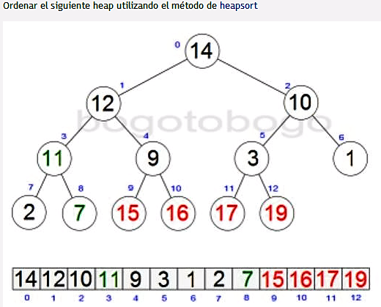
7
12
10
11
9
3
1
2
14
15
16
17
19
7 | 12 | 10 | 11 | 9 | 3 | 1 | 2 | 14 | 15 | 16 | 17 | 19

Slide 3
12
2
11
10
11
10
7
9
3
1
7
9
3
1
2
14
15
16
17
19
12
14
15
16
17
19
12 | 11 | 10 | 7 | 9 | 3 | 1 | 2 | 14 | 15 | 16 | 17 | 19
2 | 11 | 10 | 7 | 9 | 3 | 1 | 12 | 14 | 15 | 16 | 17 | 19

Slide 4
11
1
9
10
9
10
7
2
3
1
7
2
3
11
12
14
15
16
17
19
12
14
15
16
17
19
11 | 9 | 10 | 7 | 2 | 3 | 1 | 12 | 14 | 15 | 16 | 17 | 19
1 | 9 | 10 | 7 | 2 | 3 | 11 | 12 | 14 | 15 | 16 | 17 | 19

Slide 5
10
1
9
3
9
3
7
2
1
7
2
10
11
11
12
14
15
16
17
19
12
14
15
16
17
19
10 | 9 | 3 | 7 | 2 | 1 | 11 | 12 | 14 | 15 | 16 | 17 | 19
1 | 9 | 3 | 7 | 2 | 10 | 11 | 12 | 14 | 15 | 16 | 17 | 19

Slide 6
9
2
7
3
7
3
1
2
1
9
10
11
10
11
12
14
15
16
17
19
12
14
15
16
17
19
9 | 7 | 3 | 1 | 2 | 10 | 11 | 12 | 14 | 15 | 16 | 17 | 19
2 | 7 | 3 | 1 | 9 | 10 | 11 | 12 | 14 | 15 | 16 | 17 | 19

Slide 7
7
1
2
3
2
3
1
7
9
10
11
9
10
11
12
14
15
16
17
19
12
14
15
16
17
19
7 | 2 | 3 | 1 | 9 | 10 | 11 | 12 | 14 | 15 | 16 | 17 | 19
1 | 2 | 3 | 7 | 9 | 10 | 11 | 12 | 14 | 15 | 16 | 17 | 19

Slide 8
3
1
2
1
2
3
7
9
10
11
7
9
10
11
12
14
15
16
17
19
12
14
15
16
17
19
3 | 2 | 1 | 7 | 9 | 10 | 11 | 12 | 14 | 15 | 16 | 17 | 19
1 | 2 | 3 | 7 | 9 | 10 | 11 | 12 | 14 | 15 | 16 | 17 | 19

Slide 9
1
1
2
3
2
3
7
9
10
11
7
9
10
11
12
14
15
16
17
19
12
14
15
16
17
19
1 | 2 | 3 | 7 | 9 | 10 | 11 | 12 | 14 | 15 | 16 | 17 | 19
1 | 2 | 3 | 7 | 9 | 10 | 11 | 12 | 14 | 15 | 16 | 17 | 19

