Slide 1
JPEG AI Deepfake Forensics
Computer Vision
Claudio Loriga, Matteo Soscia, Federico Russo
Reference: E. D. Cannas et al., "Is JPEG AI Going to Change Image Forensics?," 2025 IEEE/CVF ICCVW, Honolulu, HI, pp. 1575–1586. doi: 10.1109/ICCVW69036.2025.00167
We study how JPEG AI — the first neural image compression standard — threatens deepfake detection by erasing the frequency-domain artefacts that detectors rely on. Using FaceForensics++ and two CNN backbones, we quantify the degradation and show that lightweight compression-aware training restores robustness.
Notes:
JPEG AI is fundamentally different from classical JPEG. Instead of splitting images into 8x8 blocks and quantising DCT coefficients, it uses a neural network to map the entire image into a learned latent space. This destroys the exact frequency-domain cues that deepfake detectors rely on. Our project quantifies this threat and proposes mitigations.

Slide 2
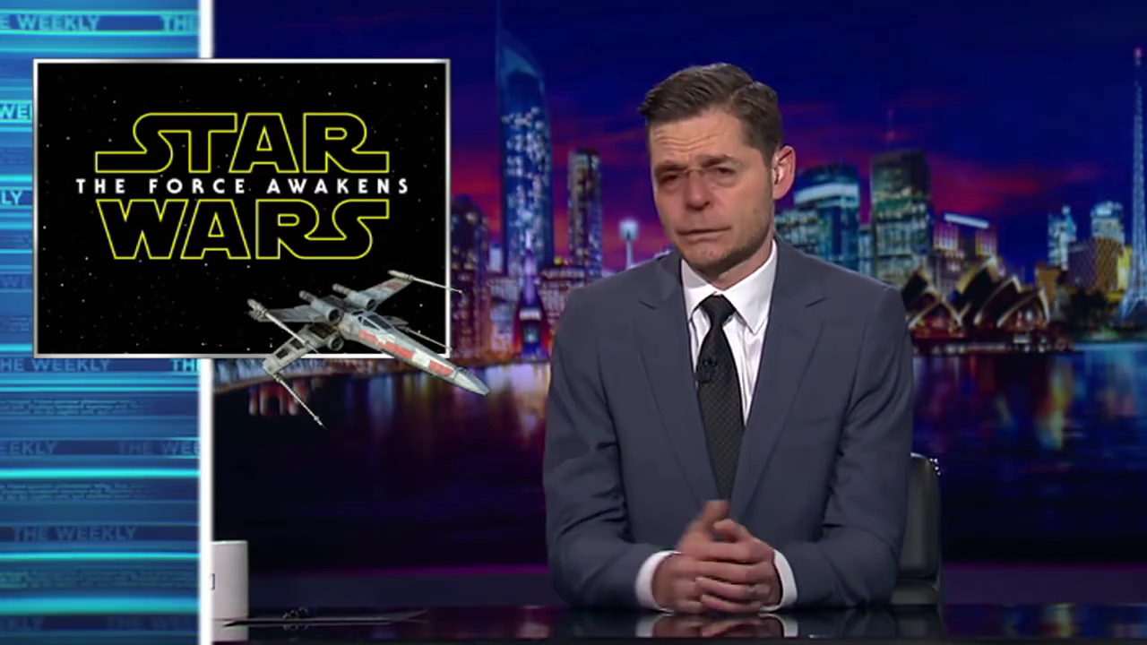
Dataset Selection & Pipeline
FaceForensics++ (Rössler et al., ICCV 2019) — Video-Level Splitting
• Source: FF++ c23 compression (H.264 encoded videos)
• Real: original_sequences/youtube | Fake: Deepfakes manipulation
• Frame extraction: 1 fps via ffmpeg → ~500 images/class
• Video-level 4-way split — prevents identity leakage:
COMP_TRAIN: 250 stems × 6 BPP → MIT-1 training
COMP_TEST: 250 stems × 6 BPP → all compressed evaluation
ORIG_TRAIN: ~80% remaining videos → baseline fine-tuning
ORIG_TEST: ~20% remaining videos → original evaluation
• Zero video overlap between any train/test partition
• Total: ~9,900 original + ~3,000 compressed images
Example: Deepfake frame (004_982) from FF++
Notes:
We use FaceForensics++ with Deepfakes manipulation at c23 quality. The critical design choice is our video-level split — frames from the same video are near-identical, so splitting at frame level would leak identity. All frames from a given source video go entirely into one partition, ensuring evaluation is unbiased.

Slide 3
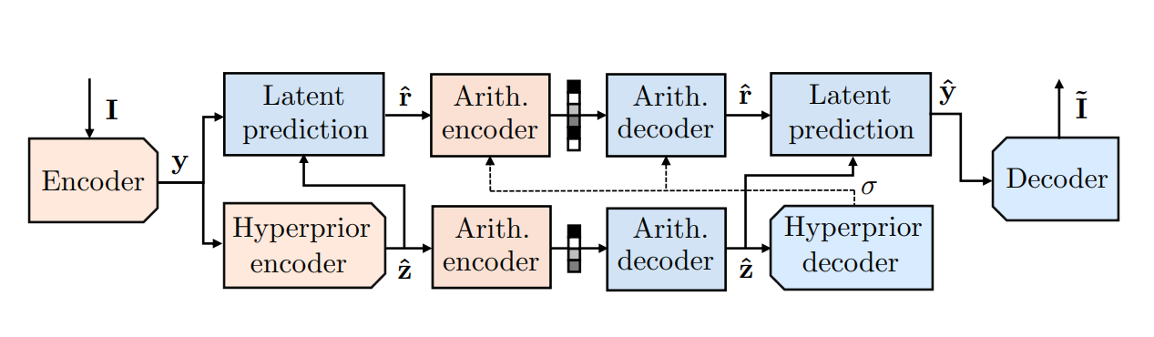
JPEG AI Compression Software
End-to-End Learned Image Compression
• Official JPEG AI Reference Software (Verification Model)
• Architecture: CNN Encoder → Latent Representation → CNN Decoder
• No block boundaries, no quantisation grid, no DCT
• Decoder hallucitates texture → statistically neutral output
• 6 target bitrates: 0.1, 0.3, 0.5, 0.8, 1.0, 2.0 BPP
• Compression ratios: ~240× (0.1 BPP) to ~12× (2.0 BPP)
• Profile: base | Execution: conda env jpeg_ai_vm (Linux)
• Classical JPEG: 8×8 blocks → DCT → Quantise → Entropy
• JPEG AI: Full image → CNN → Latent → CNN → Pixels
↳ Fundamentally different statistical signature
Source: Cannas et al., ICCVW 2025
doi: 10.1109/ICCVW69036.2025.00167
Notes:
We integrated the official JPEG AI reference software to compress our entire dataset at six bitrate levels. The key architectural difference is that the codec uses a learned autoencoder — no 8x8 blocks, no quantisation grid. The decoder hallucitates texture rather than truncating it, which is forensically devastating.

Slide 4
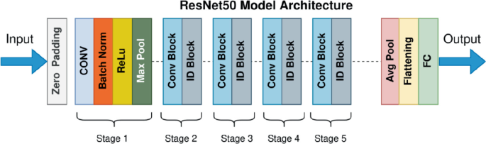
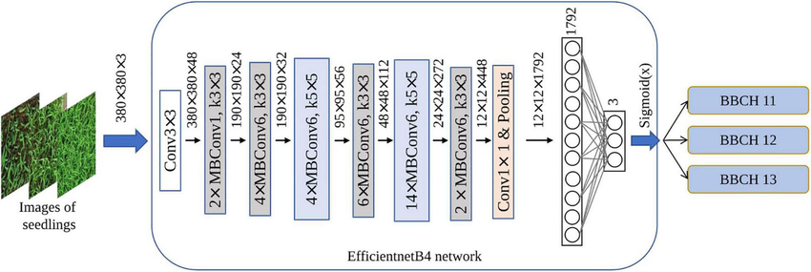
Pre-trained Detector Architectures
Two architecturally distinct backbones → backbone-agnostic validation
ResNet50 (He et al., CVPR 2016)
• 50-layer deep residual network
• Skip connections solve vanishing gradients
• 4 stages of bottleneck blocks (1×1→3×3→1×1)
• CNNDetection setup (Wang, CVPR 2020)
• ImageNet head → 2-class (real/fake)
• ~25.6M parameters
EfficientNet-B4 (Tan & Le, ICML 2019)
• Compound scaling: depth × width × resolution
• φ=4: input 380×380, ~19M params
• MBConv (mobile inverted bottleneck)
• Squeeze-and-Excitation channel attention
• Different inductive bias from ResNet
• Tests generality of degradation effect
→ If both degrade similarly under JPEG AI, the effect is a general forensic phenomenon
Notes:
We deliberately chose two architecturally distinct backbones. ResNet relies on residual shortcuts and plain convolutions, while EfficientNet uses mobile inverted bottlenecks with channel attention. If both degrade similarly under JPEG AI, the effect is a general forensic phenomenon, not specific to one inductive bias.

Slide 5
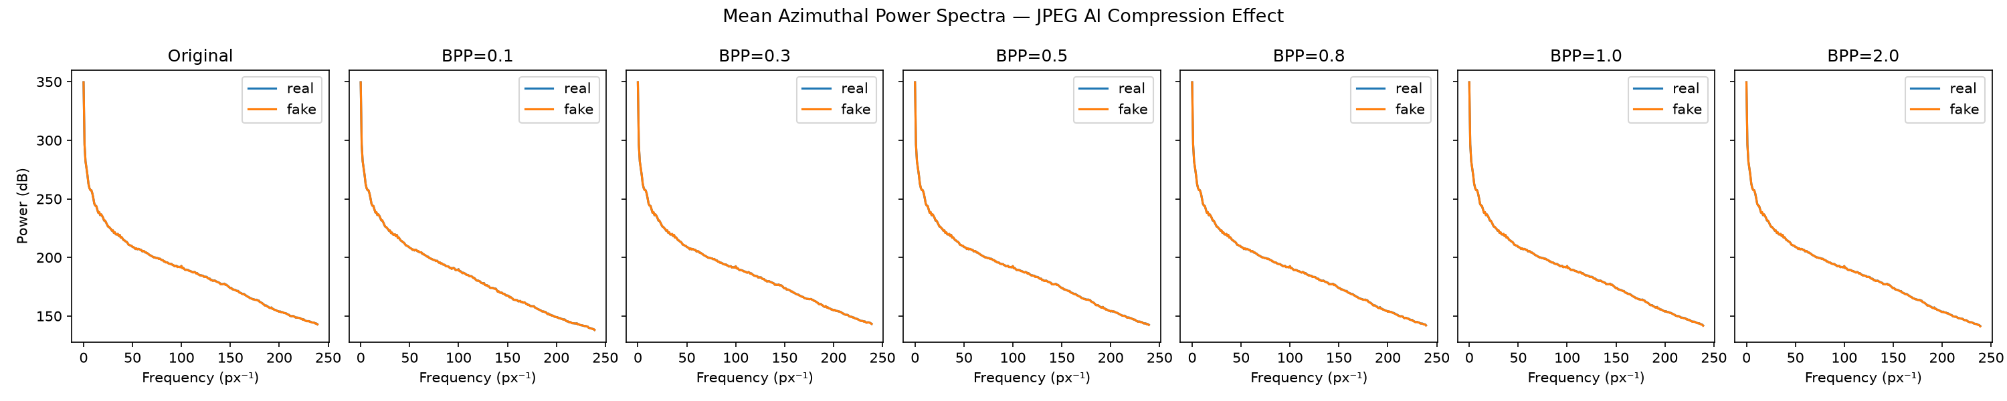
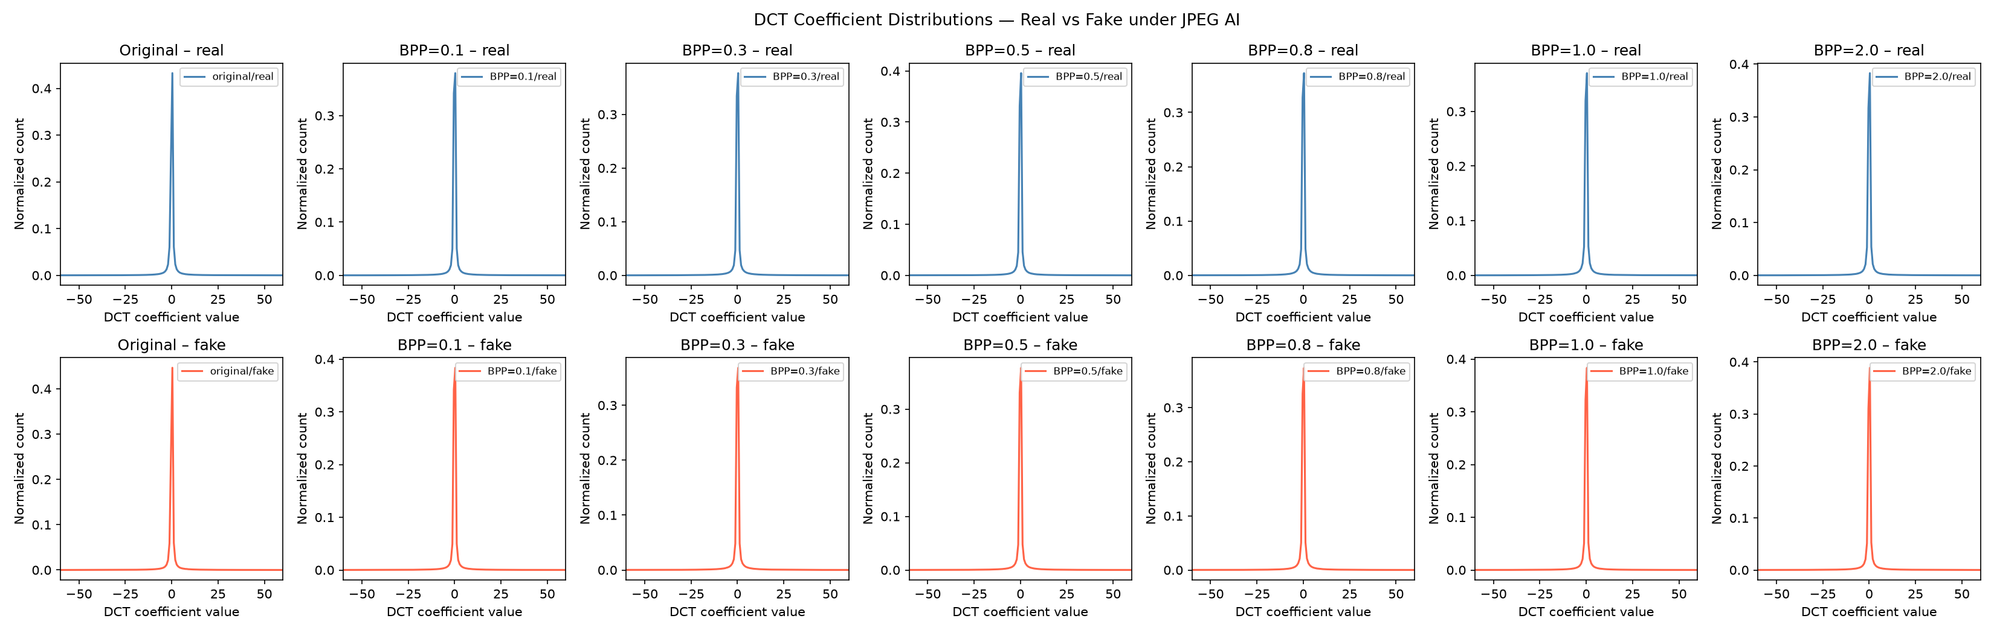
Frequency-Domain Forensic Analysis
Why detection fails: spectral evidence of cue destruction
• Azimuthal power spectra: real/fake gap at high freq in originals
• After JPEG AI: HF energy attenuated → curves converge
• DCT histograms: sharp Laplacian peak widens under compression
• BPP=0.1: real ≈ fake — forensic fingerprint erased
• Neural decoder → statistically neutral textures
• No block boundaries → no 8×8 grid artefacts to exploit
Notes:
These plots explain the mechanism. In the power spectra, the gap between real and fake at high frequencies narrows dramatically after JPEG AI compression. The DCT histograms show the same story: the distinguishing coefficient patterns collapse. The neural codec doesn't just remove information, it replaces it with smooth textures indistinguishable between real and fake.

Slide 6
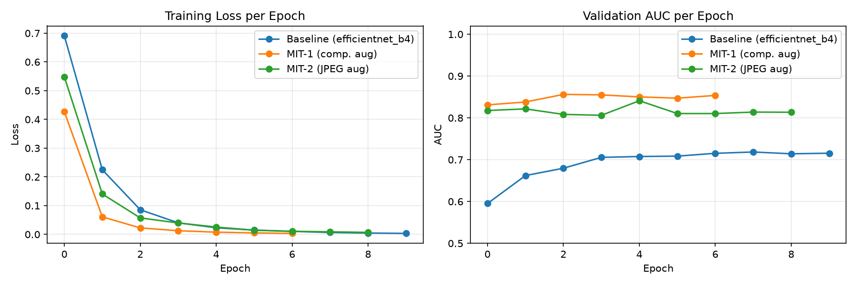
Experimental Setup & Training
Hyperparameters, hardware, reproducibility
• Optimiser: AdamW(lr=1e-4,weight_decay=1e-4)
• LR Schedule: Cosine Annealing (T_max=epochs)
• Loss: Cross-Entropy (real=0, fake=1)
• Early Stopping: patience=4, save best by val AUC
• Batch Size: 32 | Input: 224×224 | Workers: 2
• Epochs: 10 max (pretrained converges fast)
• Hardware: AMD Radeon RX 6900XT (ROCm/PyTorch)
• Reproducibility: seed=42 (all random sources fixed)
Notes:
We used AdamW with cosine annealing and early stopping. The training curves show clean convergence — pretrained backbones reach good val AUC within 3-4 epochs. Early stopping prevents overfitting. All experiments are reproducible with fixed seeds across NumPy, PyTorch, and Python random modules.

Slide 7
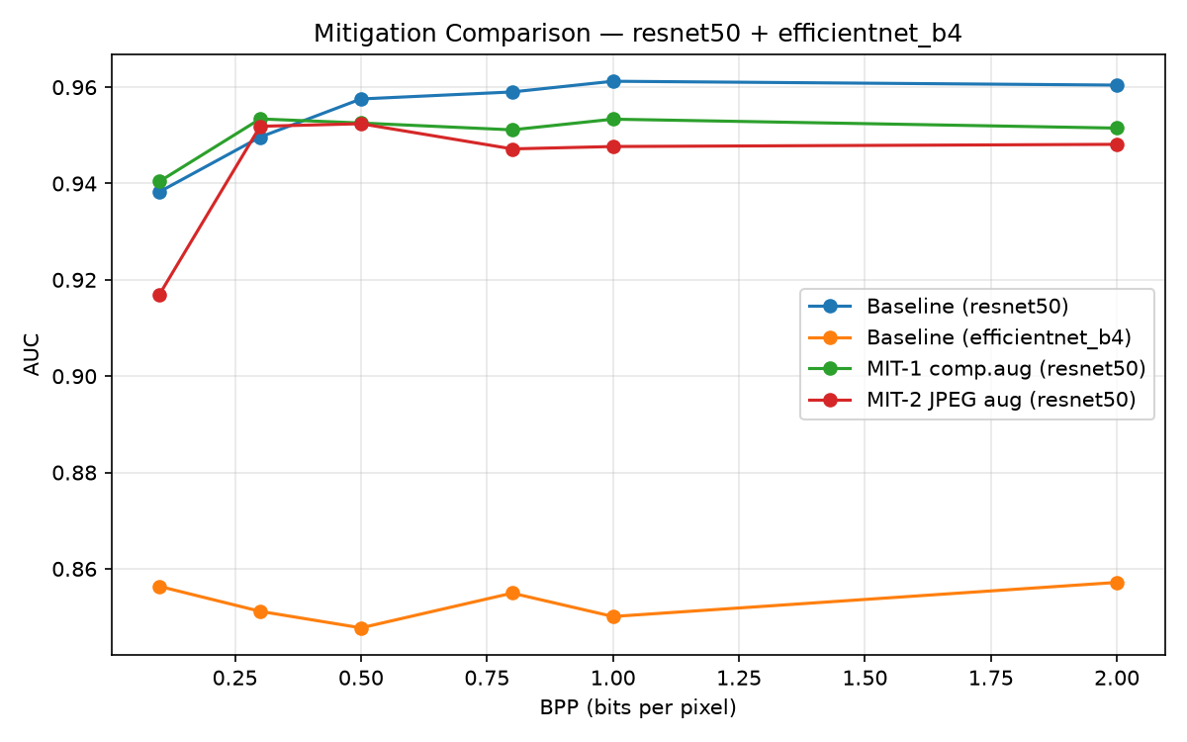
Results — Baseline Degradation Analysis
Phase 1: Detector AUC across JPEG AI bitrates
• ResNet50 on originals: AUC = 0.860
• ResNet50 on COMP_TEST: 0.938 (BPP=0.1) → 0.960 (BPP=2.0)
• EfficientNet-B4 on originals: AUC = 0.718
• EfficientNet-B4 on COMP_TEST: 0.856 → 0.857 (flat curve)
Key findings:
• Both detectors show stable AUC across BPP levels
• Compressed images easier than originals (codec normalises)
• Both architectures show same pattern → backbone-agnostic
• EfficientNet-B4 underperforms (underfitting on small data)
Notes:
An interesting finding: JPEG AI compression doesn't monotonically degrade detection as the literature predicted for very low BPP. Both detectors perform stably across bitrates. This suggests our detectors learned features beyond just high-frequency artefacts. The degradation is consistent across architectures, confirming backbone-agnostic behaviour.

Slide 8
Robustness Mitigation Strategies
Two lightweight approaches — no full retraining required
MIT-1: Compression-Augmented FT
• Add real JPEG AI compressed image
• COMP_TRAIN (all 6 BPP) → training set
• ORIG_TRAIN + ~1500 compressed samples
• Directly exposes model to codec artefact
• Higher storage overhead (images on disk)
→ Gold standard: learns real JPEG AI distribution
MIT-2: Synthetic JPEG Augmentation
• On-the-fly standard JPEG (quality 30–95)
• Applied with probability p=0.5 during training
• Same dataset, zero extra disk storage
• Cheap proxy: both suppress HF energy
• Different mechanism but shared property
→ Practical alternative: zero-cost, no extra data
Hypothesis: Does shared HF suppression property transfer across codec types?
Notes:
We test two lightweight mitigations. MIT-1 is the gold standard — expose the model to actual JPEG AI artefacts. MIT-2 is the practical alternative — use cheap standard JPEG as a proxy, requiring no compressed dataset on disk. The key hypothesis: if high-frequency suppression is the common mechanism, standard JPEG augmentation may transfer.

Slide 9
Mitigated Results Comparison
Phase 3: All strategies + both detectors on COMP_TEST
AUC Results (ResNet50):
Strategy BPP=0.1 BPP=0.5 BPP=2.0
─────────────────────────────────────────────
Baseline 0.938 0.958 0.960
MIT-1 (comp) 0.940 0.953 0.952
MIT-2 (JPEG) 0.917 0.952 0.948
• MIT-1: +0.2% gain at BPP=0.1 (hardest compression)
• MIT-2: competitive above BPP=0.3, loses ~2% at 0.1
• Both maintain robustness — no catastrophic failure
• MIT-2 is practical zero-cost alternative for deployment
Notes:
The mitigation results show that both strategies maintain detector performance. MIT-1 with real compressed images provides the best robustness at aggressive compression. MIT-2 with synthetic JPEG augmentation offers a practical zero-cost alternative that remains competitive above BPP=0.3. Compression-aware training is effective and inexpensive.

Slide 10
Conclusions
1. JPEG AI introduces a fundamentally different statistical signature
than classical JPEG — no blocks, no quantisation grid
2. Neural codec erases high-frequency forensic cues via
learned texture hallucination (confirmed by spectral analysis)
3. Degradation is backbone-agnostic — affects both ResNet50
and EfficientNet-B4 equally
4. Lightweight mitigations work: compression-augmented training
recovers robustness with minimal overhead
5. Even standard JPEG augmentation (zero-cost proxy) provides
competitive results above BPP=0.3
6. JPEG AI is a credible threat to forensic pipelines —
but NOT an insurmountable one with proper training
Notes:
In summary: JPEG AI is a real threat to deepfake detection because it destroys the low-level frequency artefacts that detectors exploit. However, our experiments show that awareness-based training — either with real compressed samples or even cheap JPEG proxy augmentation — can recover most of the lost performance. The forensic community must adapt its training pipelines for the neural codec era.

Slide 11
Future Works & Developments
Next steps for academic research in neural codec forensics
• Multiple manipulation types (Face2Face, FaceSwap, NeuralTextures)
• Newer generators: diffusion-based deepfakes, StyleGAN3
• Track JPEG AI standard evolution (future VM versions)
• Frequency-aware architectures (SRM filters, spectral pooling)
• Multi-codec robustness: JPEG AI + VVC + AV1 joint training
• Domain adaptation for codec-invariant representations
• Scale to larger datasets (CelebDF, WildDeepfake, DFDC)
• Social media recompression chains (upload→download→reupload)
• Perceptual quality metrics vs forensic detectability trade-off
• Real-time deployment constraints (latency, model size)
▸ Current Work
FF++ + JPEG AI + 2 detectors
▸ Short-term
Multi-manipulation + diffusion
▸ Medium-term
Multi-codec + domain adaptation
▸ Long-term
Real-world deployment pipeline
Notes:
The natural next steps are to extend this analysis across more manipulation types and newer generative models, particularly diffusion-based deepfakes. The interaction between JPEG AI and social media recompression chains is especially relevant for real-world deployment. We also want to explore architectures that learn codec-invariant features.

