Slide 1

MATH 331
Ordinary Differential Equations
Claudio Mirabella
Example lecture · 2026
01. Modelling with ODEs
Notes:
Timing plan for 20 minutes (in brackets on every slide). [0:20] Introduce yourself and the topic. Sources: MATH 331 lecture plan; course text J. Lebl, Notes on Diffy Qs (primary source for every definition, theorem and example in the deck).

Slide 2
Outline
I
II
III
IV
Foundations
First-order models
Numerical methods
Second-order linear
From Newton to modern science
Definitions, solutions
Intervals, existence, uniqueness
Separation of variables
Growth, decay, logistic
Equilibria and stability
Euler’s method
Order of accuracy
Pitfalls
Wronskian, Abel’s theorem
Characteristic equation
Mass–spring–damper
Thread: a differential equation is a law of change; together with an initial condition it predicts the future.
2
Notes:
[0:30] Four parts, one thread. Part I: what an ODE is, where the idea comes from (Newton), and when a solution exists. Part II: three classical models solved with pen and paper. Part III: what to do when pen and paper fail. Part IV: a first look at second-order linear equations, the language of vibrations. The thread is the sentence at the bottom.

Slide 3
Section I
Foundations
What is an ODE, and when does it have a solution?
Newton · definitions · intervals · existence and uniqueness
01. Modelling with ODEs
Notes:
[0:10] Part I: the ideas we need before solving anything.

Slide 4
From Newton to modern science
Newton’s second law is a differential equation. In the Principia (1687) the motion of a body becomes the solution of an initial value problem: position and velocity now determine the whole future.
$$m x″\left(t\right)=F\left(t,x,x′\right), x\left(t_{0}\right)=x_{0}, x′\left(t_{0}\right)=v_{0}$$
1671 · 1687
1684 · 1695
1743 · 1768
1820s – 1890
1881 – 1892
1895 – today
Newton
fluxions; laws of motion; Kepler’s orbits derived
Leibniz, the Bernoullis
dy/dx; separation of variables; Bernoulli’s equation
Euler
e^{rt} and the characteristic equation; Euler’s method
Cauchy, Lipschitz, Picard
existence and uniqueness theorems
Poincaré, Lyapunov
qualitative theory: phase plane, stability
Runge, Kutta, computers
numerical solution, chaos, modern dynamics
4
Notes:
[1:30] This is the key historical message. Newton's second law is a differential equation: the acceleration, a second derivative, is prescribed by the forces. With the Principia (1687) the motion of a body became the solution of an initial value problem: position and velocity now determine the whole future. Deriving Kepler's elliptical orbits from the inverse-square law was the first triumph of the method. Everything else in the timeline grew from this: Leibniz's notation and separation of variables, Euler's methods for linear equations and his numerical method, the existence theory of Cauchy, Lipschitz and Picard, Poincaré's qualitative theory, and the numerical methods that run on computers today. Lebl, §0.2: the laws of physics are generally written as differential equations.

Slide 5
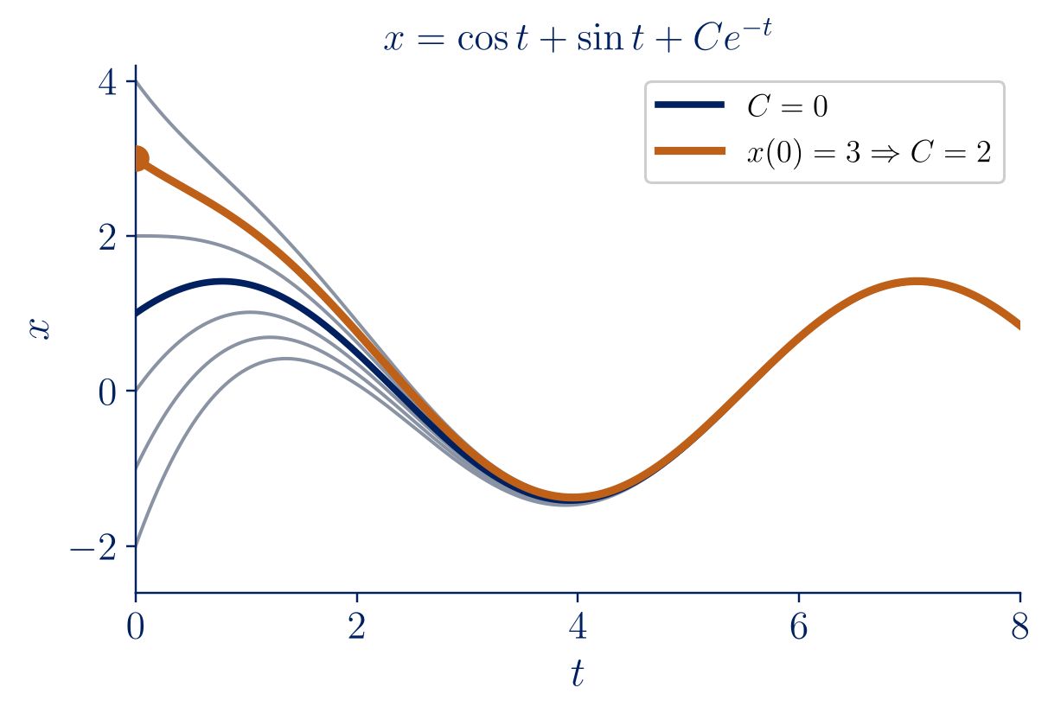
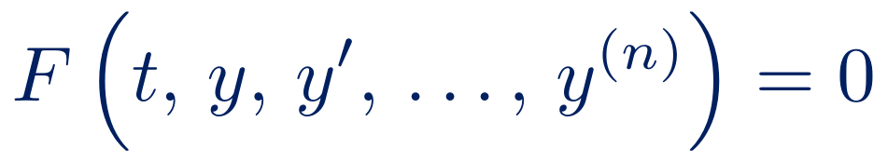
What is a differential equation?
An ordinary differential equation (ODE) relates an unknown function y(t) to its derivatives:
$$F\left(t, y, y′, …, y^{\left(n\right)}\right)=0$$
An ODE is a law of change: it prescribes how a quantity evolves, not what it is.
Order: the highest derivative that appears.
Linear: y, y′, …, y^{(n)} appear only to the first power.
Solution: a function that satisfies the equation on an interval I.
General solution: a family with one constant per order; an initial condition selects one member.
Lebl §0.2: x′ + x = 2 cos t
$$x=cost+sint+C e^{−t} ⇒ x′+x=2cost ∀ C$$
Check by substitution — the first habit of this course.
5
Notes:
[1:15] An ODE relates an unknown function to its derivatives. Stress the orange sentence: an ODE tells how a quantity changes, not what it is. A solution is a function, defined on an interval, that makes the equation an identity — keep the word interval in mind for the next slides. Lebl's first example (§0.2): x′ + x = 2 cos t. Check x = cos t + sin t by substitution; adding C e^(−t) still works, so there is a whole family of solutions, the general solution. One constant for a first-order equation; the initial condition selects the particular solution (orange curve).

Slide 6
ODEs across the disciplines
Mechanics
m x″ = F(t, x, x′)
Newton’s second law
Electrical circuits
L Q″ + R Q′ + Q/C = E(t)
series RLC circuit
Nuclear physics
N′ = −λ N
radioactive decay
Population dynamics
P′ = k P (1 − P/K)
logistic growth
Heat transfer
T′ = −k (T − T_{a})
Newton’s law of cooling
Epidemiology
S′ = −βSI, I′ = βSI − γI
SIR model (a system of ODEs)
“The laws of physics are generally written down as differential equations.” — Lebl, §0.2.1
Same mathematics, different letters: applied science talks through ODEs.
6
Notes:
[0:45] Go quickly: the same mathematical object appears everywhere. Point at the RLC circuit and the mechanics card: same structure, as we will see in Part IV. Read Lebl's sentence at the bottom.

Slide 7
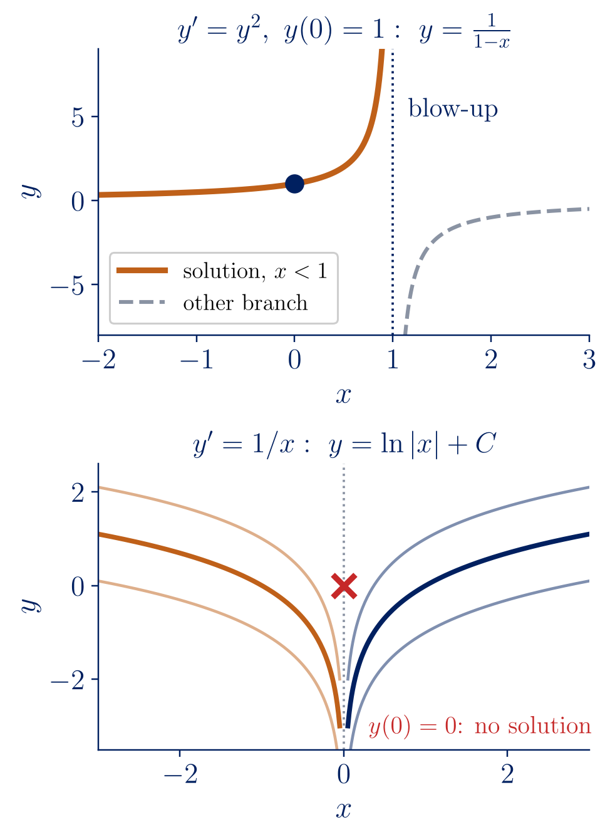
Solutions live on intervals
A solution is a differentiable function on an interval I: the interval is part of the answer.
Lebl, Ex. 1.2.3: y′ = y², y(0) = 1 gives y = 1/(1 − x), valid only on (−∞, 1). The equation is harmless everywhere, yet the solution blows up at x = 1; the branch x > 1 is a different solution.
Lebl, Ex. 1.2.1: y′ = 1/x, y(0) = 0 has no solution: ln|x| + C lives on x < 0 or on x > 0, never across 0.
Interval of existence: the largest interval containing x₀ on which the solution is defined.
Linear versus nonlinear (Lebl §1.4)
y′ + p(x) y = f(x) with p, f continuous on (a, b): the solution exists on all of (a, b).
Nonlinear: existence is only local; y = 1/(A − x) blows up at x = A, so the interval depends on the initial condition.
7
Notes:
[1:15] A point that is easy to overlook, and that Tenenbaum and Pollard insist on: a solution is a function on an interval, and the interval is part of the answer. Lebl Example 1.2.3: y′ = y² looks perfectly harmless, yet the solution with y(0) = 1 is 1/(1 − x) and blows up at x = 1. The formula also makes sense for x > 1, but that branch is a different solution that cannot be reached from y(0) = 1. Lebl Example 1.2.1: y′ = 1/x with y(0) = 0 has no solution at all. Contrast with linear equations (Lebl §1.4): if the coefficients are continuous on an interval, the solution exists on the whole interval. For nonlinear equations existence is only local, and the interval depends on the data.

Slide 8
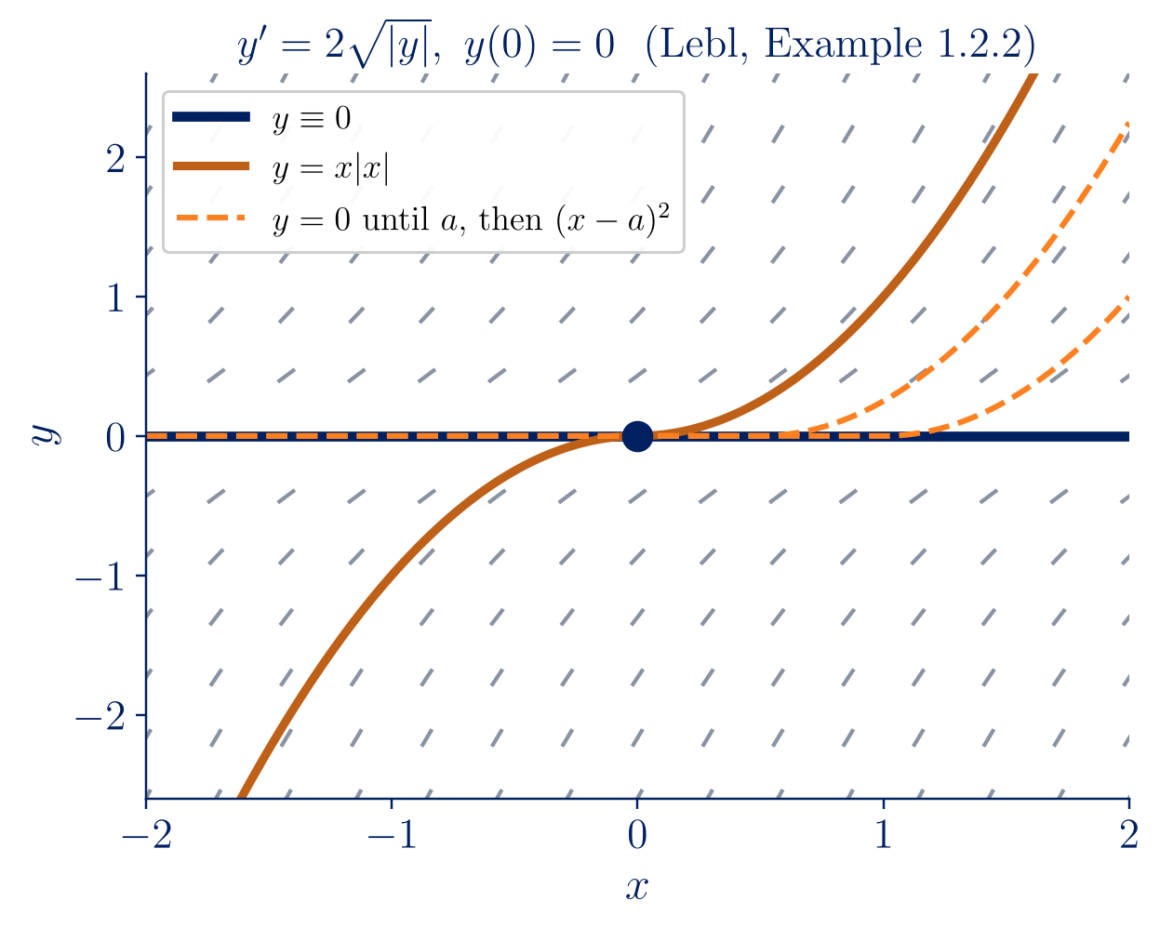
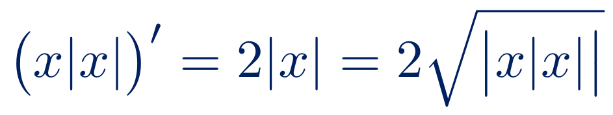
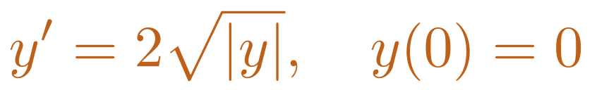
Existence and uniqueness
Theorem (Picard; Lebl, Thm 1.2.1). If f(x, y) is continuous and ∂f/∂y exists and is continuous near (x₀, y₀), then y′ = f(x, y), y(x₀) = y₀ has a solution, at least on some small interval around x₀, and it is unique.
Sample problem (Lebl, Ex. 1.2.2):
$$y′=2\sqrt{\left|y\right|}, y\left(0\right)=0$$
Both y ≡ 0 and y = x|x| are solutions:
$$\left(x\left|x\right|\right)′=2\left|x\right|=2\sqrt{|x\left|x\right||}$$
Uniqueness fails: ∂f/∂y is unbounded near y = 0.
The hypotheses are sufficient, not necessary; the conclusion is local.
A deterministic model should have unique solutions (Lebl §1.2.2).
8
Notes:
[1:15] Picard's theorem in Lebl's form (Theorem 1.2.1). Two caveats: it is local (previous slide) and its hypotheses are sufficient, not necessary. Lebl Example 1.2.2: y′ = 2√|y| with y(0) = 0. y ≡ 0 works, and so does y = x|x| — check: the derivative is 2|x|. Worse, we can wait at zero until any time a and then leave: infinitely many solutions. The culprit: ∂f/∂y = sgn(y)/√|y| is unbounded at y = 0. Lebl's remark: if the universe is deterministic, a good model must have unique solutions; non-uniqueness tells us the model is wrong. (The lecture plan uses y′ = y^(1/3), Session 5: same phenomenon.)

Slide 9
Section II
First-order models solved by hand
Separate, integrate, impose, check.
growth · decay · logistic equation · stability
01. Modelling with ODEs
Notes:
[0:10] Part II: the pen-and-paper workflow on three classical models.

Slide 10


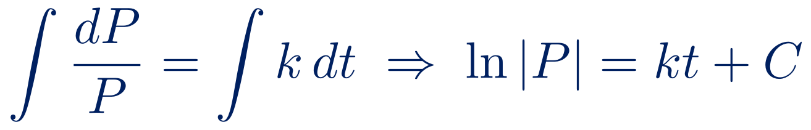
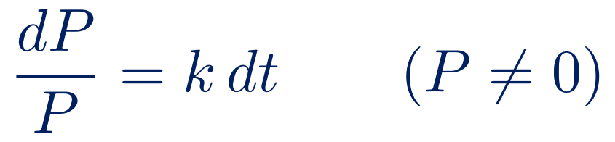
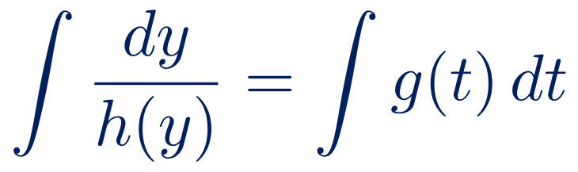
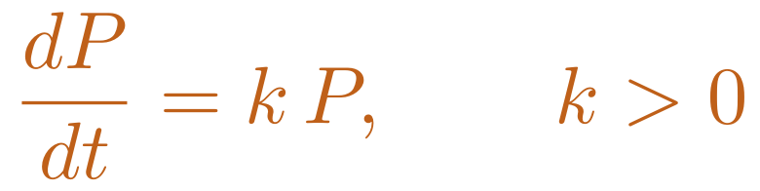
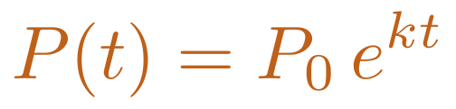
Separation of variables
Model: the growth rate is proportional to the population.
Separable: y′ = g(t) h(y)
$$\frac{dP}{dt}=k P, k>0$$
$$∫\frac{dy}{h\left(y\right)}=∫g\left(t\right) dt$$
1 Separate
$$\frac{dP}{P}=k dt \left(P≠0\right)$$
Subtle points (Lebl §1.3)
Dividing by h(y) loses the constant singular solutions h(y) = 0: here P ≡ 0.
|P| = e^{C}e^{kt} gives A = ±e^{C}; A = 0 recovers P ≡ 0, so A ∈ ℝ.
The answer may be only implicit: y′ = xy/(y² + 1) gives y² + 2 ln|y| = x² + C.
Check: P′ = kP₀e^{kt} = kP.
2 Integrate
$$∫\frac{dP}{P}=∫k dt ⇒ ln\left|P\right|=kt+C$$
3 Solve
$$\left|P\right|=e^{C}e^{kt} ⇒ P=A e^{kt}$$
4 Impose
$$P\left(0\right)=P_{0} ⇒ A=P_{0}$$
$$P\left(t\right)=P_{0} e^{kt}$$
10
Notes:
[1:30] The first model: growth rate proportional to the population (Lebl §0.2). Do the four steps on the board. Then the card on the right lists the delicate points (Lebl §1.3): dividing by P loses the constant solution P ≡ 0, a singular solution; the absolute value gives A = ±e^C, and allowing A = 0 brings back the lost solution, so P = A e^(kt) with any real A is the general solution; the integration may only give an implicit solution; and always check by differentiating.

Slide 11
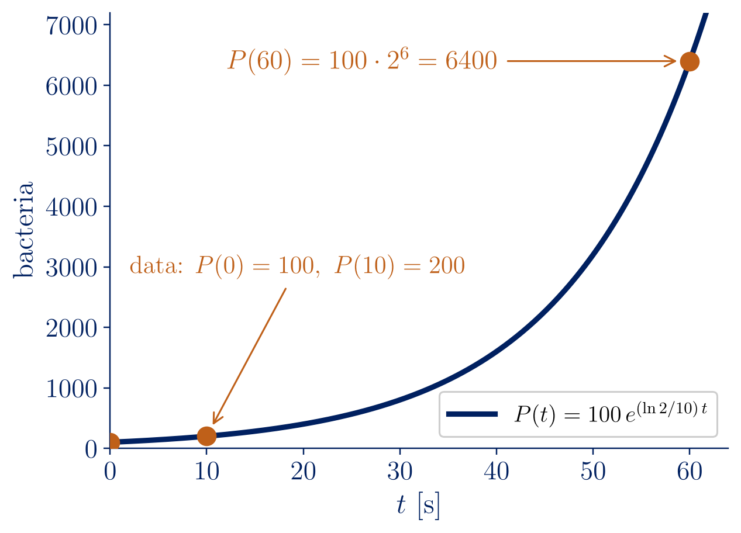
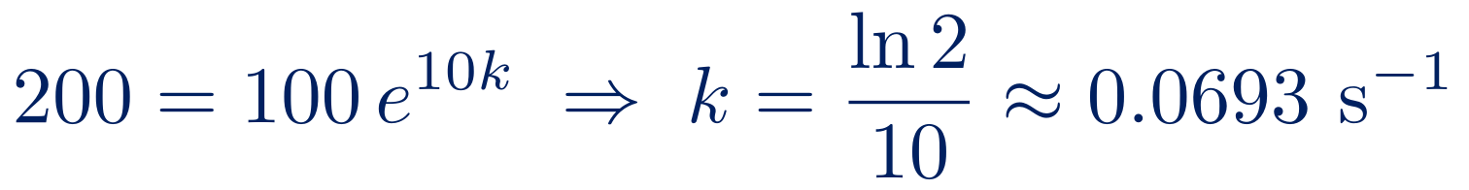
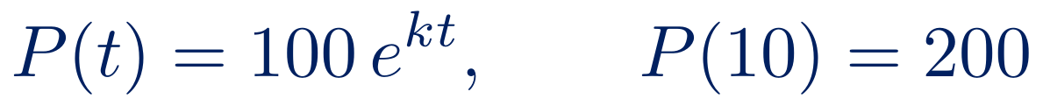
Exponential growth
Sample problem 1
A colony has 100 bacteria at t = 0 and 200 bacteria at t = 10 s. How many bacteria are there at t = 60 s?
(Lebl, Notes on Diffy Qs, Example 0.2.1)
$$P\left(t\right)=100 e^{kt}, P\left(10\right)=200$$
$$200=100 e^{10k} ⇒ k=\frac{ln2}{10}≈0.0693 s^{−1}$$
$$P\left(60\right)=100 e^{6ln2}=100⋅2^{6}=6400$$
Doubling time T_{d} = ln 2 / k = 10 s: the population doubles every 10 s, whatever its size.
11
Notes:
[1:10] A worked example from Lebl, Example 0.2.1. Ask the audience what is unknown (k) and how to find it (the second data point). Two lines give k = ln 2 / 10, and P(60) = 6400 exactly, because 60 s are six doubling times. The doubling time does not depend on the current size: the signature of exponential growth.

Slide 12
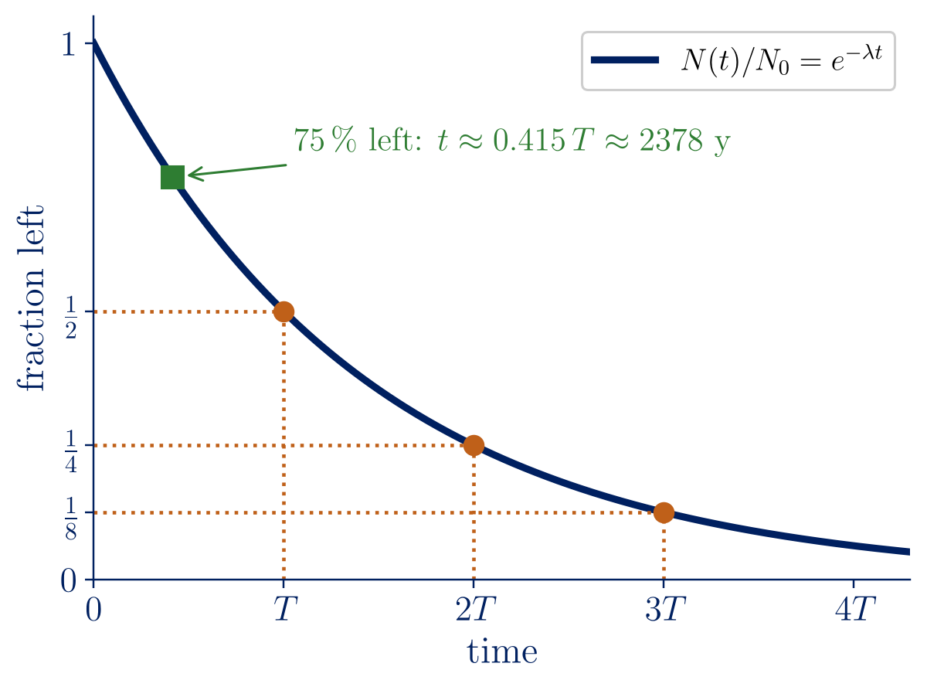
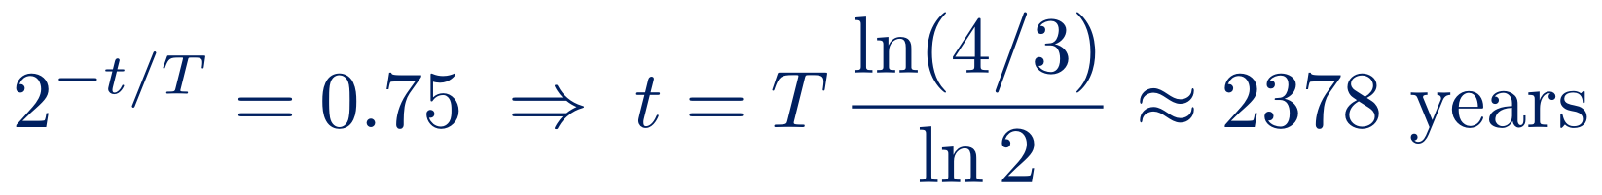
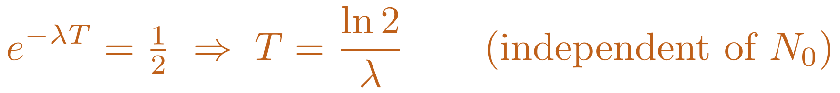
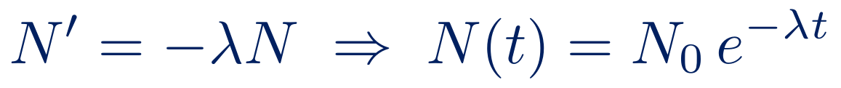
Radioactive decay and half-life
Each nucleus decays independently, with probability λ per unit time:
$$N′=−λN ⇒ N\left(t\right)=N_{0} e^{−λt}$$
Half-life T: N(T) = N₀/2
$$e^{−λT}=1/2 ⇒ T=\frac{ln2}{λ} \left(\text{independent of }N_{0}\right)$$
Sample problem 2: radiocarbon dating
A bone contains 75 % of the ¹⁴C of living tissue; T = 5730 years. How old is it? (Adkins–Davidson, Example 8)
$$2^{−t/T}=0.75 ⇒ t=T \frac{ln\left(4/3\right)}{ln2}≈2378 \text{years}$$
12
Notes:
[1:15] Same equation with a minus sign. Each nucleus decays independently, so the number of decays per unit time is proportional to N. Derive the half-life on the board: it does not depend on N0, which is why it characterises an isotope. Radiocarbon dating (Adkins–Davidson, Example 8): 75% left means less than half a half-life, about 2378 years — the green square.

Slide 13
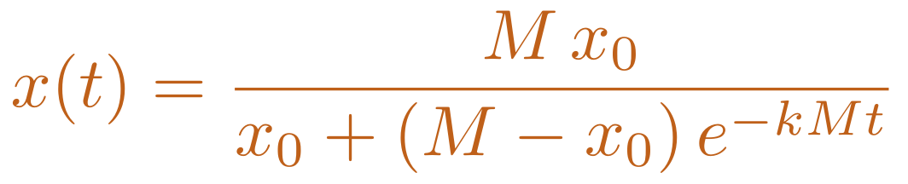
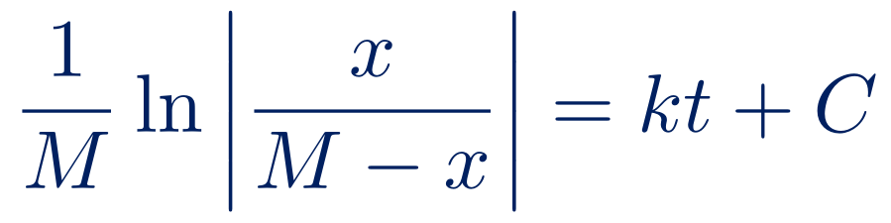
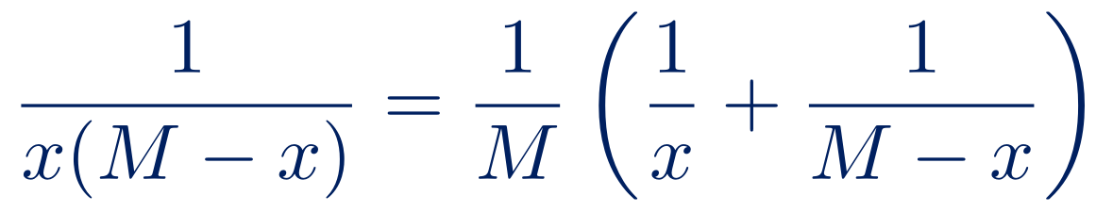
The logistic equation
Verhulst (1838): growth slows as the population approaches the carrying capacity M.
Check the answer
t = 0: x(0) = x₀.
x₀ = M: x ≡ M, an equilibrium.
t → ∞: x → M for every x₀ > 0.
x small: x′ ≈ kMx, exponential growth.
x₀ < 0: the denominator vanishes at t* = ln((M − x₀)/(−x₀))/(kM): the solution exists only on [0, t*) — intervals again.
Lebl §1.6; Adkins–Davidson §1.4
$$x′=k x \left(M−x\right), k,M>0$$
Separable — pen and paper with partial fractions:
$$\frac{1}{x\left(M−x\right)}=\frac{1}{M}\left(\frac{1}{x}+\frac{1}{M−x}\right)$$
$$\frac{1}{M}ln\left|\frac{x}{M−x}\right|=kt+C$$
$$x\left(t\right)=\frac{M x_{0}}{x_{0}+\left(M−x_{0}\right) e^{−kMt}}$$
13
Notes:
[1:15] Exponential growth cannot last. Verhulst's model slows growth near the carrying capacity M (Lebl §1.6). Nonlinear but separable; the one new tool is partial fractions — do it on the board. Then check the formula in special cases. The last bullet links back to Part I: for a negative initial value the denominator vanishes at a finite time, so the solution exists only on a bounded interval, exactly like y′ = y².

Slide 14
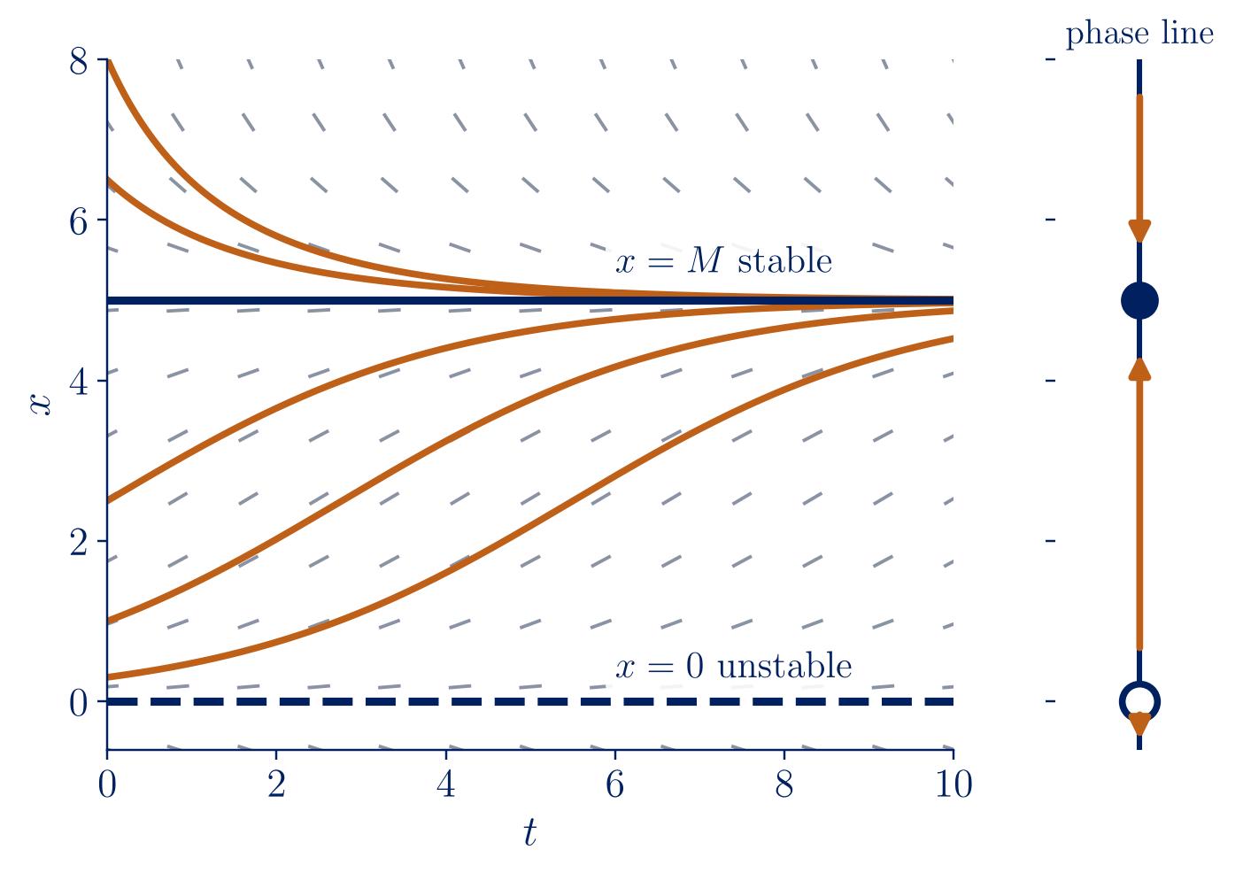
Equilibria and stability
We can understand x′ = f(x) without solving it (Lebl §1.6).
Equilibria: f(x*) = 0 → x* = 0 and x* = M.
Stability: f′(x*) < 0 stable, f′(x*) > 0 unstable; f′(x*) = 0: no conclusion.
$$f′\left(x\right)=k\left(M−2x\right): f′\left(0\right)=kM>0, f′\left(M\right)=−kM<0$$
Harvesting: x′ = k x (M − x) − h
The two equilibria merge and disappear when h = kM²/4 (a saddle-node bifurcation): over-harvesting leads to extinction.
Lebl §1.6: M = 8, k = 0.1 → critical h = 1.6
14
Notes:
[1:15] The most powerful idea of the first-order unit (Lebl §1.6): understand x′ = f(x) without solving it. Equilibria are zeros of f; the sign of f between them gives the arrows of the phase line; the sign of f′ at an equilibrium decides stability. The figure (Lebl Figure 1.6.2, k = 0.1, M = 5) shows every positive solution approaching M. Harvesting: subtracting h moves the equilibria together until they collide at h = kM²/4 and disappear — over-harvesting means extinction. Caveat: if f′(x*) = 0 the test is inconclusive.

Slide 15
Section III
When formulas fail: numerical methods
How do we approximate — and how wrong are we?
Euler’s method · order of accuracy · pitfalls
01. Modelling with ODEs
Notes:
[0:10] Part III: approximation, and how to judge it.

Slide 16
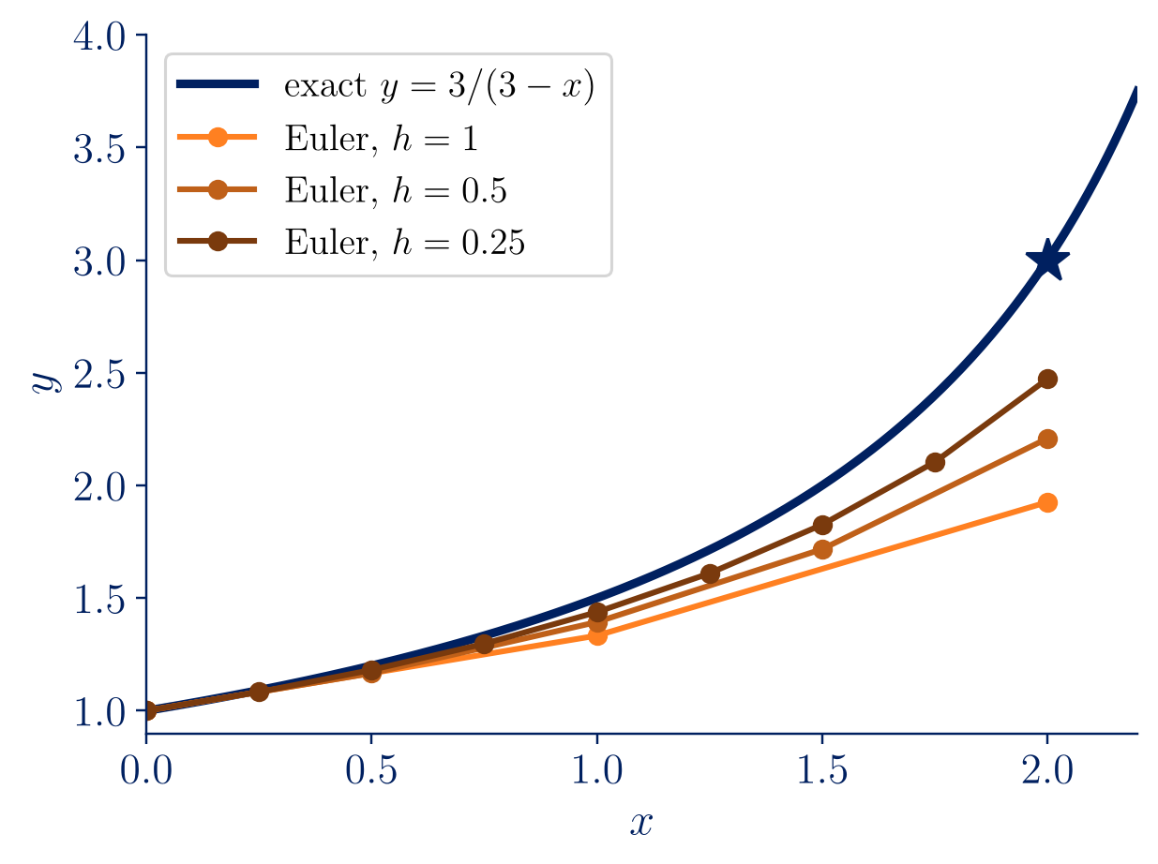
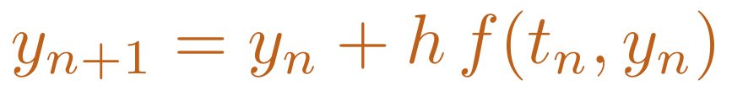
Euler’s method
Follow the tangent line for a step h (Lebl §1.7):
$$y_{n+1}=y_{n}+h f\left(t_{n},y_{n}\right)$$
Error O(h²) per step × (b − a)/h steps ⇒ global error O(h): a first-order method.
h | Euler y(2) | error | ratio
1 | 1.92593 | 1.0741 | —
0.5 | 2.20861 | 0.7914 | 0.74
0.25 | 2.47249 | 0.5275 | 0.67
0.125 | 2.68034 | 0.3197 | 0.61
y′ = y²/3, y(0) = 1, exact y(2) = 3 (Lebl, Table 1.7.1)
Pitfall (Lebl, Table 1.7.2): the solution blows up at x = 3, yet Euler returns y(3) ≈ 3.16, 4.54, 6.86, 10.80 as h halves.
16
Notes:
[1:15] Follow the tangent line for a step h. One sentence on the error: each step errs by about h², and there are about 1/h steps, so the total error is of order h — a first-order method. Lebl Table 1.7.1: the error ratio tends to one half as h halves (h = 0.25 actually gives 2.47249; the book prints 2.47250). The orange box is the important warning, Lebl Table 1.7.2: the exact solution blows up at x = 3, but Euler happily returns finite numbers. Numerics cannot replace the theory of Part I.

Slide 17
Section IV
Second-order linear equations
Two solutions are enough, if they are independent.
Wronskian · Abel · characteristic equation · vibrations
01. Modelling with ODEs
Notes:
[0:10] Part IV: the language of vibrations and circuits.

Slide 18
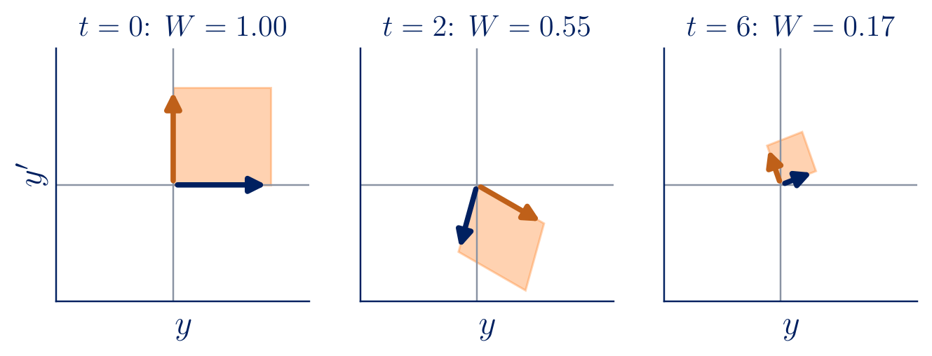
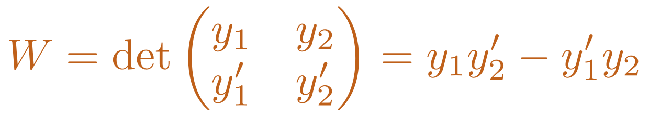
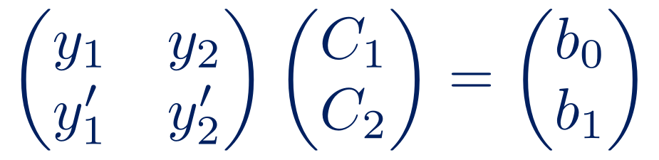
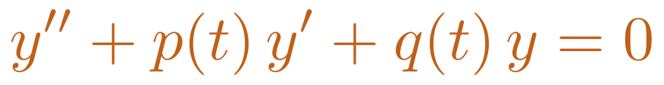
Second order: the Wronskian
$$y″+p\left(t\right) y′+q\left(t\right) y=0$$
$$W=det\left(\begin{matrix}y_{1} & y_{2} \\ y_{1}′ & y_{2}′\end{matrix}\right)=y_{1}y_{2}′−y_{1}′y_{2}$$
Superposition: if y₁, y₂ are solutions, so is C₁y₁ + C₂y₂. Are these all the solutions?
Global existence (Lebl, Thm 2.1.2): if p, q are continuous on I, every IVP has exactly one solution on all of I.
Algebra: W(t₀) ≠ 0 ⇔ every initial condition can be met ⇔ y = C₁y₁ + C₂y₂ is the general solution.
Geometry: W is the signed area spanned by the states (y₁, y₁′) and (y₂, y₂′) in the phase plane.
Impose y(t₀) = b₀, y′(t₀) = b₁:
$$\left(\begin{matrix}y_{1} & y_{2} \\ y_{1}′ & y_{2}′\end{matrix}\right)\left(\begin{matrix}C_{1} \\ C_{2}\end{matrix}\right)=\left(\begin{matrix}b_{0} \\ b_{1}\end{matrix}\right)$$
18
Notes:
[1:05] Second order is where mechanics lives. For linear equations the existence theory is global (Lebl Thm 2.1.2): continuous coefficients give a unique solution on the whole interval. Superposition gives a family from two solutions; imposing initial data gives a 2×2 system whose determinant is the Wronskian. Two readings: algebraic (any initial condition can be met) and geometric (area spanned by the two states in the phase plane — shown for a damped oscillator: the area shrinks).

Slide 19
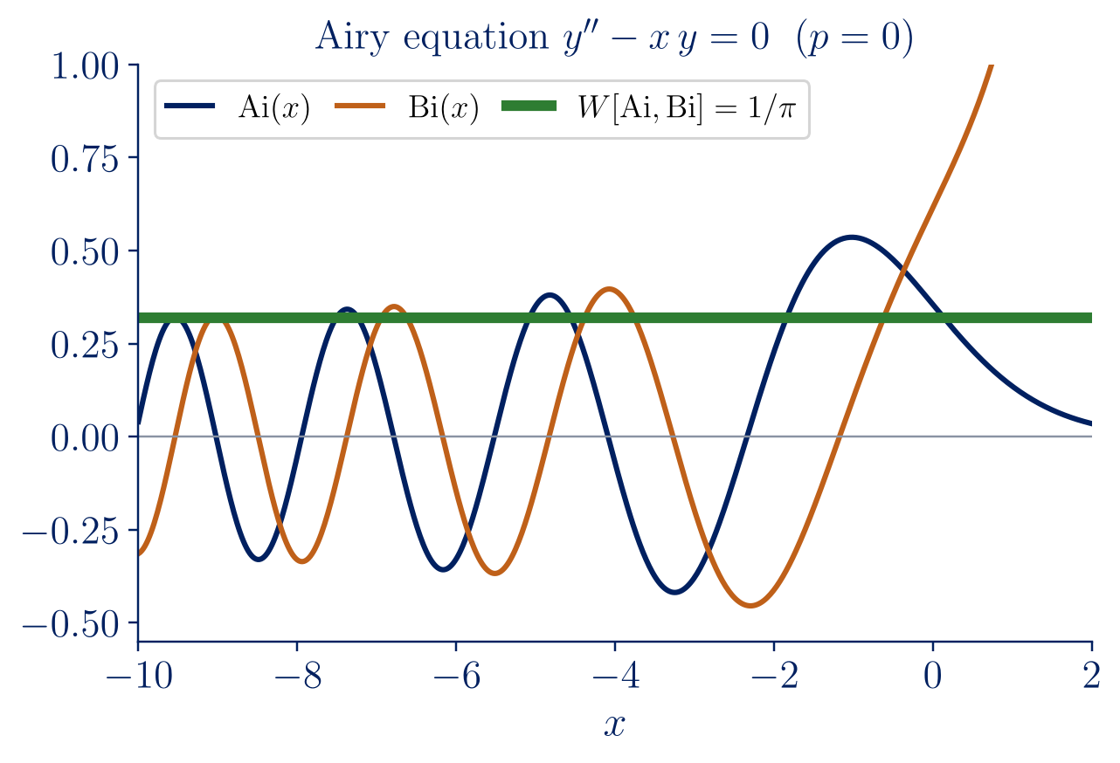
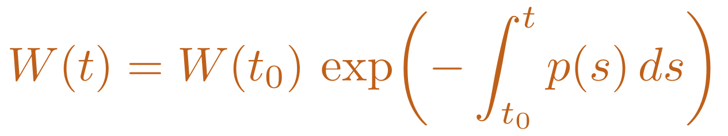
Abel’s theorem
Theorem (Abel). If y₁, y₂ solve y″ + p y′ + q y = 0 with p, q continuous, then
$$W\left(t\right)=W\left(t_{0}\right) exp​\left(−\int_{t_{0}}^{t}{p}\left(s\right) ds\right)$$
Proof in three lines
$$W′=y_{1}′y_{2}′+y_{1}y_{2}″−y_{1}″y_{2}−y_{1}′y_{2}′=y_{1}y_{2}″−y_{1}″y_{2}$$
$$y_{k}″=−p y_{k}′−q y_{k} ⇒ W′=−p W$$
W is never zero or identically zero; it is known without solving the equation.
With damping, phase-plane areas shrink as e^{−(c/m)t}.
No formula for Ai and Bi, yet W = 1/π exactly, since p = 0 (DLMF 9.2.7).
19
Notes:
[1:05] The Wronskian of two solutions obeys its own first-order equation. Three-line proof on the board: differentiate, the y1′y2′ terms cancel, substitute the equation, the q terms cancel: W′ = −pW, the decay equation again. Consequences: W is never zero or identically zero, and it is known without solving — the Airy functions have no elementary formula, yet W = 1/π exactly (DLMF 9.2.7). Caveat if asked: the theorem needs p continuous; for y″ − (2/x)y′ + (2/x²)y = 0 the solutions x and x² have W = x², zero exactly where p blows up.

Slide 20

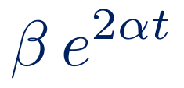
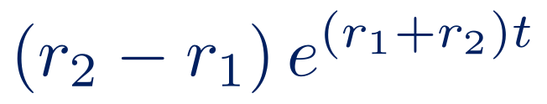
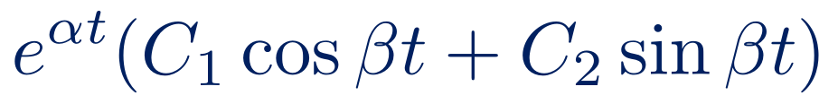
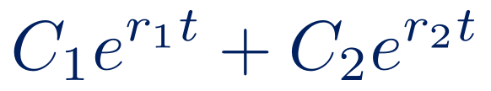


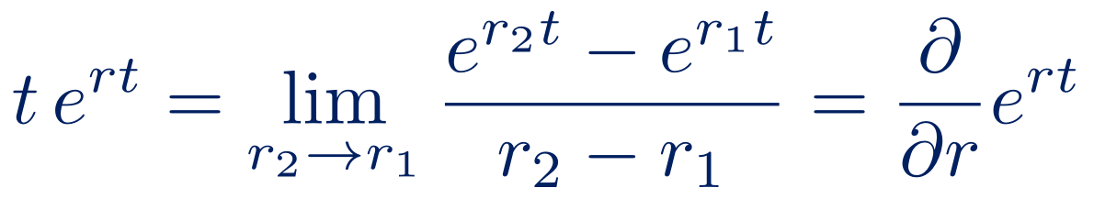

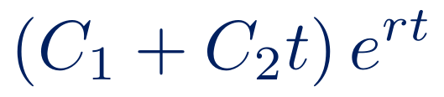
The characteristic equation
$$a y″+b y′+c y=0, y=e^{rt} ⇒ \left(ar^{2}+br+c\right)e^{rt}=0$$
b² − 4ac | roots | general solution | Wronskian
> 0
= 0
< 0
$$r_{1}≠r_{2} \text{real}$$
$$C_{1}e^{r_{1}t}+C_{2}e^{r_{2}t}$$
$$\left(r_{2}−r_{1}\right) e^{\left(r_{1}+r_{2}\right)t}$$
$$r \text{double}$$
$$\left(C_{1}+C_{2}t\right) e^{rt}$$
$$e^{2rt}$$
$$α±iβ$$
$$e^{αt}\left(C_{1}cosβt+C_{2}sinβt\right)$$
$$β e^{2αt}$$
Vieta: r₁ + r₂ = −b/a, so
$$W∝e^{\left(r_{1}+r_{2}\right)t}=e^{−bt/a} \text{(Abel’s theorem)}$$
$$t e^{rt}=\lim_{r_{2}→r_{1}}\frac{e^{r_{2}t}−e^{r_{1}t}}{r_{2}−r_{1}}=\frac{∂}{∂r}e^{rt}$$
Repeated root (Lebl §2.2):
Sample problem 3: y″ − 6y′ + 13y = 0, y(0) = 0, y′(0) = 10 (Lebl, Example 2.2.4)
$$r^{2}−6r+13=0 ⇒ r=3±2i ⇒ y=e^{3t}\left(C_{1}cos2t+C_{2}sin2t\right) ⇒ y=5 e^{3t}sin2t$$
20
Notes:
[1:00] With constant coefficients the guess e^(rt) turns the ODE into a quadratic (Lebl §2.2). Three cases, one per sign of the discriminant. Last column: W is proportional to e^((r1+r2)t) and Vieta gives r1 + r2 = −b/a, exactly Abel's theorem by another route. Delicate point: the repeated root. The guess only gives one solution; the second, t e^(rt), is the limit of (e^(r2 t) − e^(r1 t))/(r2 − r1) as the roots merge — a derivative with respect to r. Sample problem 3, Lebl Example 2.2.4.

Slide 21
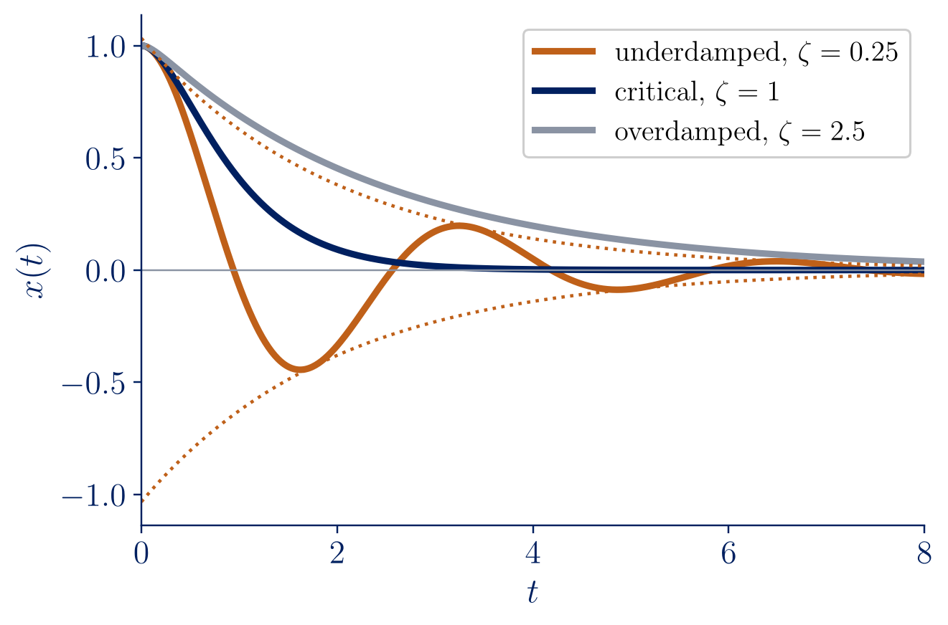
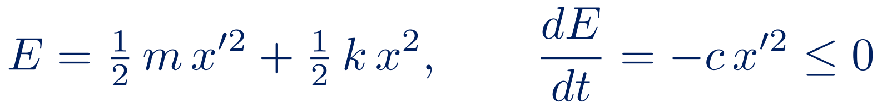
The mass–spring–damper
$$m x″+c x′+k x=0, ω_{0}=\sqrt{k/m}, ζ=\frac{c}{2\sqrt{mk}}$$
ζ < 1, underdamped: decaying oscillation, pseudo-frequency ω₁ < ω₀.
ζ = 1, critically damped: fastest return without oscillation.
ζ > 1, overdamped: slow return, no oscillation.
Energy is dissipated by the damper:
$$E=1/2 m x′^{2}+1/2 k x^{2}, \frac{dE}{dt}=−c x′^{2}≤0$$
RLC circuit: same equation with m → L, c → R, k → 1/C (Lebl §2.4).
21
Notes:
[1:00] Everything comes together (Lebl §2.4). Newton plus Hooke plus a linear damper gives a constant-coefficient equation — Newton's law, where we started. The damping ratio ζ is the discriminant in disguise. Critical damping returns fastest without oscillating, which is why suspensions and door closers are designed near ζ = 1. Energy decreases at the rate c x′², and the same equation describes an RLC circuit.

Slide 22
Summary
1
Since Newton, laws of nature are ODEs: a law of change plus an initial condition predicts the future.
2
Solutions live on intervals; Picard’s theorem gives local existence and uniqueness, linear equations global ones.
3
Separable equations: separate, integrate, impose, check — and watch for lost or implicit solutions.
4
Qualitative analysis and numerics complete the picture, but Euler cannot see a blow-up.
5
Second-order linear: two independent solutions, Wronskian and Abel, characteristic equation, vibrations.
Next lecture: forced vibrations and resonance.
22
Notes:
[0:40] One sentence per point, and connect them: Newton's law of change, intervals and uniqueness, the pen-and-paper workflow, the qualitative picture, numerics and their limits, second-order theory. End with what comes next in the course and invite questions.

