Slide 1

MATH 331
Ordinary Differential Equations
Claudio Mirabella
Example lecture · 2026
01. Modelling with ODEs
Notes:
Timing plan for 20 minutes (in brackets on every slide). [0:30] Introduce yourself and the plan: what an ODE is, three first-order models solved with pen and paper, what to do when pen and paper fails, and a first look at second-order equations. Material: MATH 331 lecture plan, course text J. Lebl, Notes on Diffy Qs.

Slide 2
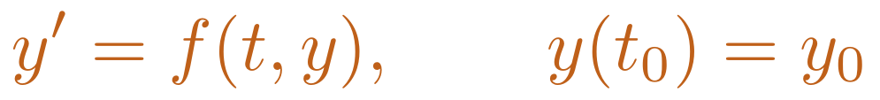
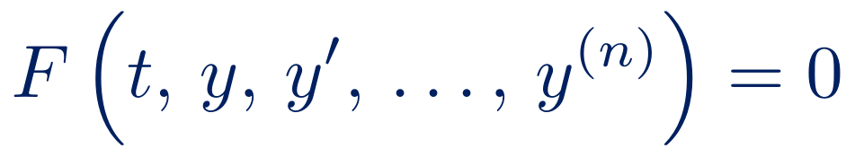
What is a differential equation?
An ordinary differential equation (ODE) relates an unknown function y(t) to its derivatives:
equation | order | type
y′ = k y | 1 | linear
x′ = k x (M − x) | 1 | nonlinear
m x″ + c x′ + k x = 0 | 2 | linear
y′ = y^{1/3} | 1 | nonlinear
$$F\left(t, y, y′, …, y^{\left(n\right)}\right)=0$$
A differential equation is a law of change: it prescribes how a quantity evolves, not what it is.
Order: the highest derivative that appears.
Linear: y, y′, …, y^{(n)} appear only to the first power.
Initial value problem (IVP): the law of change plus a starting point.
Newton, Methodus Fluxionum (1671): the first differential equations — derivatives were “fluxions”, the rates at which quantities flow.
$$y′=f\left(t,y\right), y\left(t_{0}\right)=y_{0}$$
2
Notes:
[1:30] Start from the word: Newton called derivatives fluxions, the rates at which quantities flow. An ODE links an unknown function to its derivatives. Stress the key idea in orange: a differential equation does not tell us what a quantity is, but how it changes. Define order and linearity using the table on the right: two of these examples are linear, two are not, and the last one will surprise us in a few minutes. Finish with the initial value problem: the law of change plus a starting point.

Slide 3
ODEs across the disciplines
Mechanics
m x″ = F(t, x, x′)
Newton’s second law
Electrical circuits
L Q″ + R Q′ + Q/C = E(t)
series RLC circuit
Nuclear physics
N′ = −λ N
radioactive decay
Population dynamics
P′ = k P (1 − P/K)
logistic growth
Heat transfer
T′ = −k (T − T_{a})
Newton’s law of cooling
Epidemiology
S′ = −βSI, I′ = βSI − γI
SIR model (a system of ODEs)
Same mathematics, different subjects: the language of applied science
3
Notes:
[1:00] Go quickly: the point is that the same mathematical object appears everywhere. Point at two or three cards, for instance the RLC circuit and the population model, and note that they have the same structure as the mass-spring system we will meet at the end. Close with the orange sentence: learn the method once, use it everywhere.

Slide 4
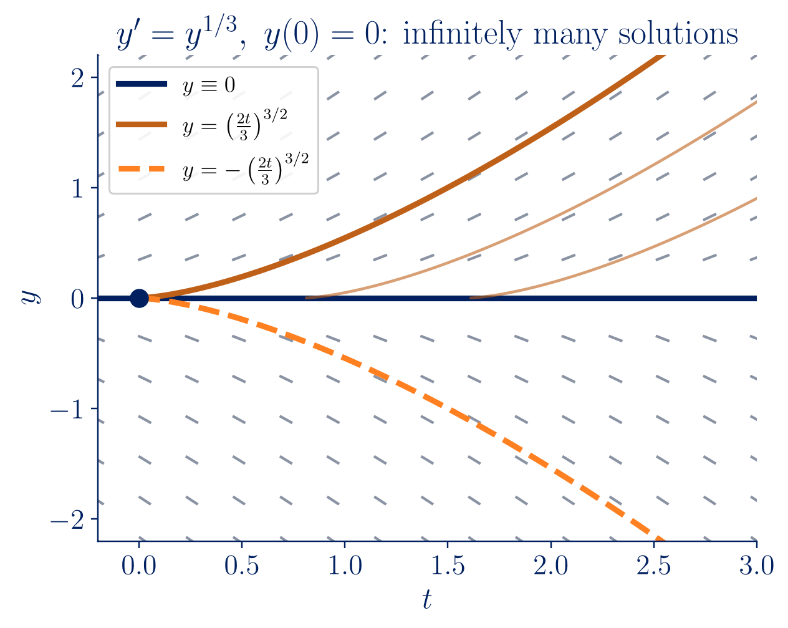
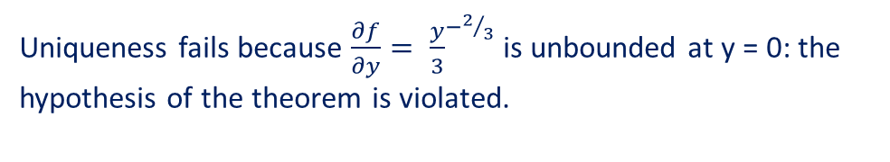
Existence and uniqueness
Theorem (Picard–Lindelöf). If f and ∂f/∂y are continuous near (t₀, y₀), the IVP* y′ = f(t, y), y(t₀) = y₀ has exactly one solution on some interval around t₀.
IVP*: Initial Value Problem
Sample problem: y′ = y^{1/3}, y(0) = 0
y ≡ 0 is a solution. Separating variables gives another one:
$$y^{−1/3} dy=dt ⇒ 3/2 y^{2/3}=t ⇒ y={\left({2t}/3\right)}^{3/2}$$
Uniqueness fails because $\frac{∂f}{∂y}= {\frac{y}{3}}^{−2/3}$ is unbounded at y = 0: the hypothesis of the theorem is violated.
4
Notes:
[1:30] Before solving, ask whether there is exactly one solution. State Picard–Lindelöf informally: if f and its derivative in y are continuous, the future is uniquely determined. Then the surprise from the table: y′ = y^(1/3) with y(0) = 0. y ≡ 0 works; separating variables gives a second solution. Write the separation on the board. In the figure, every orange curve leaves the axis at a different time: infinitely many solutions. The reason: ∂f/∂y is infinite at y = 0, so the hypothesis fails. This is Session 5 of the course.

Slide 5


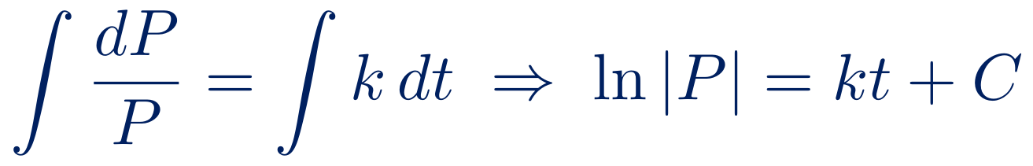
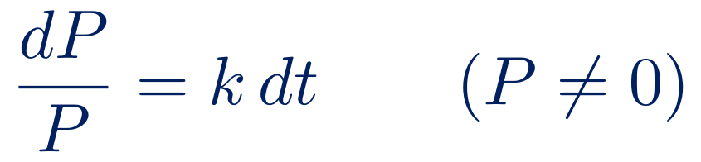
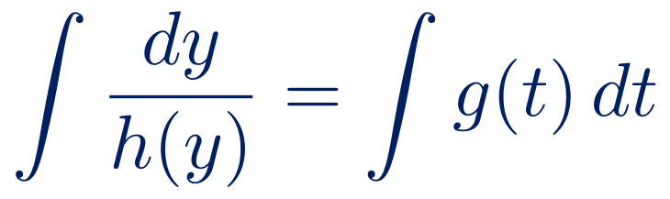
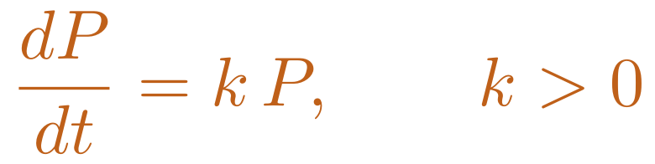
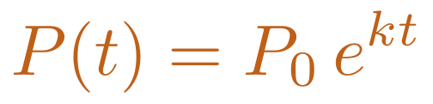
Separation of variables
Model: the growth rate is proportional to the population.
General recipe
Separable equations y′ = g(t) h(y):
$$\frac{dP}{dt}=k P, k>0$$
$$∫\frac{dy}{h\left(y\right)}=∫g\left(t\right) dt$$
1 Separate
$$\frac{dP}{P}=k dt \left(P≠0\right)$$
Dividing by h(y) loses the constant solutions h(y) = 0 — here P ≡ 0.
Check: P′ = k P₀ e^{kt} = k P.
Same steps for decay (k < 0) and for the logistic equation.
2 Integrate
$$∫\frac{dP}{P}=∫k dt ⇒ ln\left|P\right|=kt+C$$
3 Solve
$$\left|P\right|=e^{C}e^{kt} ⇒ P=A e^{kt}$$
4 Impose
$$P\left(0\right)=P_{0} ⇒ A=P_{0}$$
$$P\left(t\right)=P_{0} e^{kt}$$
5
Notes:
[1:45] The first model: the growth rate is proportional to the population. Do this derivation on the board, step by step, while the slide shows the same steps: separate, integrate, solve for P, impose the initial condition. Two habits to stress: dividing by P loses the constant solution P ≡ 0 (always look for solutions you divided away), and always check by differentiating. The right card is the general recipe, which we will reuse for decay and for the logistic equation.

Slide 6
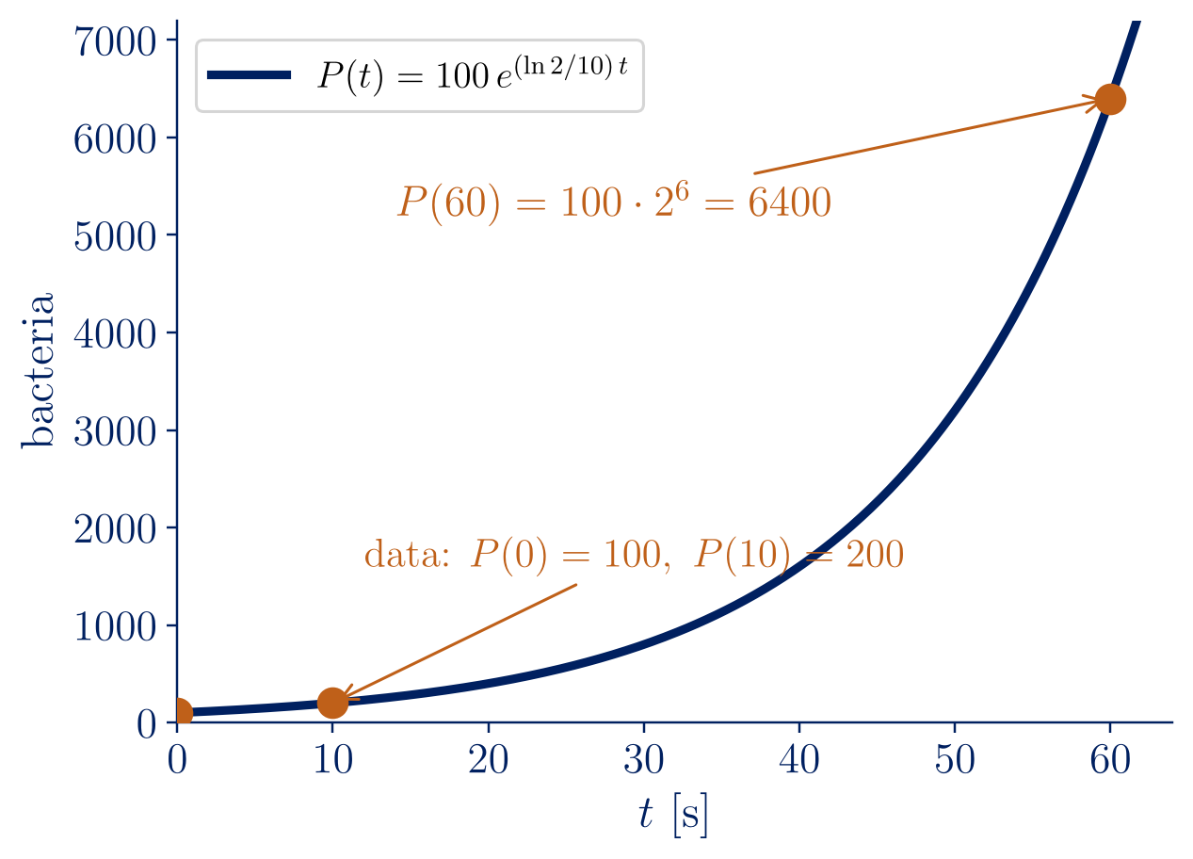
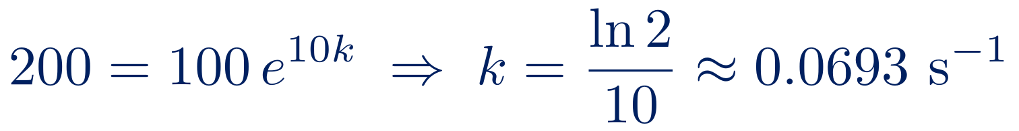
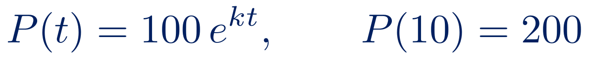
Exponential growth
Sample problem 1
A colony has 100 bacteria at t = 0 and 200 bacteria at t = 10 s. How many bacteria are there at t = 60 s?
(Lebl, Notes on Diffy Qs, Example 0.2.1)
$$P\left(t\right)=100 e^{kt}, P\left(10\right)=200$$
$$200=100 e^{10k} ⇒ k=\frac{ln2}{10}≈0.0693 s^{−1}$$
$$P\left(60\right)=100 e^{6ln2}=100⋅2^{6}=6400$$
Doubling time T_{d} = ln 2 / k = 10 s: the population doubles every 10 s, whatever its size.
6
Notes:
[1:30] A worked example from Lebl, Example 0.2.1. Read the problem, ask the audience what is unknown (k) and how to find it (the second data point). Two lines of algebra give k = ln 2 / 10. The answer 6400 comes out exactly, because 60 seconds are six doubling times. Emphasise the doubling time: it does not depend on the current size of the population, the signature of exponential growth.

Slide 7
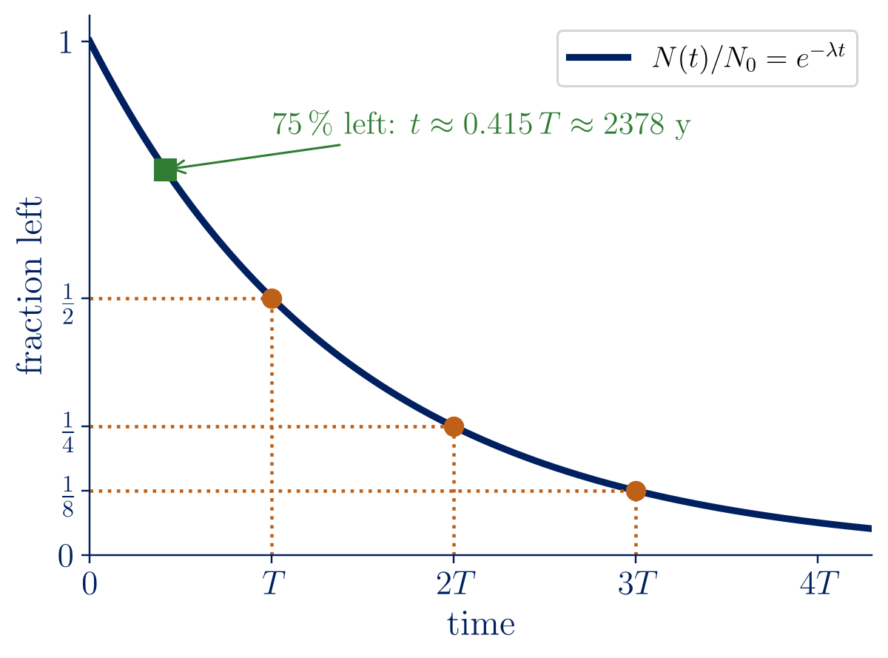
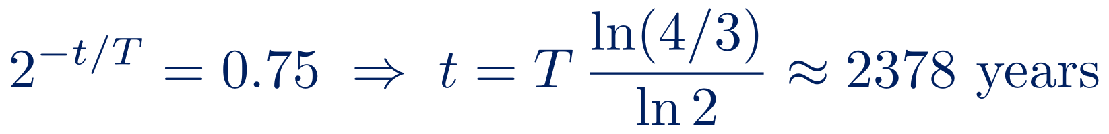
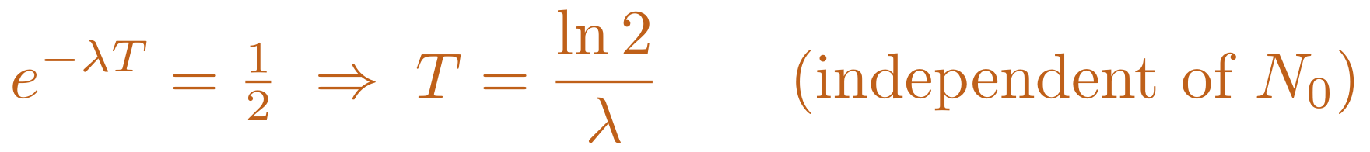
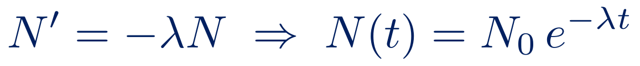
Radioactive decay and half-life
Each nucleus decays independently, with probability λ per unit time:
$$N′=−λN ⇒ N\left(t\right)=N_{0} e^{−λt}$$
Half-life T: N(T) = N₀/2
$$e^{−λT}=1/2 ⇒ T=\frac{ln2}{λ} \left(\text{independent of }N_{0}\right)$$
Sample problem 2: radiocarbon dating
A bone contains 75 % of the ¹⁴C of living tissue; T = 5730 years. How old is it? (Adkins–Davidson, Example 8)
$$2^{−t/T}=0.75 ⇒ t=T \frac{ln\left(4/3\right)}{ln2}≈2378 \text{years}$$
7
Notes:
[1:30] Same equation with a minus sign. Each nucleus decays independently, so the number of decays per unit time is proportional to N. Derive the half-life on the board: it does not depend on N0, which is why it characterises an isotope. Then radiocarbon dating, Adkins–Davidson Example 8: 75% left means less than half a half-life, about 2378 years. Point at the green square in the figure.

Slide 8
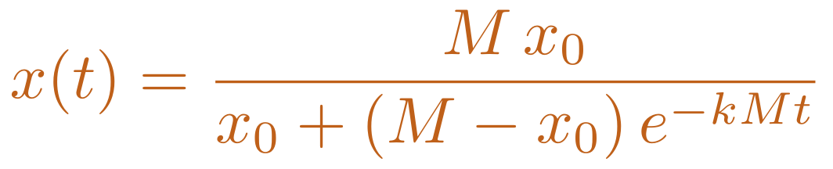
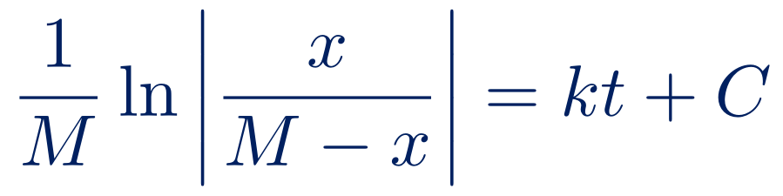
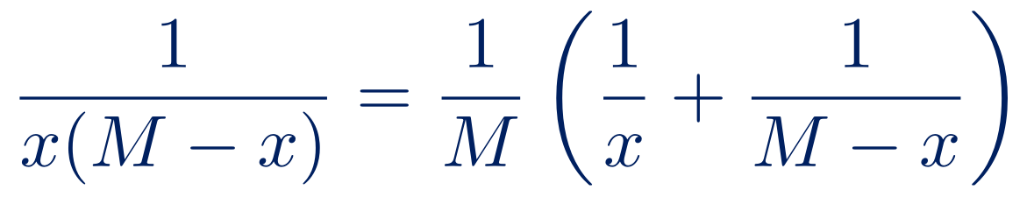
The logistic equation
Verhulst (1838): growth slows as the population approaches the carrying capacity M.
Check the answer
t = 0: x(0) = x₀
x₀ = M: x ≡ M, an equilibrium
t → ∞: x → M for every x₀ > 0
x small: x′ ≈ kMx, exponential growth with rate kM
Lebl §1.6, Adkins–Davidson §1.4
$$x′=k x \left(M−x\right), k,M>0$$
Separable — pen and paper with partial fractions:
$$\frac{1}{x\left(M−x\right)}=\frac{1}{M}\left(\frac{1}{x}+\frac{1}{M−x}\right)$$
$$\frac{1}{M}ln\left|\frac{x}{M−x}\right|=kt+C$$
$$x\left(t\right)=\frac{M x_{0}}{x_{0}+\left(M−x_{0}\right) e^{−kMt}}$$
8
Notes:
[1:30] Exponential growth cannot last: resources are finite. Verhulst's model slows growth near the carrying capacity M. The equation is nonlinear but still separable. The one new tool is partial fractions; do the decomposition on the board. Solve for x and impose x(0) = x0 to get the formula in orange. Then the habit we keep repeating: check the formula in special cases (green ticks).

Slide 9
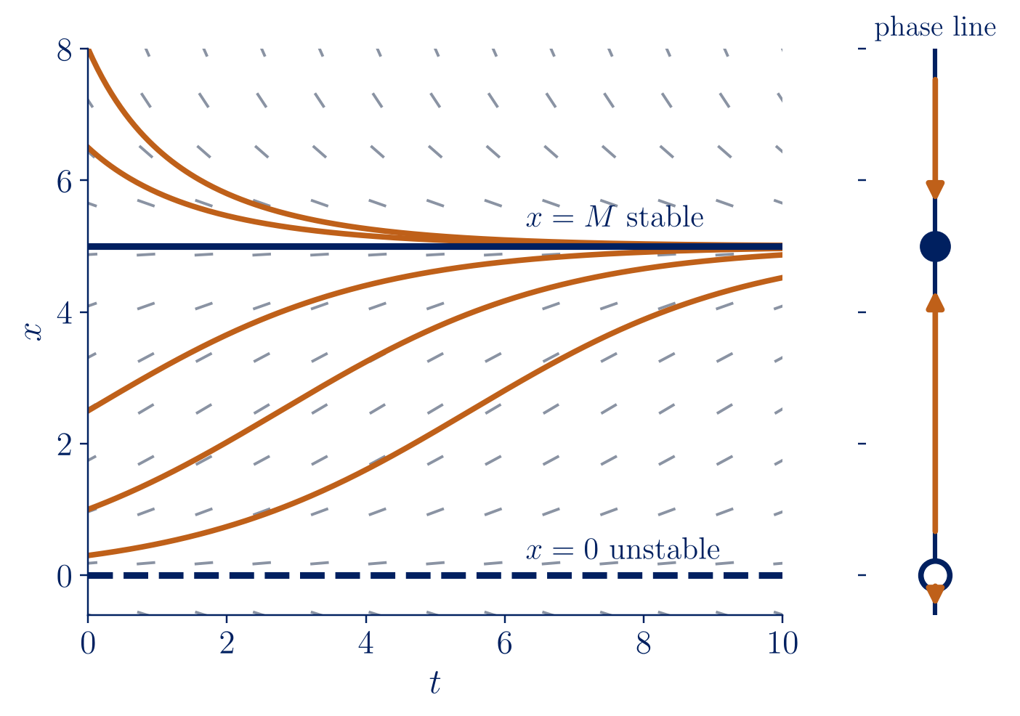
Equilibria and stability
We can understand x′ = f(x) without solving it.
Equilibria: f(x*) = 0 → x* = 0 and x* = M.
Stability: f′(x*) < 0 stable, f′(x*) > 0 unstable.
$$f′\left(x\right)=k\left(M−2x\right): f′\left(0\right)=kM>0, f′\left(M\right)=−kM<0$$
Harvesting: x′ = k x (M − x) − h
The two equilibria merge and disappear when h = kM²/4 (a saddle-node bifurcation): over-harvesting leads to extinction.
Lebl §1.6: M = 8, k = 0.1 → critical h = 1.6
9
Notes:
[1:30] The most powerful idea of the first-order unit: we can understand x′ = f(x) without solving it. Equilibria are zeros of f; the sign of f between them gives the arrows of the phase line; the sign of f′ at an equilibrium decides stability. The figure (Lebl Figure 1.6.2, k = 0.1, M = 5) shows all solutions approaching M. Finish with harvesting: subtracting a constant h makes the two equilibria approach and annihilate at h = kM²/4 — over-harvesting means extinction.

Slide 10
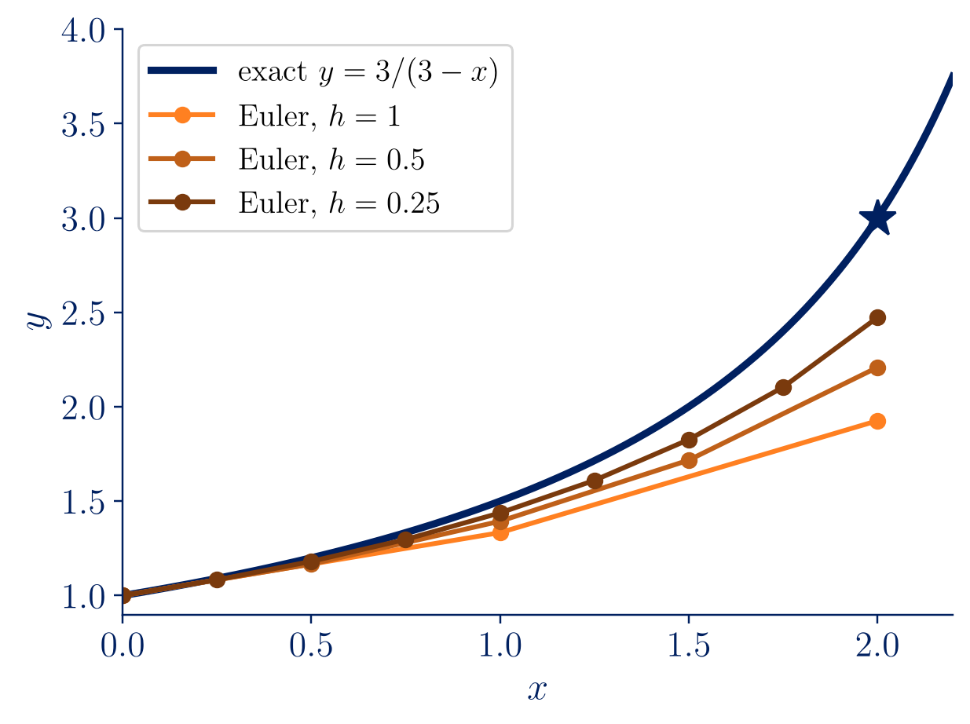
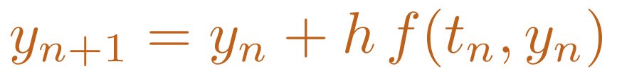
Numerical solution: Euler’s method
Most ODEs have no closed-form solution. Follow the tangent line for a step h:
$$y_{n+1}=y_{n}+h f\left(t_{n},y_{n}\right)$$
Error O(h²) per step × (b − a)/h steps ⇒ global error O(h): a first-order method.
h | Euler y(2) | error | ratio
1 | 1.92593 | 1.0741 | —
0.5 | 2.20861 | 0.7914 | 0.74
0.25 | 2.47249 | 0.5275 | 0.67
0.125 | 2.68034 | 0.3197 | 0.61
y′ = y²/3, y(0) = 1, exact y(2) = 3 (Lebl, Table 1.7.1). Better: Heun (order 2), Runge–Kutta (order 4).
10
Notes:
[1:30] Most ODEs have no closed-form solution, so we approximate. Euler follows the tangent line for a step h. Explain the error count in one sentence: each step makes an error of order h², and there are about 1/h steps, so the total is of order h — a first-order method. The table is Lebl Table 1.7.1: as h halves, the error ratio approaches one half. (We found a rounding slip in that table: h = 0.25 gives 2.47249.) Mention that Heun and Runge–Kutta are the next steps.

Slide 11
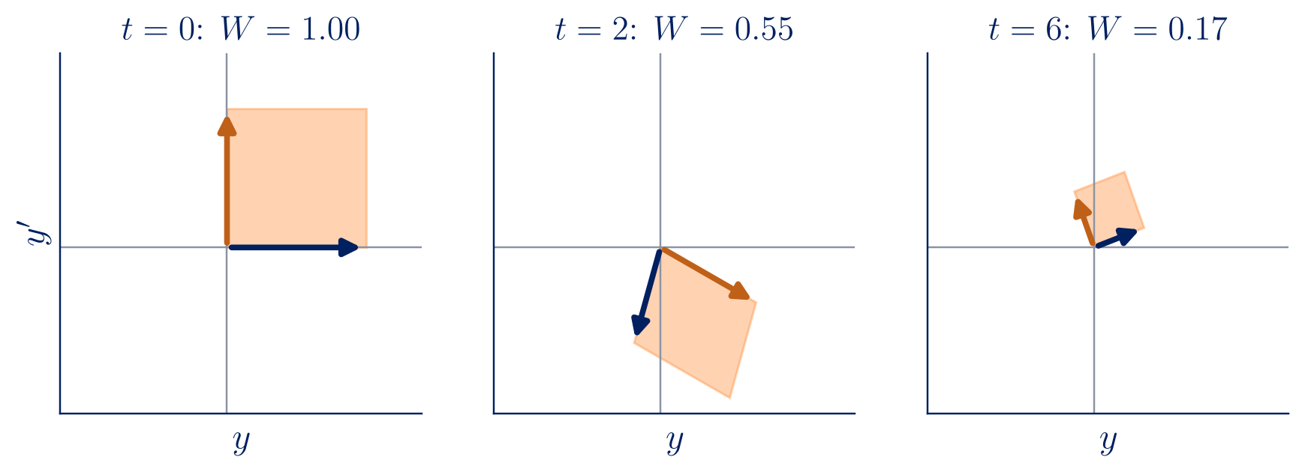
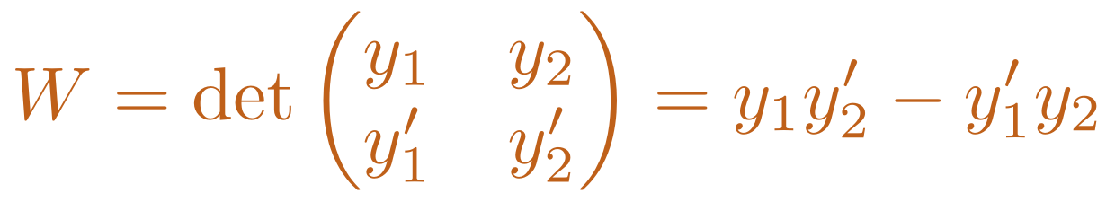
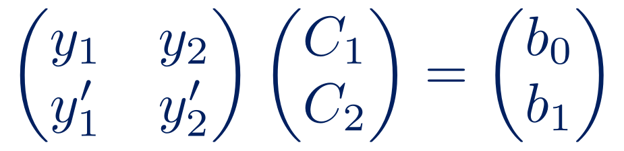
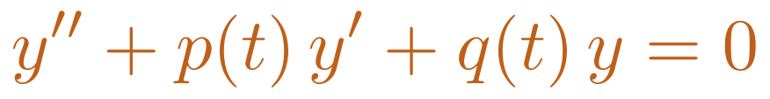
Second order: the Wronskian
$$y″+p\left(t\right) y′+q\left(t\right) y=0$$
$$W=det\left(\begin{matrix}y_{1} & y_{2} \\ y_{1}′ & y_{2}′\end{matrix}\right)=y_{1}y_{2}′−y_{1}′y_{2}$$
Superposition: if y₁, y₂ are solutions, so is C₁y₁ + C₂y₂. Are these all the solutions?
Algebra: W(t₀) ≠ 0 ⇔ every initial condition can be met ⇔ y = C₁y₁ + C₂y₂ is the general solution.
Geometry: W is the signed area spanned by the states (y₁, y₁′) and (y₂, y₂′) in the phase plane.
Impose y(t₀) = b₀, y′(t₀) = b₁:
$$\left(\begin{matrix}y_{1} & y_{2} \\ y_{1}′ & y_{2}′\end{matrix}\right)\left(\begin{matrix}C_{1} \\ C_{2}\end{matrix}\right)=\left(\begin{matrix}b_{0} \\ b_{1}\end{matrix}\right)$$
11
Notes:
[1:30] Now second order, which is where mechanics lives. Superposition gives a whole family from two solutions; the question is whether it is all solutions. Imposing initial data gives a 2×2 linear system, and its determinant is the Wronskian. Two readings: algebraic (we can meet any initial condition) and geometric (the area spanned by the two states in the phase plane, shown below for a damped oscillator: the area shrinks).

Slide 12
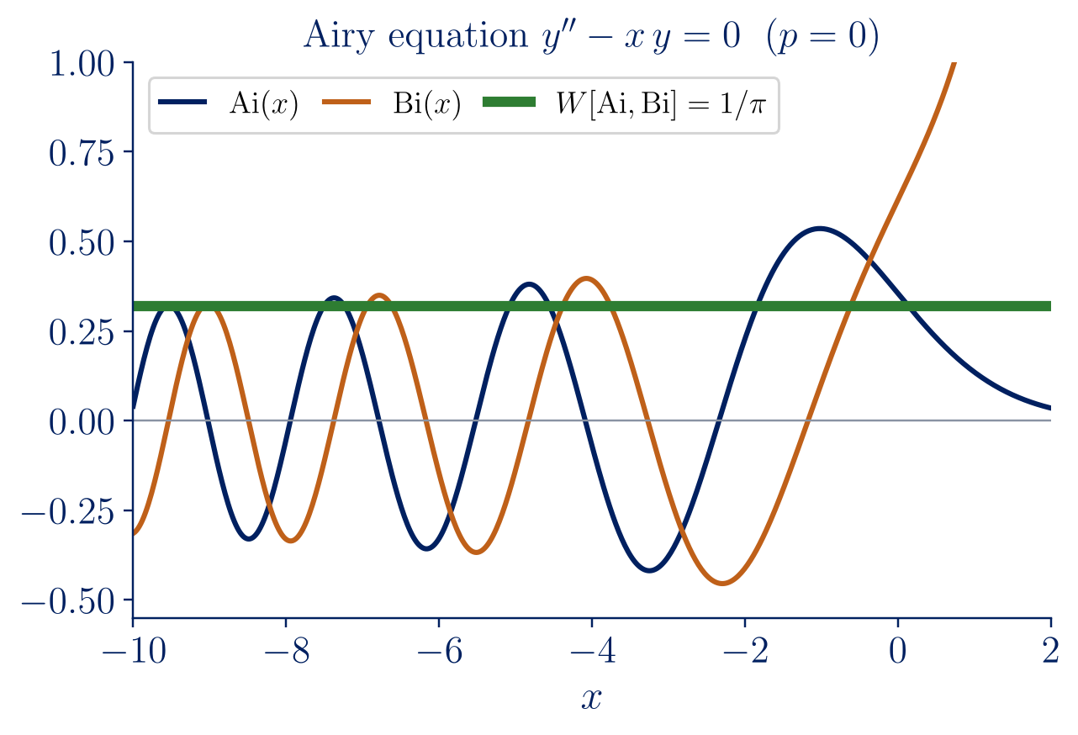
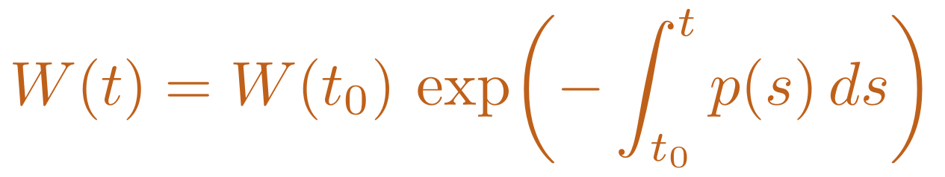
Abel’s theorem
Theorem (Abel). If y₁, y₂ solve y″ + p y′ + q y = 0 with p, q continuous, then
$$W\left(t\right)=W\left(t_{0}\right) exp​\left(−\int_{t_{0}}^{t}{p}\left(s\right) ds\right)$$
Proof in three lines
$$W′=y_{1}′y_{2}′+y_{1}y_{2}″−y_{1}″y_{2}−y_{1}′y_{2}′=y_{1}y_{2}″−y_{1}″y_{2}$$
$$y_{k}″=−p y_{k}′−q y_{k} ⇒ W′=−p W$$
W is never zero or identically zero; it is known without solving the equation.
With damping, phase-plane areas shrink as e^{−(c/m)t}.
No formula for Ai and Bi, yet W = 1/π exactly, since p = 0 (DLMF 9.2.7).
12
Notes:
[1:30] The Wronskian of two solutions obeys its own first-order equation. The proof is three lines; do it on the board: differentiate, the y1′y2′ terms cancel, substitute the equation, the q terms cancel. We get W′ = −pW, which is our decay equation again. Consequences: W is never zero or always zero; we know W without solving — the Airy functions have no elementary formula, yet their Wronskian is exactly 1/π (DLMF 9.2.7); and with friction, phase-plane areas shrink.

Slide 13
The characteristic equation
$$a y″+b y′+c y=0, y=e^{rt} ⇒ \left(ar^{2}+br+c\right)e^{rt}=0$$
b² − 4ac | roots | general solution | Wronskian
> 0 | r₁ ≠ r₂ real | C₁e^{r₁t} + C₂e^{r₂t} | (r₂ − r₁) e^{(r₁+r₂)t}
= 0 | r double | (C₁ + C₂t) e^{rt} | e^{2rt}
< 0 | α ± iβ | e^{αt}(C₁ cos βt + C₂ sin βt) | β e^{2αt}
Vieta: r₁ + r₂ = −b/a, so in every case W ∝ e^{−bt/a} — exactly Abel’s theorem.
Sample problem 3: y″ − 6y′ + 13y = 0, y(0) = 0, y′(0) = 10 (Lebl, Example 2.2.4)
$$r^{2}−6r+13=0 ⇒ r=3±2i ⇒ y=e^{3t}\left(C_{1}cos2t+C_{2}sin2t\right) ⇒ y=5 e^{3t}sin2t$$
13
Notes:
[1:15] With constant coefficients, the guess e^(rt) turns the ODE into a quadratic equation. Three cases, one per sign of the discriminant. Point at the last column: in every case W is proportional to e^((r1+r2)t), and Vieta gives r1 + r2 = −b/a — exactly Abel's theorem, by a completely different route. Sample problem 3 (Lebl Example 2.2.4): roots 3 ± 2i, so the solution grows and oscillates.

Slide 14
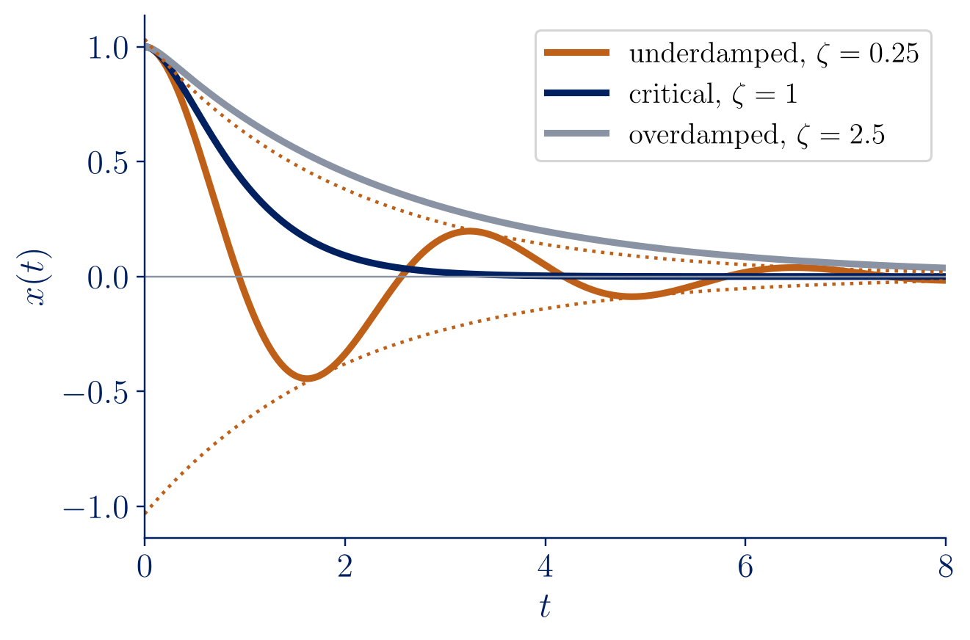
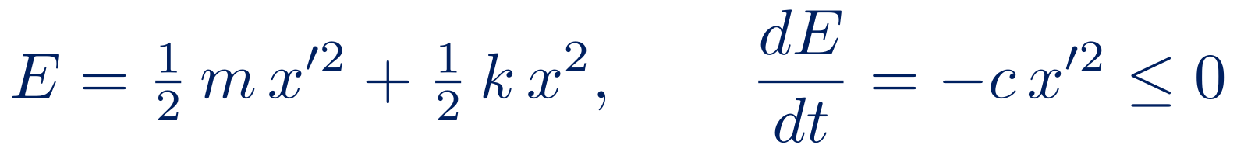
The mass–spring–damper
$$m x″+c x′+k x=0, ω_{0}=\sqrt{k/m}, ζ=\frac{c}{2\sqrt{mk}}$$
ζ < 1, underdamped: decaying oscillation, pseudo-frequency ω₀(1 − ζ²)^{1/2}.
ζ = 1, critically damped: fastest return without oscillation.
ζ > 1, overdamped: slow return, no oscillation.
Energy is dissipated by the damper:
$$E=1/2 m x′^{2}+1/2 k x^{2}, \frac{dE}{dt}=−c x′^{2}≤0$$
RLC circuit: same equation with m → L, c → R, k → 1/C.
14
Notes:
[1:15] Everything comes together. Newton plus Hooke plus a linear damper gives a constant-coefficient equation; the damping ratio ζ is the discriminant in disguise. Show the three regimes in the figure: critical damping returns fastest without oscillating, which is why car suspensions and door closers are designed near ζ = 1. Energy decreases at the rate c x′², and the same equation describes an RLC circuit.

Slide 15
Summary
1
An ODE is a law of change; with an initial condition it predicts a unique future (Picard–Lindelöf).
2
Separable equations: separate, integrate, impose the initial condition, check — growth, decay, logistic.
3
Qualitative analysis: equilibria and their stability, without solving the equation.
4
Numerical methods when formulas fail — and know their error (Euler: first order).
5
Second-order linear: two independent solutions, Wronskian and Abel, characteristic equation, vibrations.
Next lecture: forced vibrations and resonance.
15
Notes:
[0:45] Read the five points quickly, one sentence each, and connect them: law of change, pen-and-paper methods, qualitative picture, numerics, second-order theory. End with what comes next in the course (forced vibrations and resonance) and invite questions.

