Slide 1
MVC Fundamentals
Prezentare Fii Practic

Slide 2
Introduction
MVC Recap
MVC Helpers
Entity framework
DBContext
Repository Pattern

Slide 3
Model view Controller Pattern
Model
(data)
View
(user Interface)
Controller
(applies model to view)

Slide 4
MVC Recap
MVC
Convention over configuration
Scaffolding

Slide 5
Forms
Forms have an action and a method
Action – where to send the form
Method – Post or Get
Use Get when you are not changing the object
Use Post when you are updating the object

Slide 6
Demo
Adding search in controller and in view

Slide 7
HTML Helpers
@using Html.BeginForm(…)
Inputs
@Html.Label
@HtmlDropDownList
Strongly typed
Html.LabelFor
Html.DropDownListFor
Templated Helpers
HtmlEditorFor

Slide 8
HTML HELPERS
Html.Hidden
Html.Password
Html.RadioButton
HtmlRadioButtonFor
Html.CheckBox
Html.ActionLink

Slide 9
Entity Framework
Recommended by Microsoft for all new projects
ORM (Object Relational Mapper)
Similar frameworks: NHibernate
Increase Developer Productivity (focus on domain and not to Data Access)
Consistent query syntax using LINQ to Entities
EF6 is completely independent from .NET Framework and is open source
Works with any relational DB with a valid EF provider
Tracks changes to in-memory objects
Insert, Update and Delete command generation

Slide 10
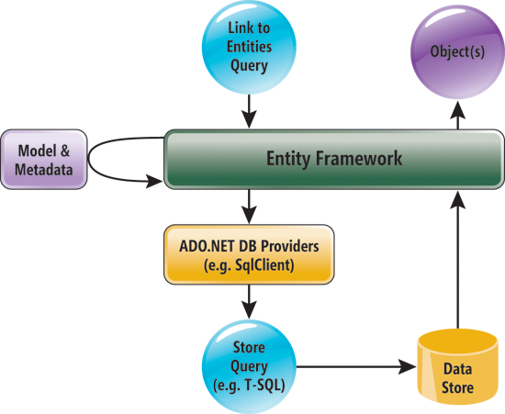
EF WorkFLow

Slide 11
EF
There are 3 ways to define DBContext Model with EF:
Database First
Model First
Code First

Slide 12
EF – Code First
Domain Classes
DbContext ModelBuild (runtime)
Configurable by data annotations & fluent api
Use tools to visualize the model – Entity Framework Power Tools

Slide 13
EF – Code First
Data Layer
DbContext
DbSet<T>
Collection of single object type
Add, Attach, Remove, Find
Use with DbContext to query database
Set for all domain object classes

Slide 14
Migrations
Enable-migrations from Package Manager Console
enable-migrations –EnableAutomaticMigrations
Migrations can be:
Automatic
Code Based
IDatabaseInitializer
CreateDatabaseIfNotExists (default)
DropCreateDBIfModelChanges
DropCreateDatabaseAlways -> for testing
MigrateDatabaseToLatestVersion

Slide 15
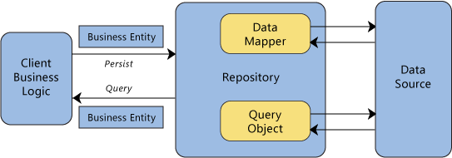
rEPOSITORY
Why use it?
Separation of concerns
Reduce repetitive code
Testability

Slide 16
repository
Applicability – any time you need data persistence
Relational databases
Web services
File system
Consequences
Increased level of abstraction
Maintainability, flexibility, testability

Slide 17
EF
Demo
Change implementation to use repository pattern

Slide 18
One Common Goal

