Slide 1
TEAM CLAUDIU
MIHAI CIORASCU
ROBERT BERES

Slide 2
WHEN DID FANTASY FOOTBALL LAST MAKE YOU FEEL SOMETHING?

Slide 3
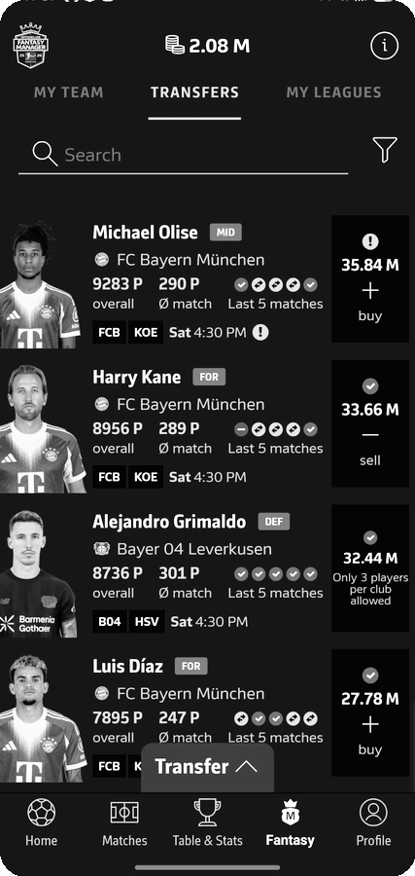
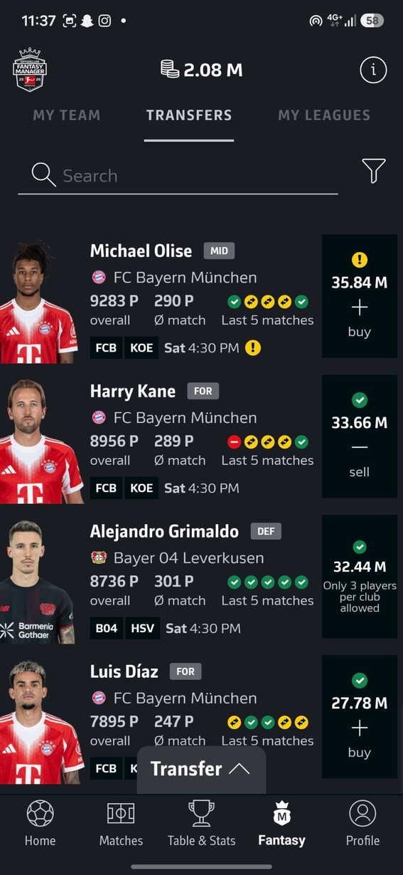
FANTASY TODAY
PLAYERS BECOME
NUMBERS
BUY. SELL. OPTIMISE. REPEAT.

Slide 4
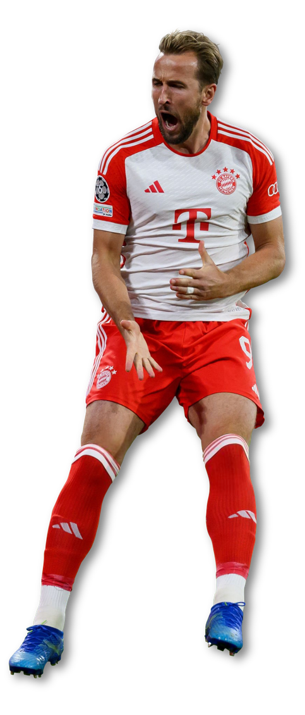


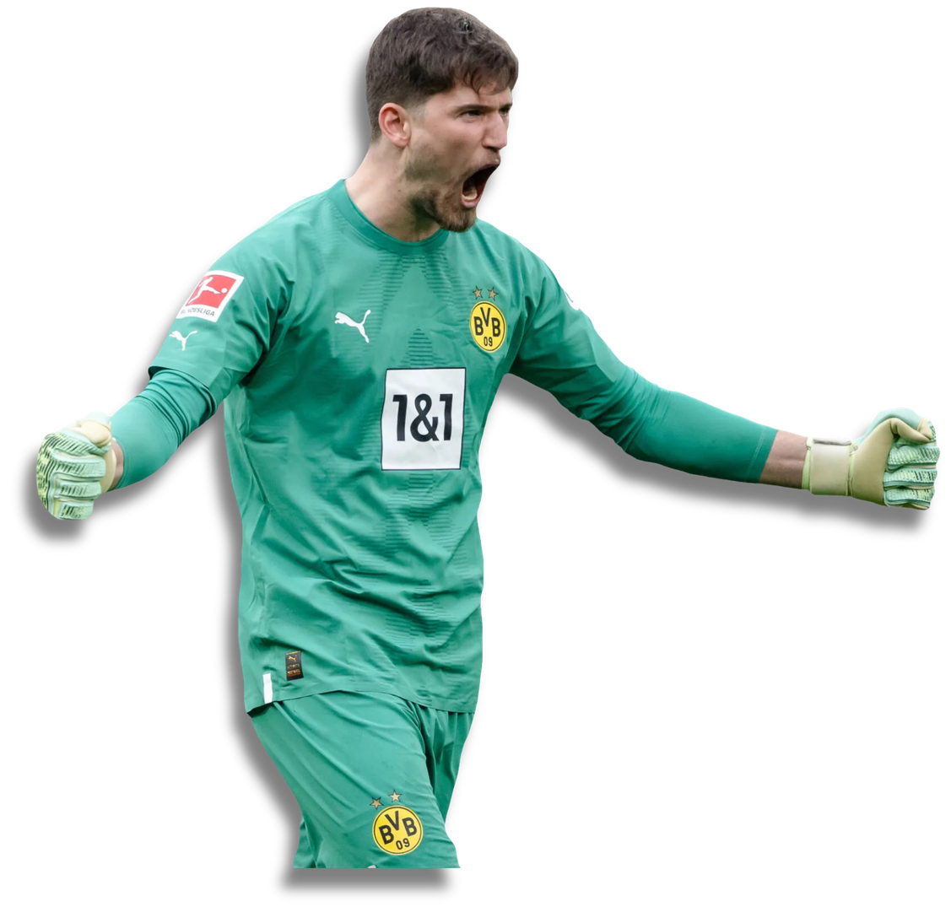


Slide 5
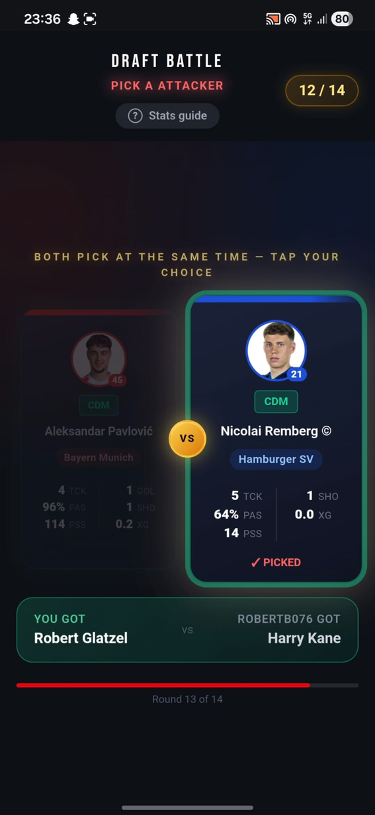
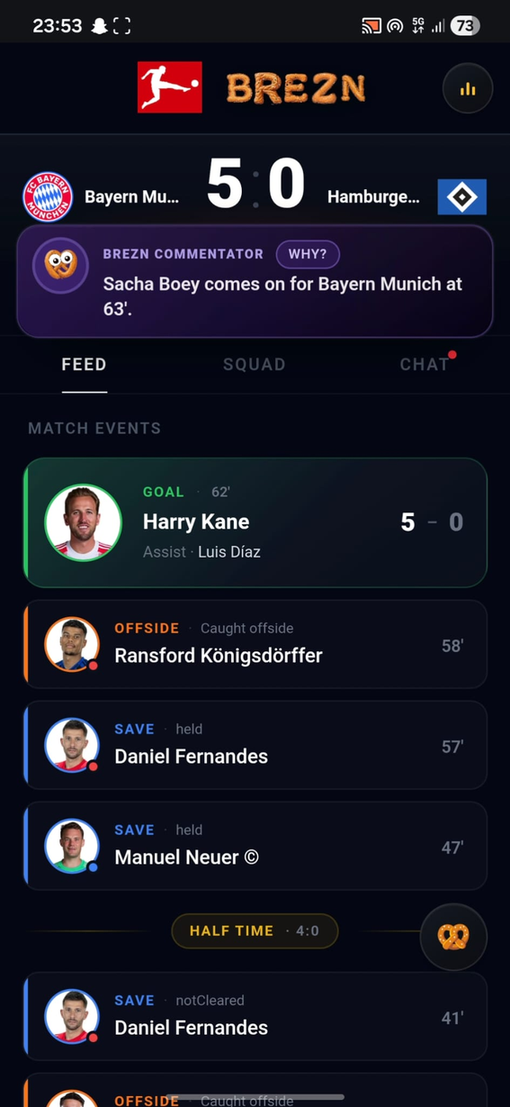
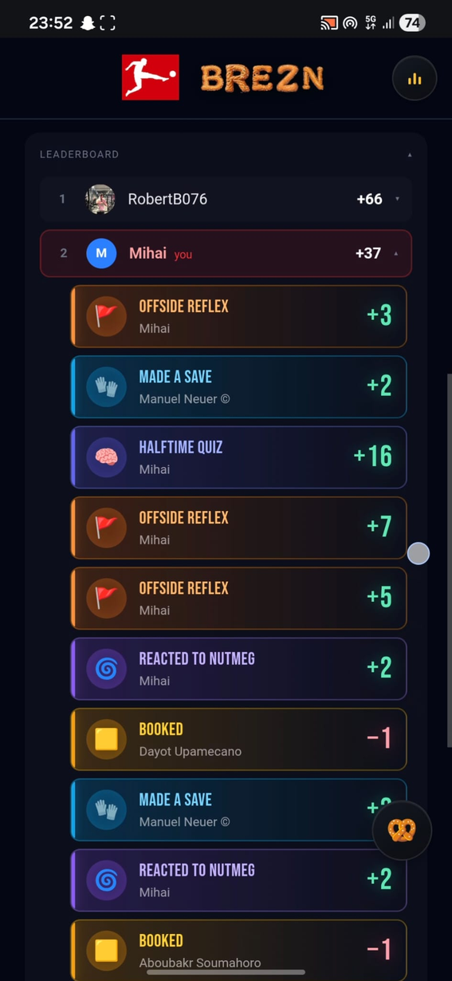

Slide 6
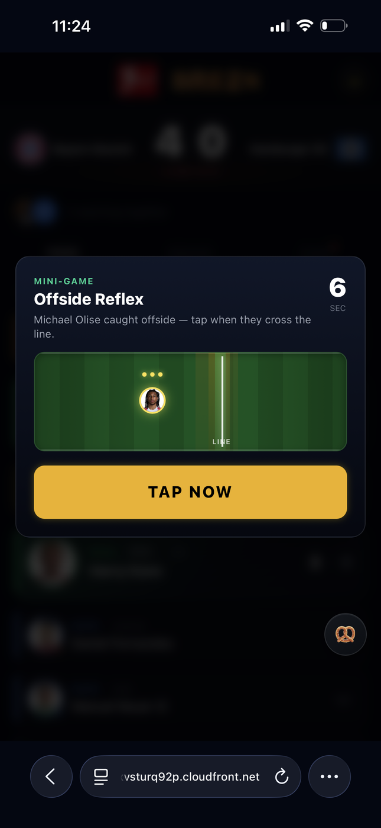
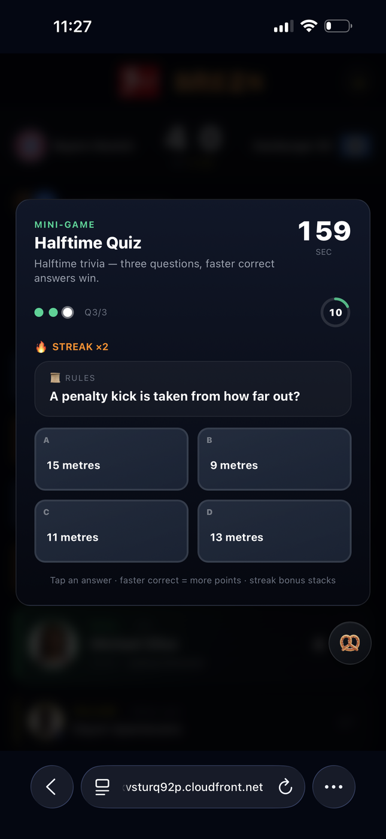
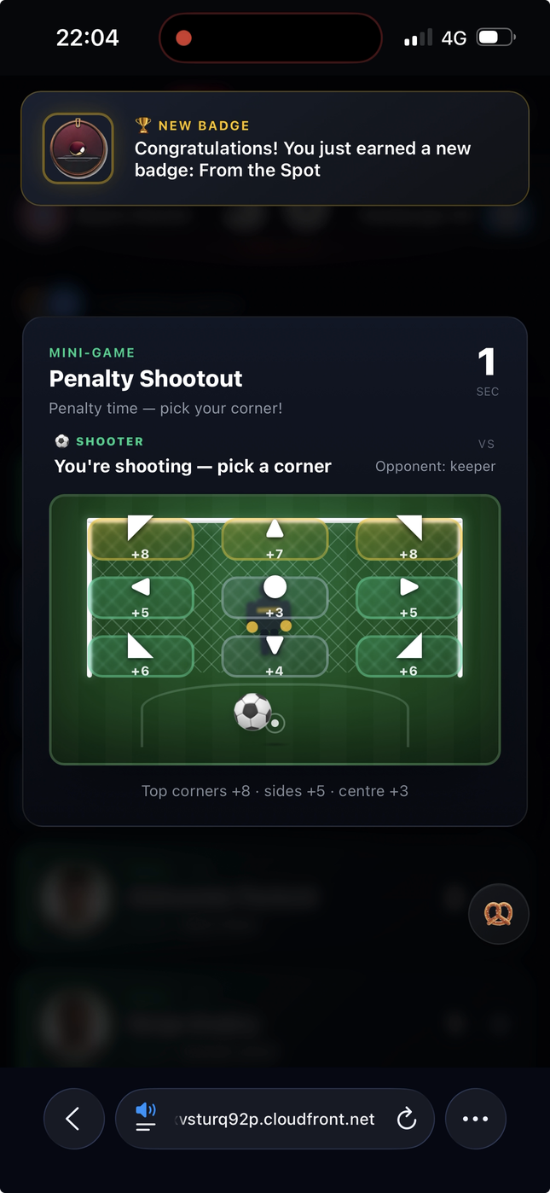

Slide 7
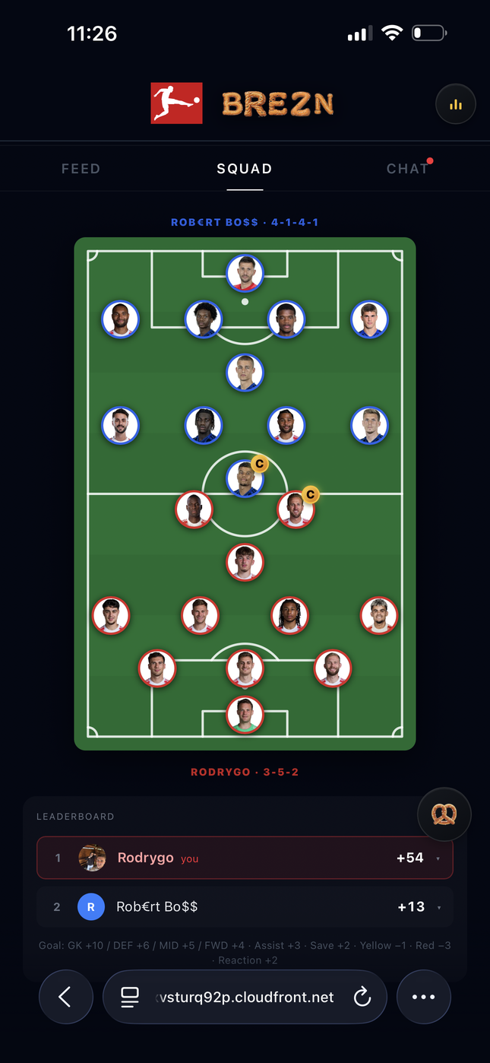
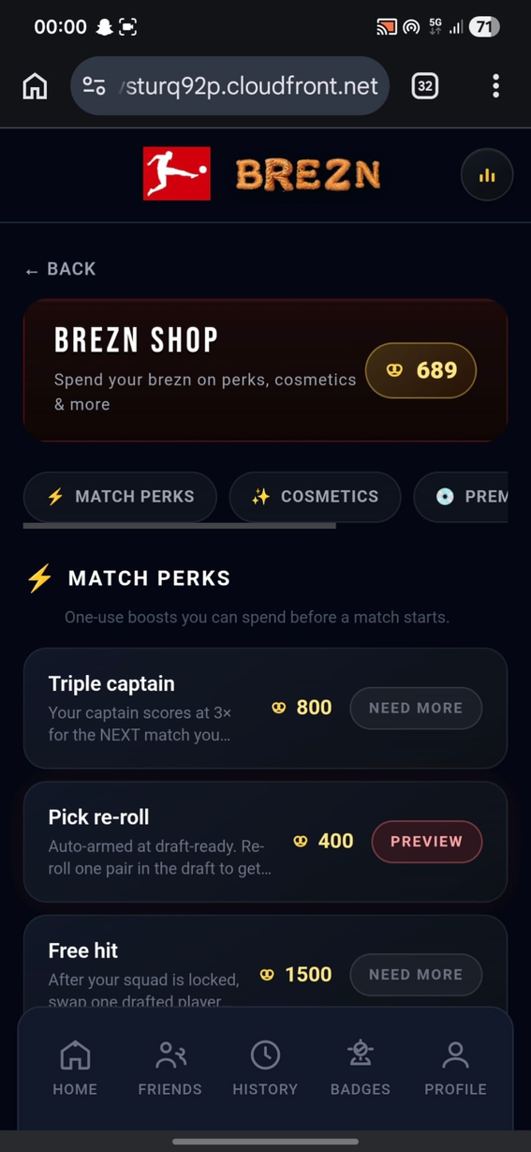
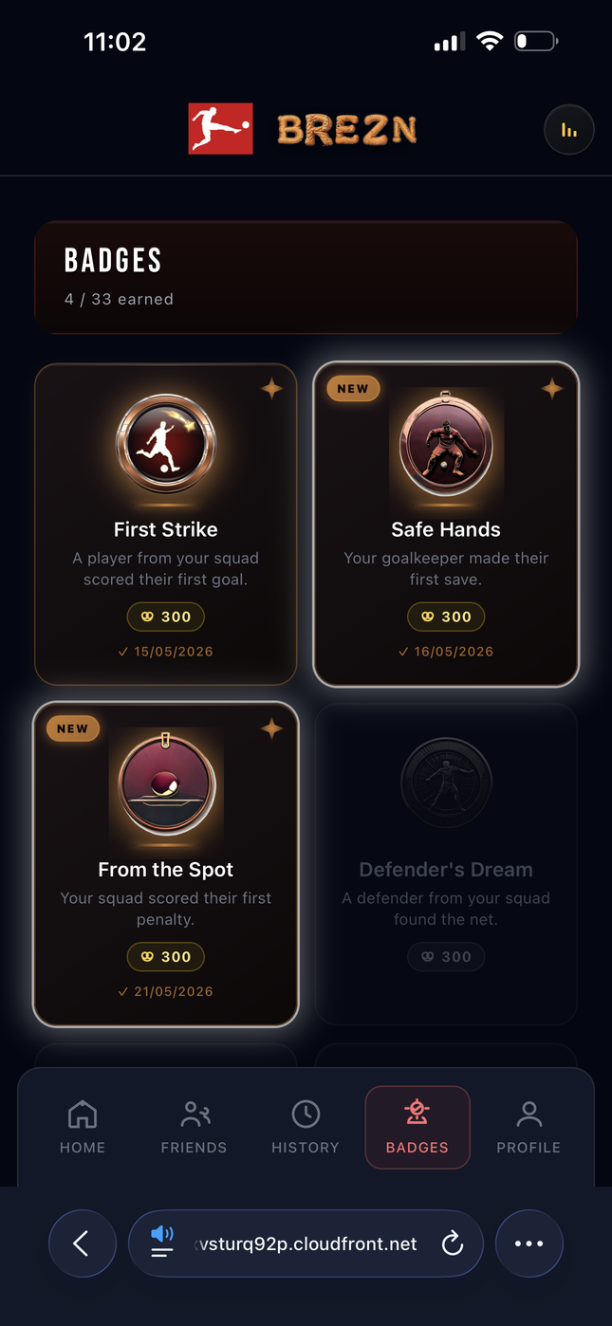

Slide 8
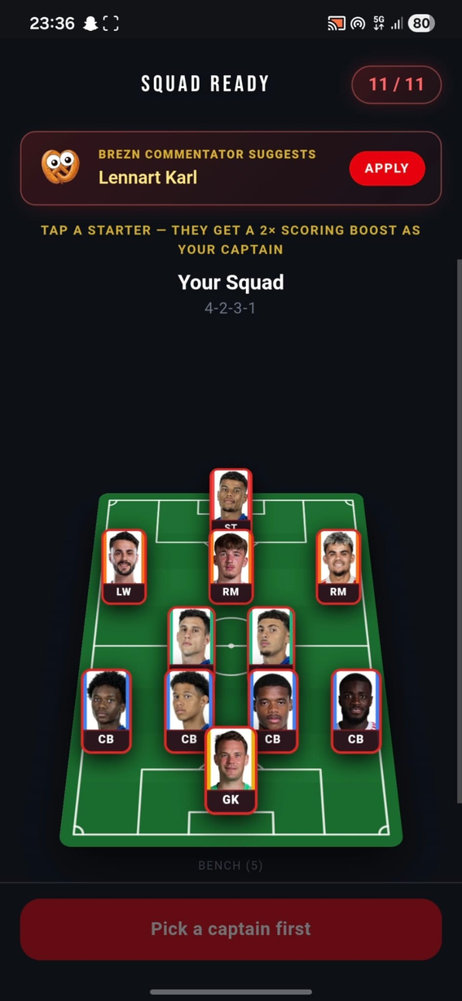
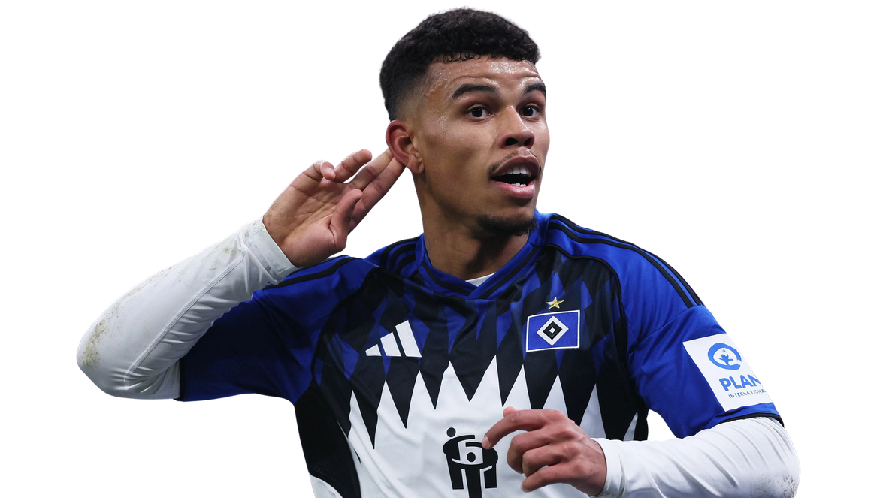
PLAYERS BECOME
YOURS

Slide 9
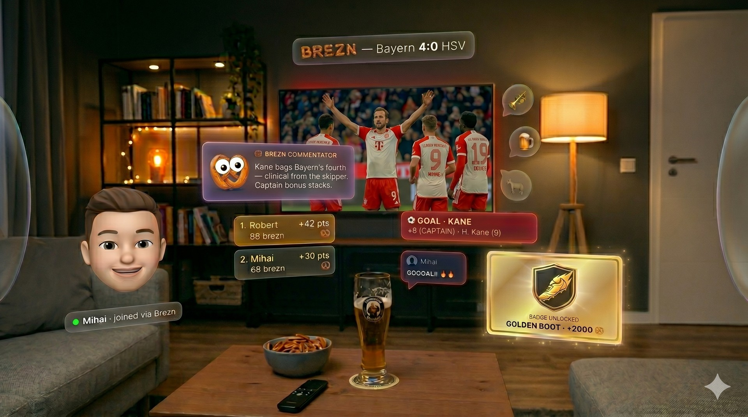
FINAL CONCEPT

Slide 10



FINAL CONCEPT

Slide 11

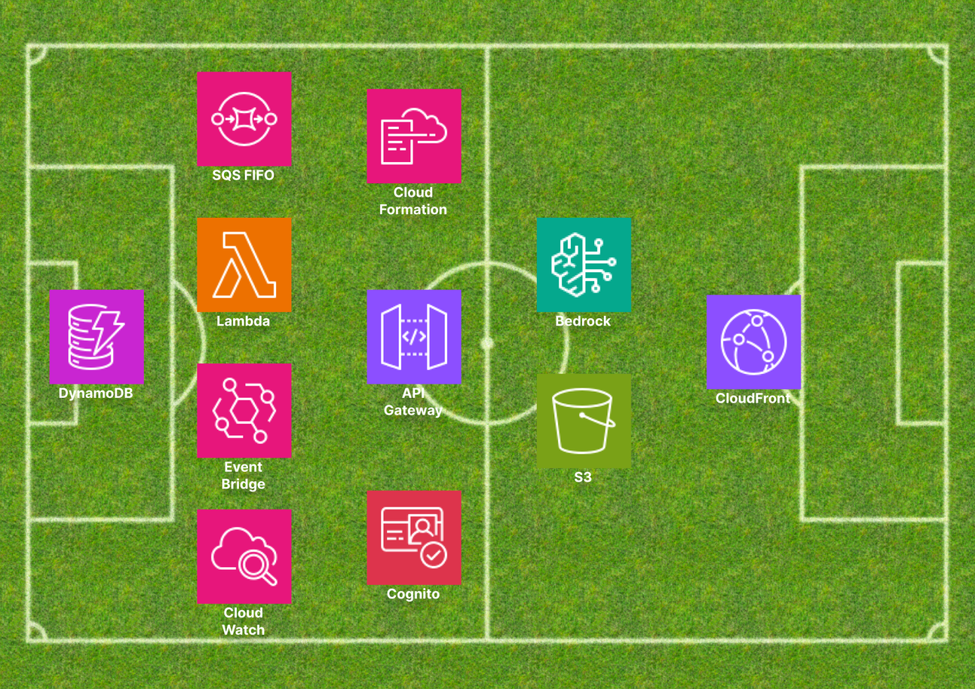
AWS DEPLOYMENT
The entire solution is AWS native:
Fully serverless on AWS, built around independent microservices:
Lambda - 6+ functions, each scoped to a single microservice
Cognito - user authentication & authorization
S3 - one bucket for storage and one for the frontend
DynamoDB - on-demand capacity for seamless scaling
CloudFront - CDN for low-latency global content delivery
API Gateway - REST APIs for standard request/response + WebSocket API for real-time communication
EventBridge - event-driven service communication
SQS FIFO - guaranteed ordered, exactly-once message delivery between services
Bedrock - real-time AI commentary & quiz generation
4-3-2-1

Slide 12
THANK YOU !

