Slide 1

Nice and easy

Slide 2
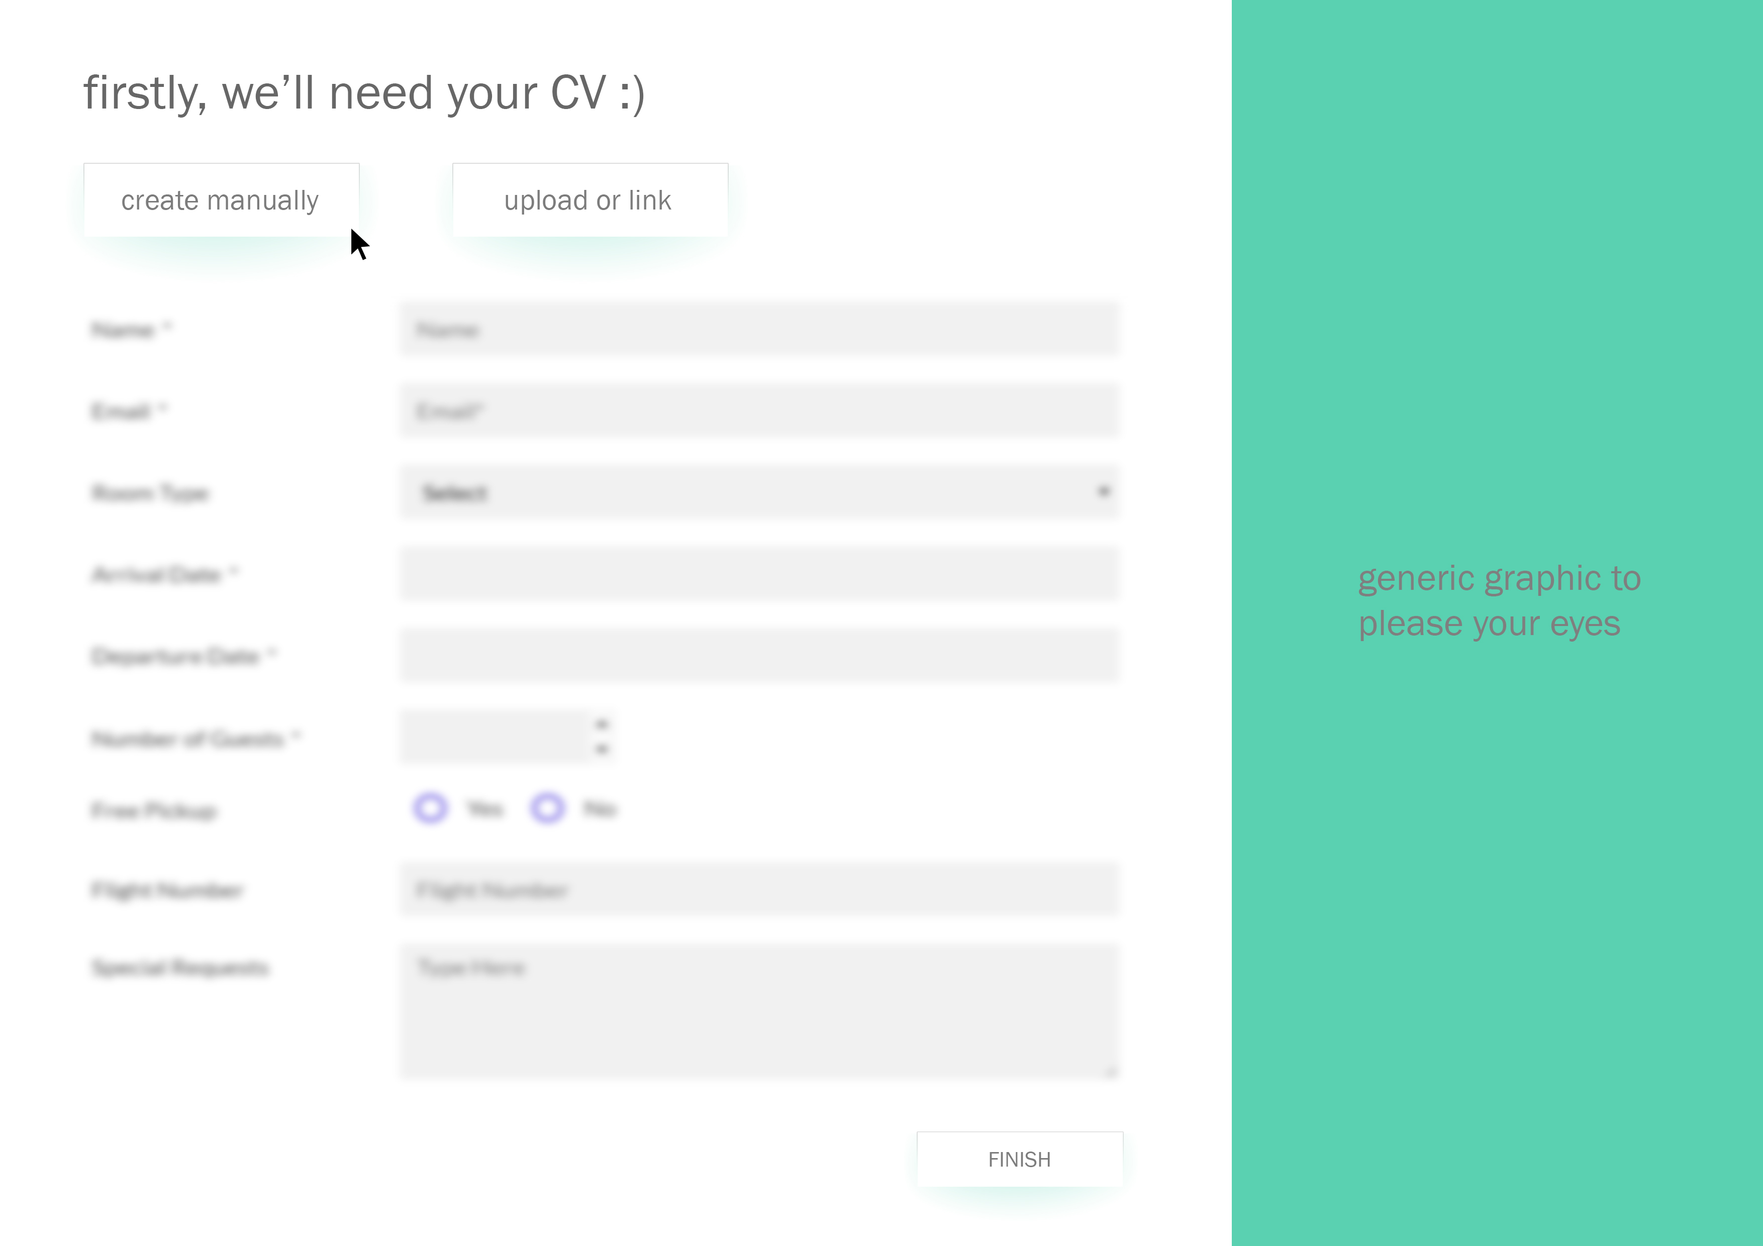
Here we go.
How do we take this cv as an input?
As clear as possible, structured and convenient for our needs, as from it we will have to easily extract the keywords which will be used in the job matching algorythm and when we generate the custom cover letters.

Slide 3
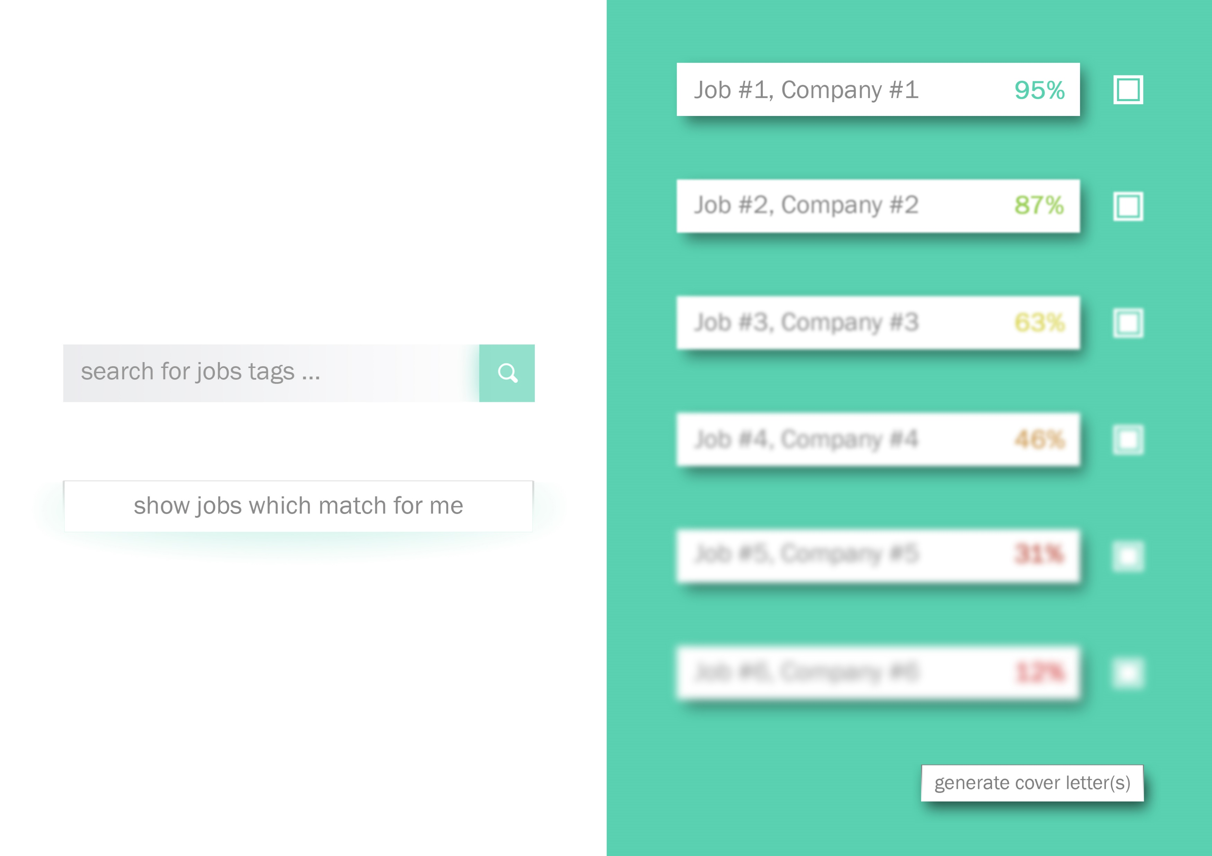



Search and matching functionalitates which find job links and scrape them to retrieve relevant information for the user.
Multiple tag search (ex: c++, game dev, Google will search for jobs which contains those tags)
Iterative searches for jobs using keywords
found in the user’s cv
Using ML now we can deploy our model to create custom cover letters taking into account similarities between user’s cv and specific jobs descriptions

Slide 4
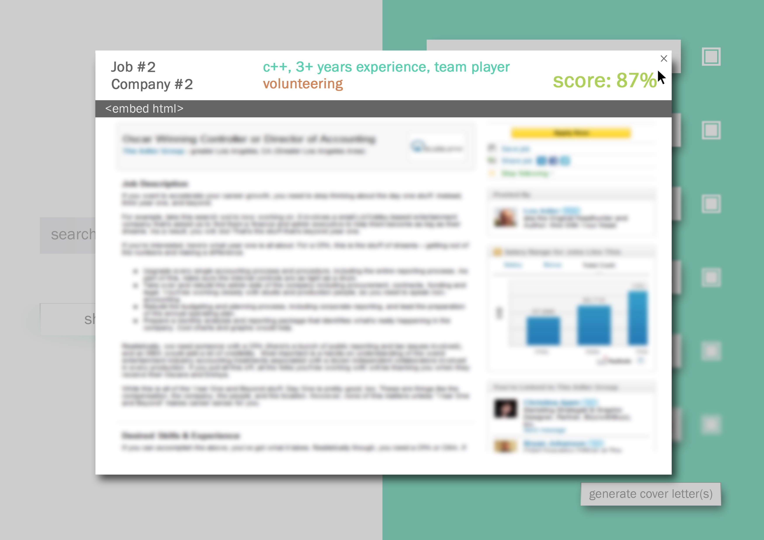
User can inspect each job returned by the algorithm for further reading
In the header the user will see some insights about the criterias used to return that specific job, like what were the matching/missing keywords between his cv and the job description.
Upon finishing inspecting the jobs, the user can choose the ones to apply to and go on the next step, ie. generating the cover letter(s).

Slide 5
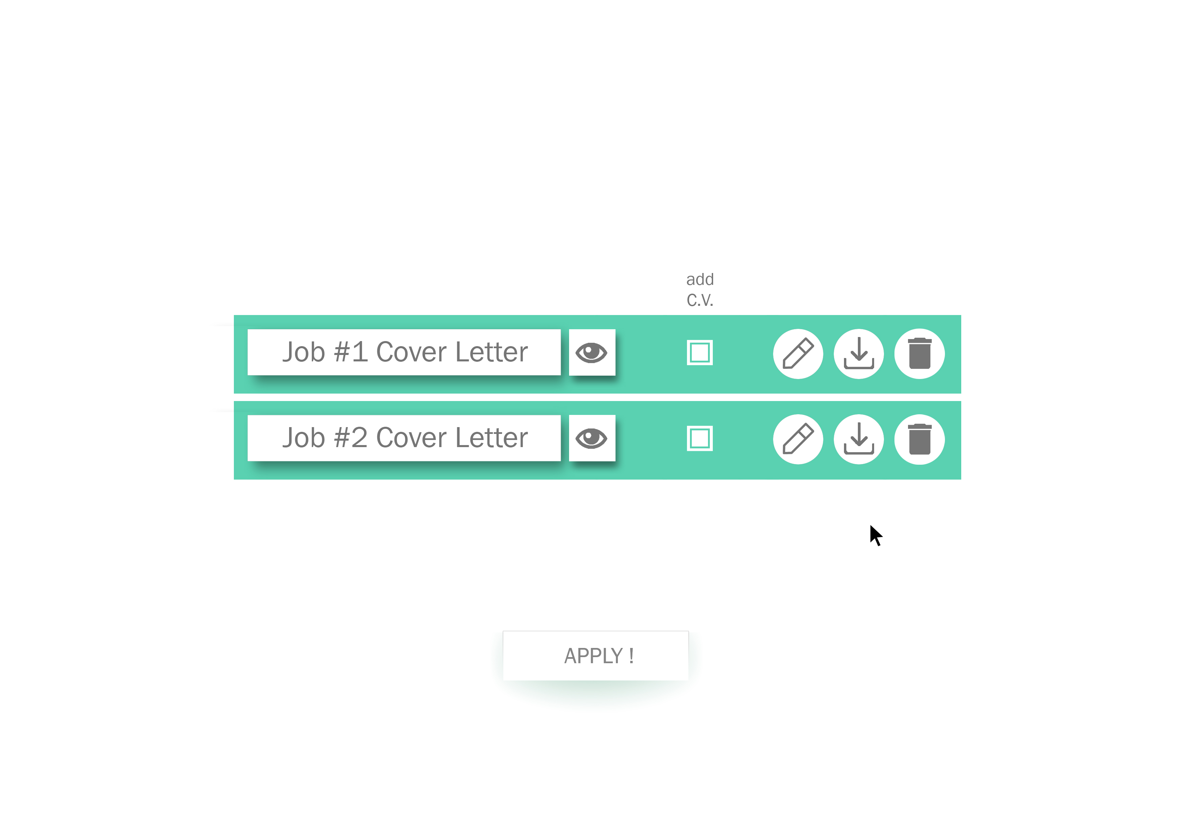
Arriving on this last page, the user will see a list containg the generated cover letters for the previous checked jobs.
He just needs to decide if he wants to remove items from the list, after which he can batch apply!

Slide 6
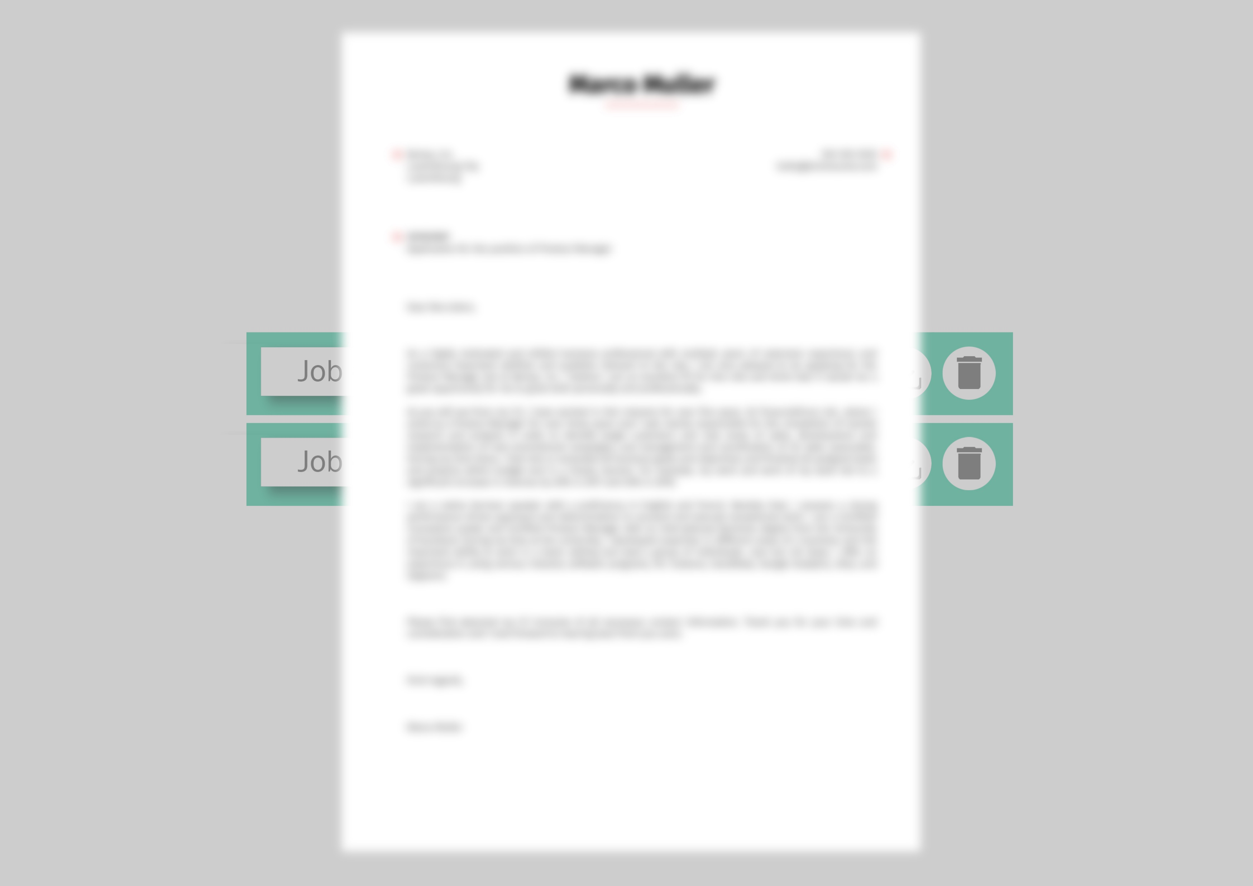
Naturally, the user can also inspect, edit, download, discard the generated letters.

Slide 7
Thank you !

