Slide 1

By Team 37 :
Teodor tonghioiu
Claudiu dărămuș
Răzvan pop
Cristian Hilohi

Slide 2
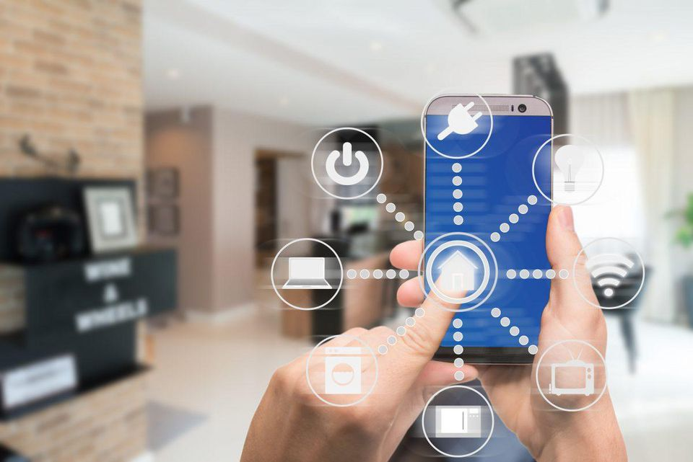
Why we made it?
Makes homes smarter
Eases your acces
You won’t need your keys anymore

Slide 3
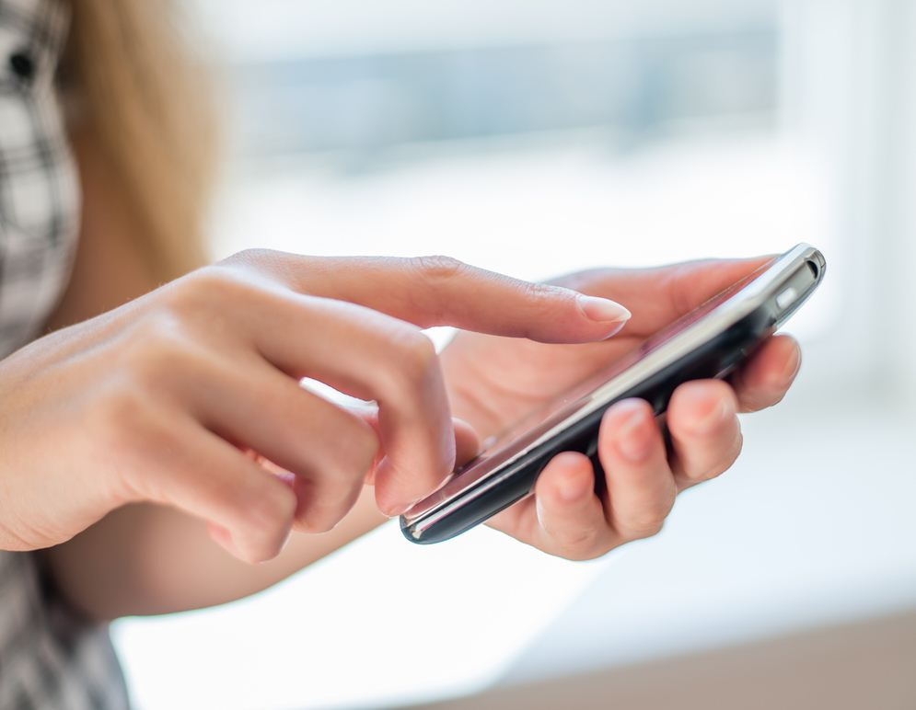
Who can use it?
Easy to afford for most people
Good for any user

Slide 4
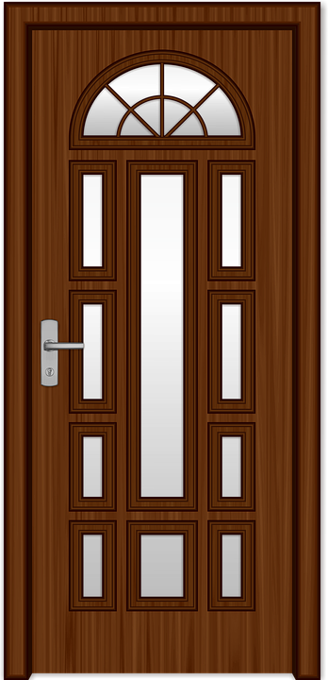

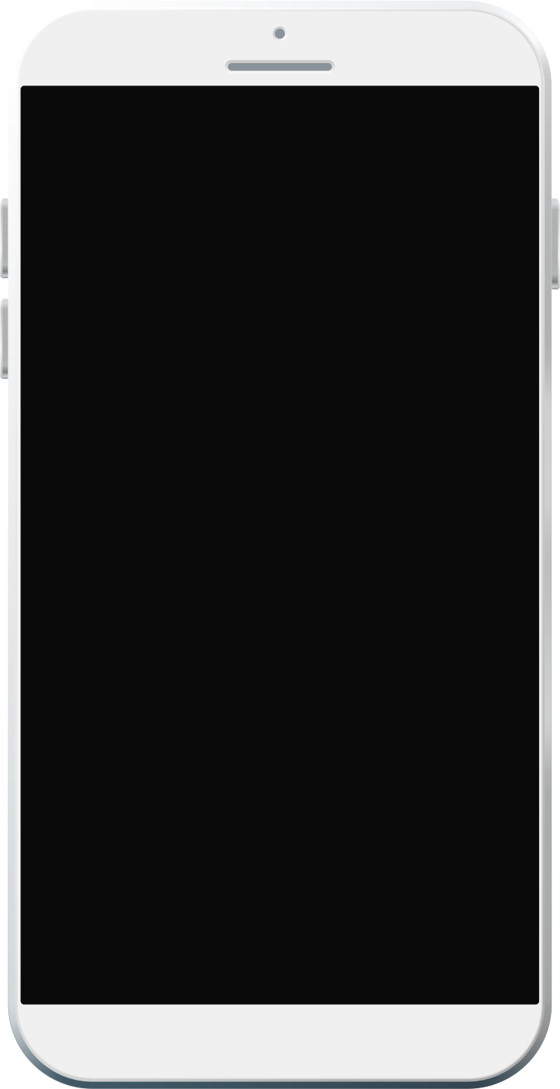

functionality
Lock/unlock your doors using just the phone
Auto-unlocking makes everything easier

Slide 5
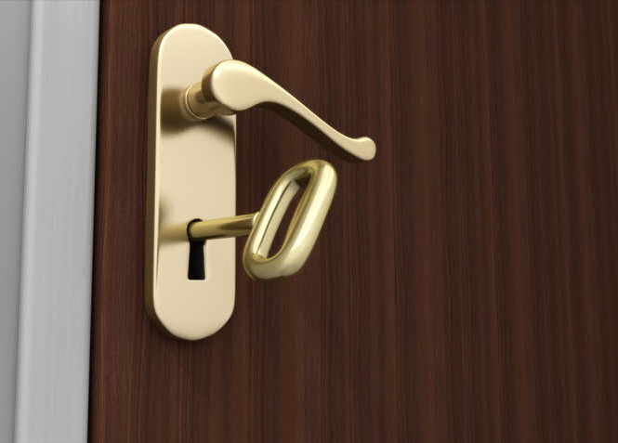
How to use it
Put the Bluetooth device on the inside of the door
Pair the lock with your phone
Save your lock
You can lock/unlock when you are paired
The lock can unlock itself if you want

Slide 6
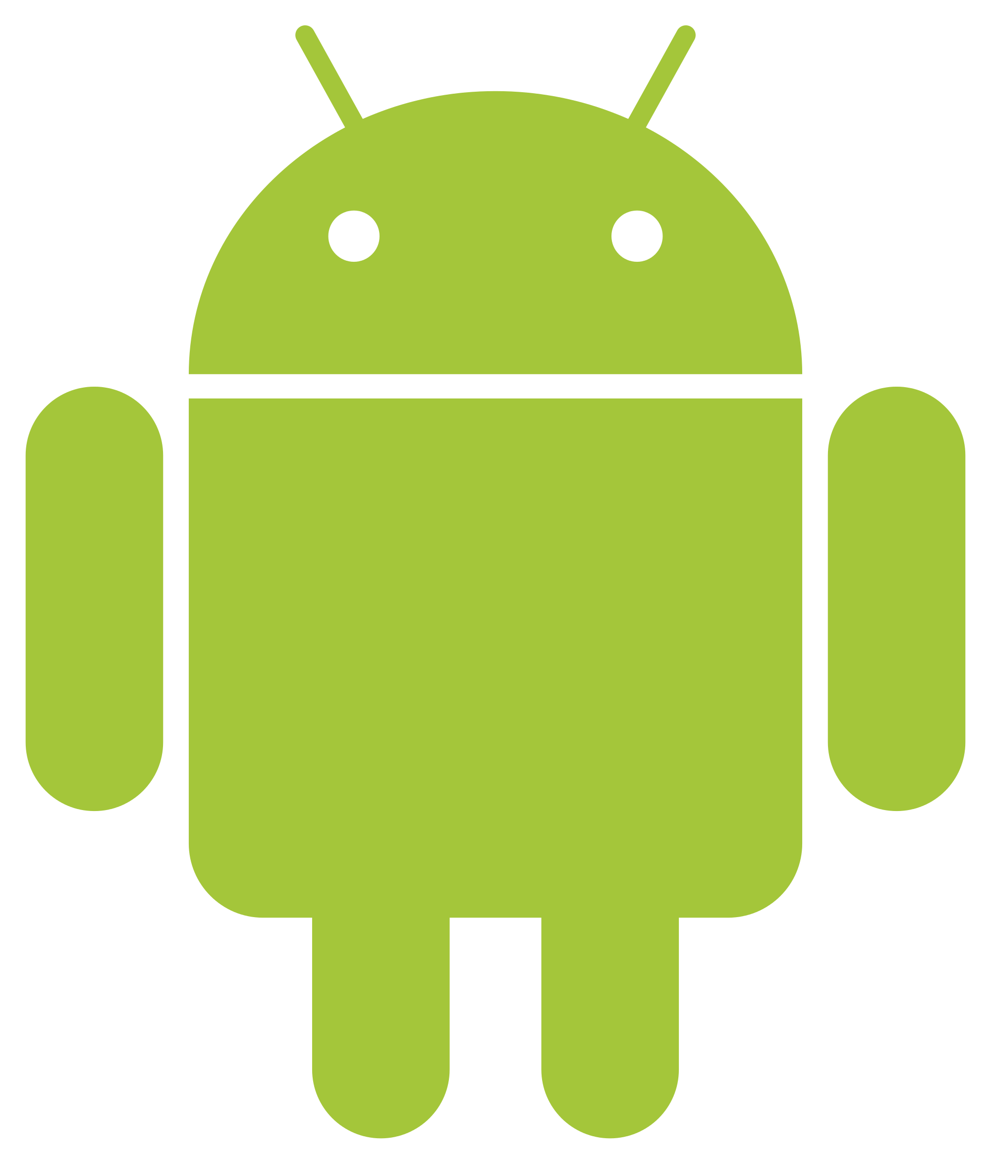


What we used?
Device using Bluetooth with Arduino
Android app made in Android Studio using Java
Icons designed in Adobe Photoshop

Slide 7
How we organised
Răzvan: phisycal device
Cristi: design and interface
Claudiu and Teo: Bluetooth and more code

Slide 8
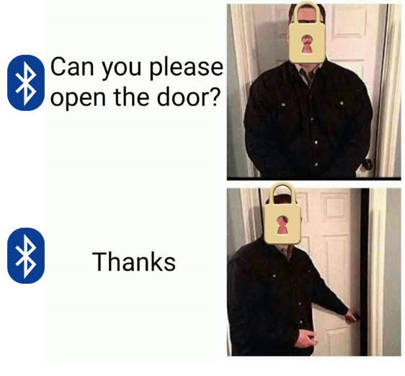
Thank you!

