Slide 1
Project development guide
https://el-bid.github.io/Developers-Guide-for-Creating-Digital-Tools/

Slide 2
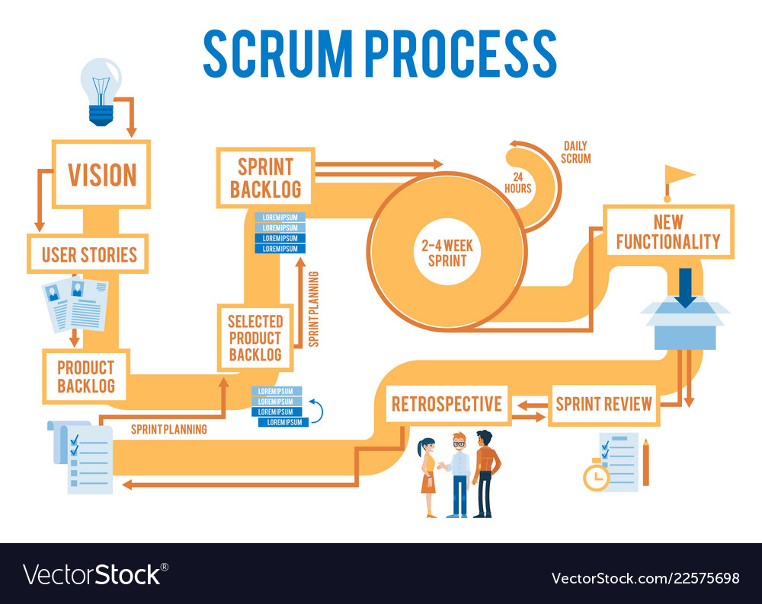

Slide 3
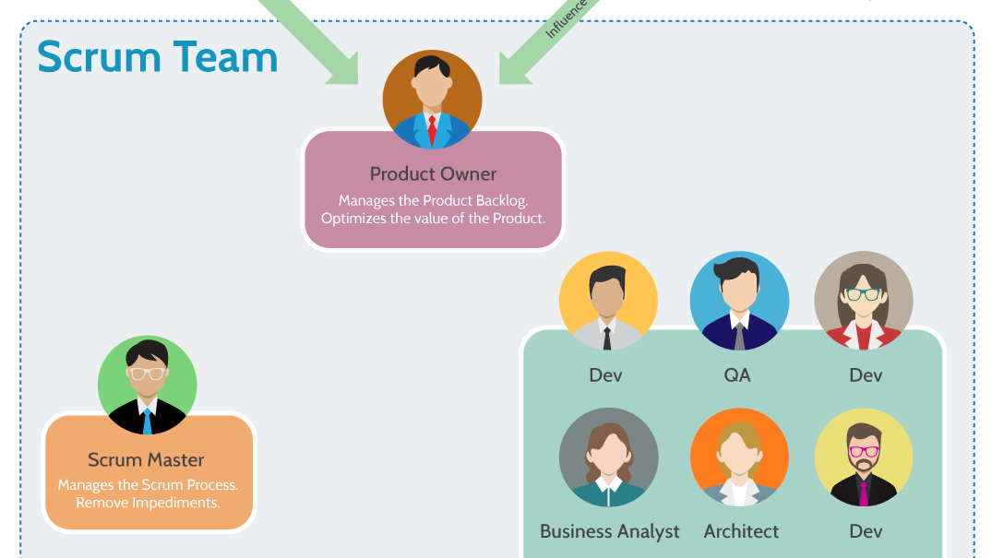

Slide 4


Slide 5
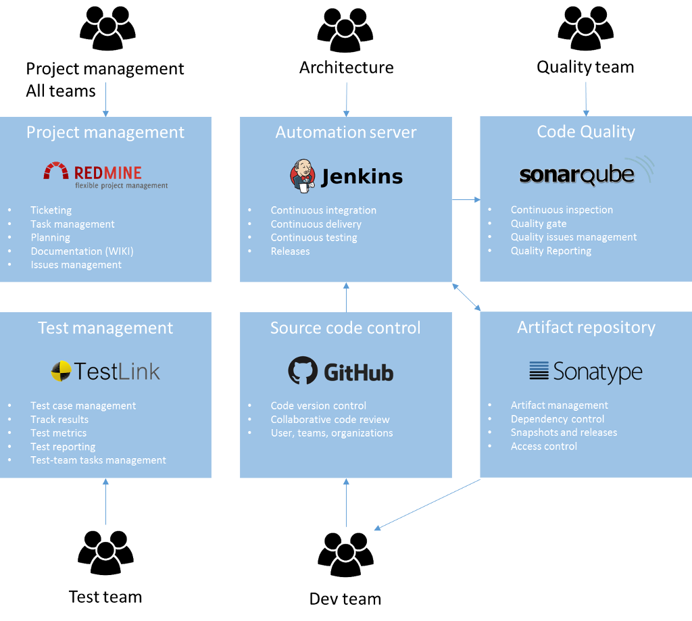

Slide 6
Predarea proiectului: 20% din nota finala la disciplina
Documentatie in format electronic (.pdf) + un exemplar listat.
Anexa (codul sursa).
prezentare power point + prezentarea practica

Slide 7
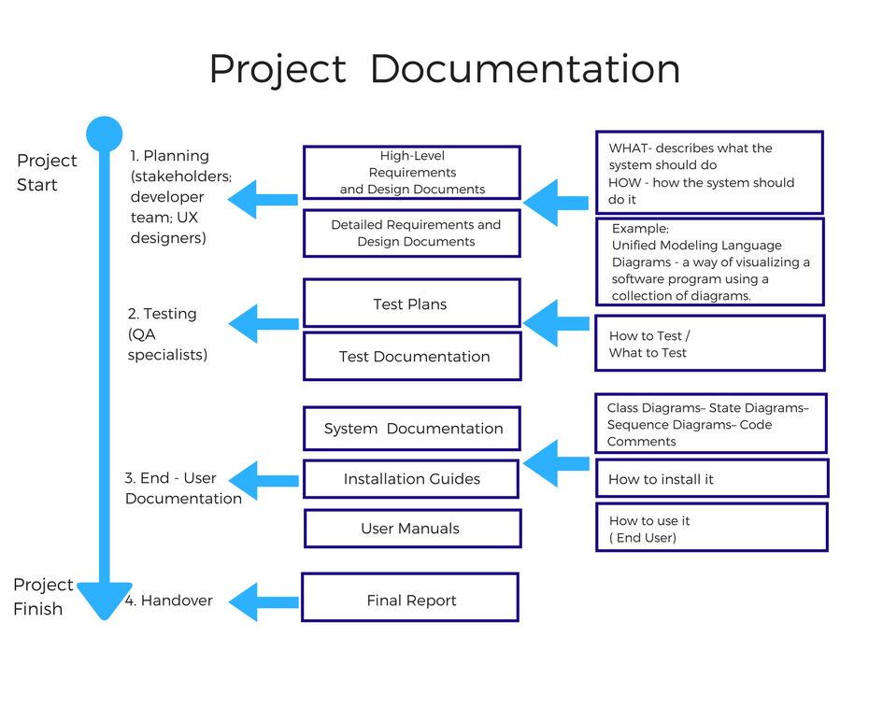

Slide 8
Next steps:
Chose a project – SM will facilitate this step
from:
https://www.kaggle.com/competitions
or
Bring your own idea for a debate
Next meeting:
PO&BA – present the project vision & functional reequipments – 20 min
SM – present the WoW – 20 min
Architect – present the initial set-up of the project and the development tools – 20 min
QA – present the testing plan – 20 min
Q&A – 10 min

