Slide 1
RESTAURANT
Bugnariu Vlad
Fildan Claudiu
Technical University of Cluj-Napoca
Automation Department

Slide 2
objective
The main goal of this program is to emulate an interface between an restaurant and a customer.
In this way some of the inconveniences can be solved in the case of making a reservation while the phone line is busy or the waiter is not coming to take your order.

Slide 3
DIAGRAM
MAIN.C
RESERVATION.H
RESERVATION.C
ROOM _DETAILS.H
ORDER.H
ROOM_DETAILS.C
ORDER.C
MISCELLANEOUS.C
MISCELLANEOUS.H
MAIN
HEADER
CODE

Slide 4
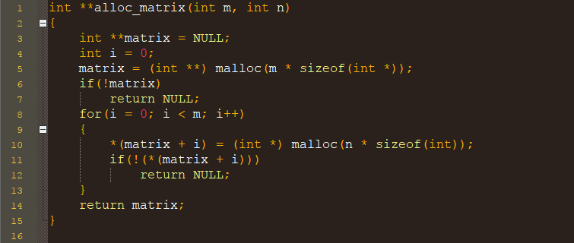
Module reservation Function alloc matrix
DESCRIPTION:
Allocates memory for a M by N matrix of integers

Slide 5
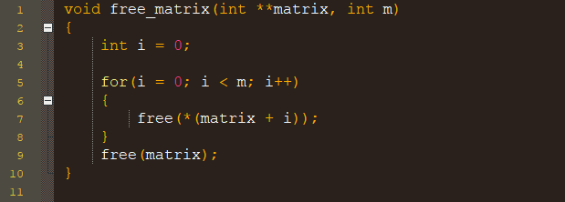
Module reservation function free matrix
DESCRIPTION:
Deallocates memory for a M by N matrix of integers

Slide 6
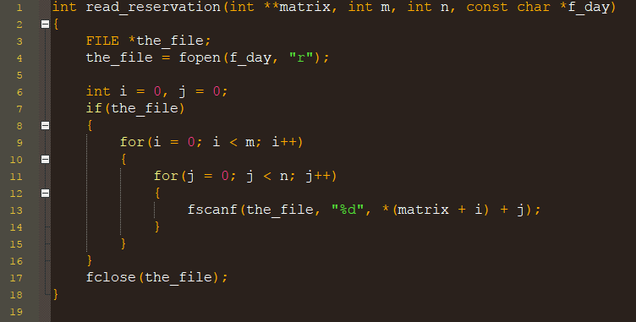
Module reservation Function read reservation
DESCRIPTION:
Reads the table status matrix from the file corresponding to the selected day

Slide 7
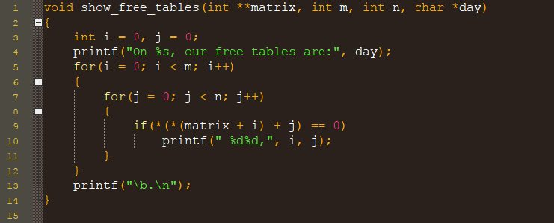
Module reservation Function show free tables
DESCRIPTION:
Displays a list of the free tables in the selected day

Slide 8
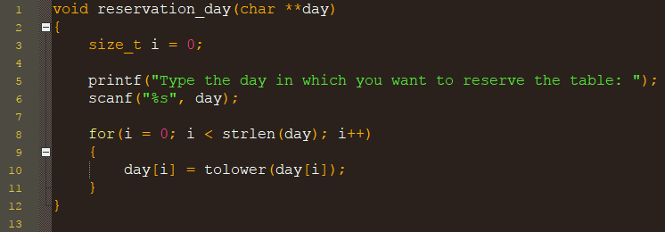
Module reservation Function reservation day
DESCRIPTION:
Gets the day of the reservation

Slide 9
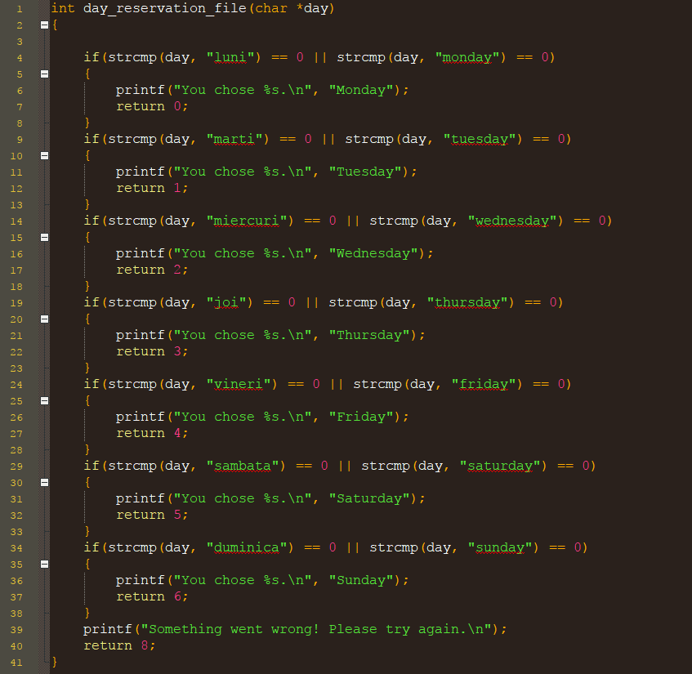
Module Room Details Function day reservation file
DESCRIPTION:
Returns the weekday as a digit between 0 and 6 or 8 in case of an error

Slide 10
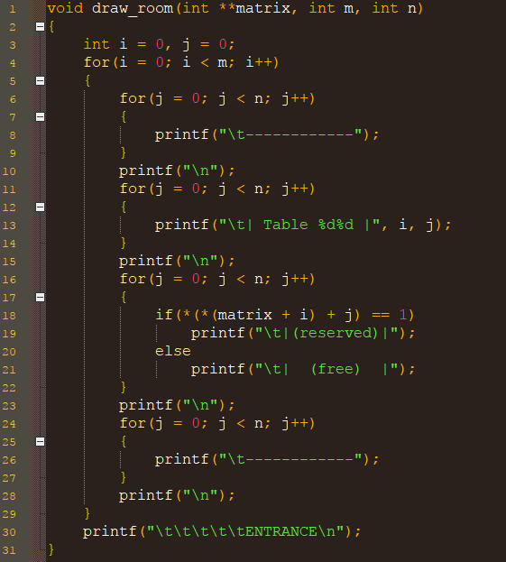
Module Room Details Function draw room
DESCRIPTION:
Graphically displays the room and which tables are reserved

Slide 11
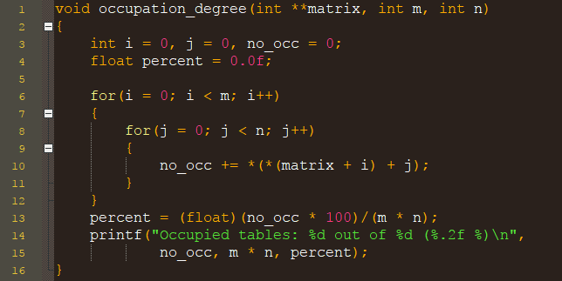
Module Room Details Function occupation degree
DESCRIPTION:
Displays the ratio between the number of occupied and total tables

Slide 12
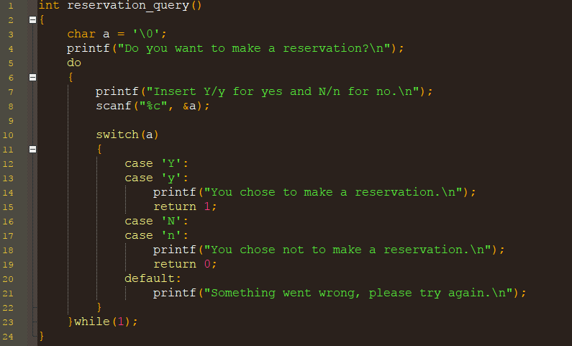
Module Room Details Function reservation query
DESCRIPTION:
Asks the user whether to make a reservation or not

Slide 13
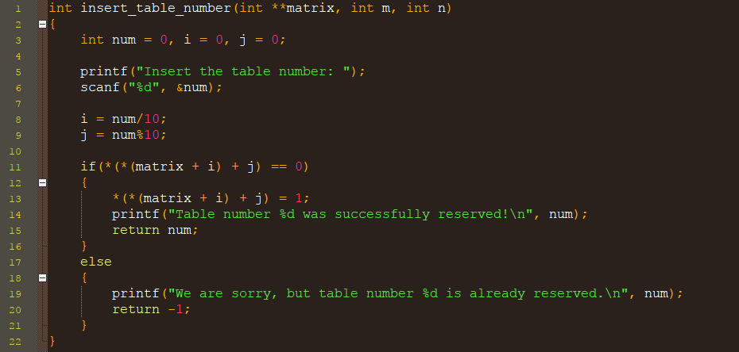
Module Room Details function insert table number
DESCRIPTION:
Gets whether the user's input table is occupied or not

Slide 14
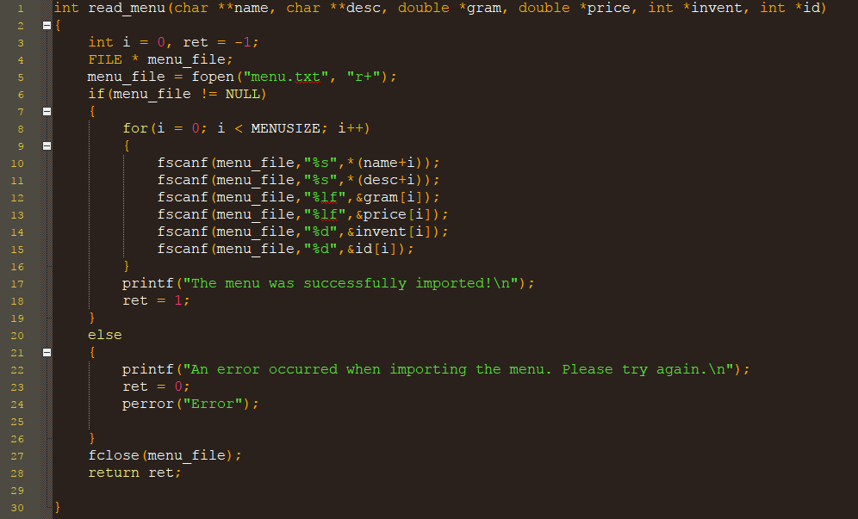
MODULE ORDER FUNCTION READ MENU
DESCRIPTION:
Reads the menu from an external file

Slide 15
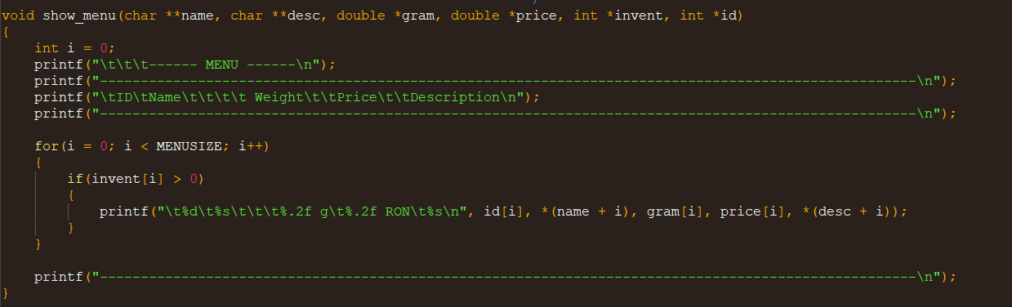
MODULE ORDER FUNCTION show menu
DESCRIPTION:
Displays the menu items along with their descriptions and specifications

Slide 16
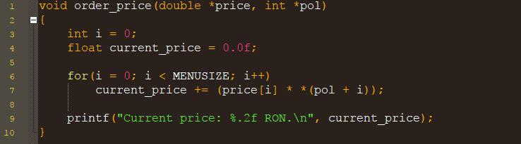
MODULE ORDER FUNCTION order price
DESCRIPTION:
Computes the price for the current order

Slide 17
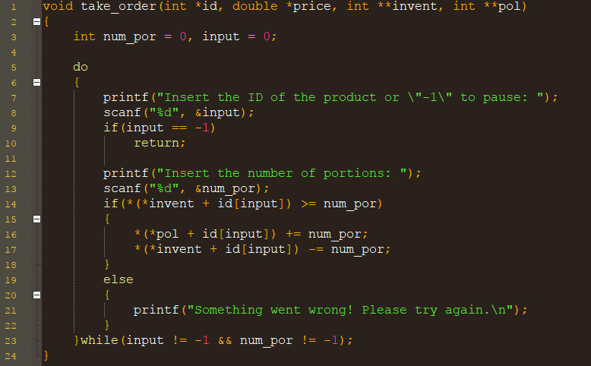
MODULE ORDER FUNCTION take order
DESCRIPTION:
Prompts the user to input his/her order

Slide 18
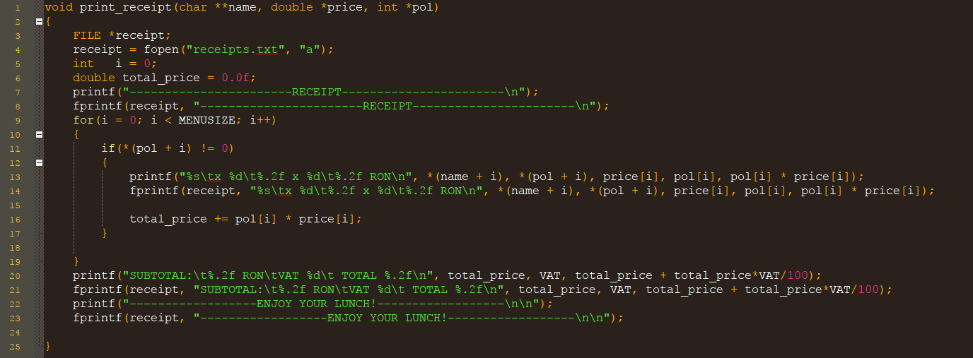
MODULE ORDER FUNCTION print receipt
DESCRIPTION:
Prints a detailed receipt of the order

Slide 19
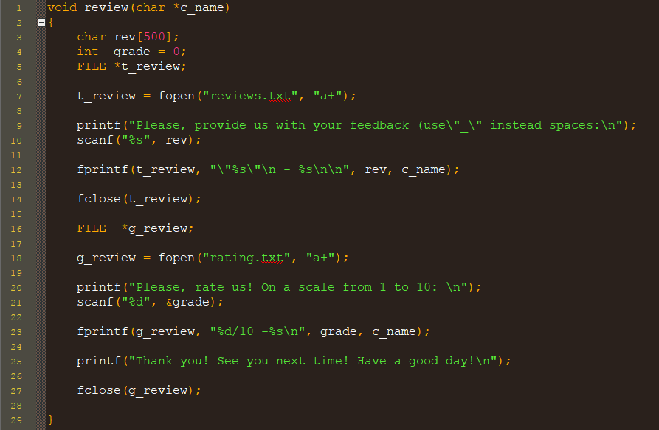
Module miscellaneous function REVIEW
DESCRIPTION:
Prompts the client to express his opinion both as text and as a grade from 1 to 10 and stores them in files

Slide 20
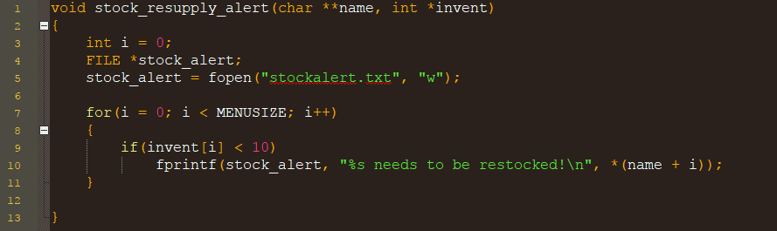
Module miscellaneous function stock resupply alert
DESCRIPTION:
Whenever the stock for a product drops under 10 pieces, the function writes in a file that the certain product needs to be restocked

Slide 21
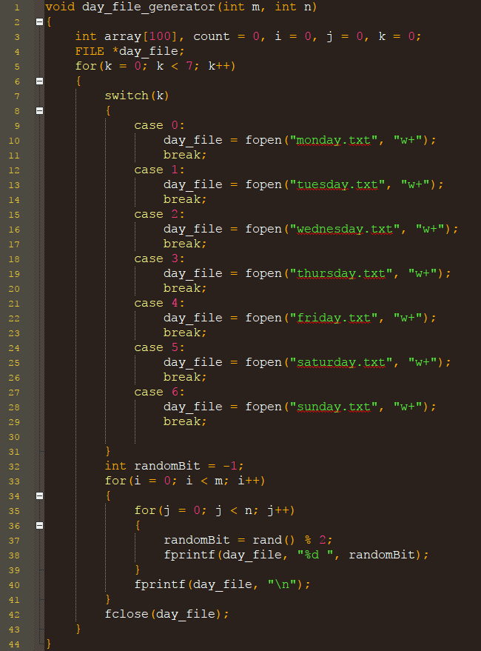
Module miscellaneous function day file generator
DESCRIPTION:
Creates the file from which the occupied table are shown

Slide 22
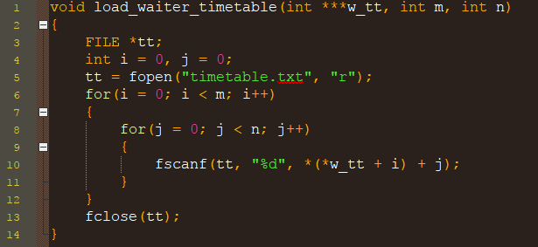
Module miscellaneous function load waiter timetable
DESCRIPTION:
Imports the waiter timetable from a file

Slide 23
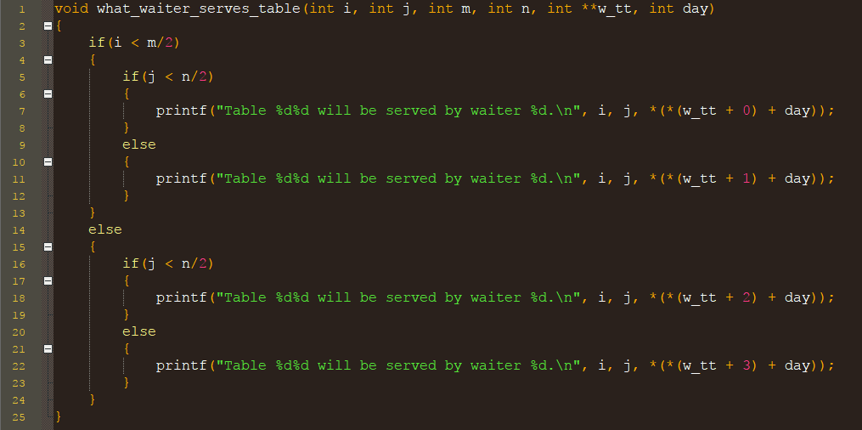
Module miscellaneous function what waiter serves table
DESCRIPTION:
Displays which waiter will serve at the respective table

Slide 24
Thank you for your attention!

