Slide 1
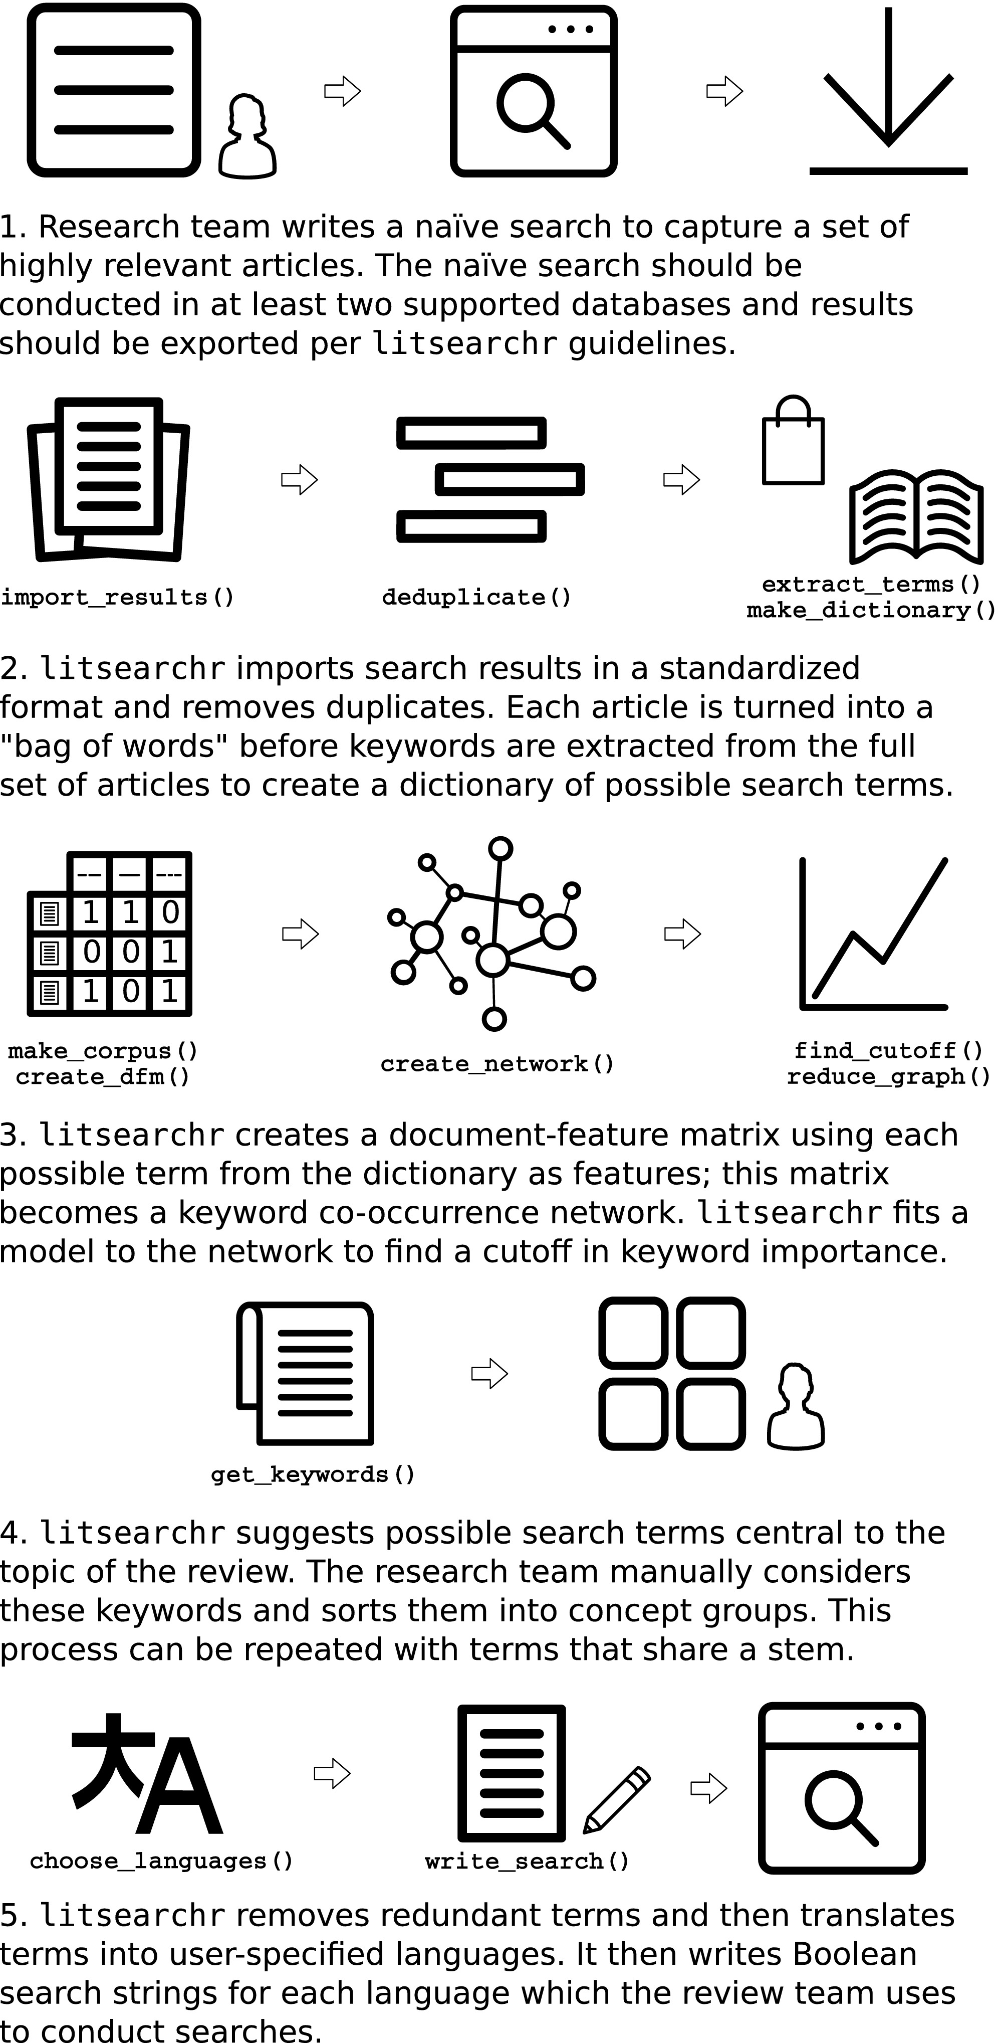
Use a naïve search to capture large set of relevant articles through:
- web scraping
- data base API
2. Use litserchr to:
- extract terms through bag-of-words approach,
- construct a document-feature matrix,
- fit a keyword Co-Occurrence Network,
- reduce to most relevant nodes based on cutoff,
- write the systematic search string based on results.
scrape_gs()
package
easyPubMed
extract_terms()
create_dfm()
create_network()
find_cutoff()
reduce_graph()
write_search()

Slide 2
An automated approach to identifying search terms for systematic reviews using keyword co‐occurrence networks
Graphical representation of the litsearchr workflow. Icons with functions listed below them can be done automatically by litsearchr whereas other steps require manual input. An information specialist or librarian should be part of the review team, especially for steps indicated with a person icon. Icons created by Calvin Goodman, Meaghan Hendricks, Yu Luck, and Mun May Tee from the Noun Project
IF THIS IMAGE HAS BEEN PROVIDED BY OR IS OWNED BY A THIRD PARTY, AS INDICATED IN THE CAPTION LINE, THEN FURTHER PERMISSION MAY BE NEEDED BEFORE ANY FURTHER USE. PLEASE CONTACT WILEY'S PERMISSIONS DEPARTMENT ON PERMISSIONS@WILEY.COM OR USE THE RIGHTSLINK SERVICE BY CLICKING ON THE 'REQUEST PERMISSIONS' LINK ACCOMPANYING THIS ARTICLE. WILEY OR AUTHOR OWNED IMAGES MAY BE USED FOR NON-COMMERCIAL PURPOSES, SUBJECT TO PROPER CITATION OF THE ARTICLE, AUTHOR, AND PUBLISHER.
Methods Ecol Evol, Volume: 10, Issue: 10, Pages: 1645-1654, First published: 20 July 2019, DOI: (10.1111/2041-210X.13268)

