Slide 1
SSM model 5updated & 6
Brief results

Slide 2
Variables
Score = euclidean error (lower = better performance).
Trial = tial number = time.
The conditionXorder interaction plot (plot_lmm_mod_5_interac) is based on model fitted values.

Slide 3
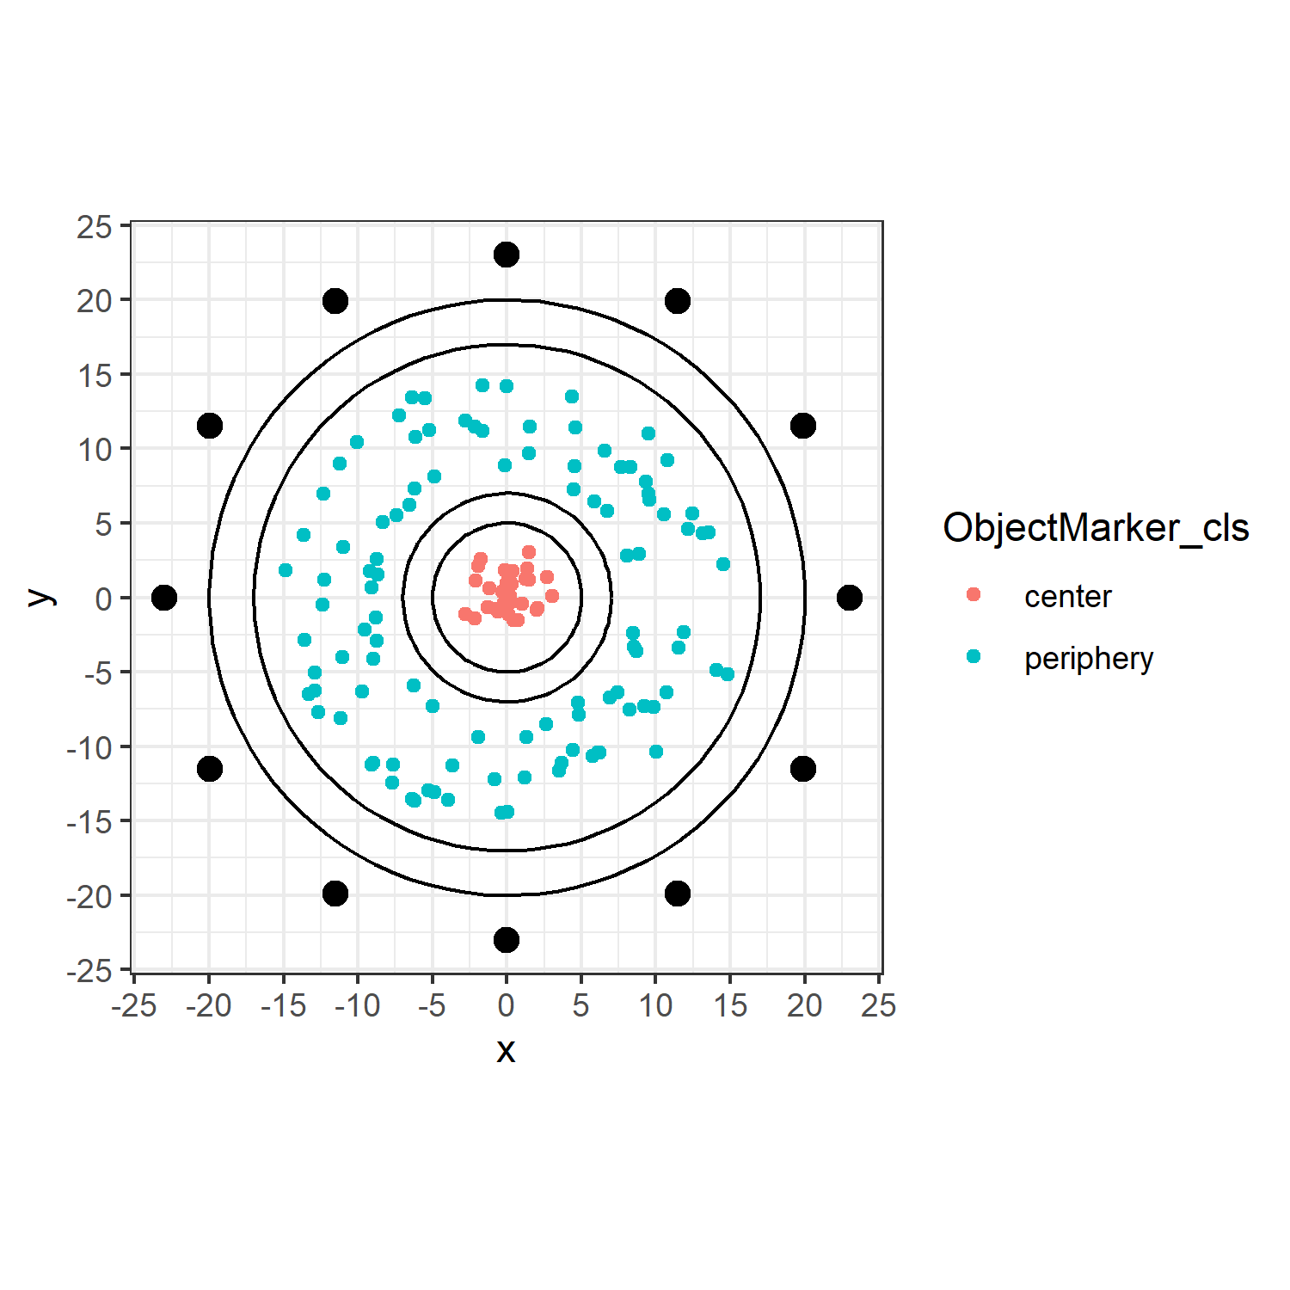
ObjectMarker_cls
ObjectMarker_cls = categorical coding for object located within the 5 radius circle (center), and outside the 7 radius circle (periphery).

Slide 4
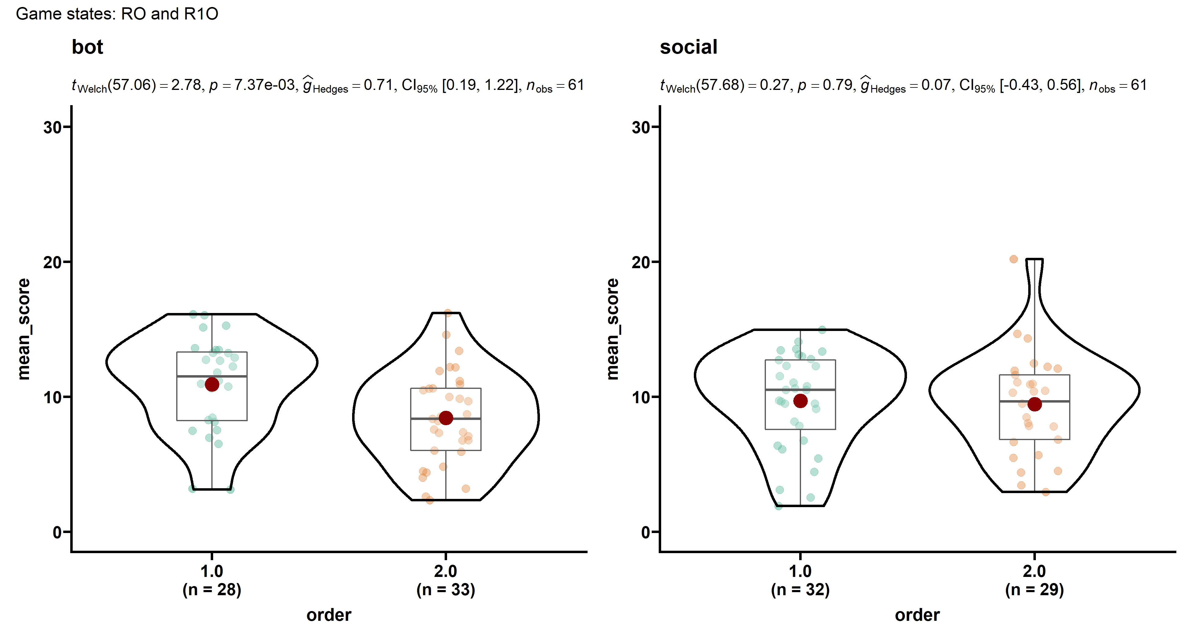
Order
The order plot is based on empirical individual-level score averages (trial-level scores are not independent observations; trial counts vary by individual).

Slide 5
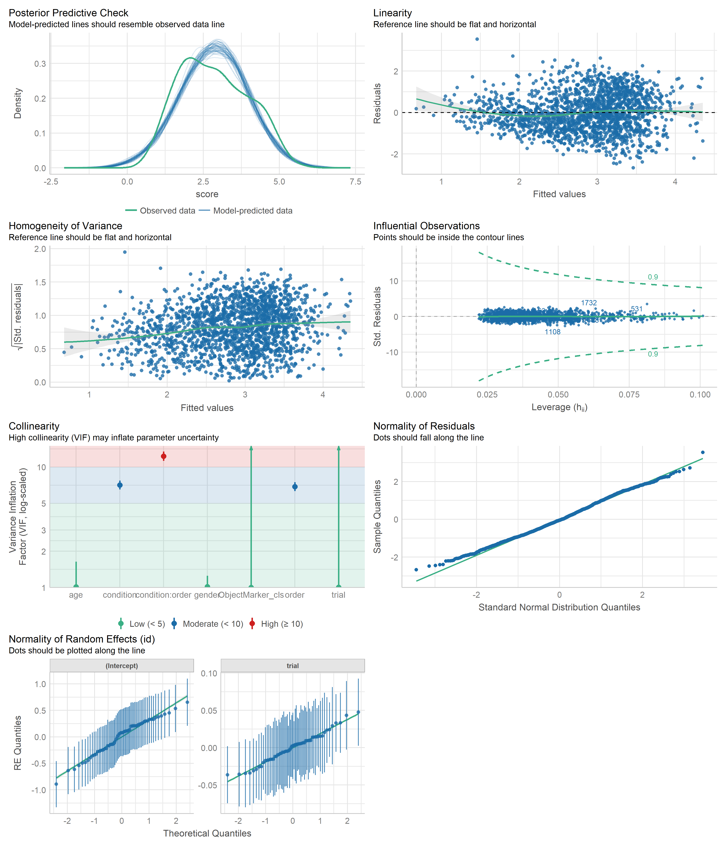
Model 5 – assumptions check

Slide 6
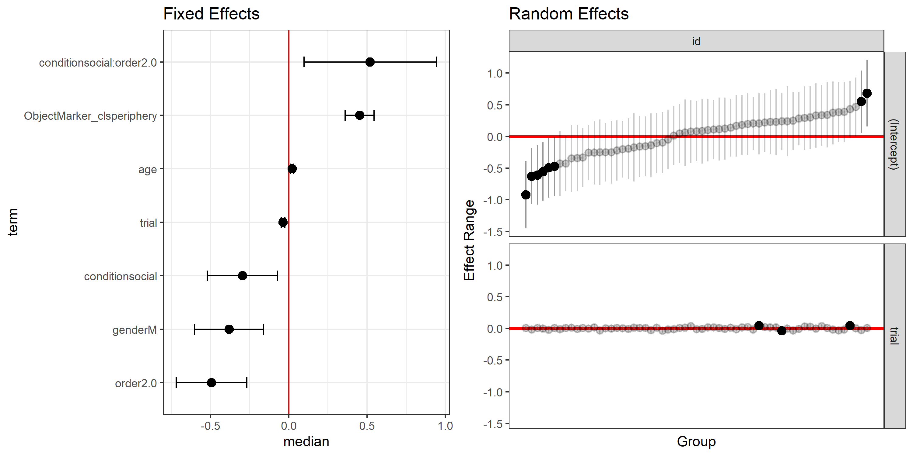
Model 5 – fixed & random effects

Slide 7
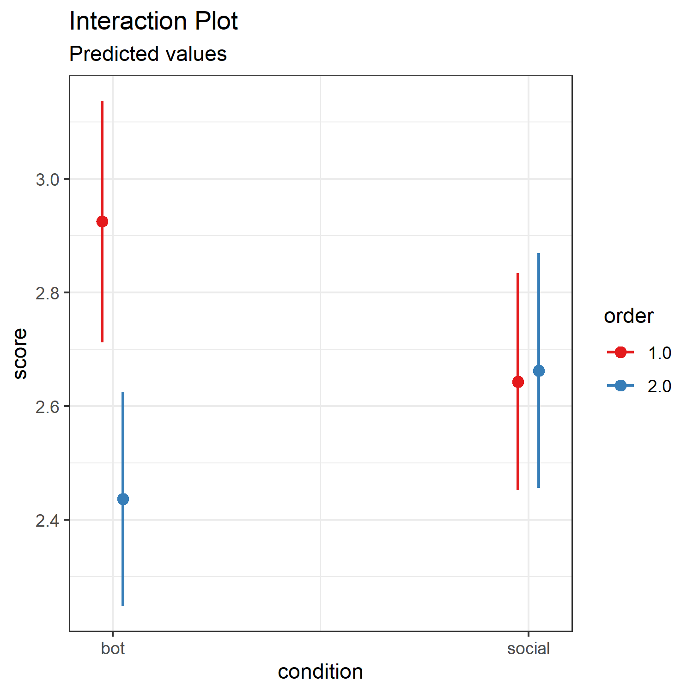
Model 5 – interaction

Slide 8
We fitted a linear mixed model (estimated using ML and optimx optimizer) to predict score with trial, condition, order, gender, age and ObjectMarker_cls (formula: score ~ 1 + trial + condition * order + gender + age + ObjectMarker_cls). The model included trial as random effects (formula: ~1 + trial | id). The model's total explanatory power is substantial (conditional R2 = 0.31) and the part related to the fixed effects alone (marginal R2) is of 0.16. The model's intercept, corresponding to trial = 0, condition = bot, order = 1.0, gender = F, age = 0 and ObjectMarker_cls = center, is at 2.45 (95% CI [2.00, 2.91], t(1786) = 10.53, p < .001). Within this model:
- The effect of trial is statistically significant and negative (beta = -0.04, 95% CI [-0.05, -0.02], t(1786) = -5.82, p < .001; Std. beta = -0.16, 95% CI [-0.21, -0.11])
- The effect of condition [social] is statistically significant and negative (beta = -0.28, 95% CI [-0.52, -0.05], t(1786) = -2.35, p = 0.019; Std. beta = -0.25, 95% CI [-0.46, -0.04])
- The effect of order [2.0] is statistically significant and negative (beta = -0.49, 95% CI [-0.72, -0.26], t(1786) = -4.12, p < .001; Std. beta = -0.43, 95% CI [-0.64, -0.23])
- The effect of gender [M] is statistically significant and negative (beta = -0.37, 95% CI [-0.60, -0.14], t(1786) = -3.10, p = 0.002; Std. beta = -0.33, 95% CI [-0.53, -0.12])
- The effect of age is statistically significant and positive (beta = 0.02, 95% CI [0.01, 0.03], t(1786) = 3.94, p < .001; Std. beta = 0.19, 95% CI [0.10, 0.29])
- The effect of ObjectMarker cls [periphery] is statistically significant and positive (beta = 0.45, 95% CI [0.35, 0.56], t(1786) = 8.70, p < .001; Std. beta = 0.40, 95% CI [0.31, 0.49])
- The effect of condition [social] × order [2.0] is statistically significant and positive (beta = 0.51, 95% CI [0.08, 0.94], t(1786) = 2.33, p = 0.020; Std. beta = 0.45, 95% CI [0.07, 0.83])

Slide 9
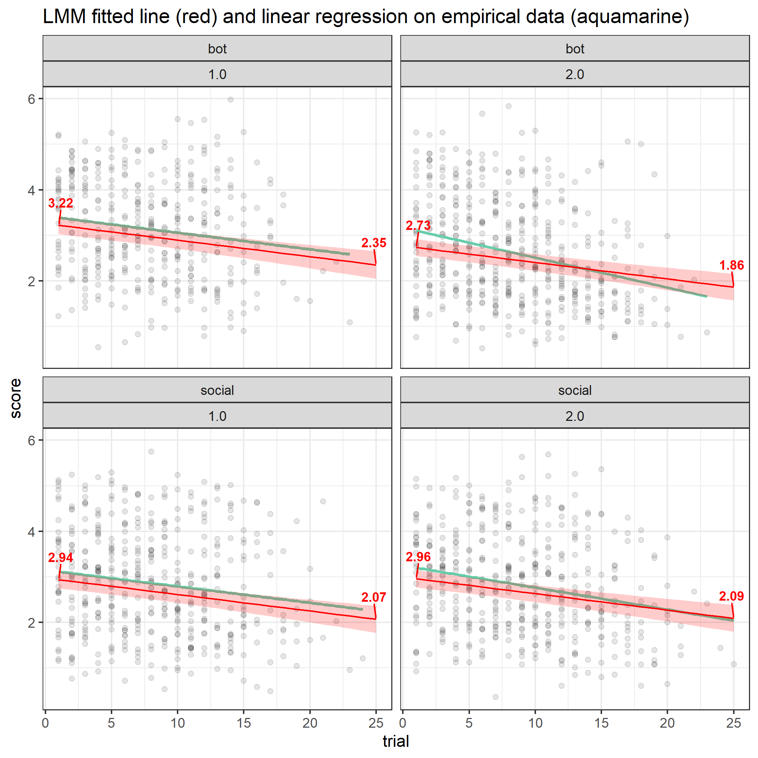

Slide 10
Model 6
added Prosocial Interactions from SRQ
Prosocial Interactions: kind, reciprocal relationships with others
e.g, I enjoy treating others fairly

Slide 11

Model 6 – assumptions check

Slide 12
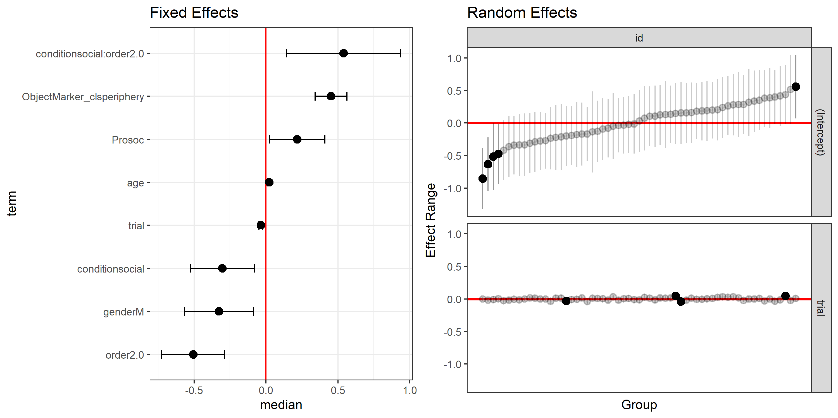
Model 6 – fixed & random effects

Slide 13
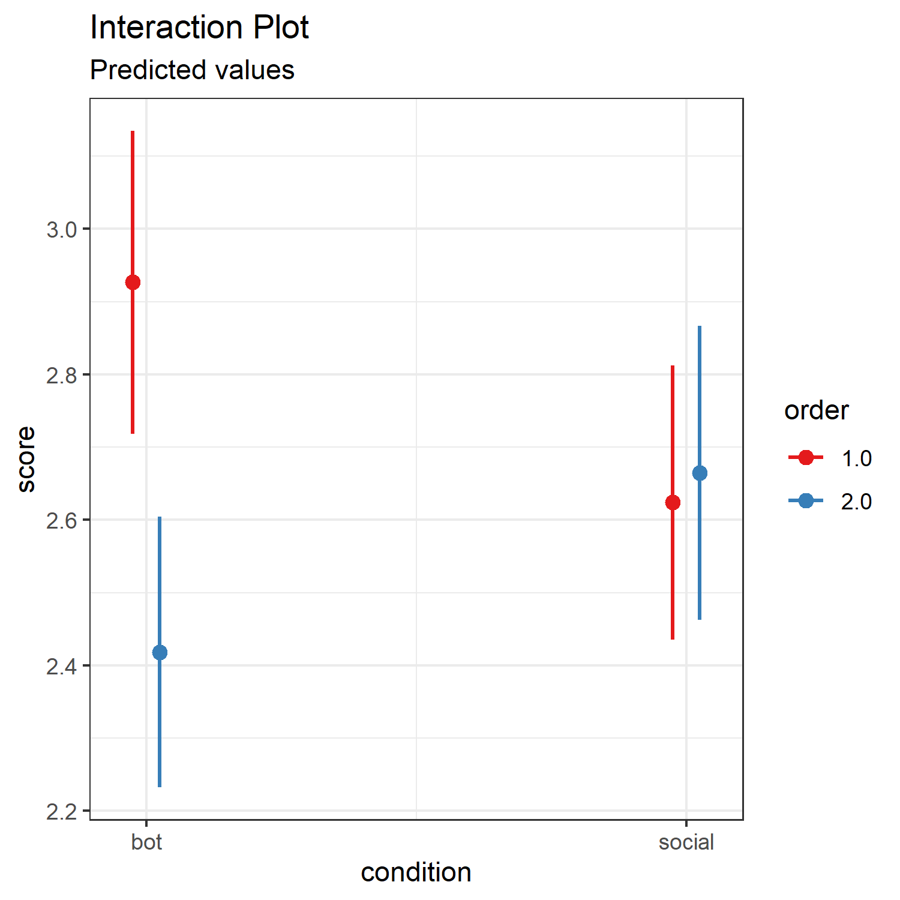
Model 5 – interaction

Slide 14
We fitted a linear mixed model (estimated using ML and optimx optimizer) to predict score with trial, condition, order, gender, age, ObjectMarker_cls and Prosoc (formula: score ~ 1 + trial + condition * order + gender + age + ObjectMarker_cls + Prosoc). The model included trial as random effects (formula: ~1 + trial | id). The model's total explanatory power is substantial (conditional R2 = 0.31) and the part related to the fixed effects alone (marginal R2) is of 0.17. The model's intercept, corresponding to trial = 0, condition = bot, order = 1.0, gender = F, age = 0, ObjectMarker_cls = center and Prosoc = 0, is at 1.05 (95% CI [-0.37, 2.48], t(1785) = 1.45, p = 0.148). Within this model:
- The effect of trial is statistically significant and negative (beta = -0.04, 95% CI [-0.05, -0.02], t(1785) = -5.79, p < .001; Std. beta = -0.16, 95% CI [-0.21, -0.11])
- The effect of condition [social] is statistically significant and negative (beta = -0.30, 95% CI [-0.53, -0.07], t(1785) = -2.58, p = 0.010; Std. beta = -0.27, 95% CI [-0.47, -0.06])
- The effect of order [2.0] is statistically significant and negative (beta = -0.51, 95% CI [-0.74, -0.28], t(1785) = -4.38, p < .001; Std. beta = -0.45, 95% CI [-0.65, -0.25])
- The effect of gender [M] is statistically significant and negative (beta = -0.34, 95% CI [-0.57, -0.11], t(1785) = -2.93, p = 0.003; Std. beta = -0.30, 95% CI [-0.50, -0.10])
- The effect of age is statistically significant and positive (beta = 0.02, 95% CI [0.01, 0.03], t(1785) = 4.22, p < .001; Std. beta = 0.20, 95% CI [0.11, 0.30])
- The effect of ObjectMarker cls [periphery] is statistically significant and positive (beta = 0.45, 95% CI [0.35, 0.56], t(1785) = 8.69, p < .001; Std. beta = 0.40, 95% CI [0.31, 0.49])
- The effect of Prosoc is statistically significant and positive (beta = 0.21, 95% CI [8.49e-03, 0.41], t(1785) = 2.04, p = 0.041; Std. beta = 0.10, 95% CI [4.07e-03, 0.20])
- The effect of condition [social] × order [2.0] is statistically significant and positive (beta = 0.55, 95% CI [0.13, 0.97], t(1785) = 2.58, p = 0.010; Std. beta = 0.48, 95% CI [0.12, 0.85])

Slide 15
