Slide 1
SSM model 5
Brief results

Slide 2
Variables
Score = euclidean error (lower = better performance).
Trial = tial number = time.
The conditionXorder interaction plot (plot_lmm_mod_5_interac) is based on model fitted values.

Slide 3
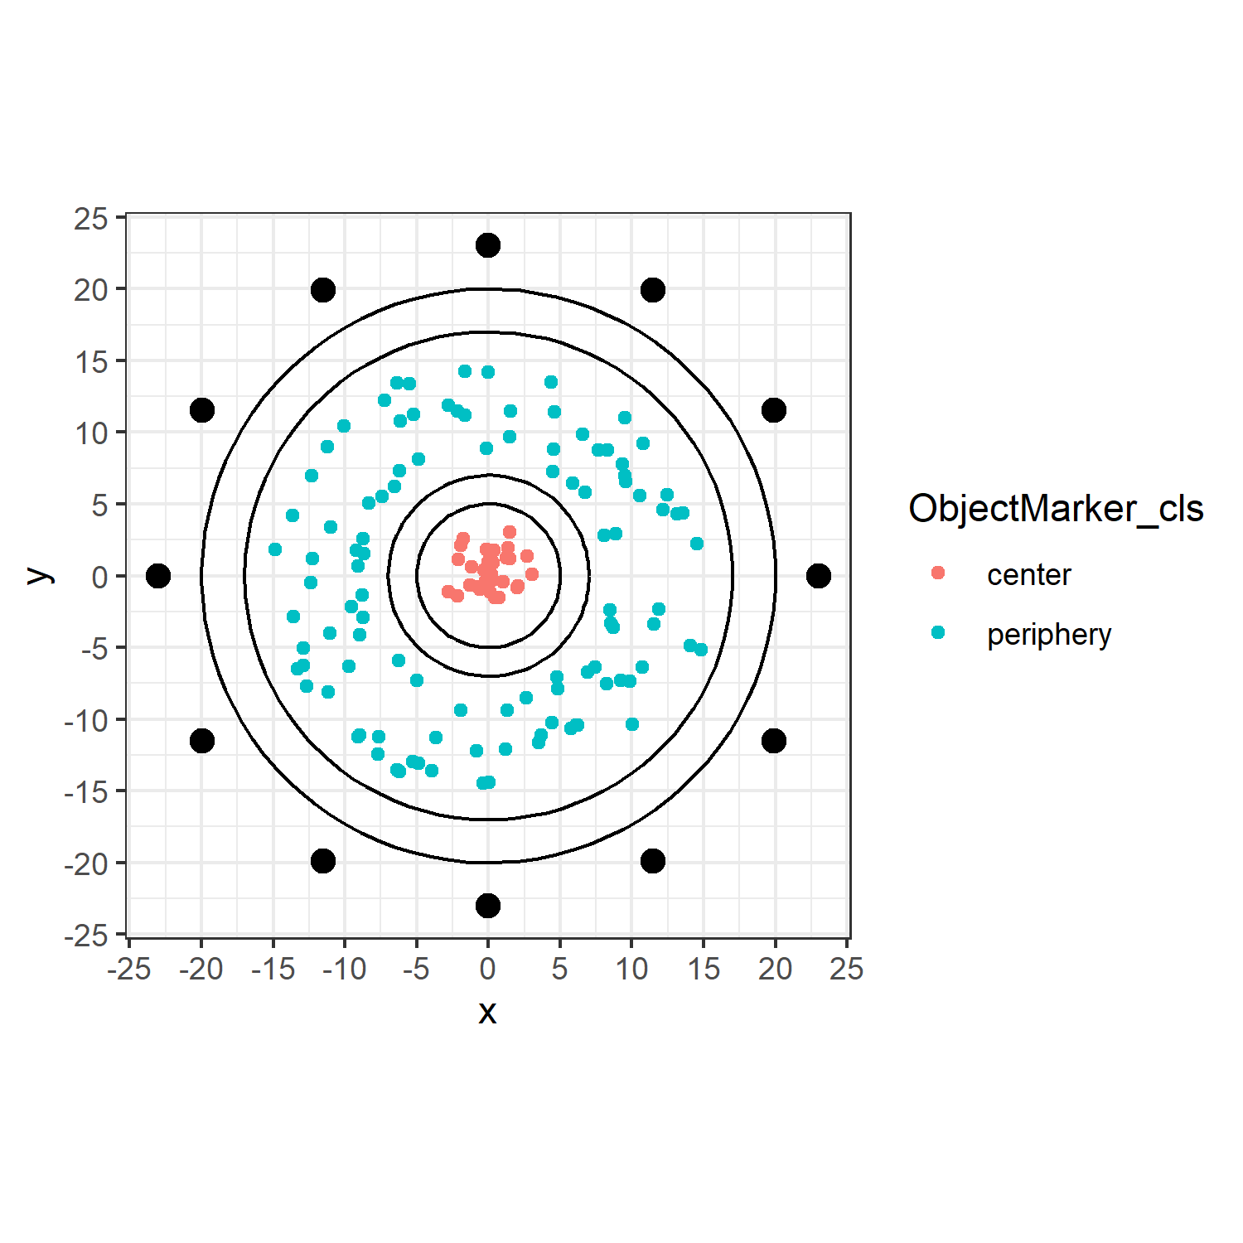
ObjectMarker_cls
ObjectMarker_cls = categorical coding for object located within the 5 radius circle (center), and outside the 7 radius circle (periphery).

Slide 4
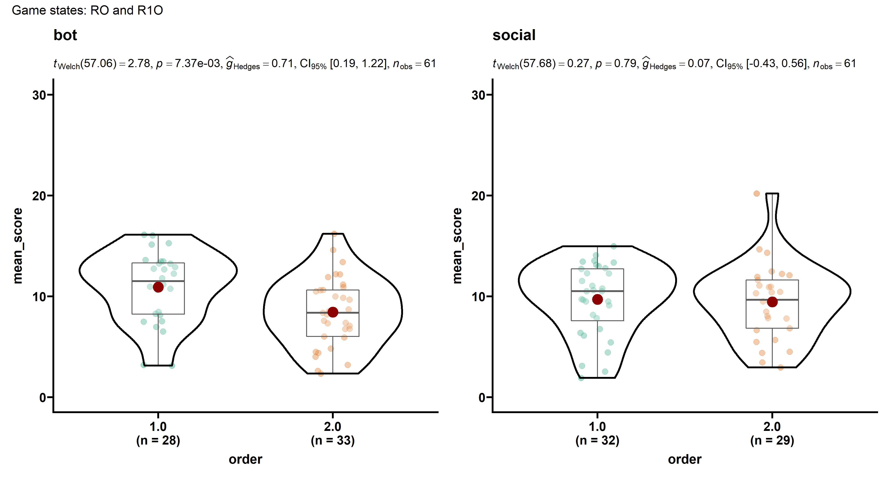
Order
The order plot is based on empirical individual-level score averages (trial-level scores are not independent observations; trial counts vary by individual).

Slide 5
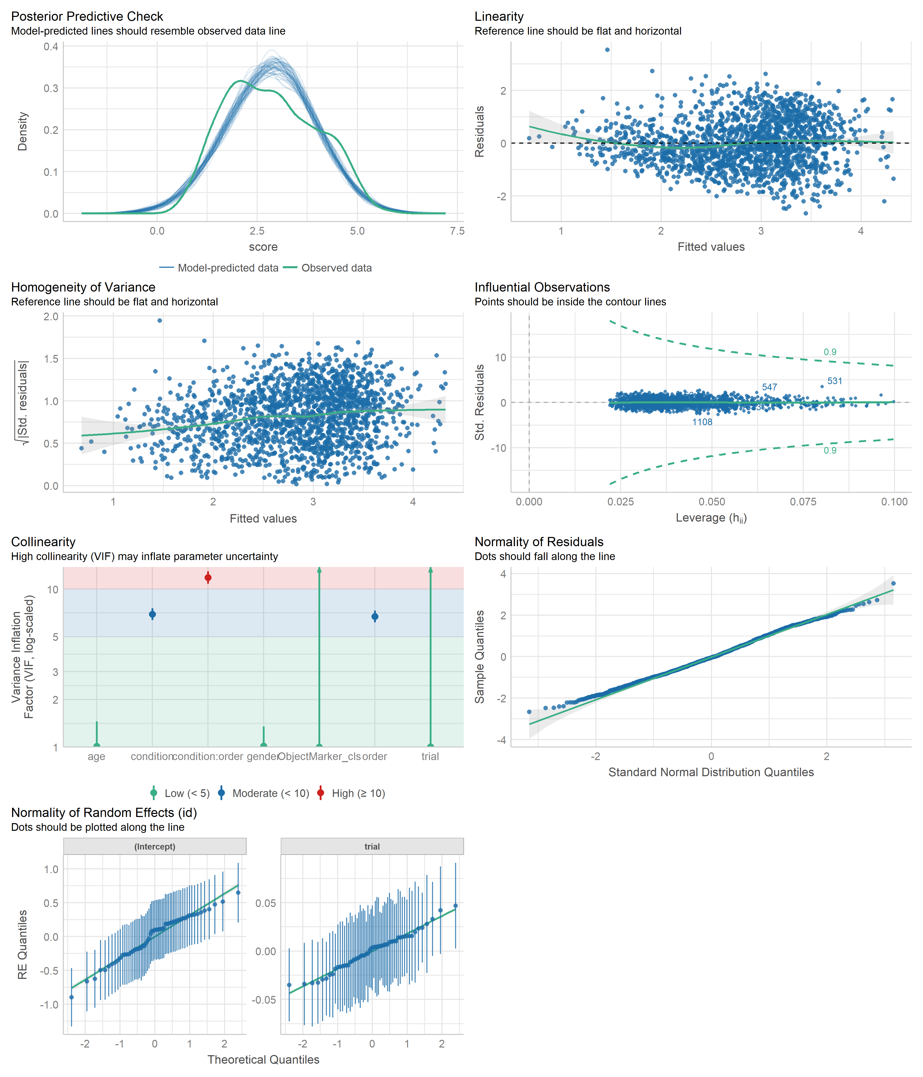
Model 5 – assumptions check

Slide 6
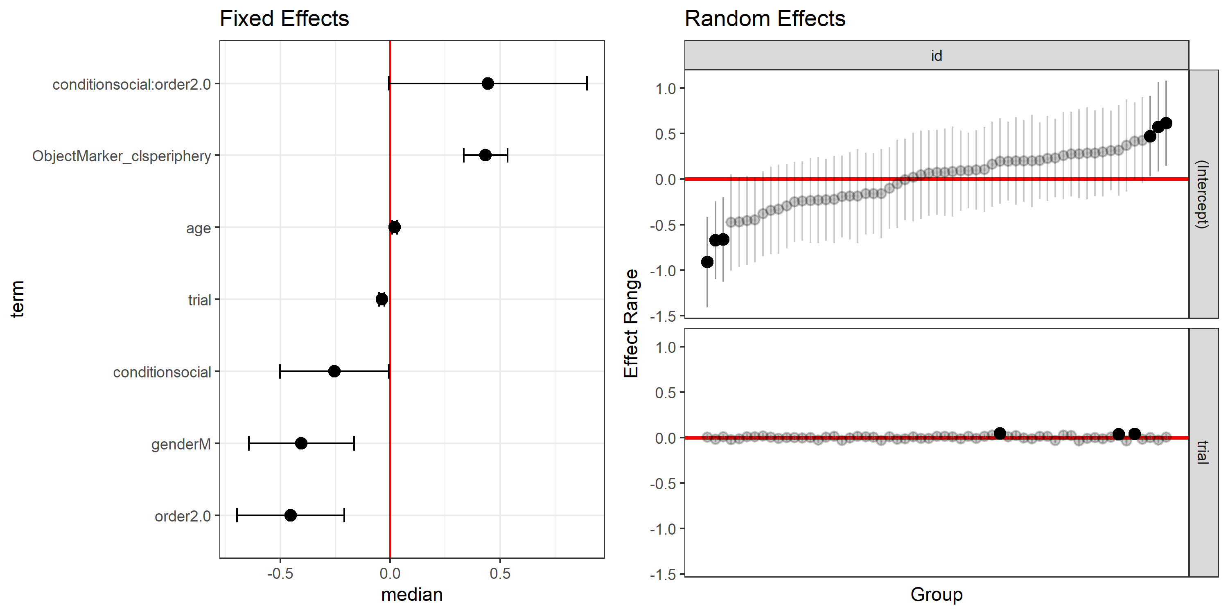
Model 5 – fixed & random effects

Slide 7
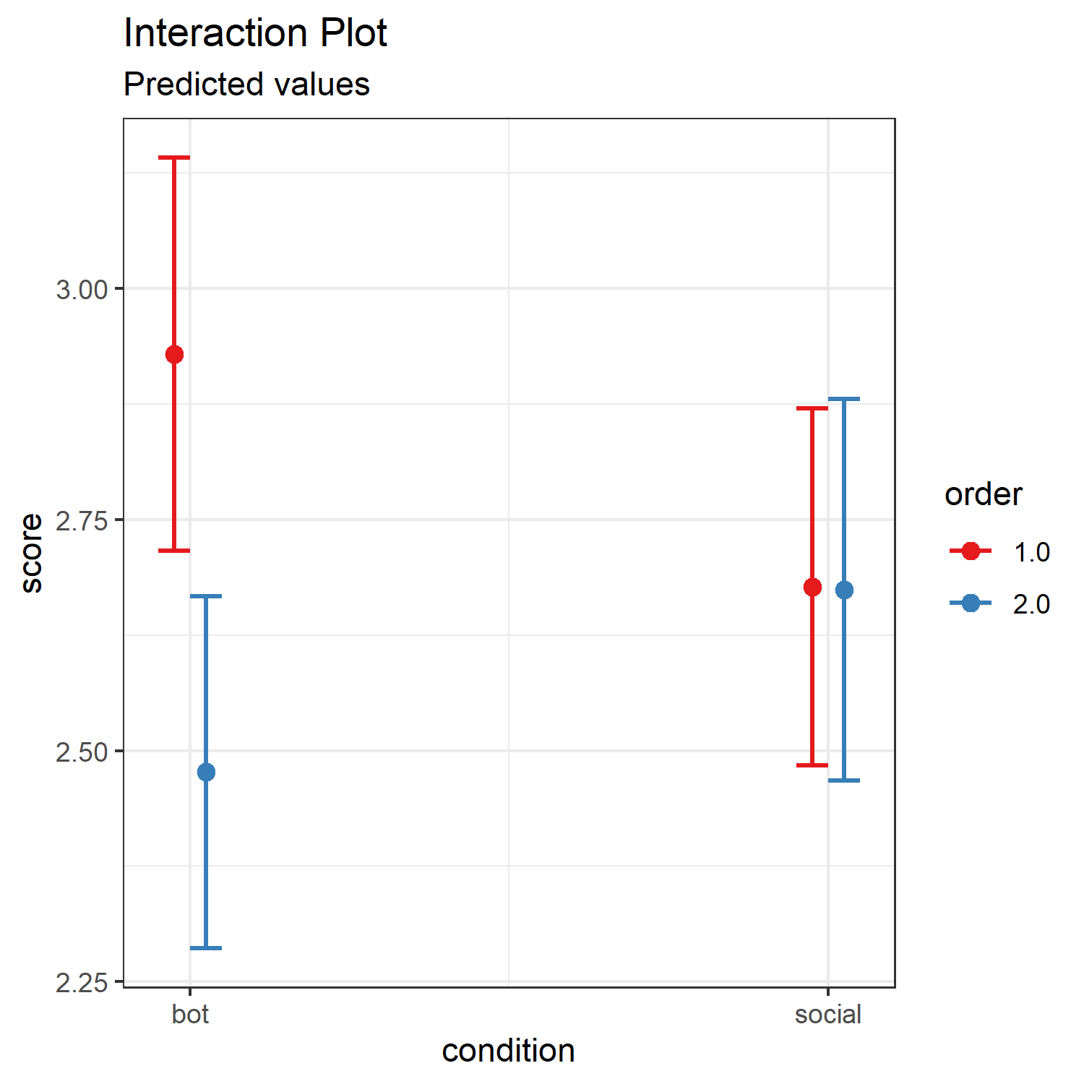
Model 5 – interaction

Slide 8
We fitted a linear mixed model (estimated using ML and optimx optimizer) to predict score with trial (formula: score ~ 1 + trial + condition * order + gender + age + ObjectMarker_cls). The model included trial as random effects (formula: ~1 + trial | id). The model's total explanatory power is substantial (conditional R2 = 0.30) and the part related to the fixed effects alone (marginal R2) is of 0.16. The model's intercept, corresponding to trial = 0, is at 2.50 (95% CI [2.04, 2.95], t(1730) = 10.77, p < .001). Within this model: - The effect of trial is statistically significant and negative (beta = -0.04, 95% CI [-0.05, -0.03], t(1730) = -6.04, p < .001; Std. beta = -0.17, 95% CI [-0.22, -0.11]) - The effect of condition [social] is statistically significant and negative (beta = -0.25, 95% CI [-0.49, -0.02], t(1730) = -2.10, p = 0.036; Std. beta = -0.22, 95% CI [-0.43, -0.01]) - The effect of order [2.0] is statistically significant and negative (beta = -0.45, 95% CI [-0.69, -0.22], t(1730) = -3.80, p < .001; Std. beta = -0.40, 95% CI [-0.61, -0.19]) - The effect of gender [M] is statistically significant and negative (beta = -0.40, 95% CI [-0.63, -0.16], t(1730) = -3.30, p < .001; Std. beta = -0.35, 95% CI [-0.56, -0.14]) - The effect of age is statistically significant and positive (beta = 0.02, 95% CI [0.01, 0.03], t(1730) = 3.84, p < .001; Std. beta = 0.19, 95% CI [0.09, 0.29]) - The effect of ObjectMarker cls [periphery] is statistically significant and positive (beta = 0.44, 95% CI [0.33, 0.54], t(1730) = 8.25, p < .001; Std. beta = 0.39, 95% CI [0.30, 0.48]) - The interaction effect of order [2.0] on condition [social] is statistically significant and positive (beta = 0.45, 95% CI [0.02, 0.88], t(1730) = 2.06, p = 0.040; Std. beta = 0.40, 95% CI [0.02, 0.78])

