Slide 1
Improve time to market proposal
Geordie Quiroa

Slide 2
continuous delivery implications
Reduce feedback loop with stakeholders
More time adding real value and Less time configuring infrastructure
Reduce costs detecting errors earlier
Increase revenue with faster and more frequent production deployments
Protect revenue with automated tests
Avoid responsiblity silos with Continuous Delivery

Slide 3
Key performance indicators
Currently
With Continuous Delivery
Lead time to production
3 weeks
1.5 weeks
Rollback rate
6 out of 13 executions
2 out of 10 executions
Time to failure
4 days
10 minutes
Production uptime
3 hours
14 minutes

Slide 4
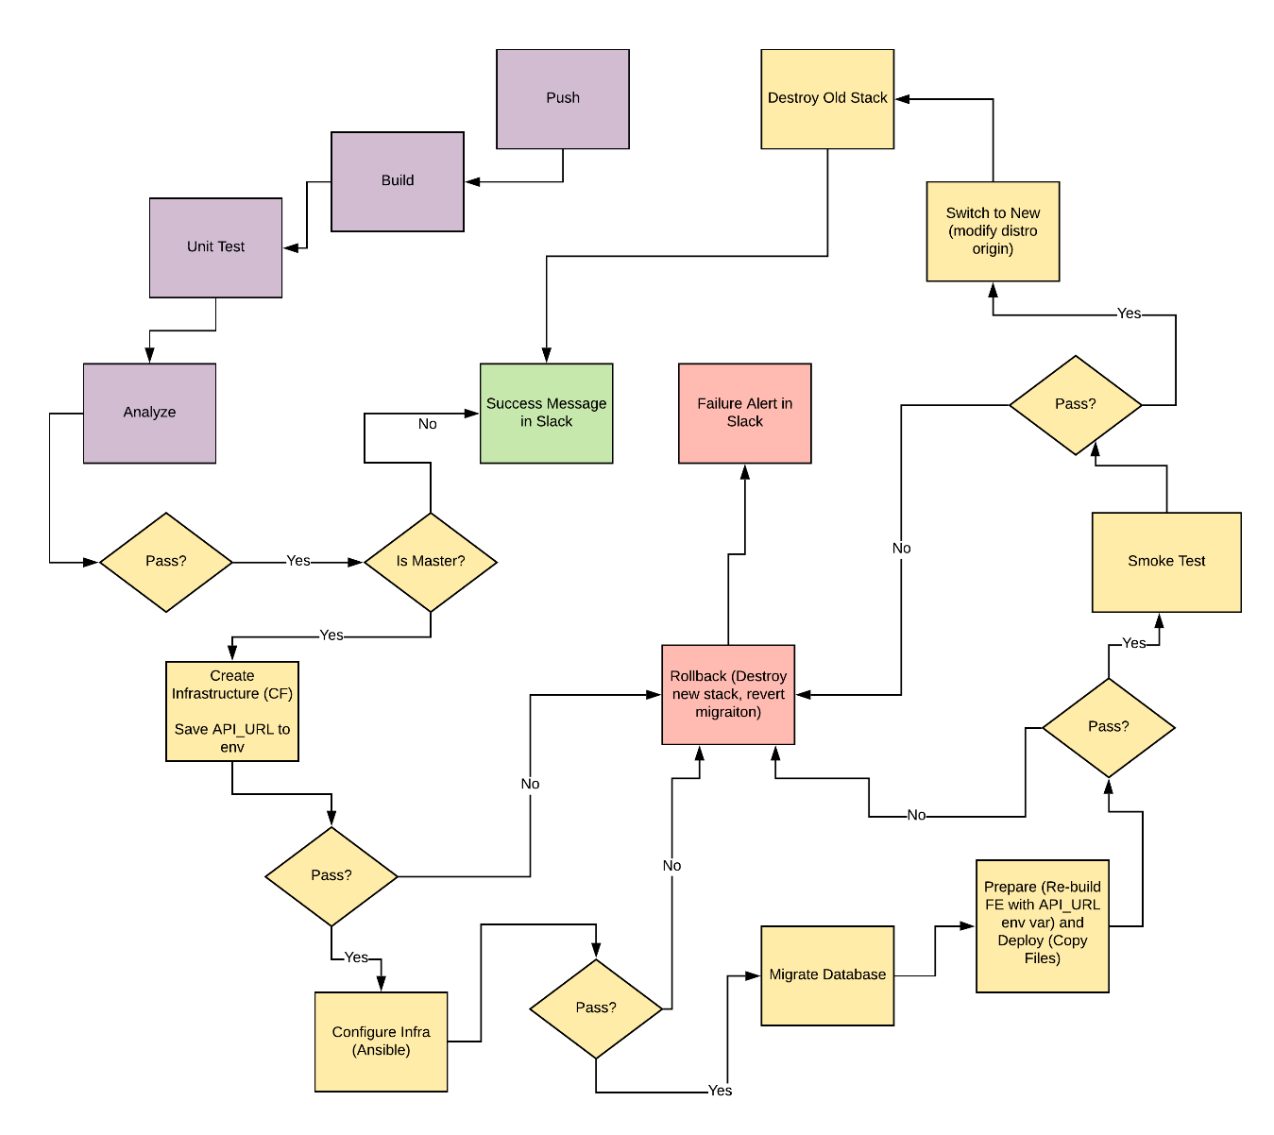
Current manual process diagram

Slide 5
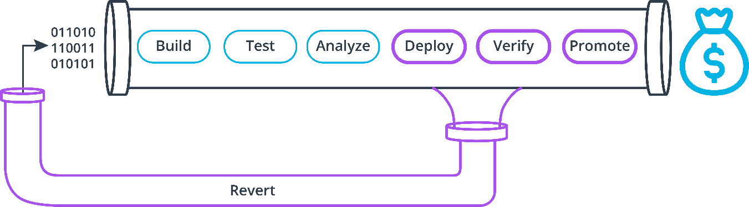
Proposed process flow

