Slide 1

Neural Network and AI.
Course 21
Harmon Hall Claudio Vargas

Slide 2
ARTIFICIAL
INTELLIGENCE
Neural
Network

Slide 3
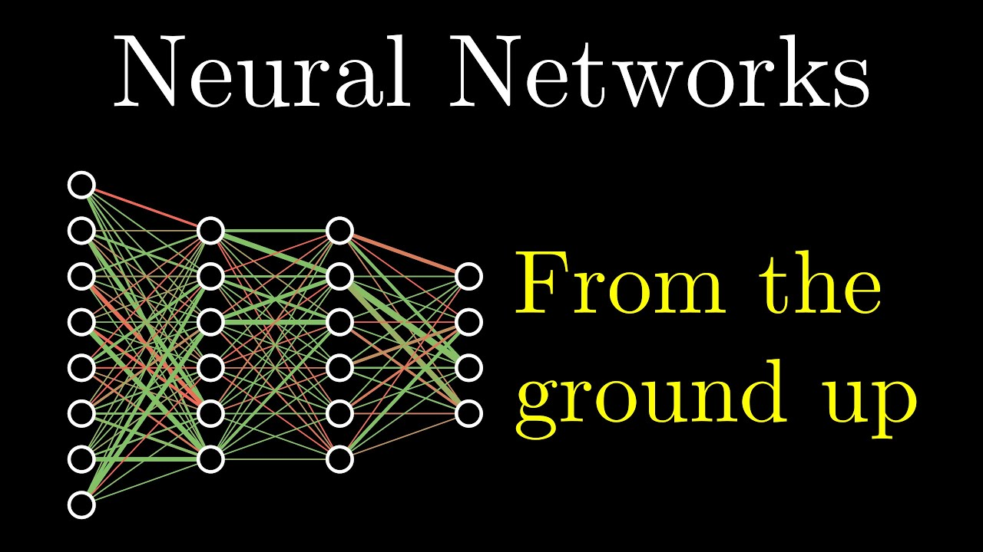

Slide 4
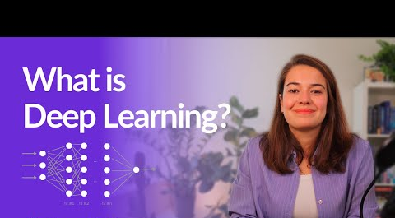

Slide 5
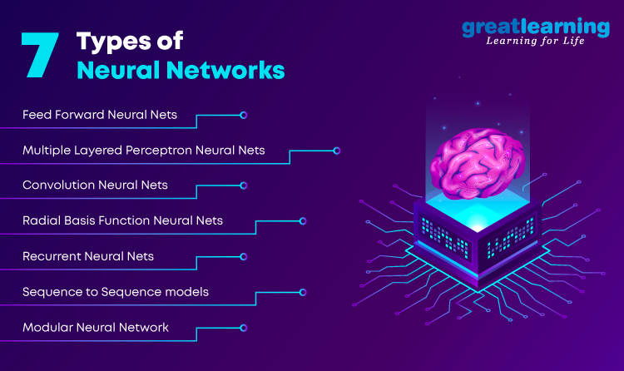

Slide 6
Two Columns Style
01
You can simply impress your audience and add a unique zing and appeal to your Presentations.
You can simply impress your audience and add a unique zing and appeal to your Presentations. I hope and I believe that this Template will your Time, Money and Reputation. You can simply impress your audience and add a unique zing and appeal to your Presentations. Get a modern PowerPoint Presentation that is beautifully designed. You can simply impress your audience and add a unique zing and appeal to your Presentations. I hope and I believe that this Template will your Time, Money and Reputation.
02
You can simply impress your audience and add a unique zing and appeal to your Presentations.
You can simply impress your audience and add a unique zing and appeal to your Presentations. I hope and I believe that this Template will your Time, Money and Reputation. You can simply impress your audience and add a unique zing and appeal to your Presentations. Get a modern PowerPoint Presentation that is beautifully designed. You can simply impress your audience and add a unique zing and appeal to your Presentations. I hope and I believe that this Template will your Time, Money and Reputation.

