Slide 1

The importance of Having a Dedicated Study or Work Space
Final Proyect 2023

Slide 2

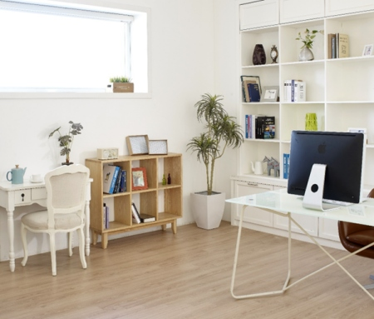

Slide 3


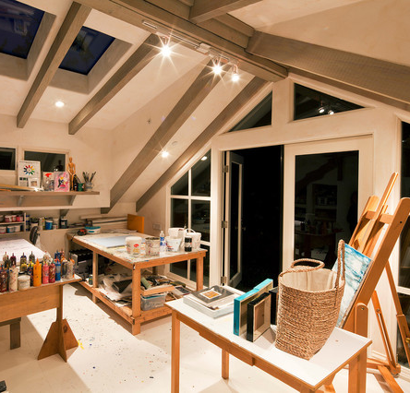

The Benefits of Having a Dedicated Space

Slide 4
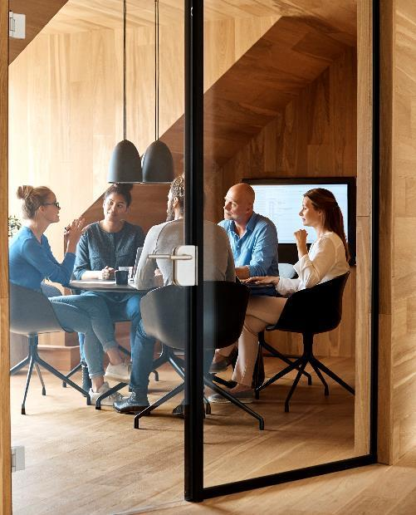



Investing in Comfort and Ergonomics

Slide 5

Adding Technology and Accessories

Slide 6
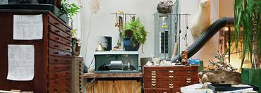
Creating a Cozy and Pleasing Environment

Slide 7

Conclusion

Slide 8


Thank you

