Slide 1

POLITICAL POSTS CLASSIFICATION USING GRAPH NEURAL NETWORKS AND TEXTUAL EMBEDDINGS
Students: Saponaro Claudio, Mattiace Alessio

Slide 2
INTRODUCTION
This project aims to predict political orientation of a post using graph-structured data.
The post is classified not only from its content but also from its connections to other blogs in the network.
It utilizes a transformer-based technique to create embeddings from blog posts, which are then used with edge information in a Graph Convolutional Network (GCN).

Slide 3
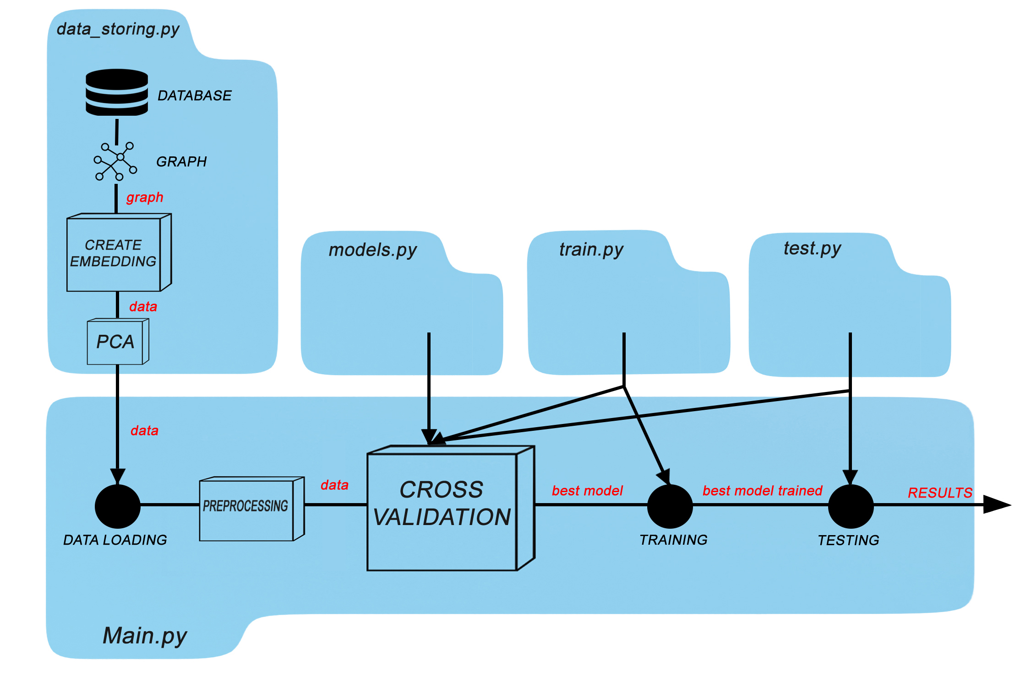
PROCESS VISUALIZATION

Slide 4
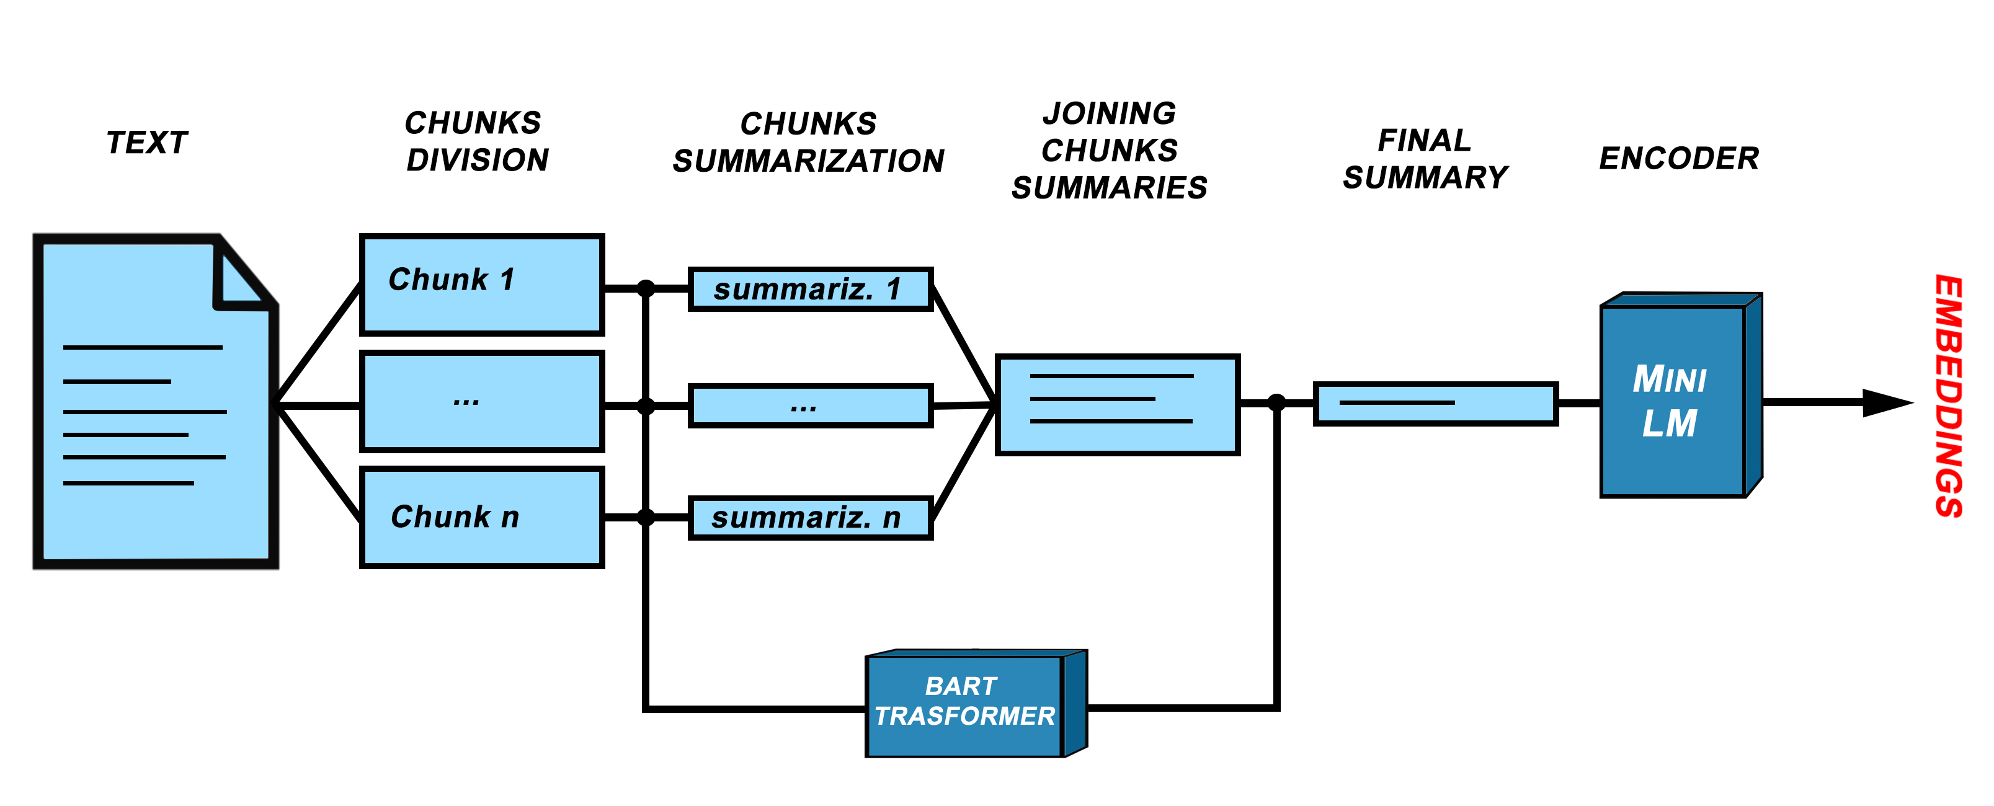
EMBEDDINGS GENERATION PROCESS

Slide 5
TESTED CONV. LAYERS
GCNConv (+ ReLU)
ChebConv (+ LeakyReLU)
GATConv (+ ELU)
TESTED OPTIMIZERS
Adam
RMSProp
Adagrad

Slide 6
MODEL ARCHITECTURE
Inputs
Dropout
Dropout
Dropout
Conv layer
Conv layer
Conv layer
Linear layer
Activation function
Activation function
Activation function
Sigmoid
Outputs

Slide 7
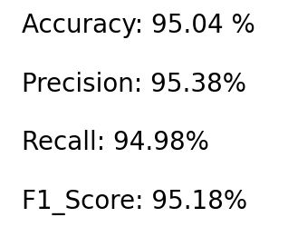
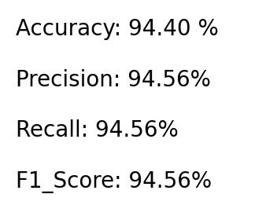
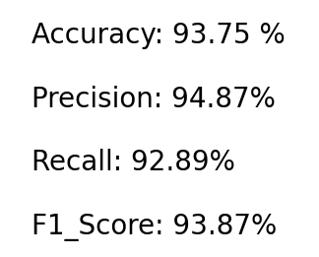
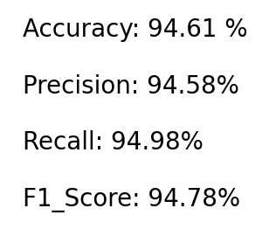
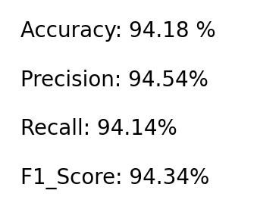
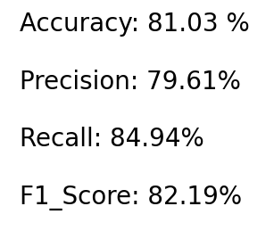
RESULTS
Below are the performances achieved for some different models in the evaluation phase:
GAT Conv + Adam
GAT Conv + RMSProp
ChebConv + Adam
GCN Conv + RMSProp
GCN Conv + Adam
GCN Conv + Adagrad

Slide 8
CONCLUSIONS
In our work, we faced several challenges, such as the careful selection of the right transformer for summarization, the handling of non-functional links, etc.
Further developments for this task could involve using more complex models by employing different convolutional layers, loss functions, or better hyperparameters.

