Slide 1
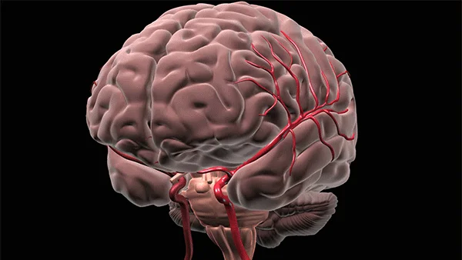
BRAIN STROKE DATA
PROJECT NO. 4
Jay Laxami
Will Macmillan
Candida Miranda
Claudia Yurrita
Notes:
W

Slide 2

Brain stroke dataset
Notes:
W

Slide 3
Brain stroke dataset
We retrieved our dataset in csv format from Kaggle. The data was cleaned and we used PostgreSQL database and SQL alchemy. We used four machine learning modules to check the accuracy of the dataset.
Notes:
W

Slide 4
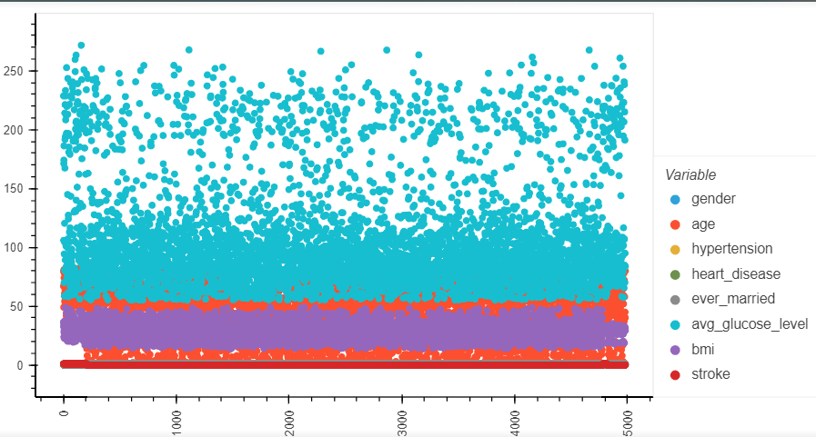
Data plots

Slide 5
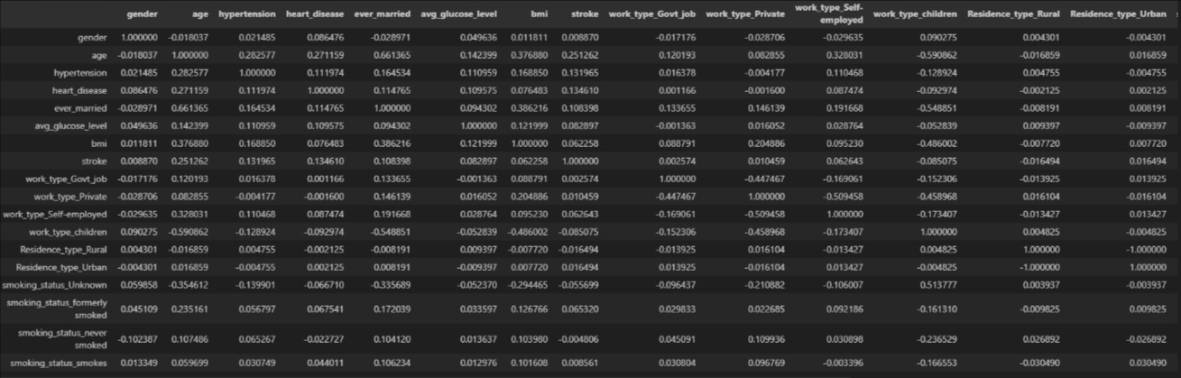
Correlation matrix

Slide 6
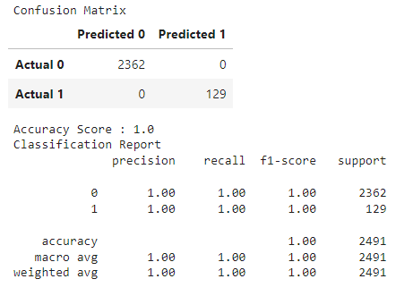
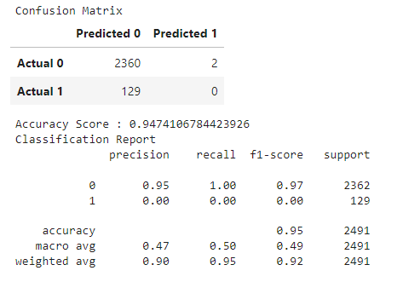
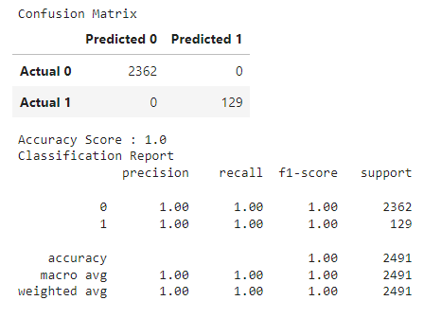
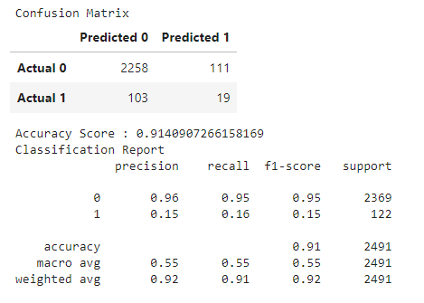
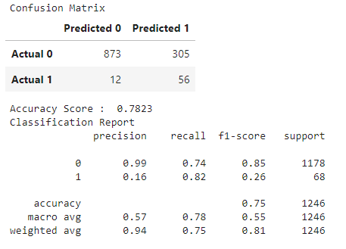
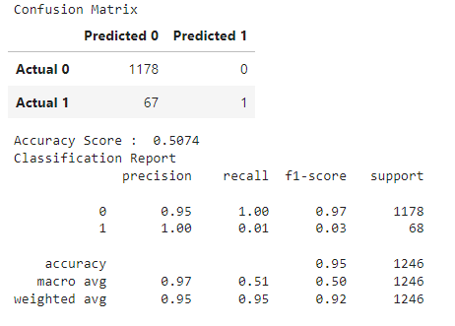
Accuracy comparisons
Regression Model
Base
Regression Model
Oversample
Decision Tree Model
Decision Tree Oversample
Neural Network Model
Random Forest Model
Random Forest Oversample
Notes:
CL

Slide 7
Accuracy comparisons
Regression Model
Base
Regression Model
Oversample
Decision Tree Model
Decision Tree Oversample
Neural Network Model
Random Forest Model
Random Forest Oversample
Notes:
CL

Slide 8
Accuracy comparisons
Regression Model
Base
Regression Model
Oversample
Decision Tree Model
Decision Tree Oversample
Neural Network Model
Random Forest Model
Random Forest Oversample
Notes:
J

Slide 9
Accuracy comparisons
Regression Model
Base
Regression Model
Oversample
Decision Tree Model
Decision Tree Oversample
Neural Network Model
Random Forest Model
Random Forest Oversample
Notes:
J

Slide 10
Accuracy comparisons
Regression Model
Base
Regression Model
Oversample
Decision Tree Model
Decision Tree Oversample
Neural Network Model
Random Forest Model
Random Forest Oversample
Notes:
CM

Slide 11
Accuracy comparisons
Regression Model
Base
Regression Model
Oversample
Decision Tree Model
Decision Tree Oversample
Neural Network Model
Random Forest Model
Random Forest Oversample
Notes:
CM

Slide 12
Accuracy comparisons
Regression Model
Base
Regression Model
Oversample
Decision Tree Model
Decision Tree Oversample
Neural Network Model
Random Forest Model
Random Forest Oversample
Notes:
CM

Slide 13
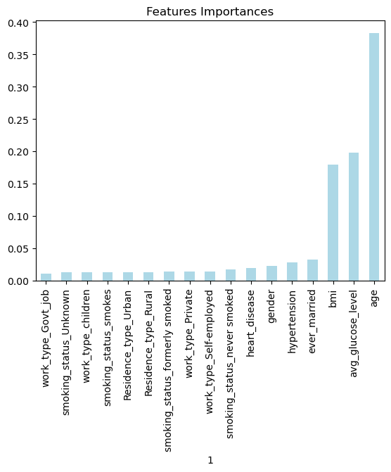
Features importance
Notes:
CL

Slide 14
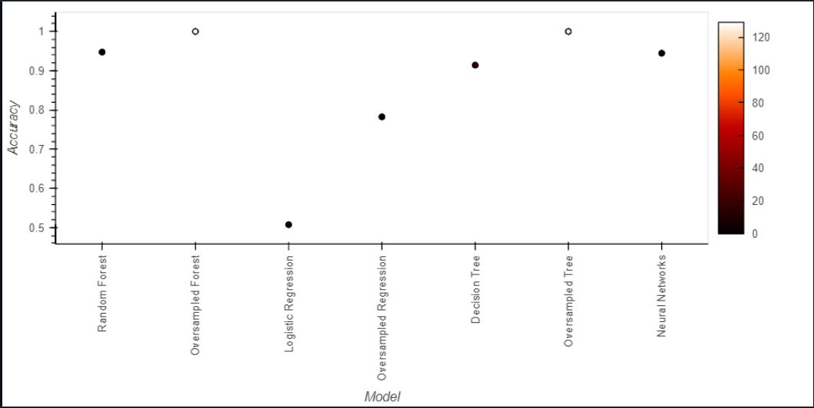
ACCURACIES PLOT
Notes:
CL

Slide 15

Q
U
E
S
T
I
O
N
S
How gender affects brain stroke deaths?
Are there noticeable different factors between the people dead by brain stroke and those who do not?
Is there a model that estimates the outcomes better (we will test 2 models at least)?
At what age are people having the highest probability of a brain stroke in this dataset?
Are there any factors that better predict increased risk of brain stroke?
Notes:
J

Slide 16

We answered these questions through visualizations. You may preview the dashboards by accessing the links below.
DASHBOARD NO. 1
DASHBOARD NO. 2
Notes:
J&W

Slide 17
THANK YOU!
Project 4 - Group 6
Notes:
W

