Slide 1
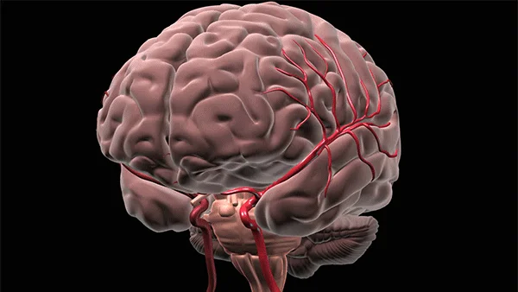
BRAIN STROKE DATA
PROJECT NO. 4
Jay Laxami
Will Macmillan
Candida Miranda
Claudia Yurrita
Notes:
All?

Slide 2
DATA SET

Slide 3
CLEANING THE DATA

Slide 4
SQL ALCHEMY

Slide 5
MODULES (3) - ACCURACY
Module 1
Type:
Module 2
Type:
Module 3
Type:
Module 4
Type:

Slide 6
The best module was … No. 4

Slide 7

How gender affects brain stroke deaths?
Are there noticeable different factors between the people dead by brain stroke and those who do not?
Is there a model that estimates the outcomes better (we will test 2 models at least)?
At what age are people having the highest probability of a brain stroke in this dataset?
Are there any factors that better predict increased risk of brain stroke?

Slide 8
VISUALIZATIONS

Slide 9
FINAL COMMENTS/CONCLUSIONS

Slide 10
THANK YOU!

