Slide 1
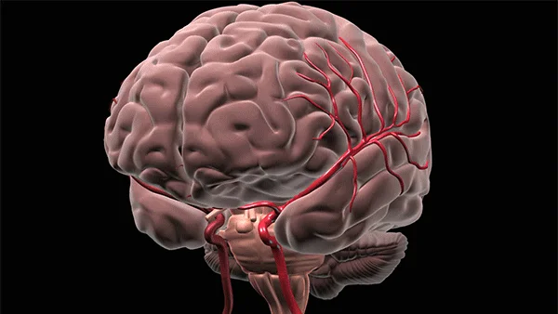
BRAIN STROKE DATA
PROJECT NO. 4
Jay Laxami
Will Macmillan
Candida Miranda
Claudia Yurrita
Notes:
All?

Slide 2

THE dATA

Slide 3
THE dATA
ID
GENDER
AGE
HYPERTENSION
The data used for this project was found in csv format. The data was cleaned by removing unnecessary columns that would bring no contribution to our analysis.
HEART DISEASE
EVER MARRIED
Yes = 1 & No = 0
WORK TYPE
RESIDENCE TYPE
AVERAGE GLUCOSE LEVEL
BMI
SMOKING STATUS
STROKE

Slide 4
SQL ALCHEMY

Slide 5
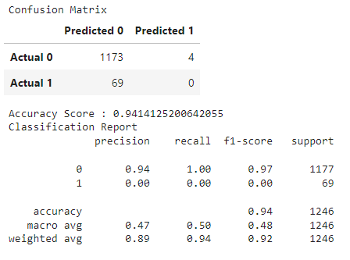
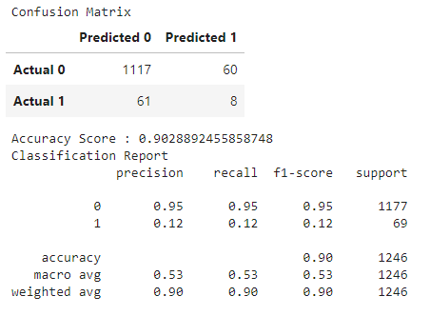
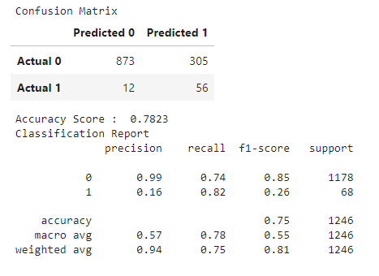
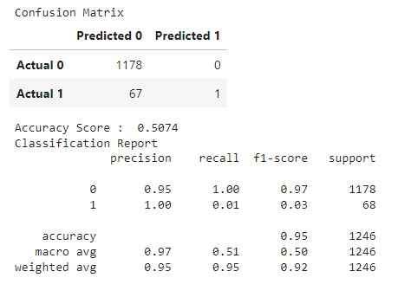
Accuracy comparisons
Regression Module
Base
Regression Module
Oversample
Decision Tree Module
Predictions Module
Random Forest Module

Slide 6
Accuracy comparisons
Regression Module
Base
Regression Module
Oversample
Decision Tree Module
Predictions Module
Random Forest Module

Slide 7
Accuracy comparisons
Regression Module
Base
Regression Module
Oversample
Decision Tree Module
Predictions Module
Random Forest Module

Slide 8
Accuracy comparisons
Regression Module
Base
Regression Module
Oversample
Decision Tree Module
Predictions Module
Random Forest Module

Slide 9
Accuracy comparisons
Regression Module
Base
Regression Module
Oversample
Decision Tree Module
Predictions Module
Random Forest Module

Slide 10
The best module was … No. 4

Slide 11

How gender affects brain stroke deaths?
Are there noticeable different factors between the people dead by brain stroke and those who do not?
Is there a model that estimates the outcomes better (we will test 2 models at least)?
At what age are people having the highest probability of a brain stroke in this dataset?
Are there any factors that better predict increased risk of brain stroke?

Slide 12
VISUALIZATIONS

Slide 13
FINAL COMMENTS/CONCLUSIONS

Slide 14
THANK YOU!

