Slide 1
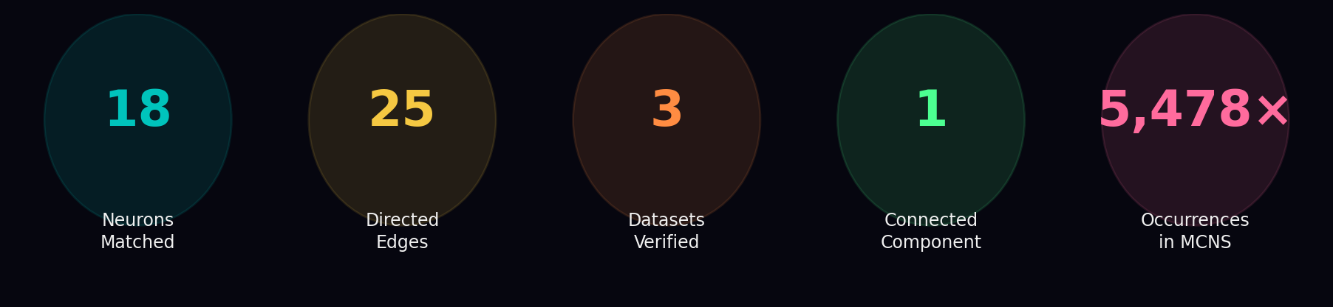
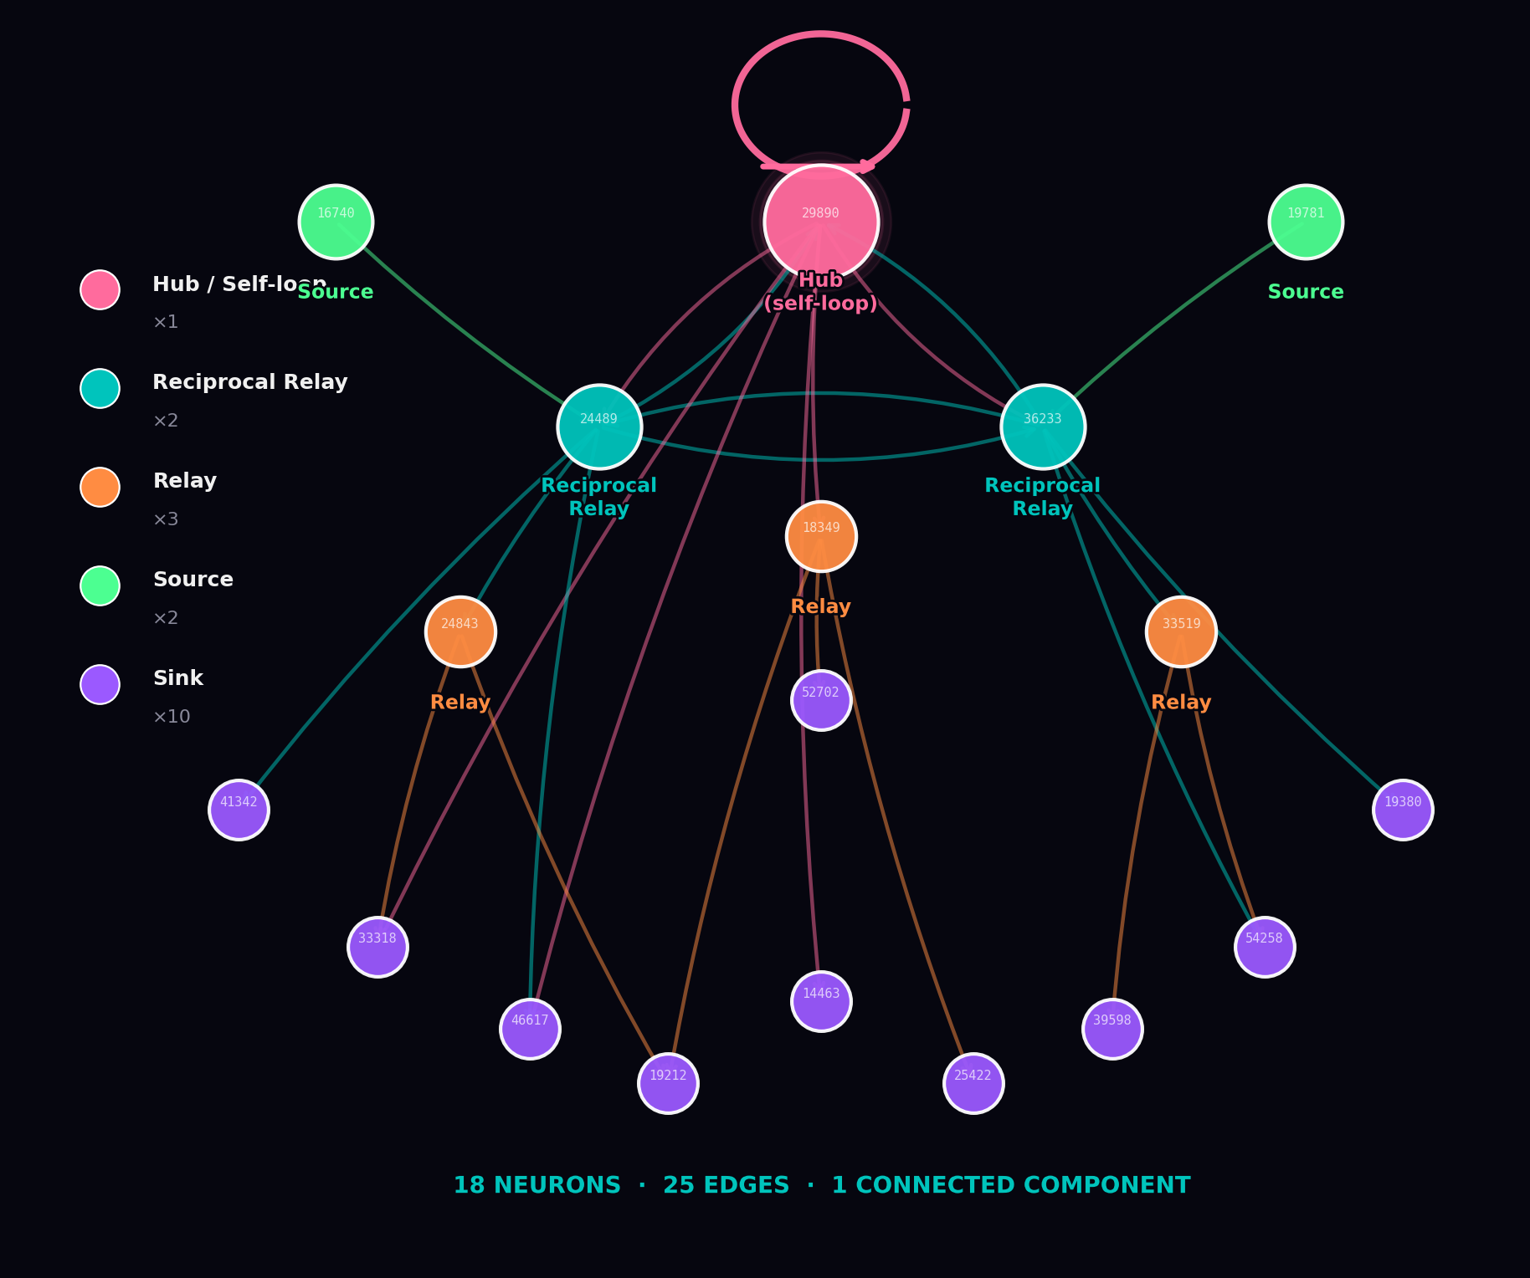
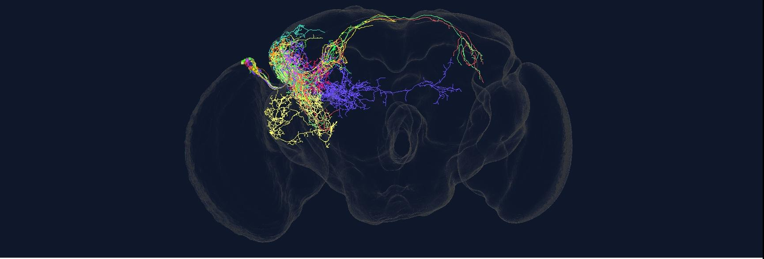
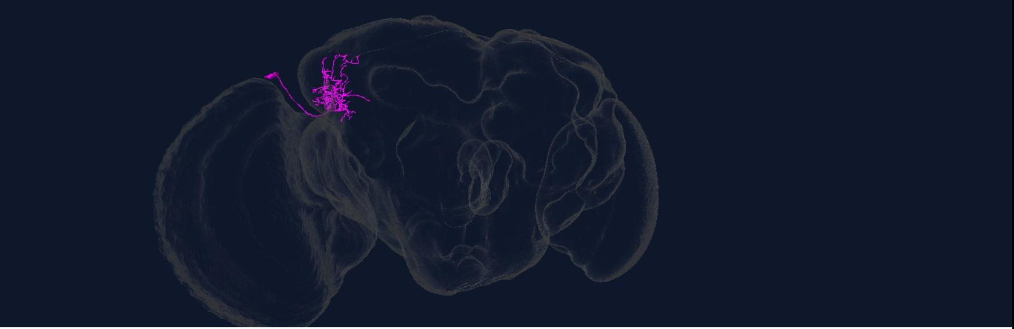
A Conserved 18-Neuron Circuit Across Three Male Drosophila Connectomes
MAOL v1.1
MANC v1.2.1
MCNS v0.9
CIRCUIT TOPOLOGY · MAOL
CODEX 3D MESH · All 18 Circuit Neurons · MAOL v1.1
CIRCUIT ROLES
Hub / Self-loop
×1
in=1, out=5 + loop
Reciprocal Relay
×2
in=1, out=5
Relay
×3
in=1–2, out=1–3
Source
×2
in=0, out=1–2
Sink
×10
in=1–2, out=0
Each colour = one neuron · Optic lobe upper-left · Projections extend toward central brain
KEY OBSERVATIONS
CODEX 3D MESH · Hub Neuron 29890 · Self-loop anchor
↺
Self-loop hub sustains signal without re-excitation
⇌
Reciprocal relays amplify via mutual excitation
♂
Absent from female datasets — sex-specific wiring
?
All 18 neurons unclassified — novel circuit territory
HYPOTHESIS
Structural backbone of male visuomotor integration; coordinates optic lobe output with nerve cord locomotor circuits during visual pursuit.
Test: optogenetic silencing (GtACR1) during courtship chase.
Nodes coloured by functional role · Arrows = directed synapses · Loop = auto-excitation
Magenta · Upper optic lobe · Long projection toward central brain visible
[1] Dorkenwald et al. (2023) Nat. Methods 19:119 · [2] Schlegel et al. (2023) Nature 634:139 · [3] Namiki et al. (2018) eLife 7:e34272 · [4] Sapkal et al. (2023) bioRxiv · [5] Masland (2012) Neuron 76:266 · [6] Gruntman & Turner (2013) Nat. Neurosci. 16:1821
codex.flywire.ai · KNUST, Ghana

