Slide 1

CLAWBIO × GENOMIC INTELLIGENCE
Agentic Genomics in Practice
AI agents are starting to do real genomics work end to end. The hard part is no longer writing the code. It is trusting the result.
Manuel Corpas
Senior Lecturer in Genomics, AI, and Data Science · University of Westminster
Founder, ClawBio
Webinar · ClawBio × Genomic Intelligence · 24 June 2026

Slide 2
TODAY
What we will cover in the next 90 minutes
Manuel (ClawBio) State of the art in agentic genomics: what changed, why trust is the bottleneck, and concrete examples with ClawBio skills.
Benjamin (GI) What the Genomic Intelligence models are and where they fit in a genomics workflow.
Benjamin (GI) Live scenarios: using GI skills inside ClawBio to solve real bioinformatics problems, in Codex and on the web platform.
Everyone Q&A, and an open call: build your own use case with the platform over the next two weeks.
For bioinformaticians, computational biologists, genomics researchers, and anyone building with AI agents in the life sciences.

Slide 3
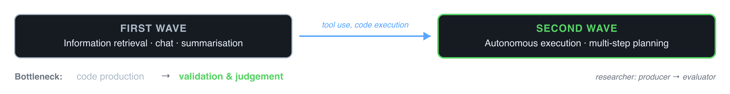
THE SHIFT
Two Waves of LLMs in Biology
First wave: information retrieval
→ Summarising papers, answering pathway questions, extracting structured data from text.
→ Useful but incremental.
Second wave: autonomous execution
→ Modern LLMs can write, debug, and execute code.
→ Connected to file systems, databases, and command-line tools, they plan multi-step analyses and adapt on intermediate results.

Slide 4
DEFINITION
Defining Agentic Genomics
An AI agent that plans and executes a genomic analysis end to end: it reads the data, chooses the tools, runs them, inspects intermediate results, and revises its own plan, with a human evaluating rather than typing every command.
Senses
Reads VCFs, FASTQs, manifests, guidelines, and prior outputs as context.
Acts
Invokes real tools: aligners, variant callers, annotation and reporting skills.
Adapts
Checks intermediate results and re-plans, instead of running a fixed script.
Grounded in the Corpas, Fatumo & Guio Perspective on agentic genomics, and a Briefings in Bioinformatics benchmark of frontier LLMs in pharmacogenomics.

Slide 5
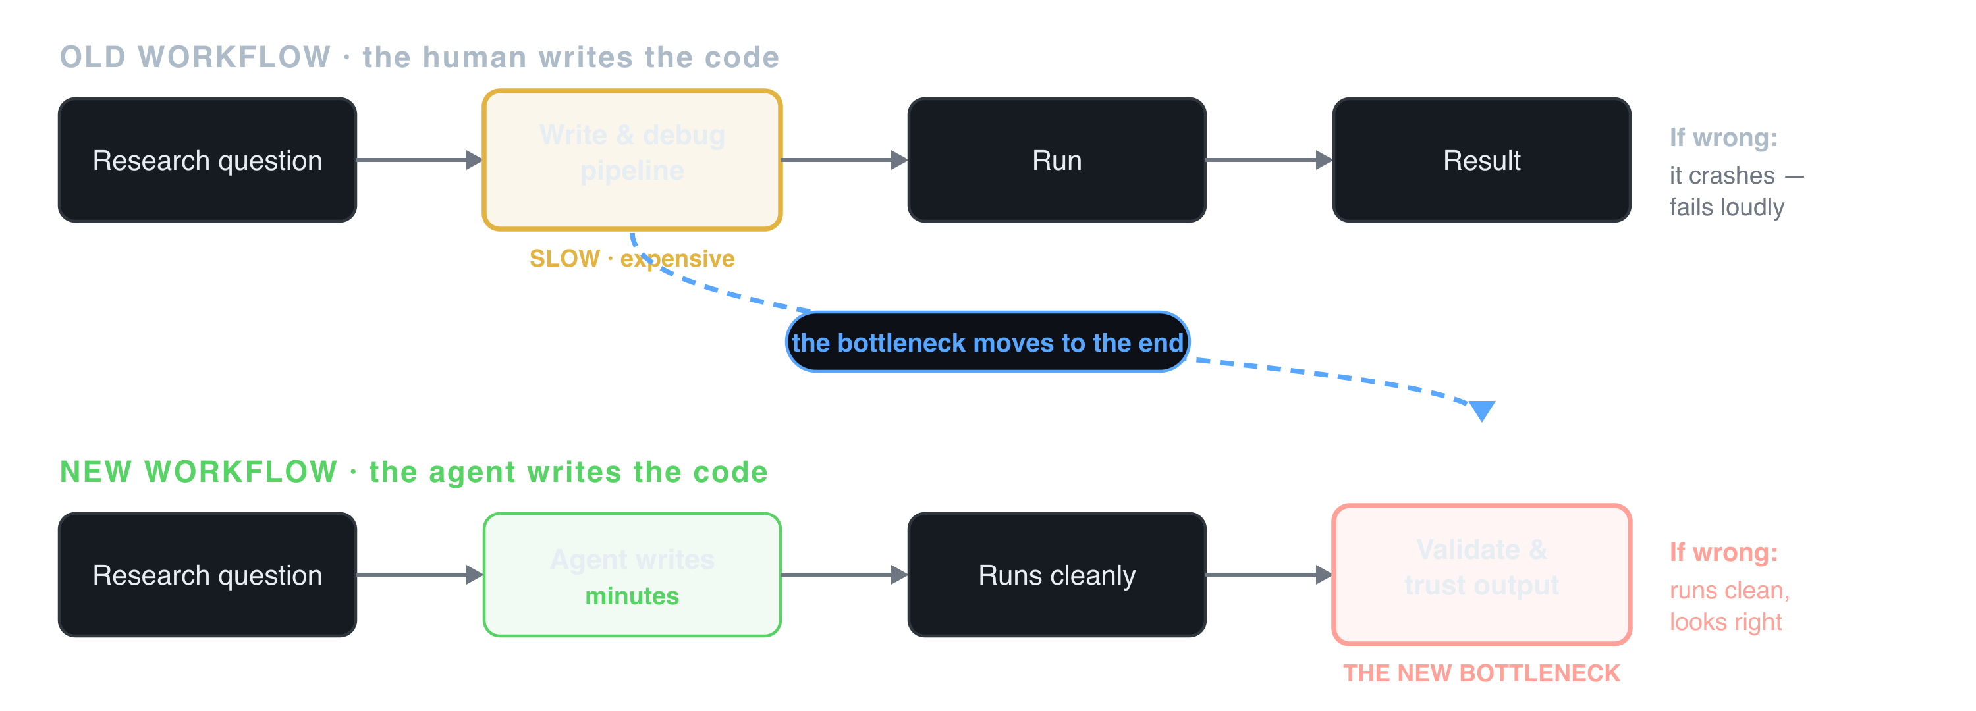
THE PARADIGM SHIFT
The work moves from code production to validation
Generating the analysis is no longer the hard part. Knowing you can trust it is.

Slide 6
THE NEW BOTTLENECK
The Validation Bottleneck: silent, plausible-looking failure
Plausible
The output is formatted correctly, reads fluently, and matches what a reviewer expects to see.
Confident
The agent states a wrong answer with the same tone as a right one. No flag, no uncertainty.
Consequential
In genomics the failure mode is a missed cancer gene or a wrong dose, not a 404. And it scales.
A healthy 32-year-old's exome is screened. The agent calls a pathogenic BRCA1 frameshift “likely benign”, with a clean report, a citation, and no flag raised. She is never offered screening or risk-reducing surgery. The first sign is stage IV cancer.
Nothing crashed. Now run that same pipeline across 10,000 genomes overnight.
A confident, plausible, wrong answer is worse than no answer. Safe uncertainty beats confident hallucination.

Slide 7
ClawBio
An open, agent-native skill library for bioinformatics.
Open-source · local-first · reproducible
993
GitHub stars
90
open skills
48
contributors
218
forks
From a standing start in February 2026. Nearly 1,000 stars in four months, heading for 5,000.
A skill is a contract
Each skill is a plain-text SKILL.md plus code: what it does, what it needs, and the steps the agent must follow.
The connecting layer
ClawBio links AI agents to genomic databases, clinical knowledge, and validation workflows.
Open and shared
Anyone can write, audit, and reuse skills. The aim: a trust layer for agentic genomics.
github.com/ClawBio/ClawBio · today, Genomic Intelligence's models run as skills inside this library.

Slide 8
EMPIRICAL QUESTION
Can a plain-text SKILL.md reach clinical-grade?
Pharmacogenomics, ground truth from CPIC guidelines, 44,550 scored evaluations across frontier models and three conditions: free prompt, the skill's reasoning, and executing the skill.
80.6%
Free prompt
(no specification)
95.5%
Skill reasoning
(guideline loaded)
100%
Skill execution
(deterministic)
Accuracy climbs as correctness is constrained by architecture, not by asking the model more nicely.

Slide 9
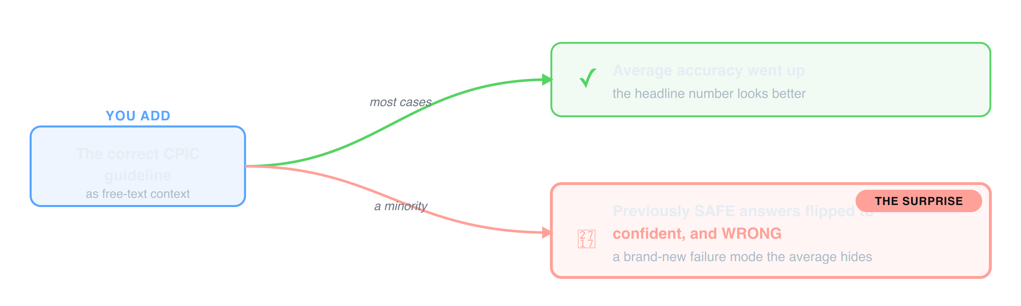
THE COUNTERINTUITIVE RESULT
Giving the model the right guideline made it more dangerous
Trust is architectural: it comes from deterministic, auditable, model-invariant execution, not from a better prompt.

Slide 10
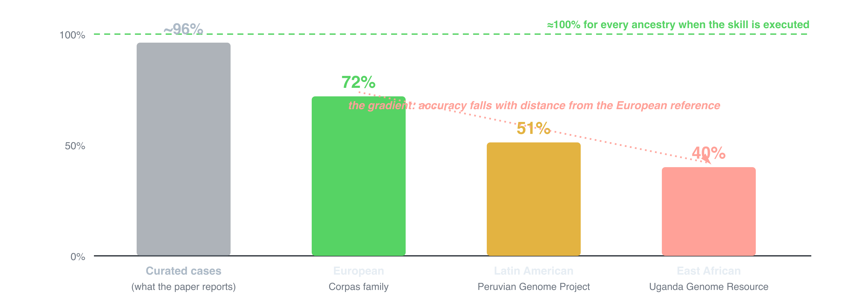
AND IT IS NOT EQUAL
On real genomes, accuracy falls by ancestry
Curated ~96% does not transfer to real diplotypes from over 7,000 individuals. Executing the skill removes the gradient. Validation is also an equity problem.

Slide 11
OVER TO GENOMIC INTELLIGENCE
From the framing to the live work
Next, with Benjamin and the GI team
→ What the Genomic Intelligence models are and where they fit.
→ Live scenarios: GI skills running inside ClawBio on real bio problems.
→ Follow along in Codex; prompts and links will be in the chat.
Try it yourself, now
→ Ask a real, openly published genome questions, live: every answer executed by a ClawBio skill.
→ conversational.clawbio.ai
→ Star the repo: github.com/ClawBio/ClawBio
The point of the demos: not “the agent can run it”, but “you can trust what it ran”.

Slide 12
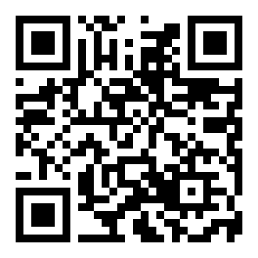
OUT NOW
Build an Agentic Genomics System (From Scratch)
A hands-on, build-it-yourself guide. You will not just read about agentic genomics, you will build it in your browser on a real, openly published genome with ClawBio.
What you will build
→ Your first runnable skill, in minutes, no setup required.
→ Agents that choose a method, run it, read the result, and notice when it is wrong.
→ Validation and guardrails to keep them honest.
Scan to get the book
Paperback & Kindle · 328 pages
amazon.co.uk/dp/B0H6GN1ZVZ

Slide 13
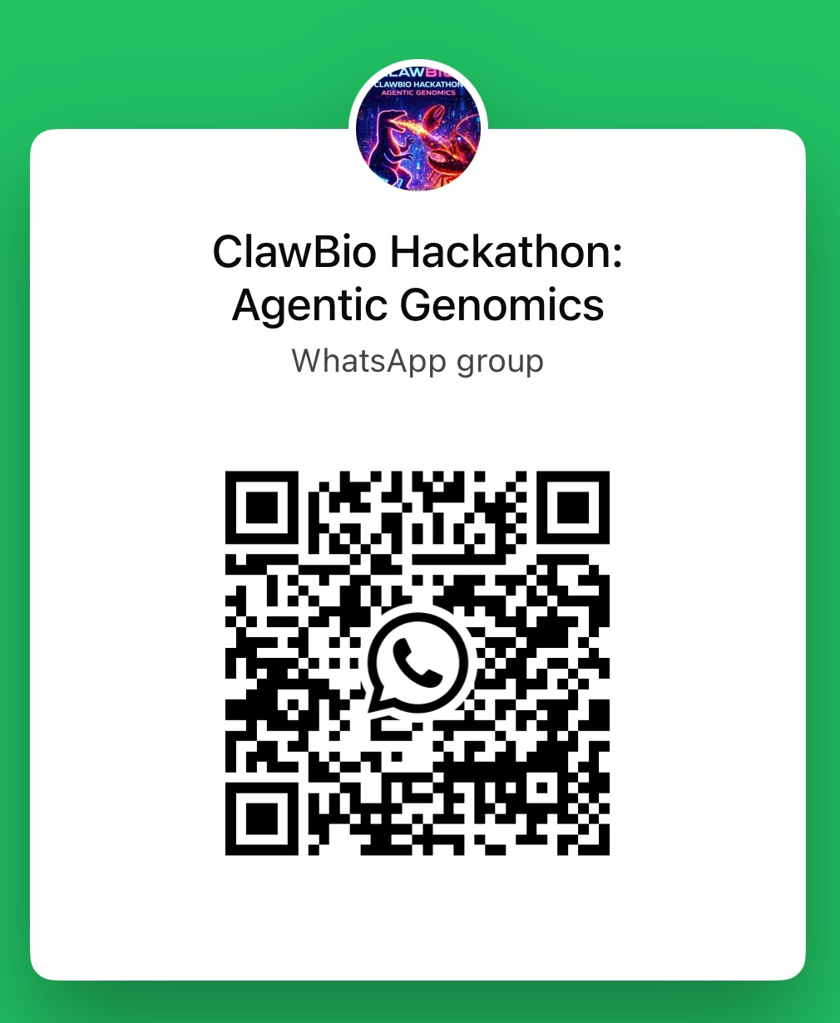

KEEP IN TOUCH
Join the ClawBio community
Subscribe to events
Hackathons & workshops
luma.com/ClawBio
Join the WhatsApp group
Scan with the WhatsApp camera
Try it live: conversational.clawbio.ai · Build with us: github.com/ClawBio/ClawBio
Open call: ship your own use case on the platform over the next two weeks. Best submissions win. The book and the pharmacogenomics preprint are linked on the previous slides.

