Slide 1
2026 WORLD CONGRESS OF PSYCHIATRIC GENETICS
Compounding Neglect:
How AI Widens the Equity Gap
in Psychiatric Genomics,
and How We Close It
Manuel Corpas
University of Westminster
WCPG 2026 / COMPOUNDING NEGLECT
Corpas, Guio, Fatumo, 2026, Cell Genomics
01

Slide 2
COMPOUNDING NEGLECT
Compounding
Neglect.
AI inherits our gaps.
It can compound them.
WCPG 2026 / COMPOUNDING NEGLECT
Corpas, Freidin, Valdivia-Silva et al., 2026, Nature Communications (under review)
02

Slide 3
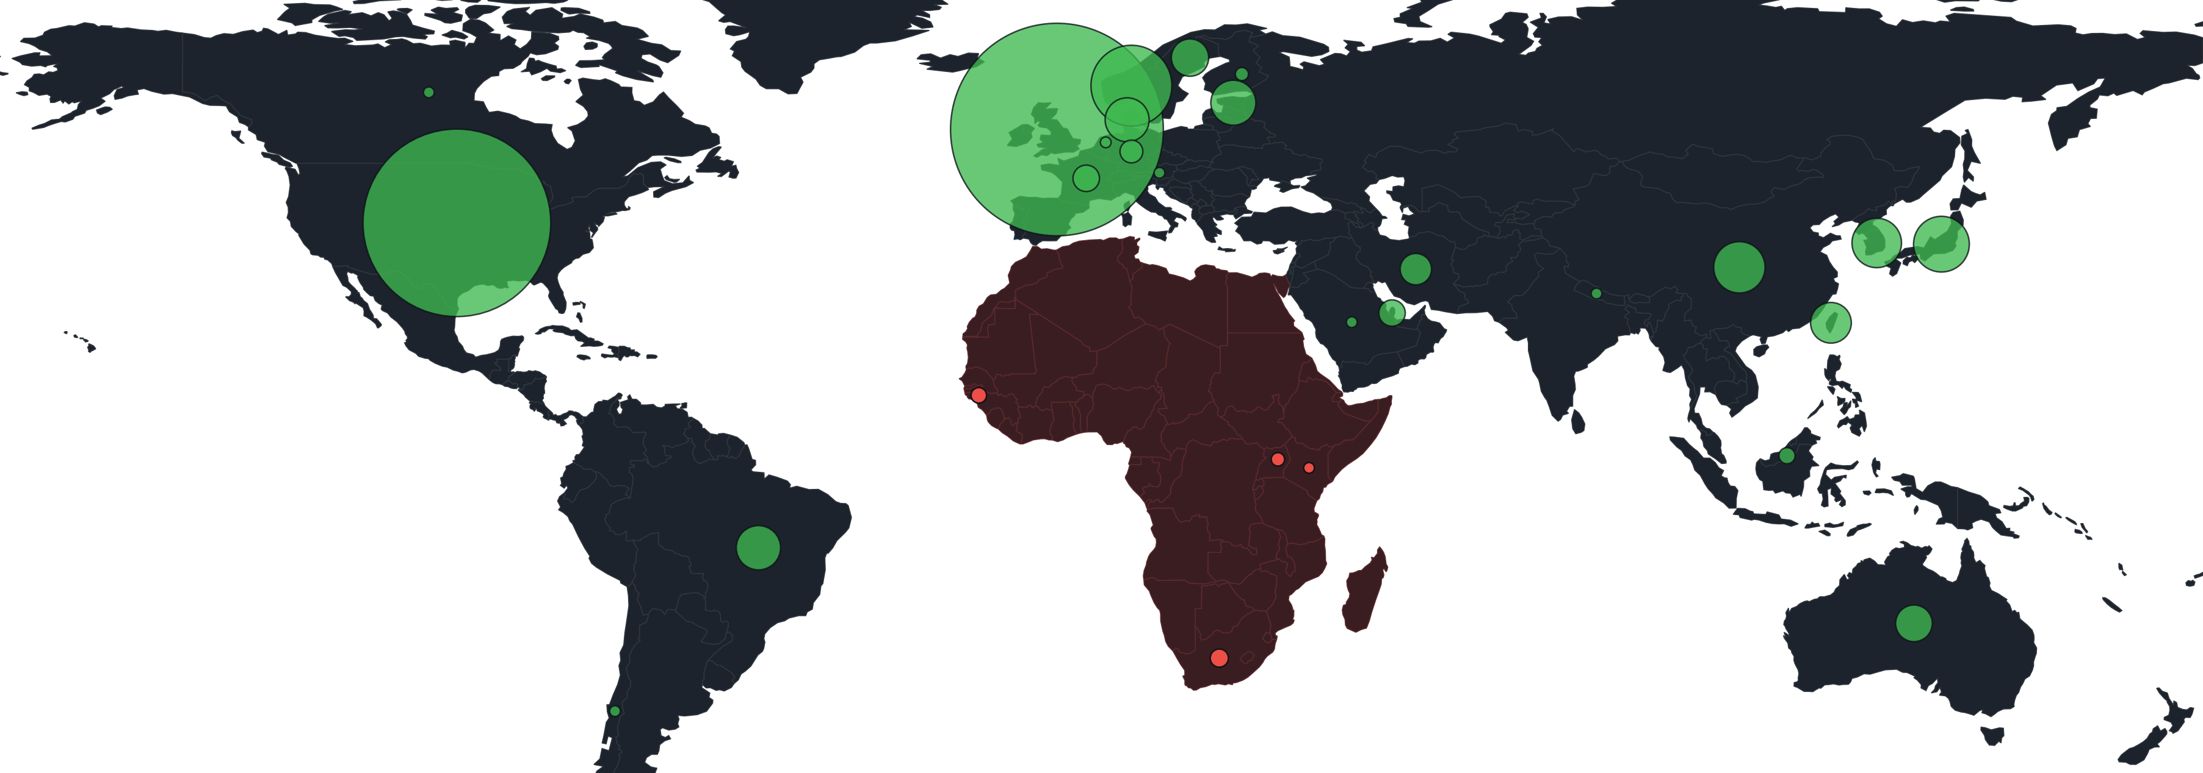
SEVENTY BIOBANKS / 29 COUNTRIES / 2000 TO 2025
Does research follow suffering?
Europe + North America
88% of papers
Africa
24% of disease burden
0.7% of papers
A 34-fold gap. 71.8% of 770,178 trial sites are in high-income countries.
Bubble area: biobank publications by country, 2000 to 2025. A further 1,908 papers from international consortia are not mapped.
WCPG 2026 / COMPOUNDING NEGLECT
Corpas, Freidin, Valdivia-Silva et al., 2026, Nature Communications (under review)
03

Slide 4
FIVE BIOBANKS / MAPPED PUBLICATIONS / 2000 TO 2024
Psychiatric evidence is concentrated.
WCPG 2026 / COMPOUNDING NEGLECT
Corpas, Ojewunmi, Guio et al., 2026, Annual Review of Biomedical Data Science
04

Slide 5
PHARMGKB / 11,198 VARIANT ANNOTATIONS / CLASSIFIABLE PARTICIPANTS
Whose genomes wrote the dosing rules?
Half of all participants had no classifiable ancestry at all (49.8%).
WCPG 2026 / COMPOUNDING NEGLECT
Corpas, Siddiqui, Soremekun et al., 2024, Annual Review of Pharmacology and Toxicology
05

Slide 6
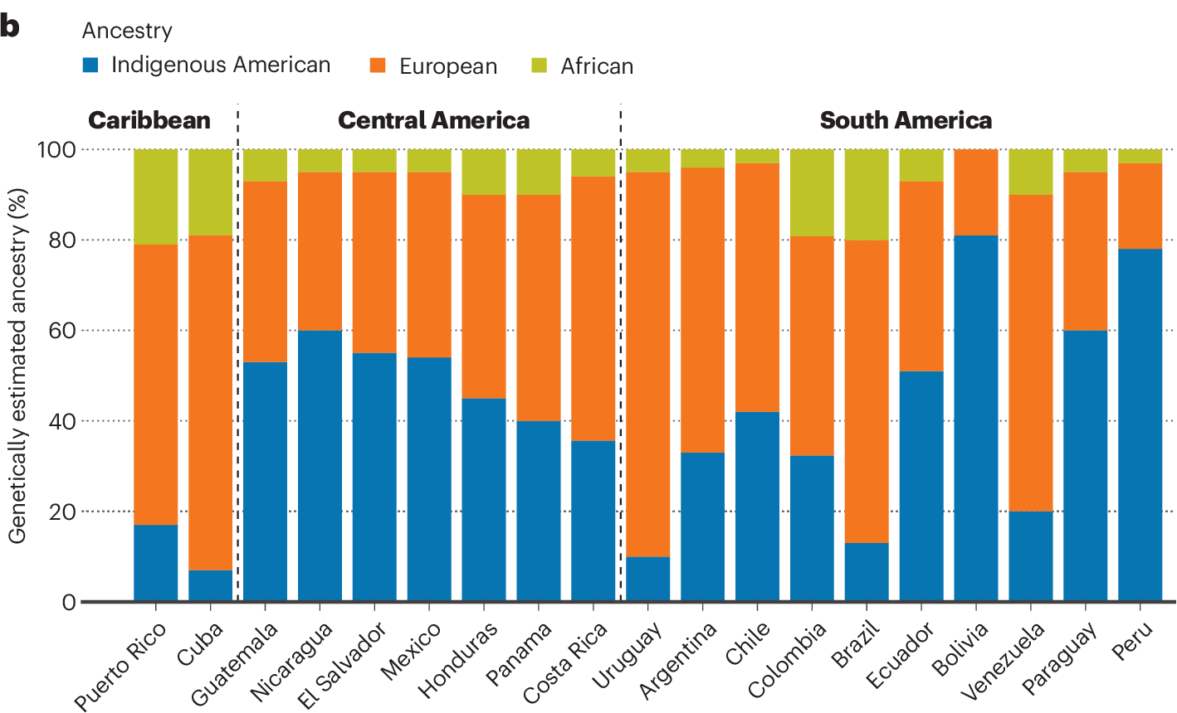
THE INHERITANCE / POPULATIONS
One label. Different ancestries.
WCPG 2026 / COMPOUNDING NEGLECT
Corpas, Guio, Lopez-Correa et al., 2025, Nature Genetics
06

Slide 7
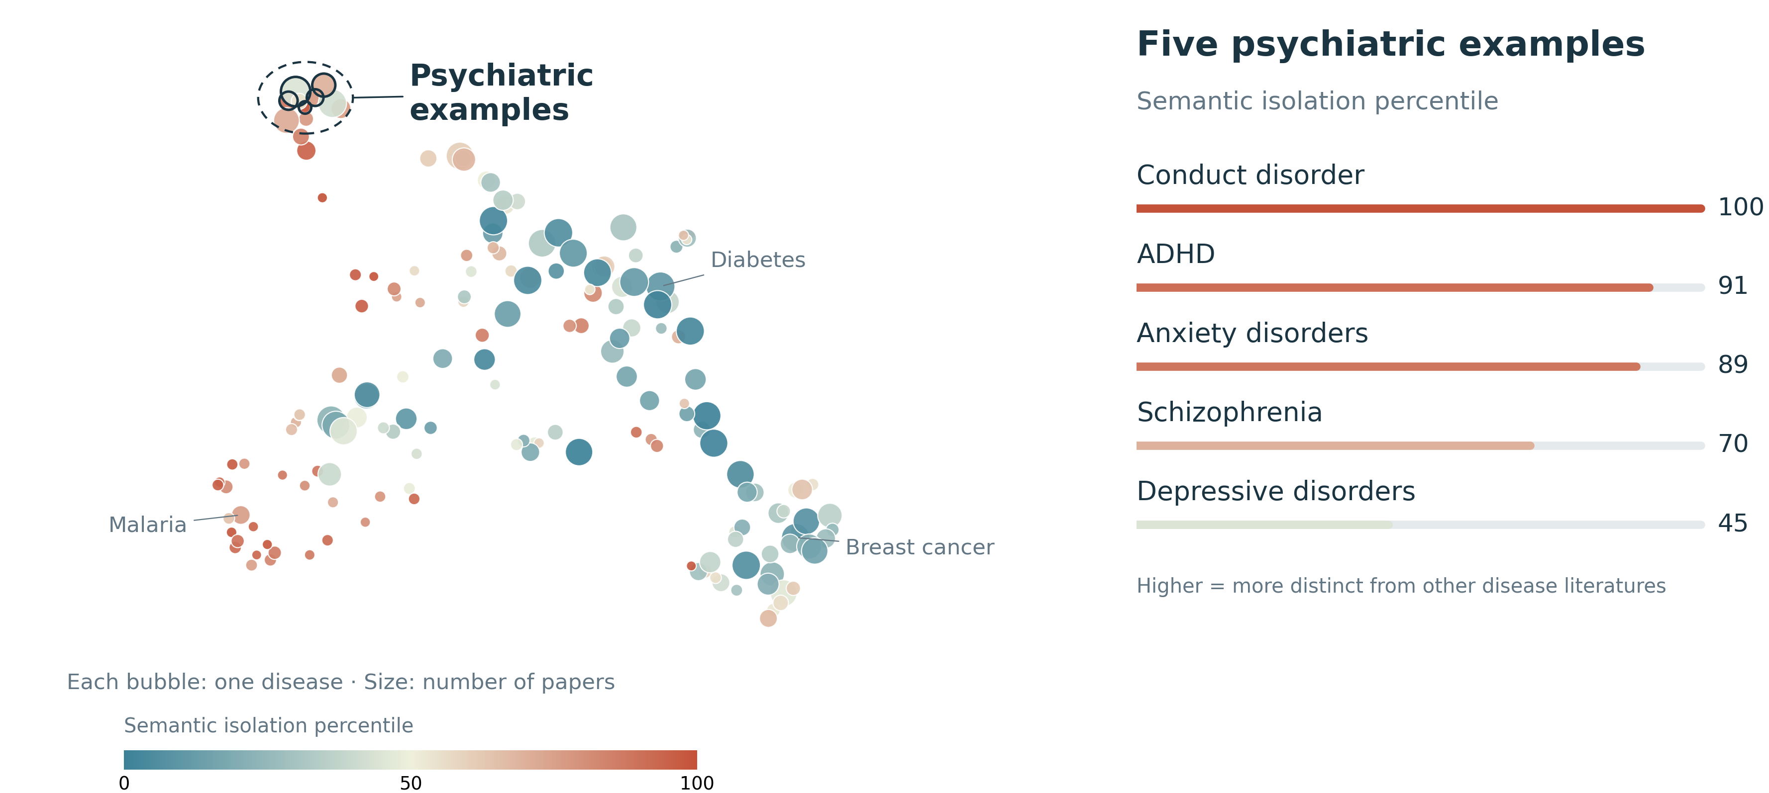
THE INHERITANCE / KNOWLEDGE
Some knowledge sits at the edges.
WCPG 2026 / COMPOUNDING NEGLECT
Corpas, Kalungi, Ndure et al., 2026, Communications Biology (accepted)
07

Slide 8
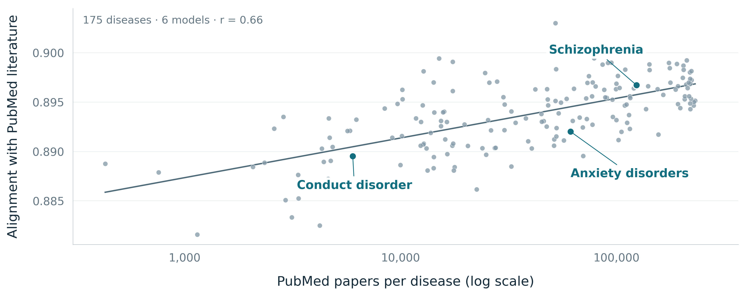
MODEL BEHAVIOUR / TEXTUAL ALIGNMENT
AI inherits an uneven record.
WCPG 2026 / COMPOUNDING NEGLECT
Corpas, Kalungi, Ndure et al., 2026, Communications Biology (accepted)
08

Slide 9
AGENTIC GENOMICS
Lowers the barrier to producing.
Not to judging.
WCPG 2026 / COMPOUNDING NEGLECT
Corpas, Guio, Fatumo, 2026, Cell Genomics
09

Slide 10
CONSTRAIN THE MACHINE
An executable methods section.
SKILL.md
›_
Specification
Code
v1.0
Demo data
Tests + provenance
WCPG 2026 / COMPOUNDING NEGLECT
10

Slide 11
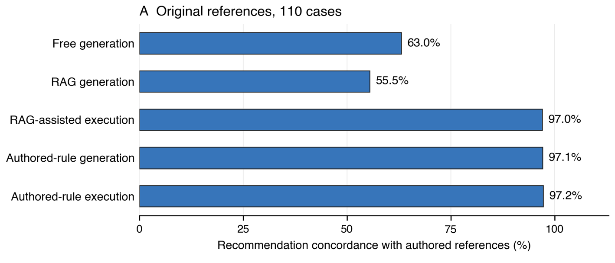
PHARMACOGENOMICS / 8 MODELS, 110 CASES
Agreement with our reference.
WCPG 2026 / COMPOUNDING NEGLECT
Corpas, Iacoangeli, Bourdenx et al., 2026, Cell Genomics (accepted)
11

Slide 12
THE REFERENCE WAS WRONG
Shared error.
Perfectly reproduced.
Negative result.
Uncertain susceptibility.
WCPG 2026 / COMPOUNDING NEGLECT
Corpas, Iacoangeli, Bourdenx et al., 2026, Cell Genomics (accepted)
12

Slide 13
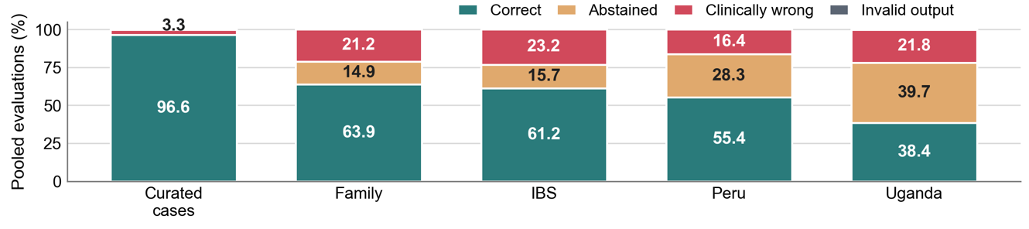
REAL GENOMES / SEVEN MATCHED MODELS
Who receives a useful answer?
Iberian
Scorable states per model: Family 26, Iberian 95, Peru 42, Uganda 190. Invalid output: 0.2% curated, 0.1% Uganda, none elsewhere.
Rule coverage of distinct states: Family 21.6%, Iberian 16.1%, Peru 19.2%, Uganda 6.6%.
WCPG 2026 / COMPOUNDING NEGLECT
Corpas, Iacoangeli, Bourdenx et al., 2026, Cell Genomics (accepted)
13

Slide 14
SAFE UNCERTAINTY
Safe uncertainty.
Still a gap.
Investigate why.
WCPG 2026 / COMPOUNDING NEGLECT
14

Slide 15
ONE LEVEL DEEPER
Three things to do next.
01
Measure the silence.
Count who gets no answer, population by population.
02
Audit the answer key.
Test the reference, not only the model.
03
Write the missing rules.
By and for the populations the rules miss.
Every silence is a coordinate. Every coordinate a research question.
WCPG 2026 / COMPOUNDING NEGLECT
Corpas, Ojewunmi, Guio et al., 2026, Annual Review of Biomedical Data Science
15

Slide 16
PARTICIPATION IN AGENTIC SCIENCE
Publish a method others can challenge.
Replay
PAPER
›_
Reuse
Figure 3
SKILL
Challenge
Access requires compute, training and support.
WCPG 2026 / COMPOUNDING NEGLECT
16

Slide 17
RESPONSIBILITY TO PARTICIPANTS
Responsibility travels with the data.
Consent
Data
AGENT
Stop / ask
Retention
Approval
Delegation does not remove responsibility.
WCPG 2026 / COMPOUNDING NEGLECT
17

Slide 18
WHAT KIND OF AGENTIC SCIENCE WILL WE BUILD?
A gap in evidence.
A reason to
investigate.
Never a verdict
on a person.
WCPG 2026 / COMPOUNDING NEGLECT
18

Slide 19
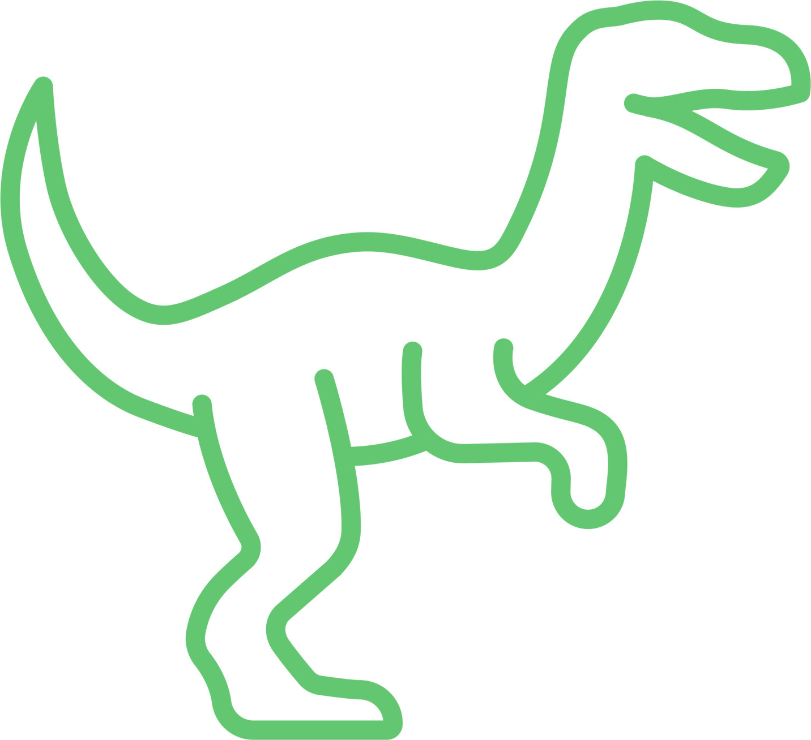
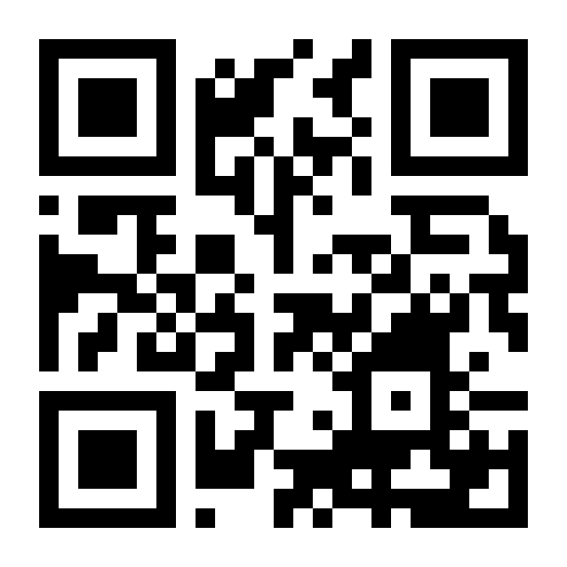
THANK YOU
Open, inspectable, and built together.
With thanks to
ClawBio
Segun Fatumo
Heinner Guio
Alfredo Iacoangeli
Mathieu Bourdenx
Mahmoud Aldraimli
M. Reza Jabalameli
Nathan Skene
Allan Kalungi
Sainabou Ndure
Oyesola Ojewunmi
Maxim B. Freidin
Julio Valdivia-Silva
Simeon Baker
Moneeza K. Siddiqui
Opeyemi Soremekun
Rohini Mathur
Dipender Gill
Catalina Lopez-Correa
clawbio.ai
Skills, benchmarks
and evidence
And the communities and families who shared their genomes.
WCPG 2026 / COMPOUNDING NEGLECT
19

