Slide 1
About me

Slide 2
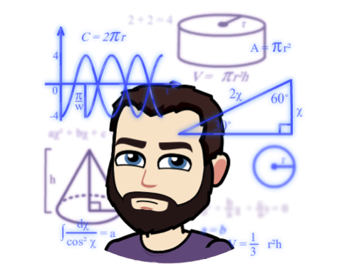
Who is this guy?

Slide 3
Education
B.S. in Statistics from WSU
M.S. in Applied Statistics from WSU
Ph.D. in Applied Mathematics from AFIT
Topics in Statistical Calibration: http://www.dtic.mil/docs/citations/ADA598921

Slide 4
Research interests
Statistical/machines learning
Interpretable machine learning (e.g., quantifying and visualizing both feature importance and feature effects)
Statistical computing (e.g., developing useful/useless R packages)
Inverse estimation (e.g., inverse prediction—maybe in this class? 🤔)

Slide 5
R packages
investr
pdp

Slide 6


Slide 7
vip
sure
RBitmoji
roundhouse

