Slide 1
Association and Simple Linear Regression
Brandon M. Greenwell

Slide 2
library(ggplot2) # for advanced plotting library(investr) # for crystal and arsenic data sets p1 <- ggplot(crystal, aes(x = time, y = weight)) + geom_point() + labs(x = "Time (hours)", y = "Weight (grams)") p2 <- ggplot(arsenic, aes(x = actual, y = measured)) + geom_point() + labs(x = "True amount of arsenic", y = "Measured amount of arsenic") gridExtra::grid.arrange(p1, p2, nrow = 1)

Slide 3
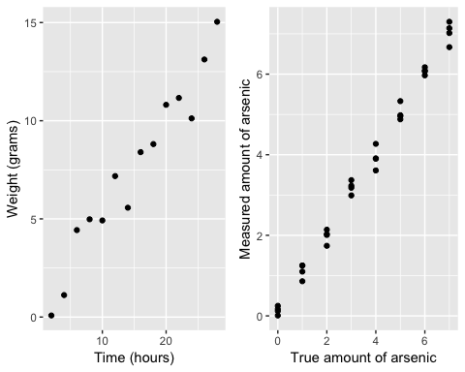

Slide 4
library(HistData) # for Galton's height data library(ggplot2) # for advanced plotting ggplot(Galton, aes(x = parent, y = child)) + geom_point(alpha = 0.1) + geom_smooth(method = "lm", formula = y ~ x, se = FALSE) + geom_abline(intercept = 0, slope = 1, linetype = "dashed") + labs(x = "Height of child (in)", y = "Height of mid-parent (in)")

Slide 5
