Slide 1
Lecture 02
Inferences in regression and correlation

Slide 2
“The analysis of variance is not a mathematical theorem, but rather a convenient method of arranging the arithmetic.”
- Fisher

Slide 3


Inferences concerning $β_{1}$
Is there a relationship between $X$ and $Y$?

Slide 4

Inferences concerning $β_{1}$
Is there a relationship between $X$ and $Y$?
Is there a statistically significant linear relationship between $X$ and $Y$?

Slide 5

Inferences concerning $β_{1}$
Is there a relationship between $X$ and $Y$?
Is there a statistically significant linear relationship between $X$ and $Y$?
How can we reformulate this as a statistical test?

Slide 6
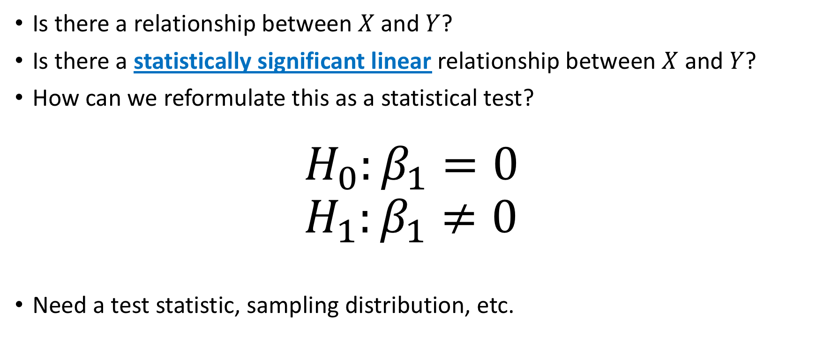
Inferences concerning $β_{1}$
Is there a relationship between $X$ and $Y$?
Is there a statistically significant linear relationship between $X$ and $Y$?
How can we reformulate this as a statistical test?
$$H_{0}:β_{1}=0 \\ H_{1}:β_{1}≠0$$
Need a test statistic, sampling distribution, etc.

Slide 7


Sampling distribution of ${\hat{β}}_{1}$
Test statistic: ${\hat{β}}_{1}=S_{xy}/S_{xx}$
Sampling distribution:
Assuming $ε_{i}\sim NID\left(0, σ^{2}\right)$, then $\hat{β}\sim ?$

Slide 8

Sampling distribution of ${\hat{β}}_{1}$
Test statistic: ${\hat{β}}_{1}=S_{xy}/S_{xx}$
Sampling distribution:
Assuming $ε_{i}\sim NID\left(0, σ^{2}\right)$, then $\hat{β}\sim N\left(?,?\right)$

Slide 9

Sampling distribution of ${\hat{β}}_{1}$
Test statistic: ${\hat{β}}_{1}=S_{xy}/S_{xx}$
Sampling distribution:
Assuming $ε_{i}\sim NID\left(0, σ^{2}\right)$, then $\hat{β}\sim N\left(β_{1},?\right)$

Slide 10

Sampling distribution of ${\hat{β}}_{1}$
Test statistic: ${\hat{β}}_{1}=S_{xy}/S_{xx}$
Sampling distribution:
Assuming $ε_{i}\sim NID\left(0, σ^{2}\right)$, then $\hat{β}\sim N\left(β_{1},σ^{2}/S_{xx}\right)$

Slide 11
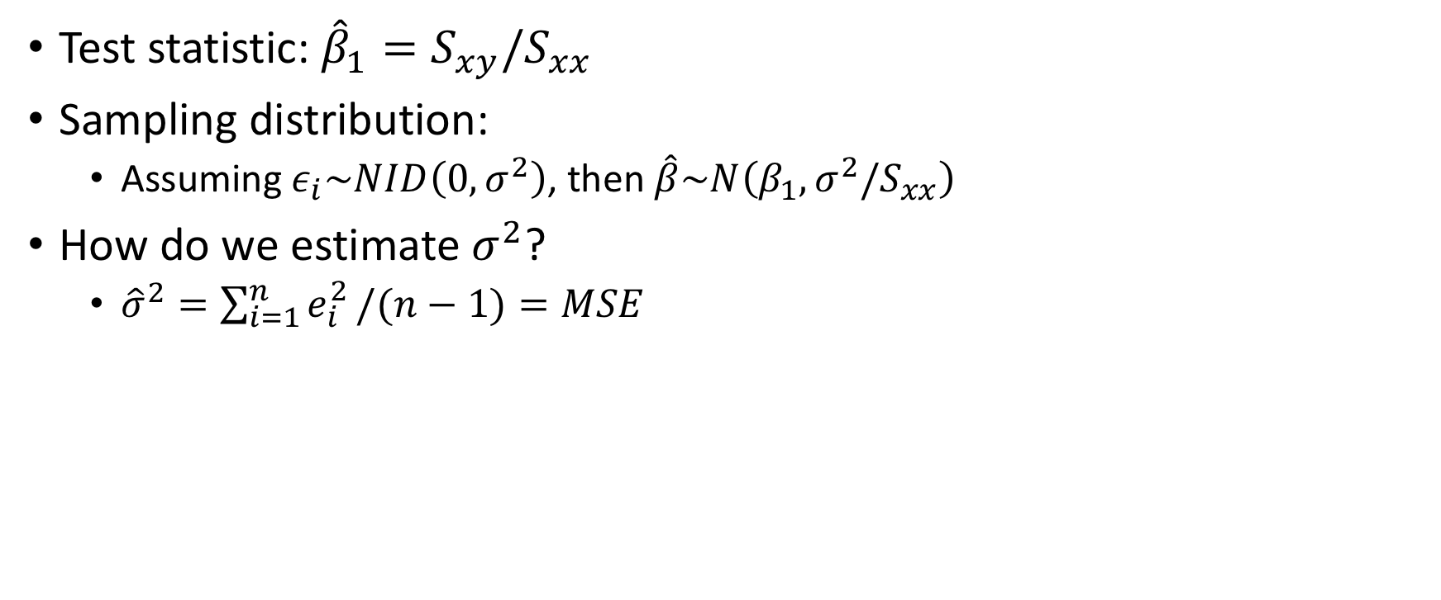
Sampling distribution of ${\hat{β}}_{1}$
Test statistic: ${\hat{β}}_{1}=S_{xy}/S_{xx}$
Sampling distribution:
Assuming $ε_{i}\sim NID\left(0, σ^{2}\right)$, then $\hat{β}\sim N\left(β_{1},σ^{2}/S_{xx}\right)$
How do we estimate $σ^{2}$?
${\hat{σ}}^{2}=\sum_{i=1}^{n}{e_{i}^{2}}/(n−1)=MSE$

