Slide 1
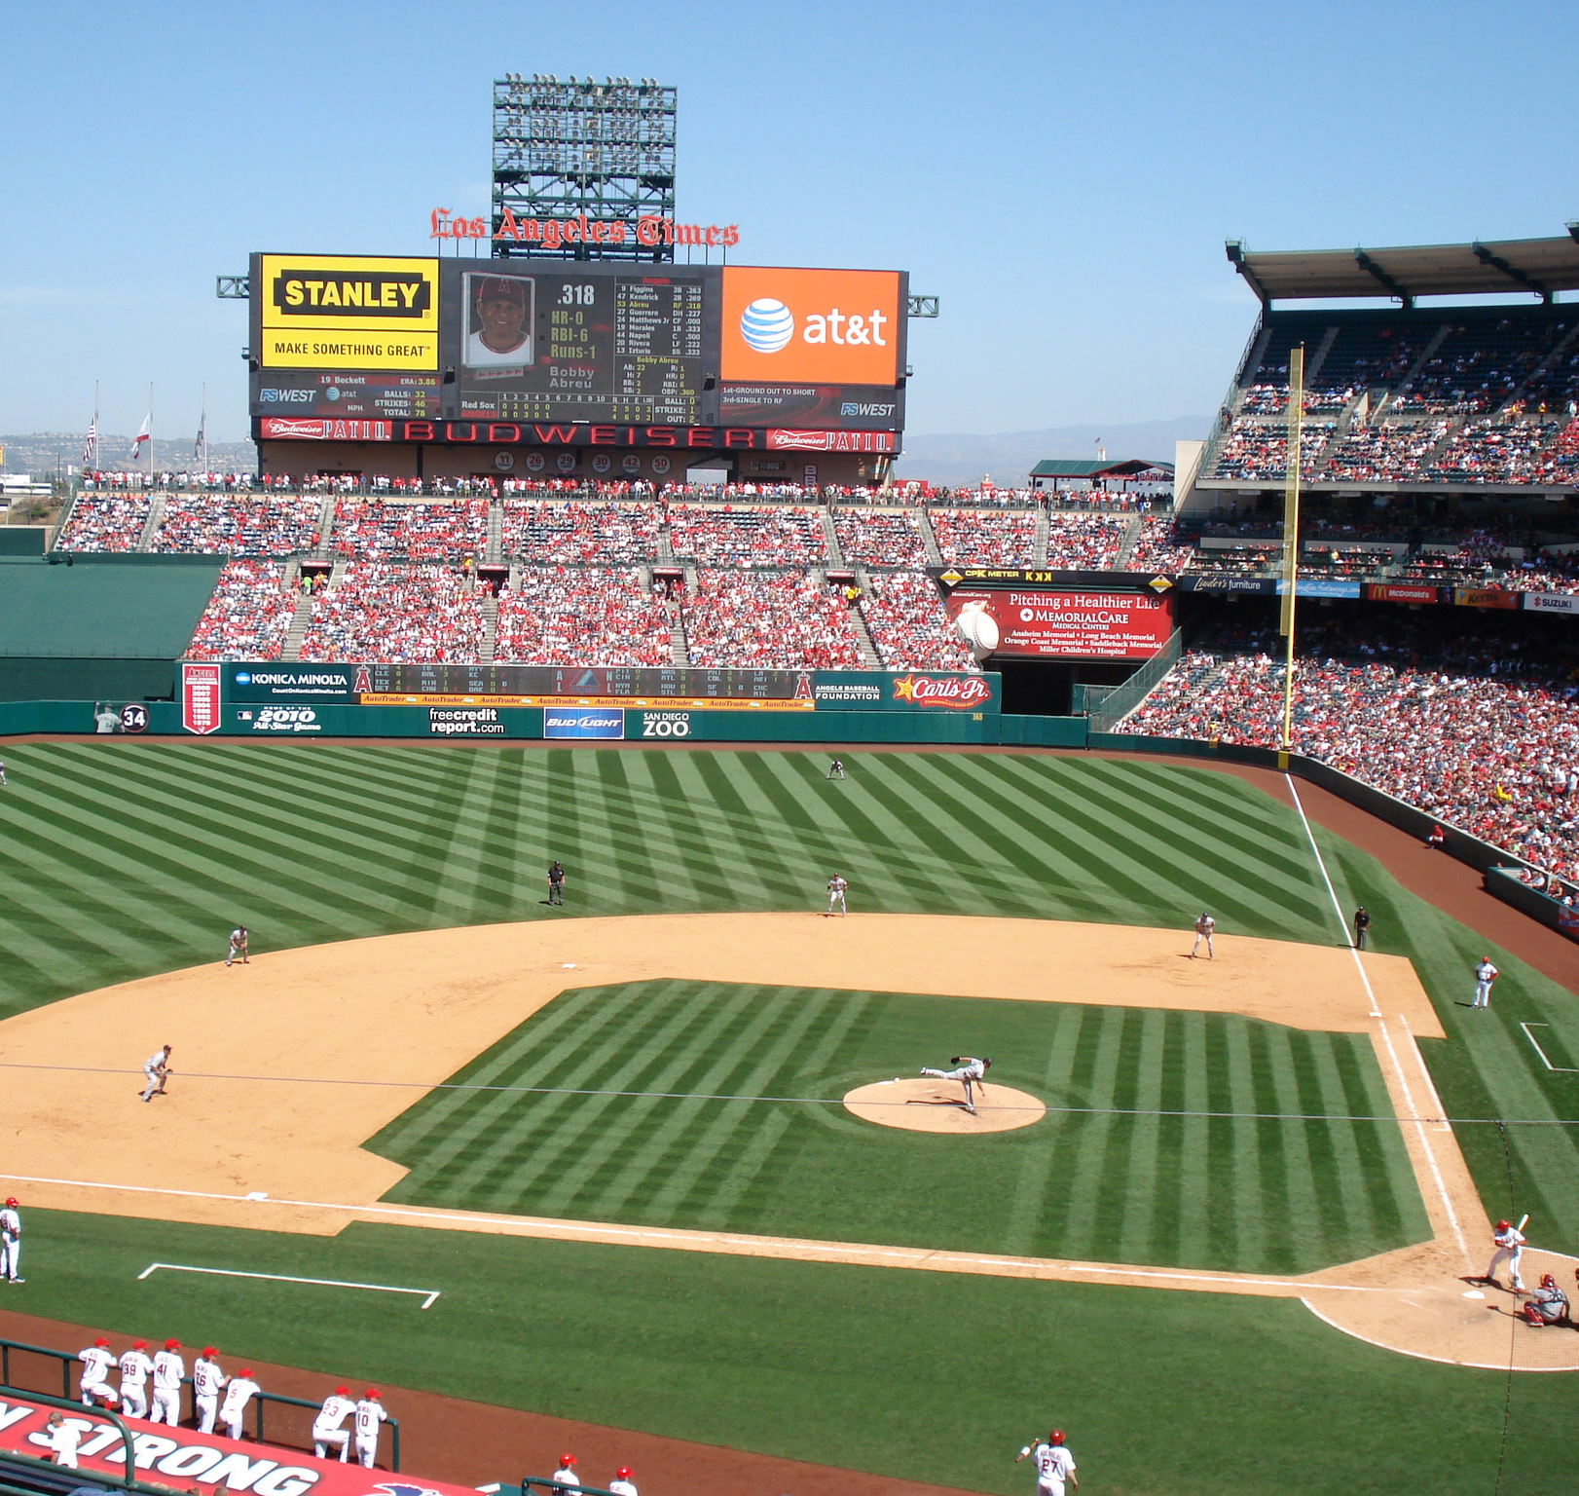
Predicting MLB Wins & Salary
Hunn Analytics:
Clay Hunn

Slide 2
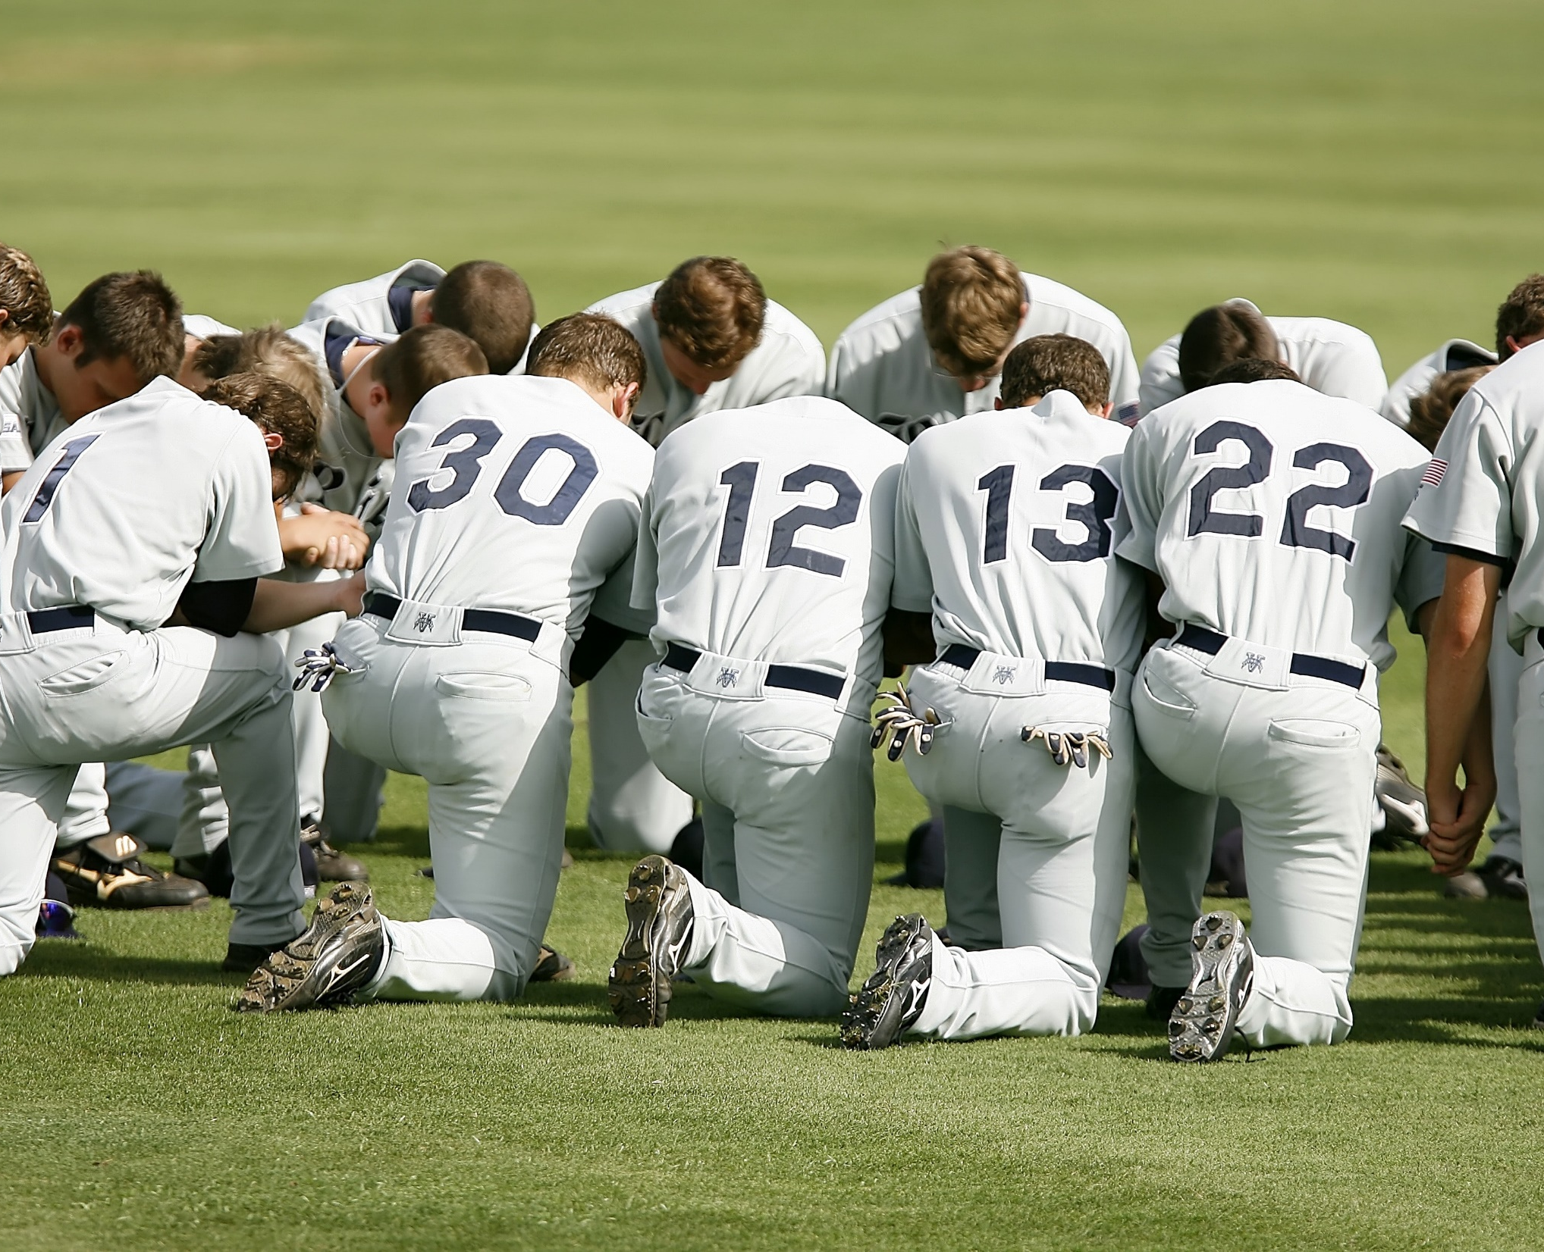
Overview
Introduction
Business Problem
Data Overview
Models & Metrics
Findings & Recommendations
Conclusion & Questions

Slide 3

Introduction
Hometown: Arlington, Tx (Go Rangers)
Experience:
Three years of Oil and Gas
Two years of Mortgage Banking
Three years of Cryptocurrency
Three years of Sales and Management
Hobbies and Skills:
Scuba Diving
Fluent in Spanish
Boardgames and Traveling

Slide 4
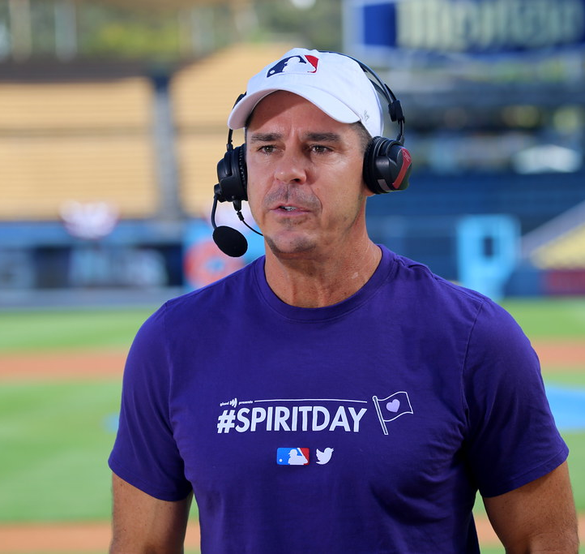
“The problem we're trying to solve is that there are rich teams and there are poor teams. Then there's fifty feet of crap, and then there's us. It's an unfair game. And now we've been gutted.” - Billy Beane (Moneyball)
This Photo by Unknown Author is licensed under CC BY
This Photo by Unknown Author is licensed under CC BY-SA
Notes:
MLB teams have a unique challenge in being the only professional sports league in America without a hard salary cap, this give the smaller market teams a unique disadvantage and allows the large markets to just outspend the smaller markets. This analysis is to assist you in making the best decisions for your team and remain competitive

Slide 5
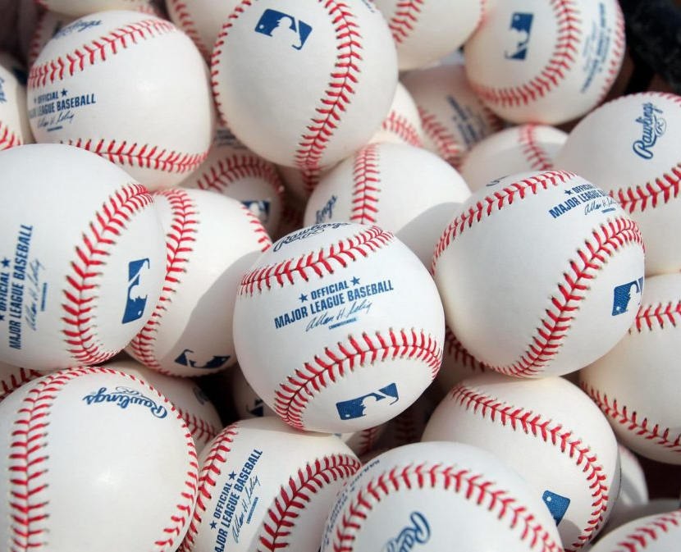
Data Overview
Season Statistics from 2016 to 2022
Fielding, Batting, Pitching, and Salary
22k unique statistics*
www.baseball-reference.com/
www.thebaseballcube.com/
This Photo by Unknown Author is licensed under CC BY-ND

Slide 6
Modeling
Models
Models
Fielding
Batting
Pitching
Salary

Slide 7
Win percentage
Win Total
Adjusted R-squared: .898
Win Percentage : +- 2.25%
Adjusted R-squared: .957
Win Total : +- 3.96
Model
Batting:
1. Runs
2. Hits
3. Batting Average
4. Total Bases
Pitching:
1. Quality Starts
2. Walks
3. Strike Outs
4. Batters Faced
Fielding:
1. Fielding Percentage
2. Runs Against
Notes:
Adjusted r squared

Slide 8
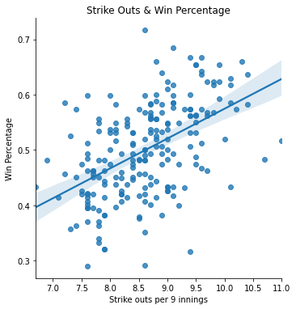
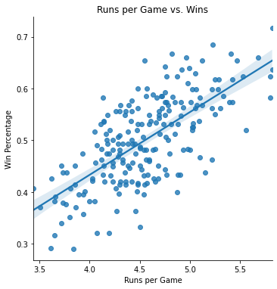
SO/9 & Runs per Game Fit Line w/ Win %

Slide 9
Yearly Salary
Salary per win
Adjusted R-squared: .771
Salary: +- 25 mil
Adjusted R-squared: .611
Salary per win: +- 760k
Model
Last Year Payroll
Pitcher & Batter Age
Simple Rating System (SRS)
Model
Batting:
1. Total Bases
2. Runs
Pitching:
1. Games Started
2. Earned Runs Average
Fielding:
1. Runs Against

Slide 10
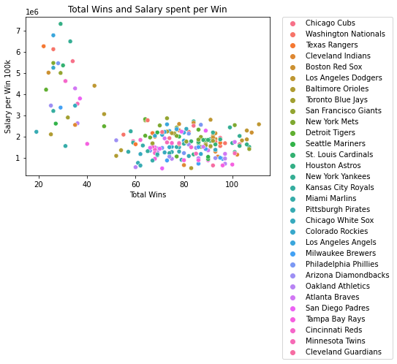
Per win spending and Win Totals
Outliers below the 40-win line are Covid Season
Baltimore Orioles are best at high wins and low spending per win

Slide 11
Findings
The best indicators for wins
The best indicators for Salary
Runs, Hits, Batting Average, and Total Bases
Quality Starts, Walks, Strike Outs
Fielding Percentage Runs Against
Last Years Salary
Batter and Pitcher Age
SRS (On a neutral field how strong is this expected team)

Slide 12
Recommendations
One: Focus on batter production and pitcher quality for wins
Two: Focus on keeping organization young and drafting well for salary optimization

Slide 13
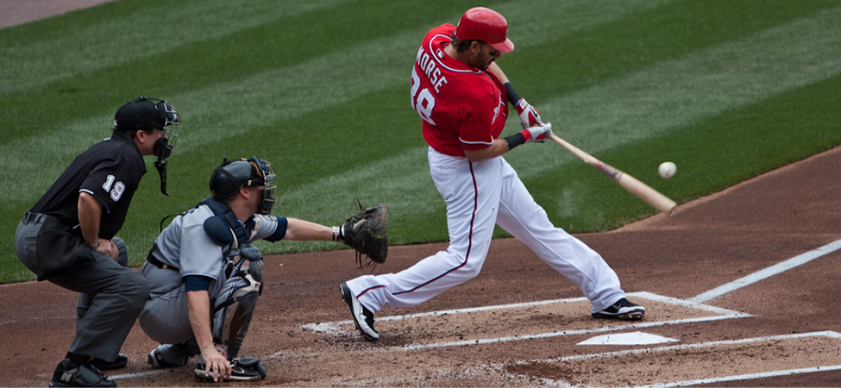
Thank You
LinkedIn www.linkedin.com/in/clayhunn
Email Hunnclay@gmail.com
Phone +01-817-404-9260
GitHub github.com/ClayHunn
This Photo by Unknown Author is licensed under CC BY

