Slide 1

Wireframe
Clayton Dixon C856

Slide 2
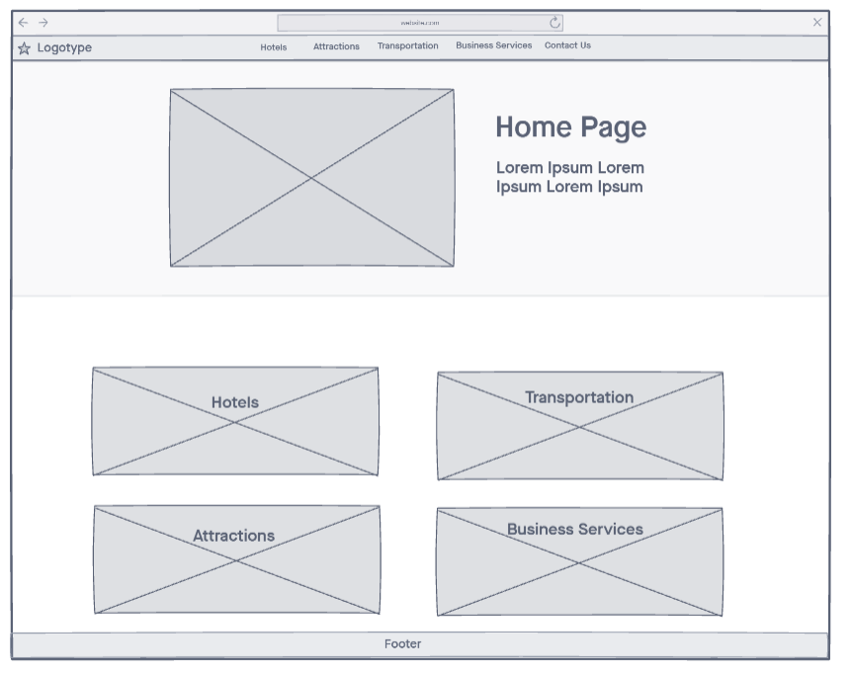
Home page with a persistent header. Logotype goes to the home page.
Hotels goes to the hotels page.
Attractions goes to the attractions page.
Transportation goes to the transportation page.
Business services goes to the business services page.
Contact us goes to the contact form.
Main photo of the island with four photos below for each web page. Each are labelled and goes to the corresponding page when clicked.
Footer down below that links to the privacy policy, Instagram page, twitter page, and facebook page.

Slide 3
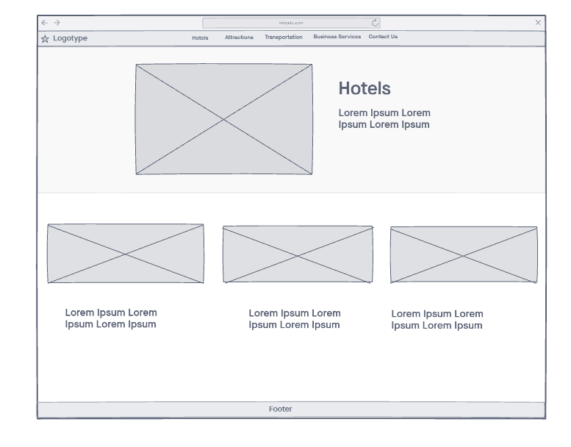
Same header that leads to all the 6 different pages that correspond with the label. Logotype goes to the homepage.
Hotels main photo with text paragraph.
Three photos below showing three different hotel properties with their names. Links to options provided.
Footer down below that links to the privacy policy, Instagram page, twitter page, and facebook page.

Slide 4
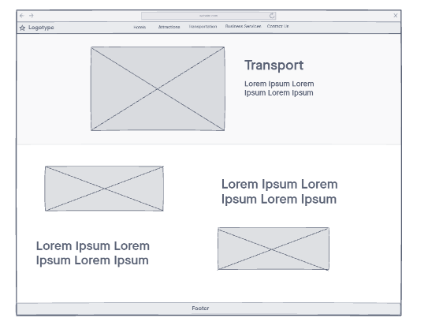
Same header that leads to all the 6 different pages that correspond with the label. Logotype goes to the homepage.
Main photo up top with a paragraph.
Down below photos of transportation methods and sample text. Links to options provided.
Footer down below that links to the privacy policy, Instagram page, twitter page, and facebook page.

Slide 5
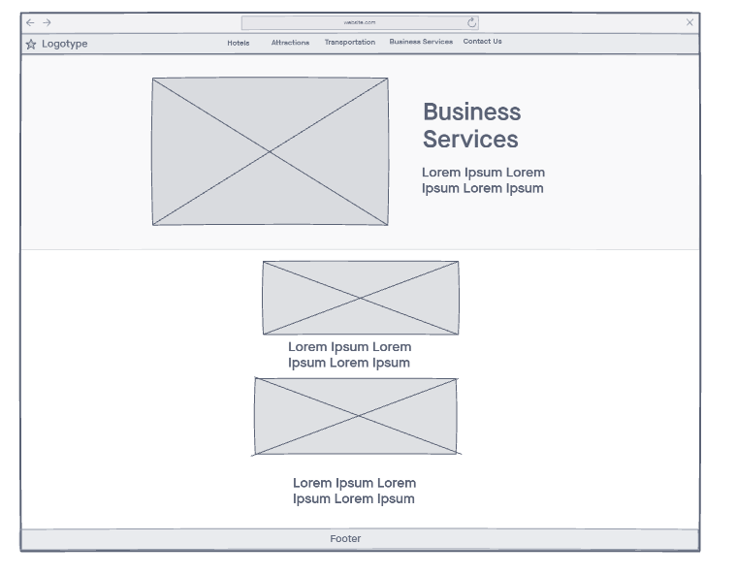
Same header that leads to all the 6 different pages that correspond with the label. Logotype goes to the homepage.
Business services label and text corresponding to topic.
Down below two pictures of business services and sample text. Links to options provided.
Footer down below that links to the privacy policy, Instagram page, twitter page, and facebook page.

Slide 6
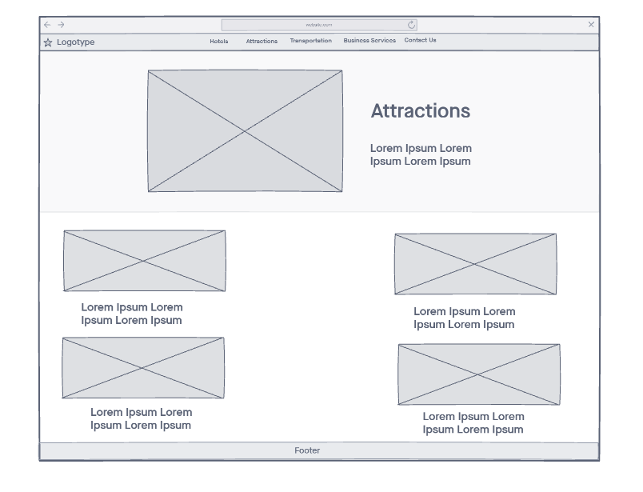
Same header that leads to all the 6 different pages that correspond with the label. Logotype goes to the homepage.
Attractions label with text below it. Picture that displays attraction.
Below that pictures of attractions on the island and text to explain what they are
Footer down below that links to the privacy policy, Instagram page, twitter page, and facebook page.

Slide 7
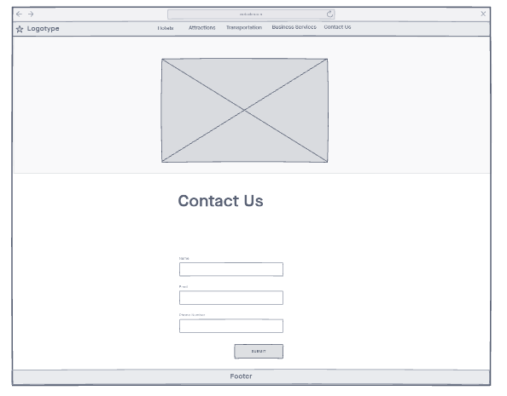
Same header that leads to all the 6 different pages that correspond with the label. Logotype goes to the homepage.
Main photo that corresponds to contact us topic.
Below that name field, email field, phone number field. Submit button to email the taniti website address.
Footer down below that links to the privacy policy, Instagram page, twitter page, and facebook page.

